Slide 1
The Man on the Beat: John Gilliland and The Pop Chronicles
Andrew Justice, University of North Texas
Jonathan Thorn, Safe Sound Archive
Assoc. for Recorded Sound Collections
28 March 2008, Stanford University

Slide 2
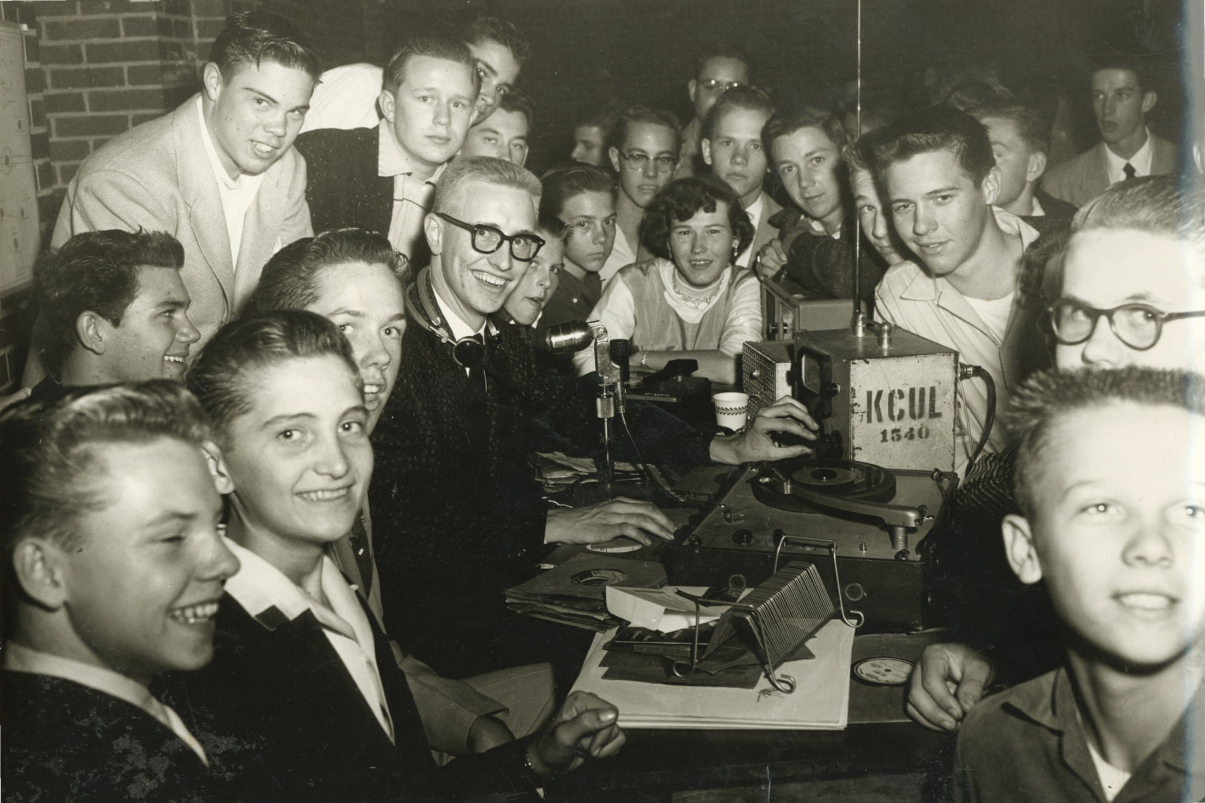
Working on location for KCUL (1955)

Slide 3
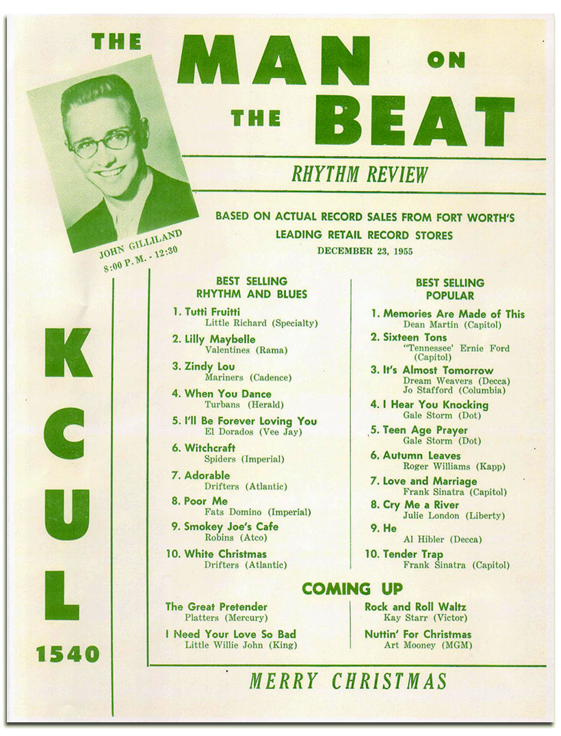
“Rhythm Review”
Most Requested Songs
(1955)

Slide 4
With Laverne Baker
(1955)

Slide 5
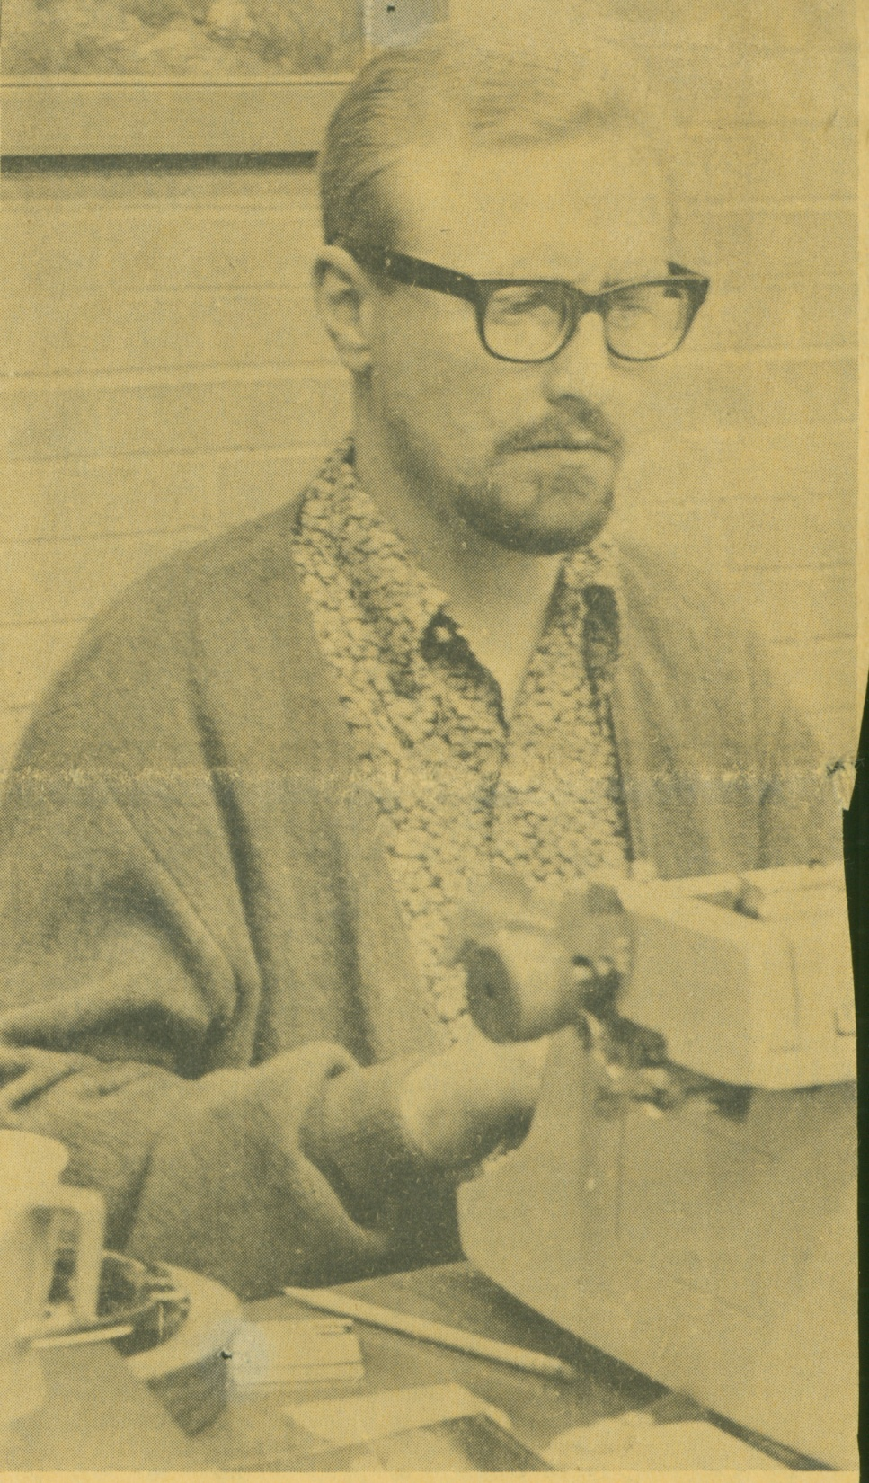
1966

Slide 6
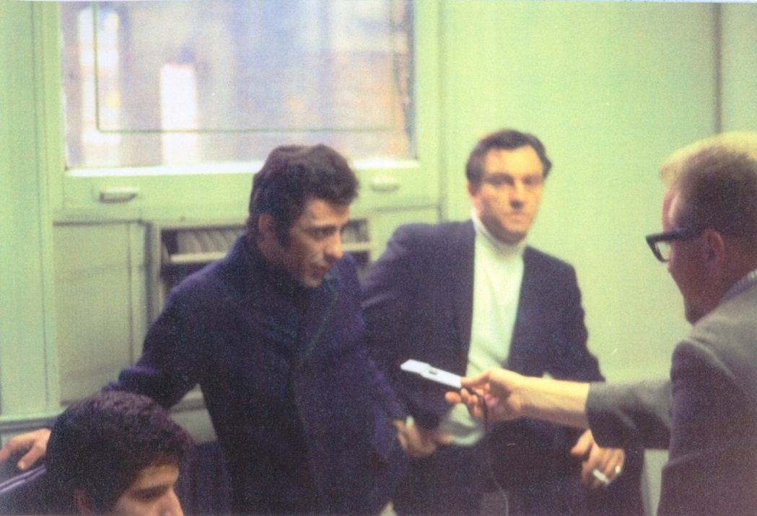
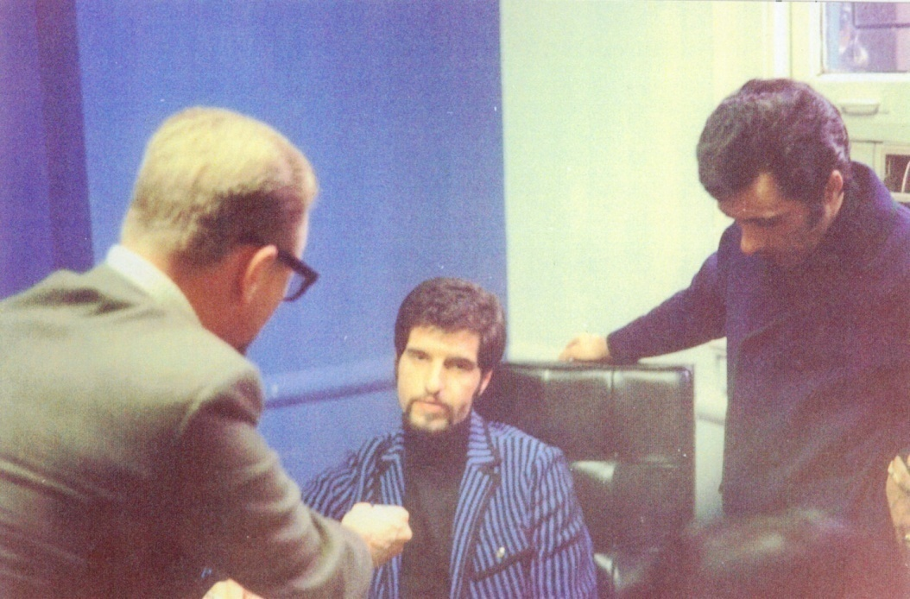
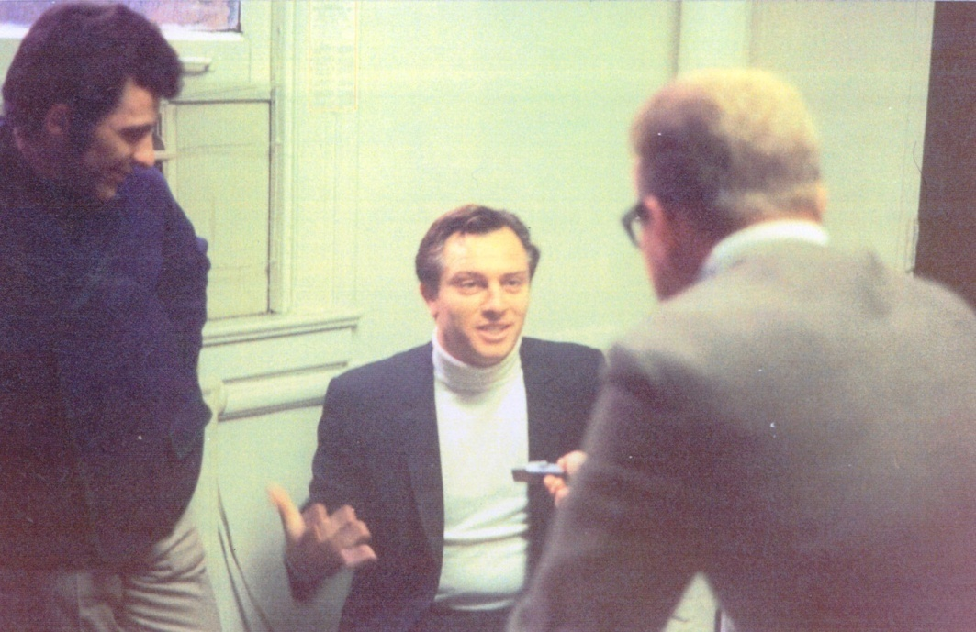
Interviewing
The Four Seasons
(1965)

Slide 7
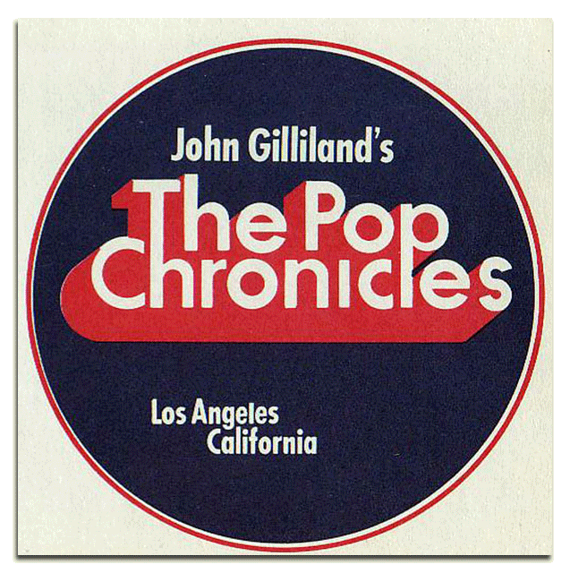
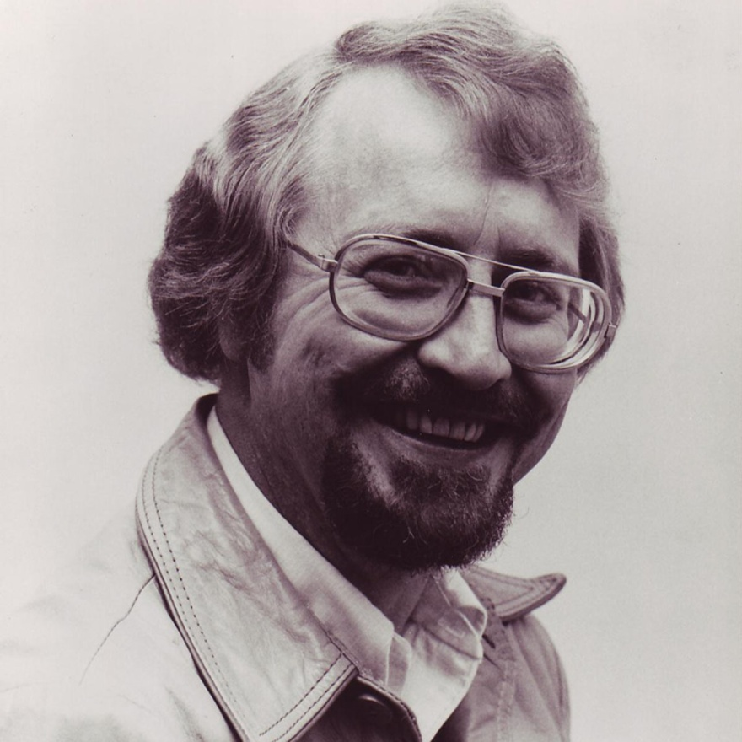
Studio Portrait Reel-to-Reel Logo
(1968) (1972)

Slide 8
The Pop Chronicles
Team at KRLA
(1969)

Slide 9
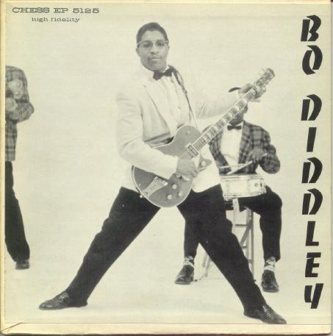
Bo Diddley (1968)

Slide 10
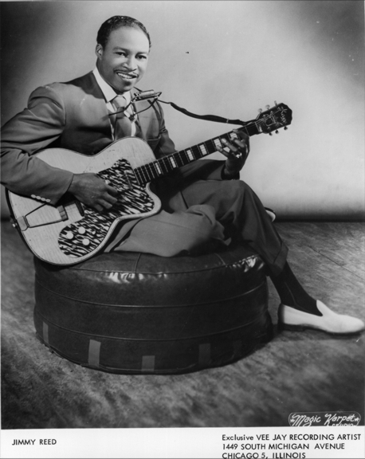
Jimmy Reed (1968)

Slide 11
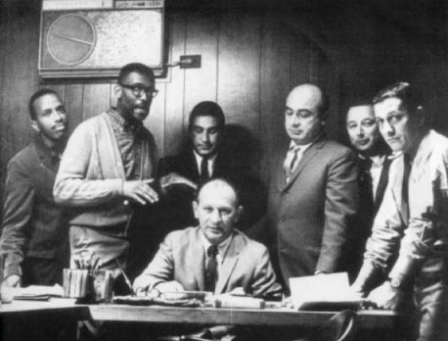
Leonard Chess (1968)

Slide 12
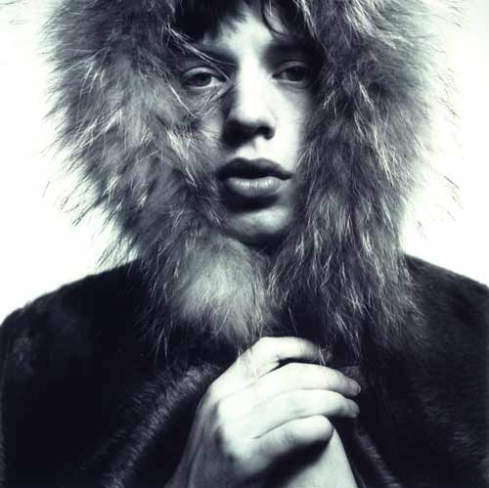
Mick Jagger (1968)

Slide 13
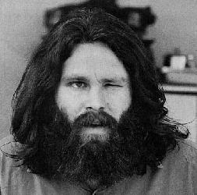
Jim Morrison (1967)

Slide 14
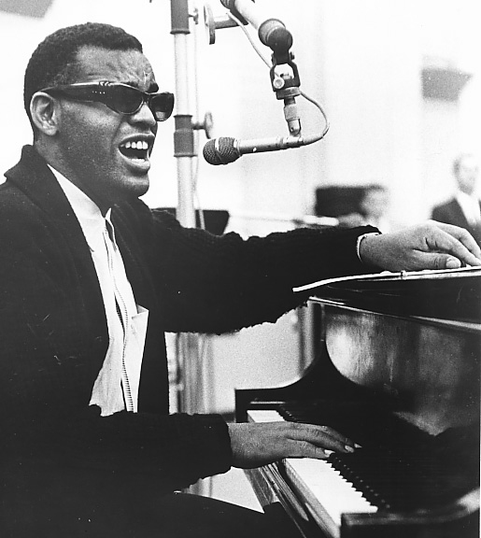
Ray Charles (1968)

Slide 15
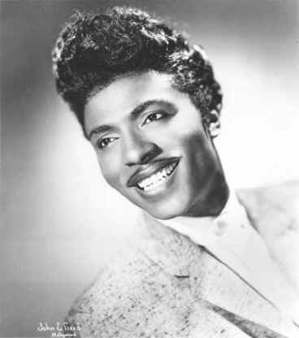
Little Richard (1968)

Slide 17
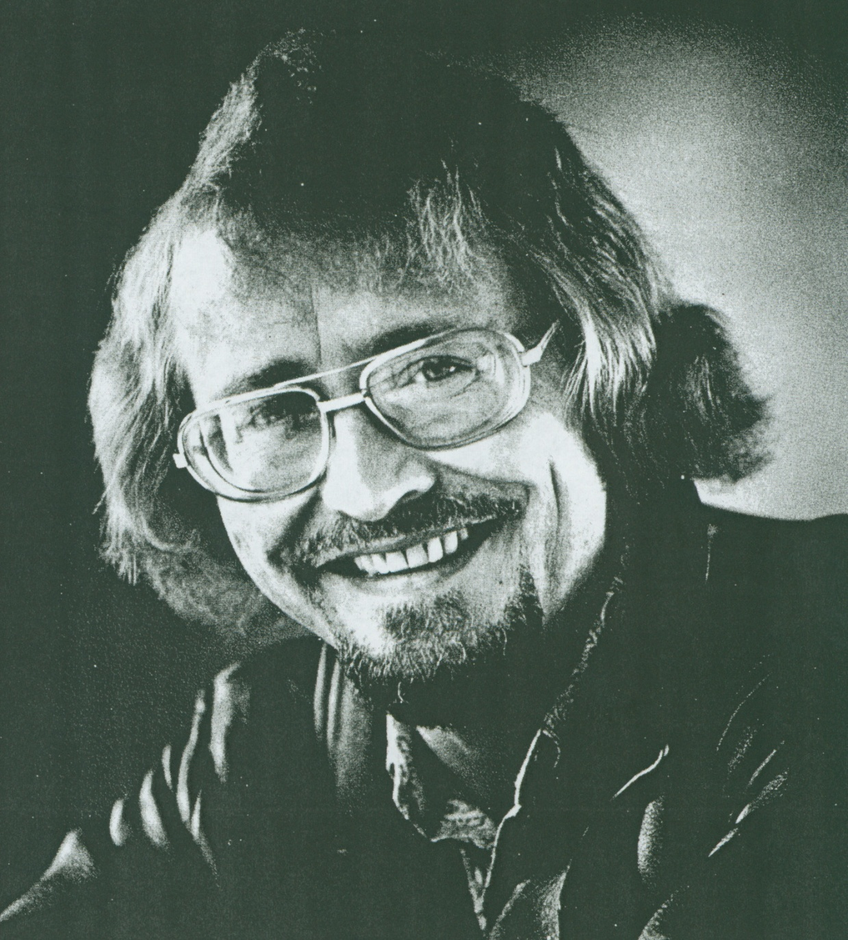

Slide 18
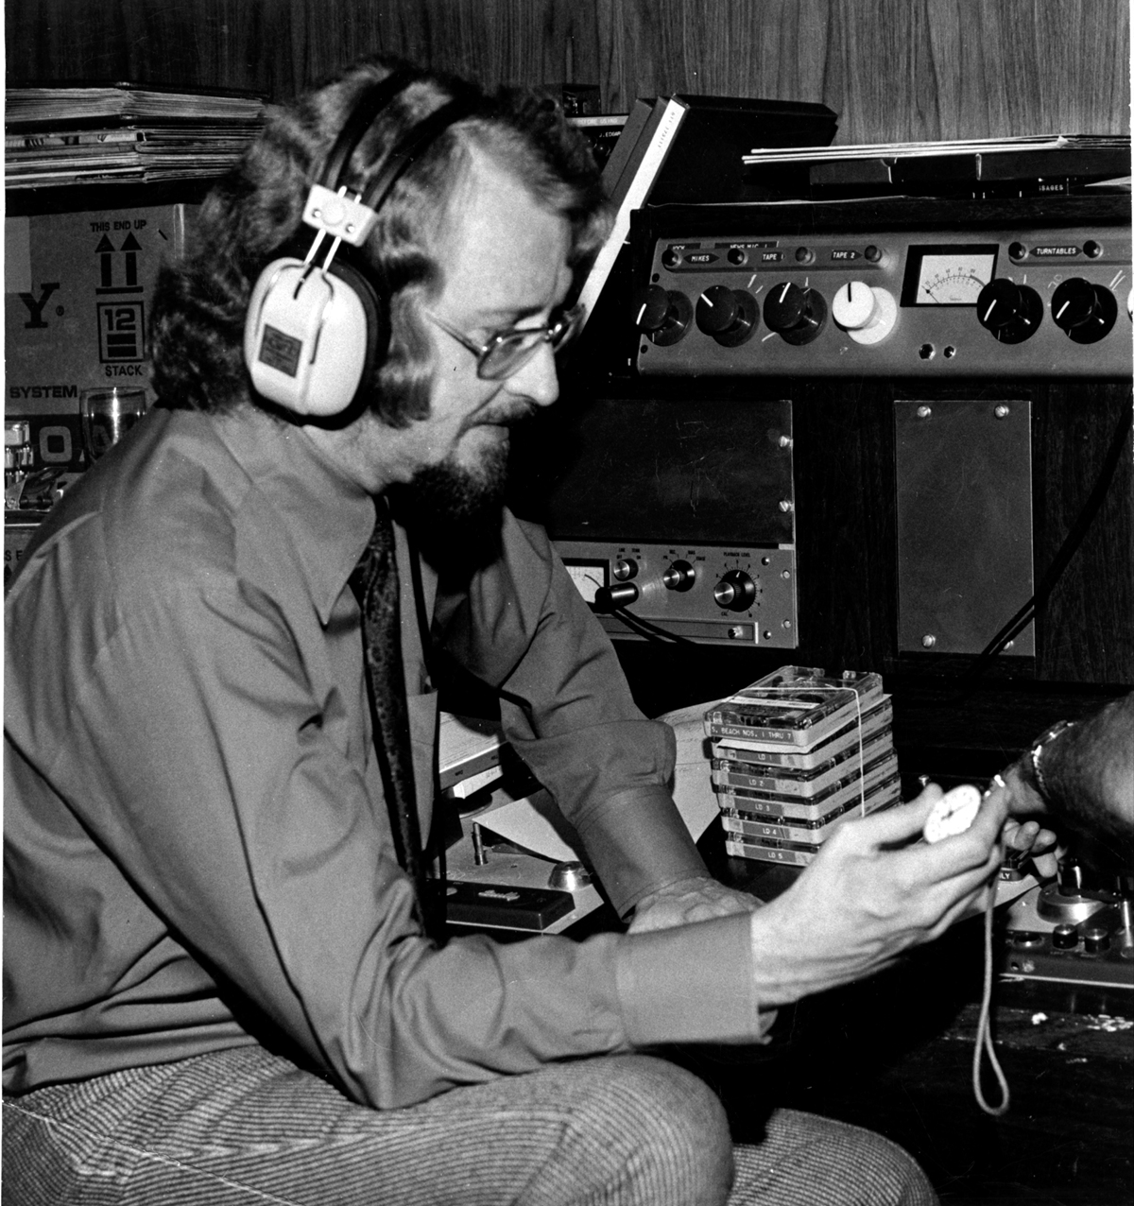
Promo 45 for
1940s Series
Producing in
1969

Slide 19
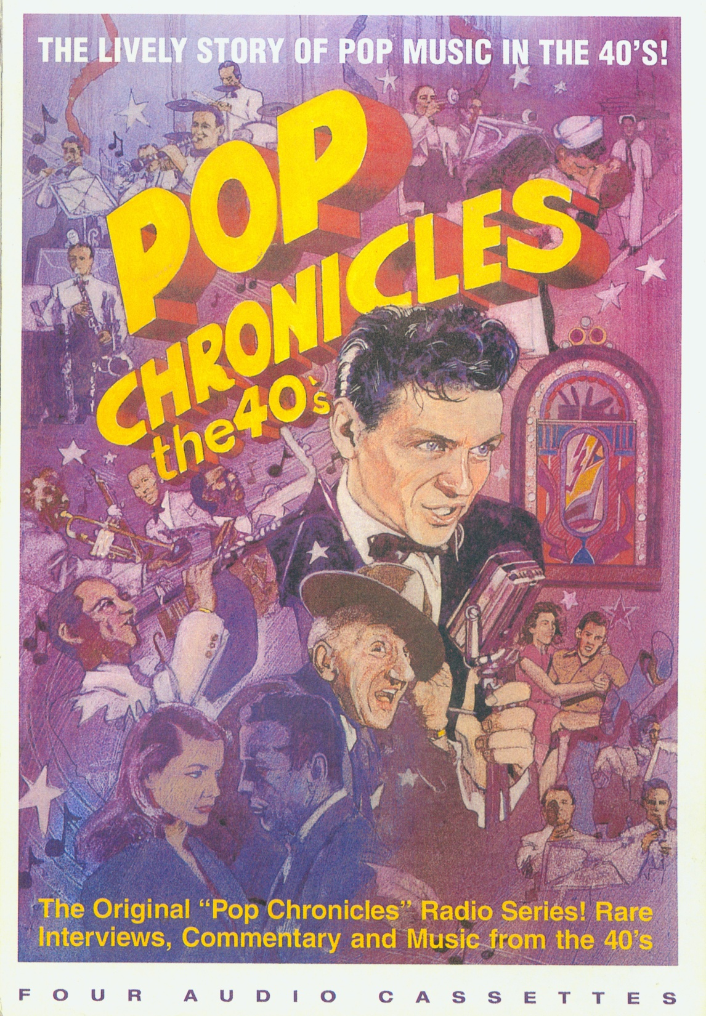

Slide 20
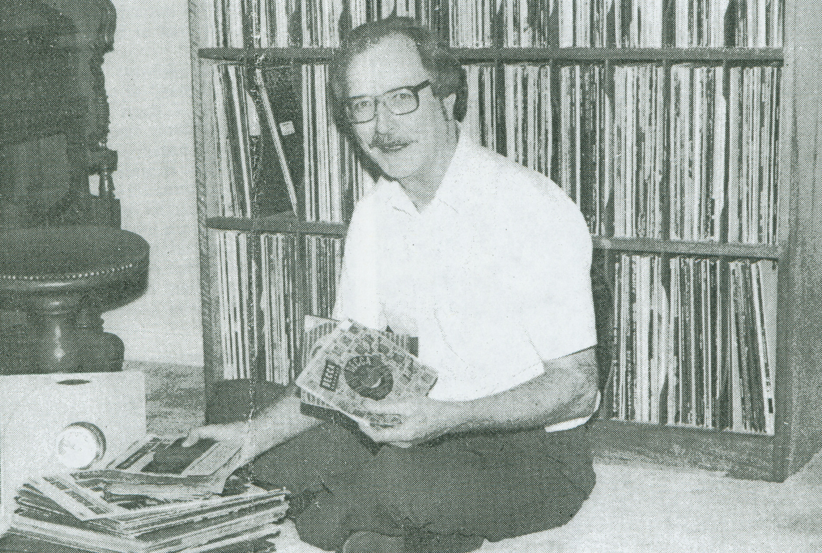
1988

Slide 22
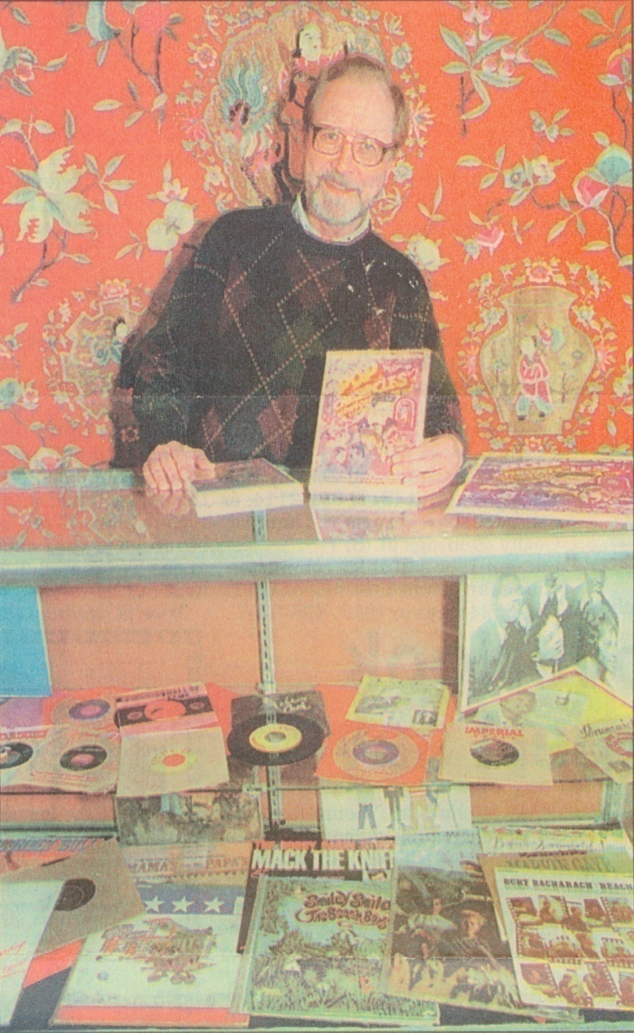
1994

Slide 23
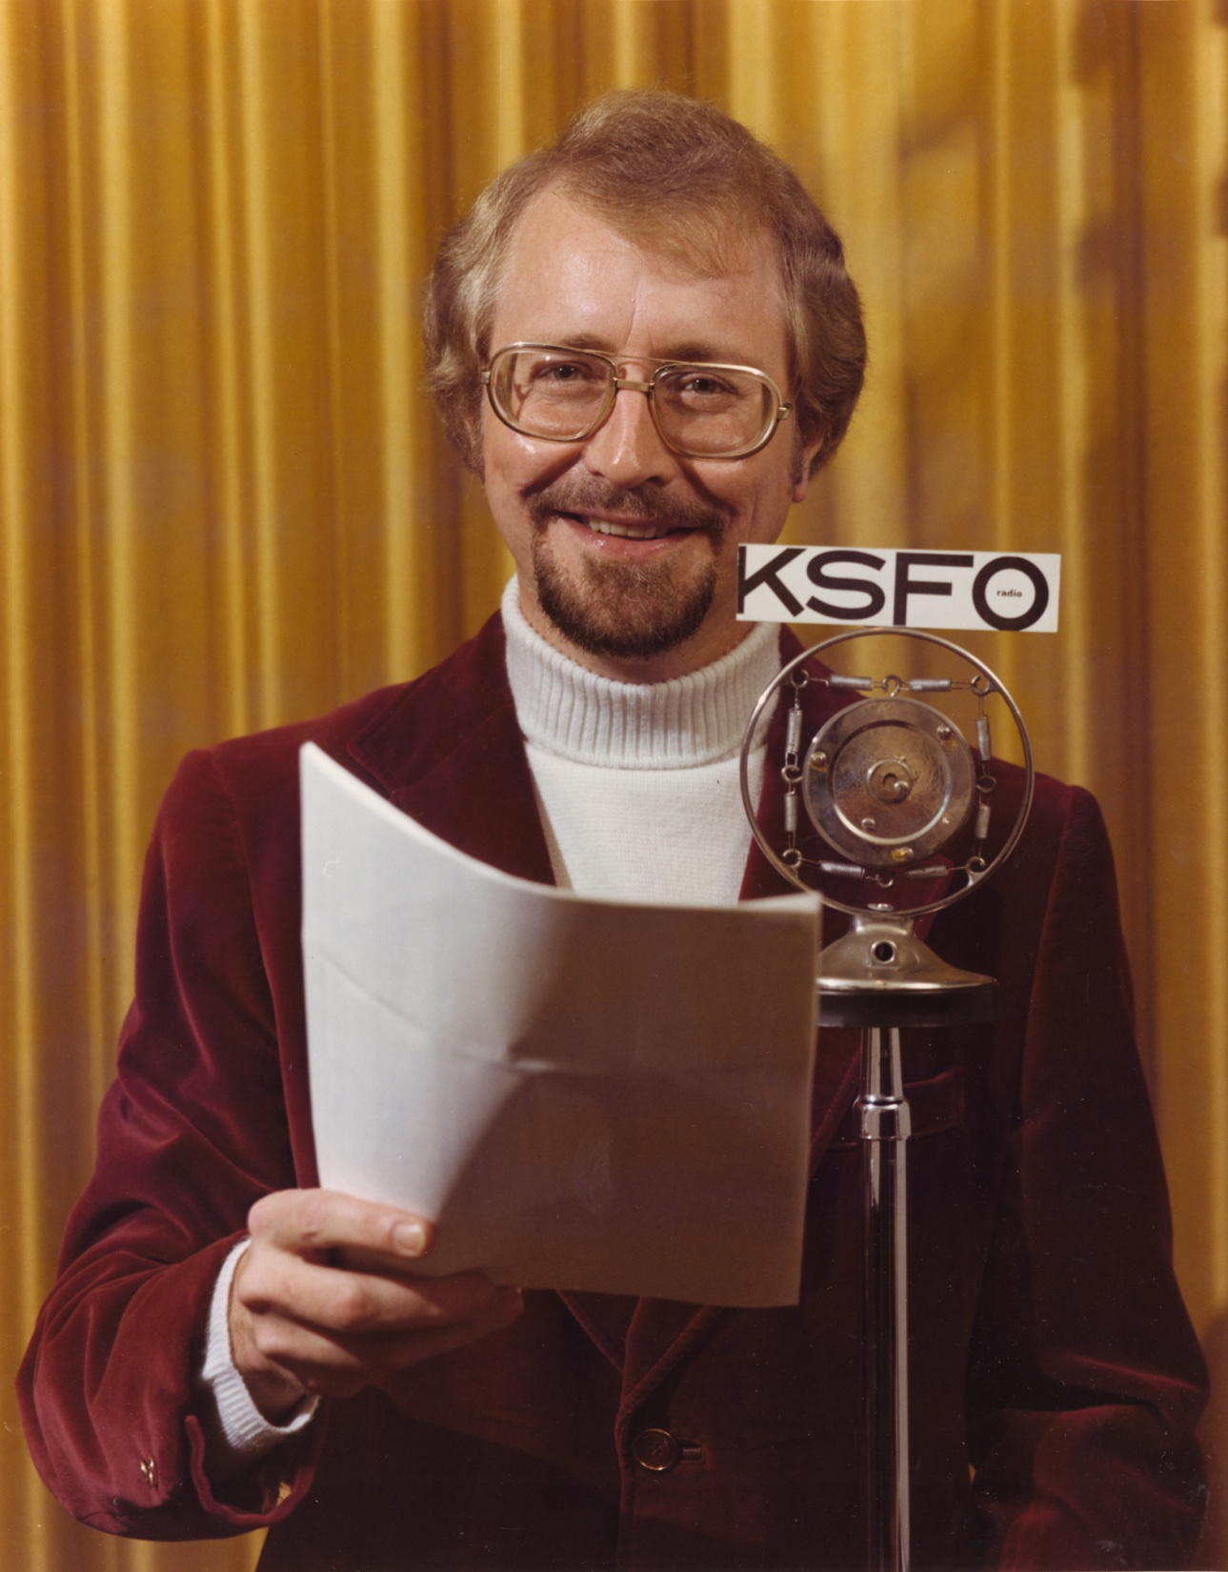
1971

