Slide 1
“The Melody That Made You Mine” Remembering Morton Downey
Presentation By
Barry Stapleton

Slide 2
Family Beginnings
Grandfather, John Downey: b. Little Hills, Co. Kilkenny, Ireland 1839. Immigrated to U.S. in 1858.
Grandmother, Elizabeth Fahey: b. 1840, Ireland
Father was James Downey and mother was Elizabeth Cox
Father was the Fire Chief of Wallingford, Conn.
Morton was one of 10 siblings
Morton Downey b. Nov. 14, 1901: Wallingford, Conn.

Slide 3
Early Career
At age six made $1 singing for a minstrel show
Unsuccessfully auditioned for the Paulist Choristers in 1915. An internationally known boys chorus that sang a cappella. Leader was Father Finn.
Sold candy on trains
Worked in an insurance agency
Sang at church socials and at Elks Club meetings
Acted in small time Vaudeville
Was an agent for Victrola Records
At age 16 (1917) Morton enlisted in the Navy. His father found out and notified the authorities…he was held in the “jug” until his folks picked him up.

Slide 4
Paul Whiteman
1919 at age 19, discovered by Paul Whiteman at the Sheridan Square Theater in New York.
Sang on the SS Leviathon until 1924
Joined Whiteman’s main band in 1924
One of the first vocalists with Whiteman
Ended up making $350 a week
In between songs he sat in the brass section and pretended to blow a horn

Slide 5
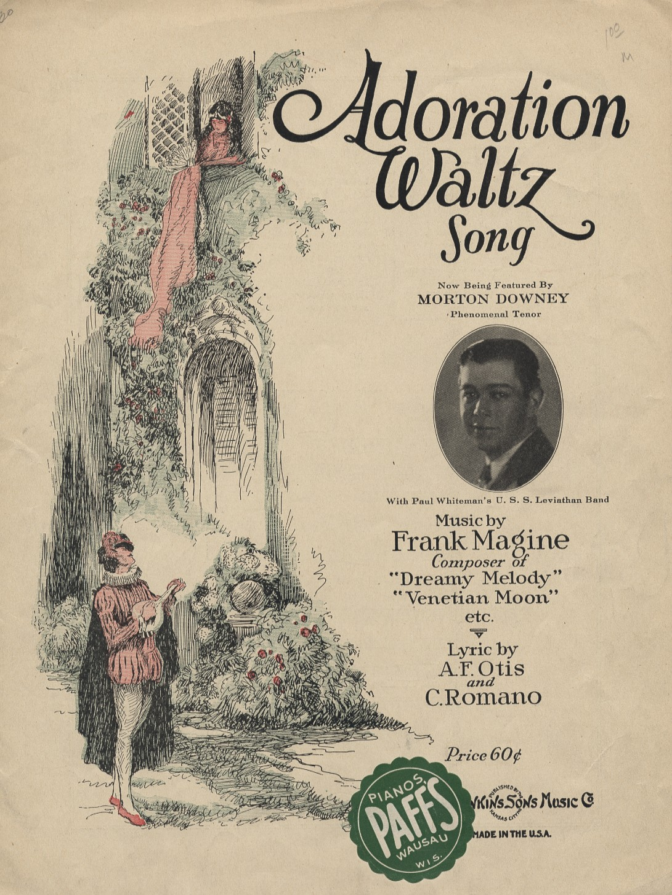
1924
Notes:
USS Leviathon Band

Slide 6
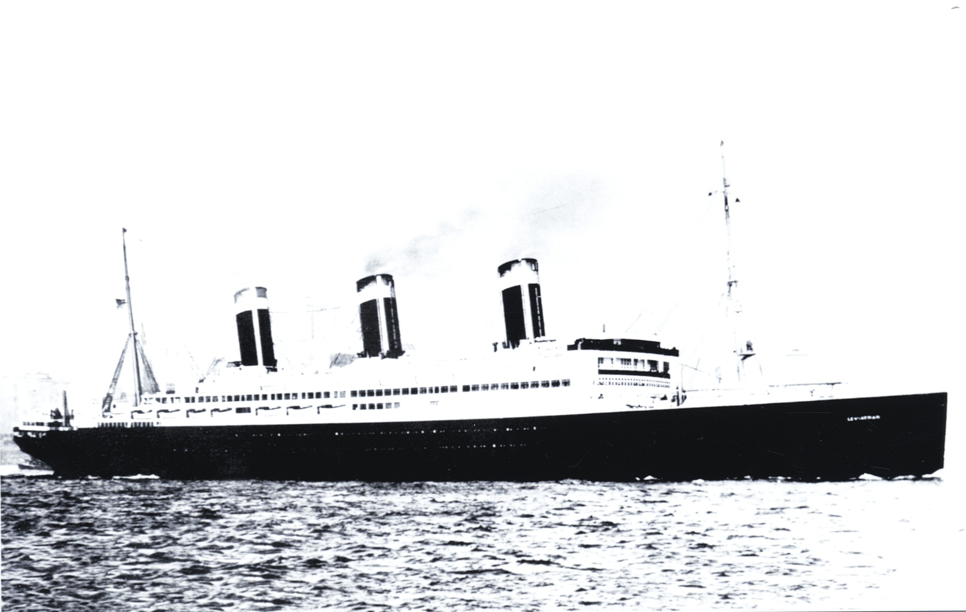

Slide 7
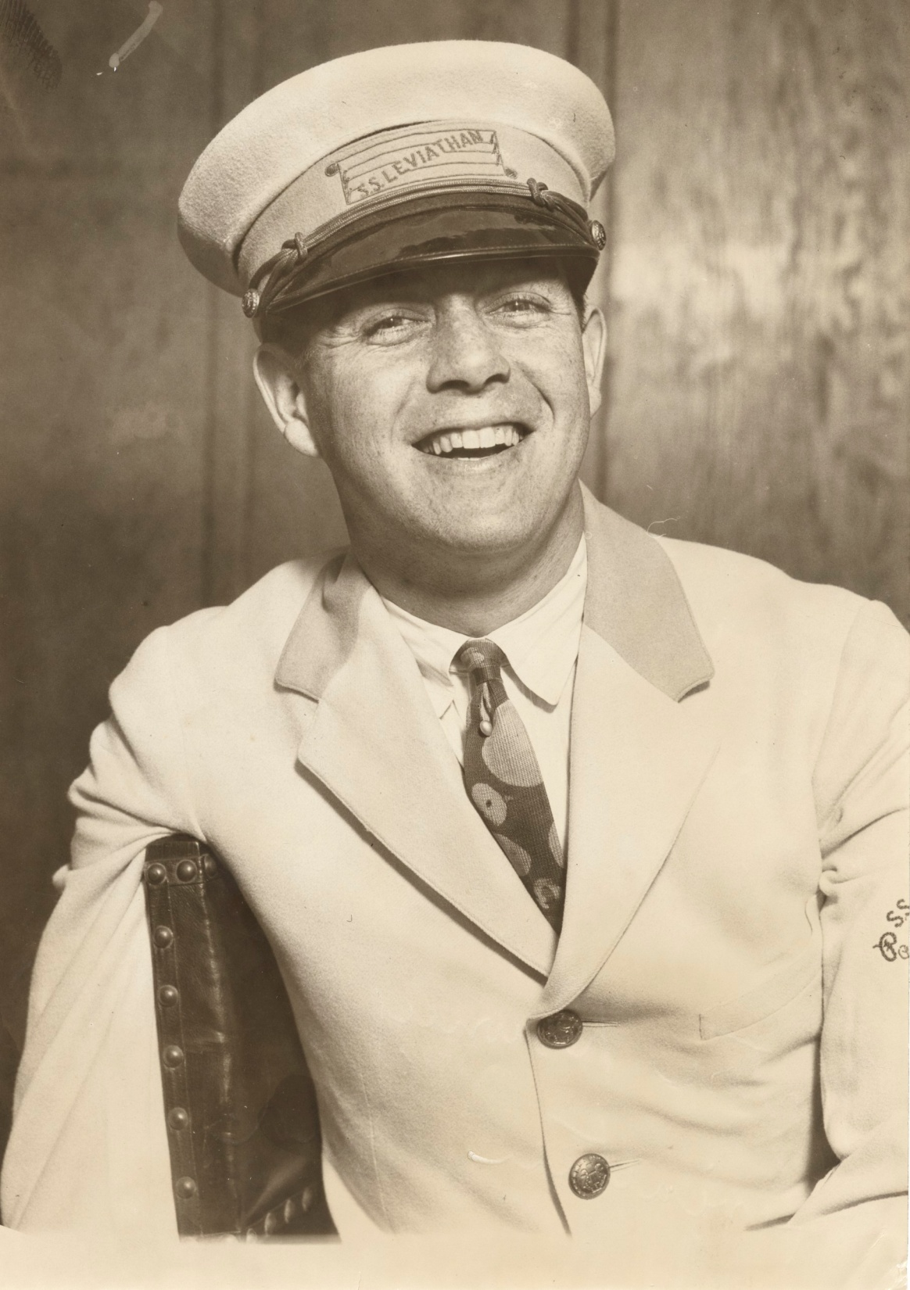

Slide 8
1924

Slide 9
1924

Slide 10
1925 - 1931
Left the Paul Whiteman band in 1925
Embarked on a theatre tour as a soloist
Signed with Brunswick Records
1926: Appeared in Ziegfeld’s Palm Beach Nights
Went on a tour of European supper clubs
1930: Opened his own restaurant “The Demonico Club” in NY. It closed in May 1931.

Slide 11
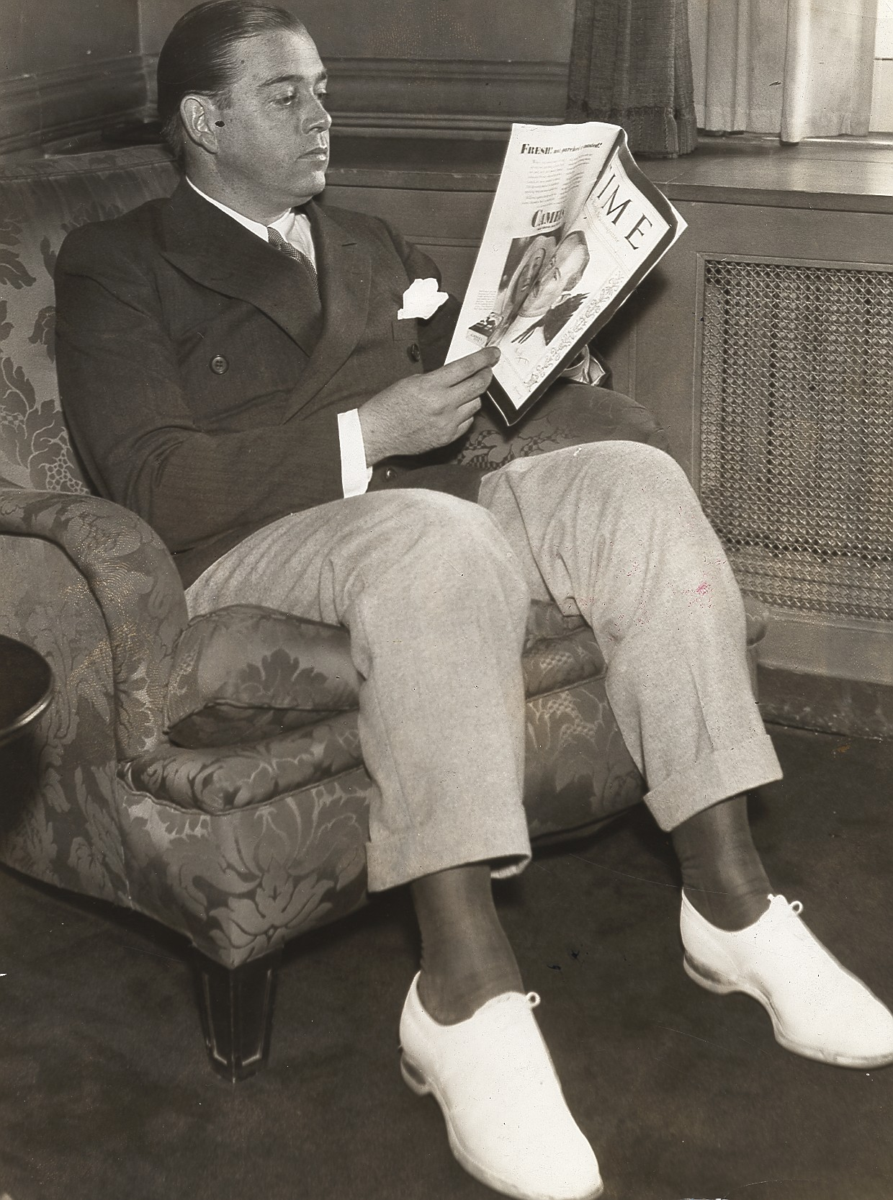

Slide 12
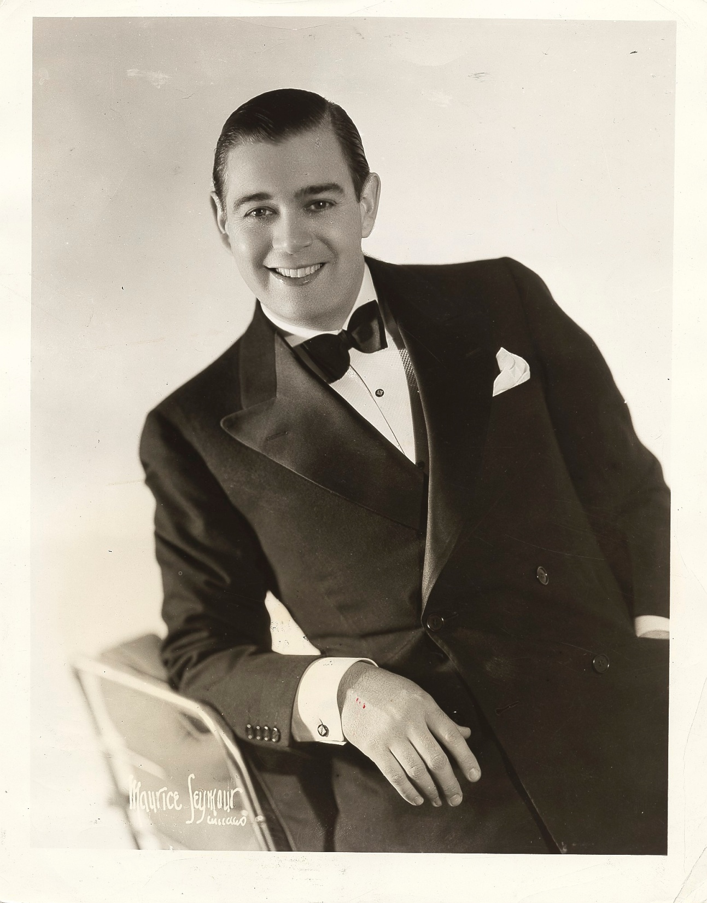

Slide 13
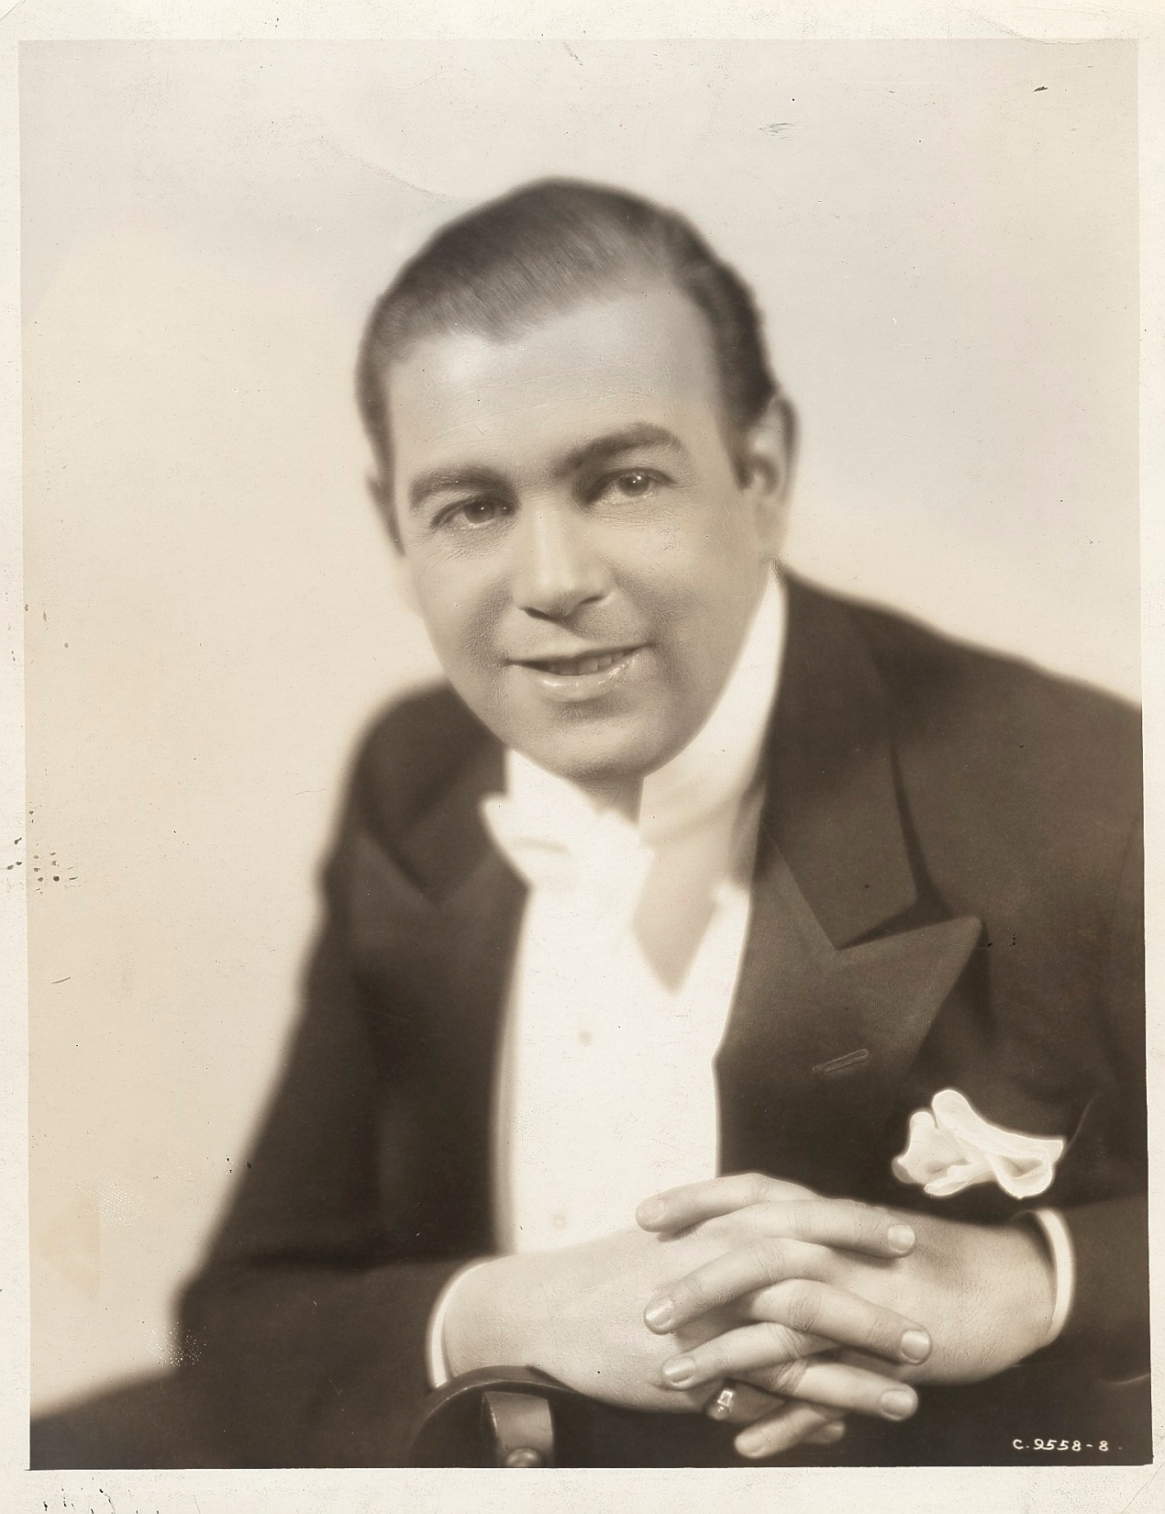

Slide 14
Early Songs 1925

Slide 15
1926

Slide 16
1927

Slide 17
Films
Lucky in Love (1929)
Mother’s Boy (1929)
Syncopation (1929)
The Devil’s Holiday (1930)
The Castle of Dreams (1934)
Off the Beat (1934)
Dublin in Brass (1935)
The Ghost Catchers (1944)

Slide 18
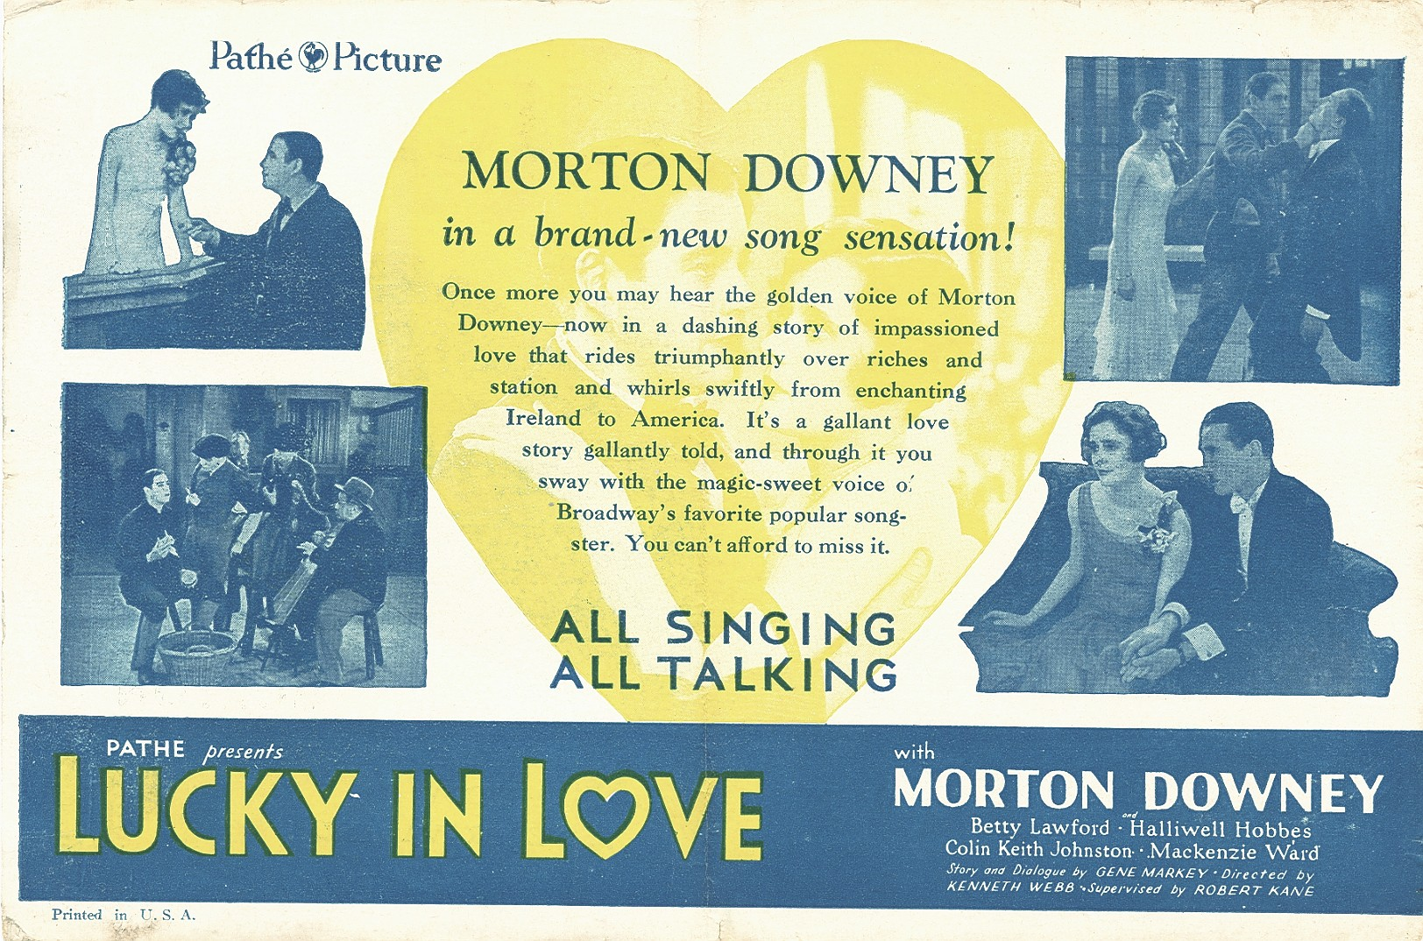

Slide 19
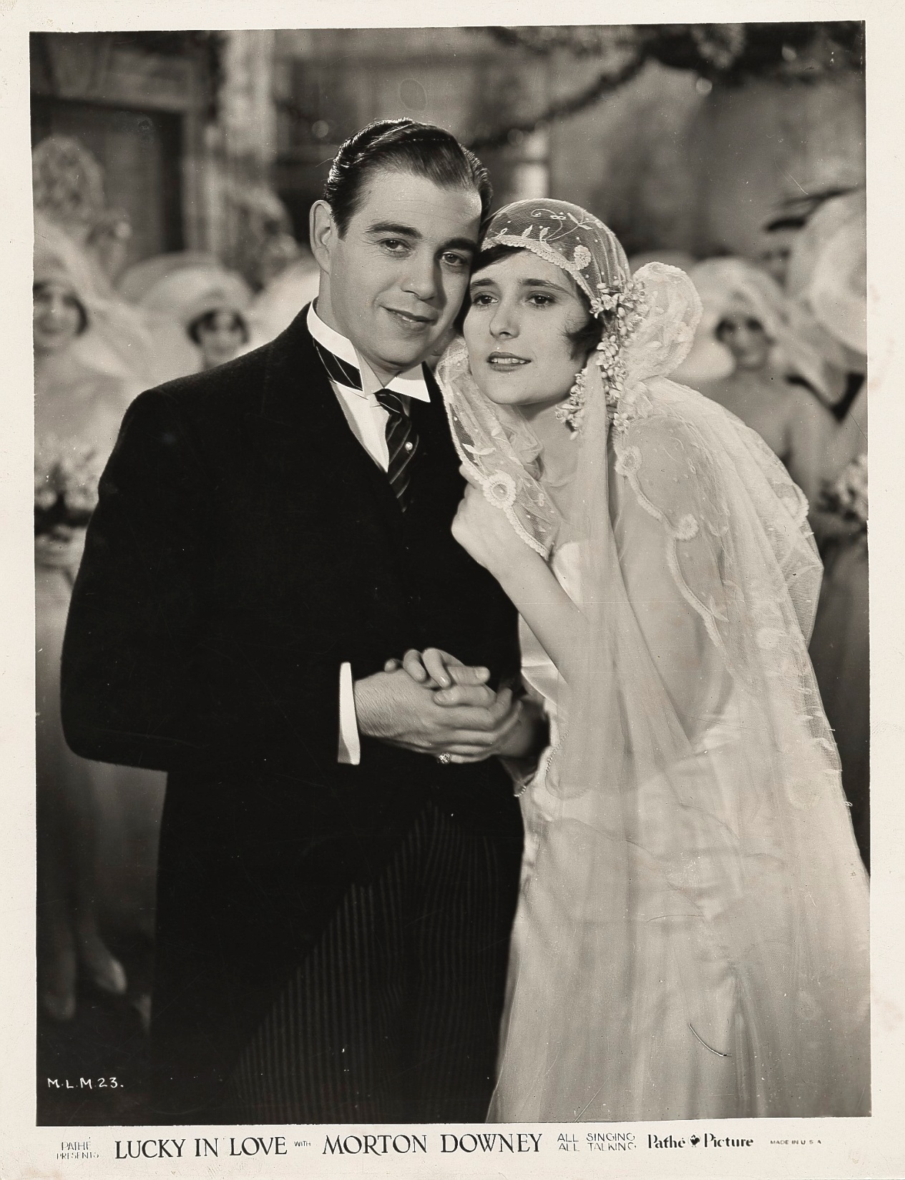
Notes:
IFMD 00-047

Slide 20
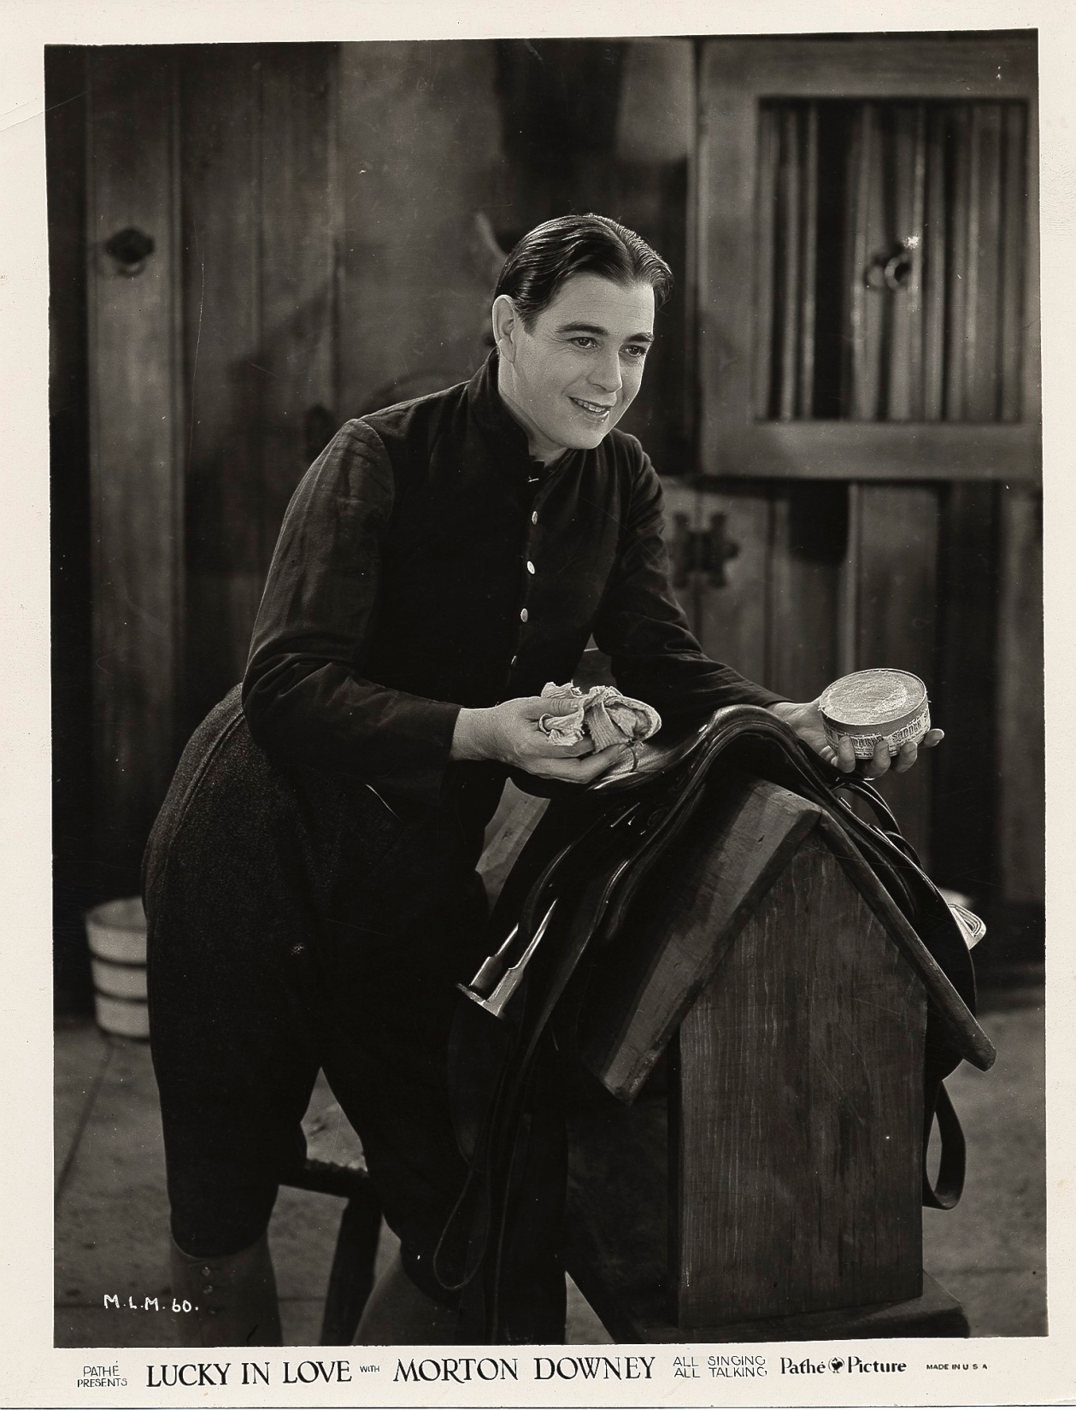
Notes:
IFMD 00-048

Slide 21
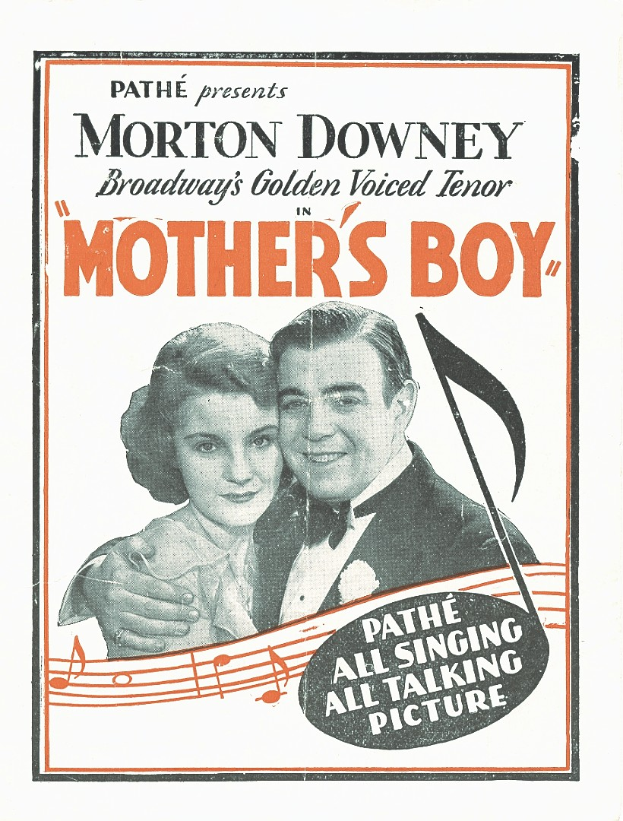

Slide 22
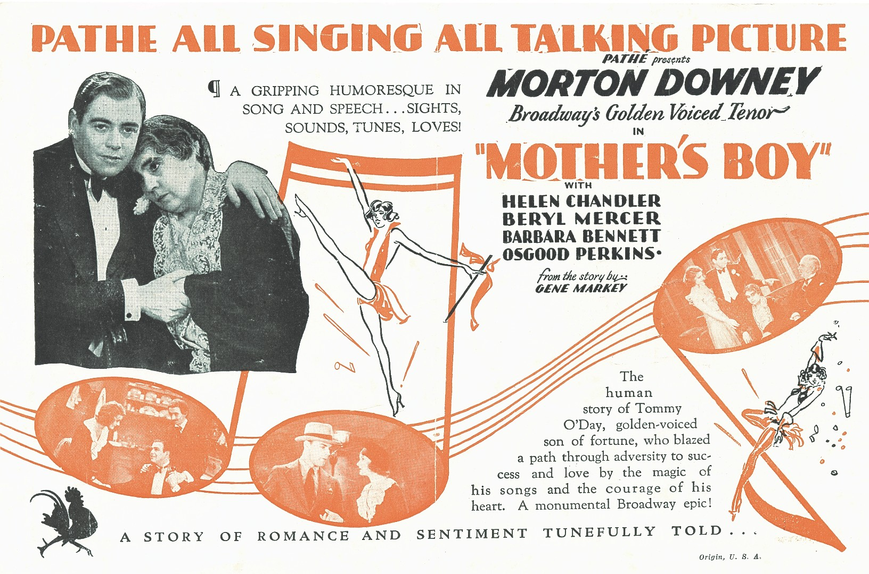

Slide 23
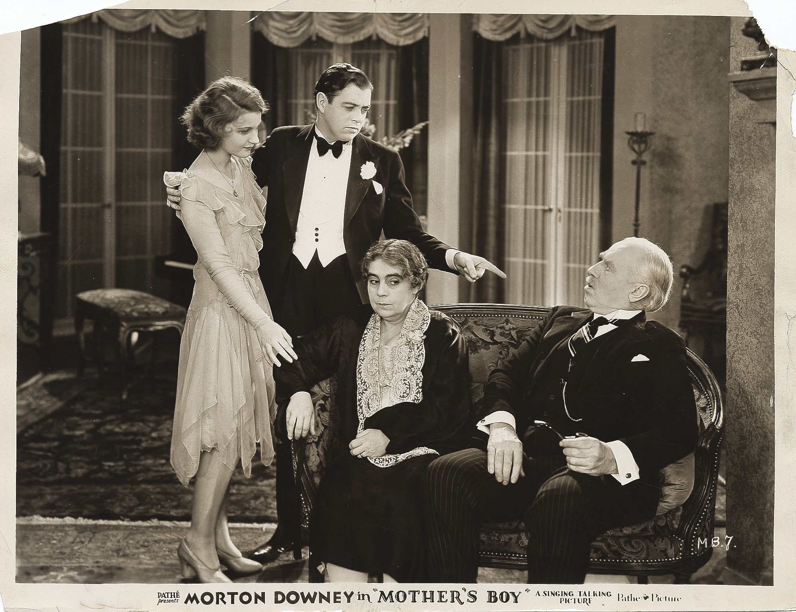
Notes:
IFMD 00-033

Slide 24
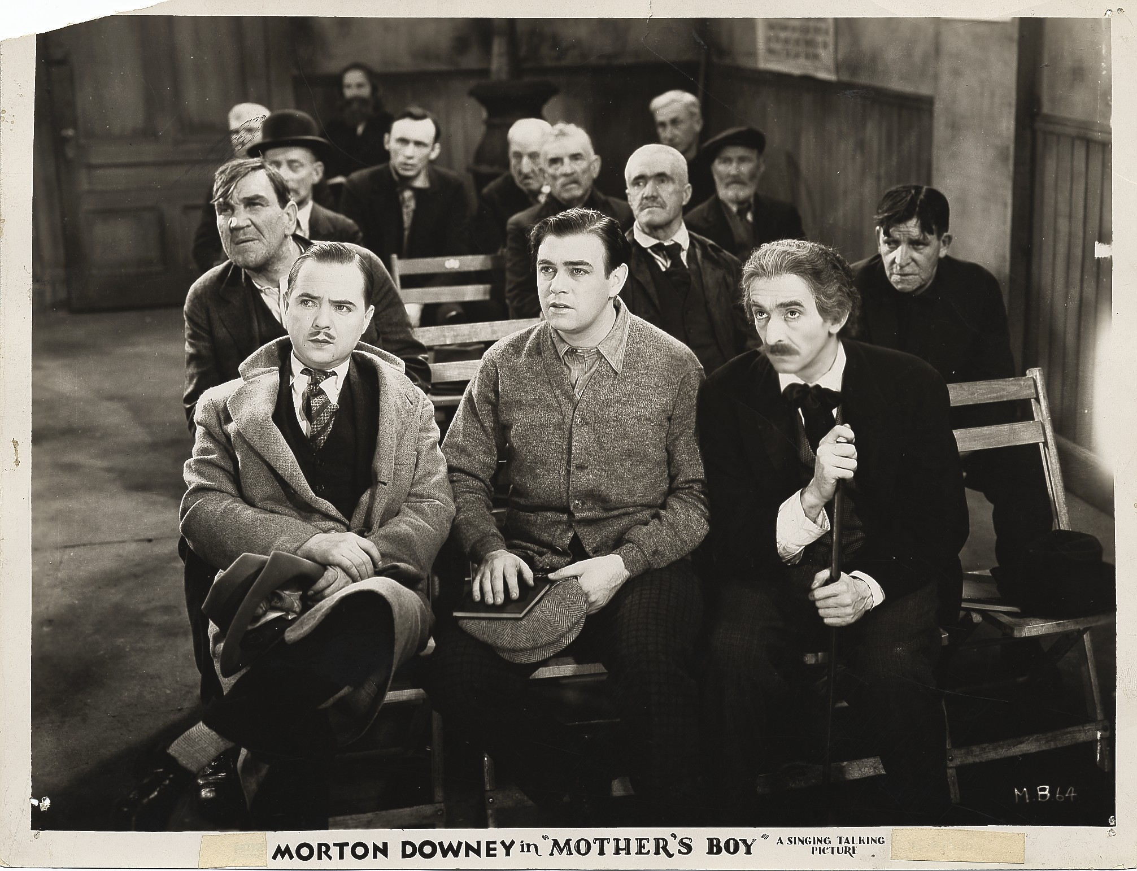
Notes:
IFMD 00-0034

Slide 25
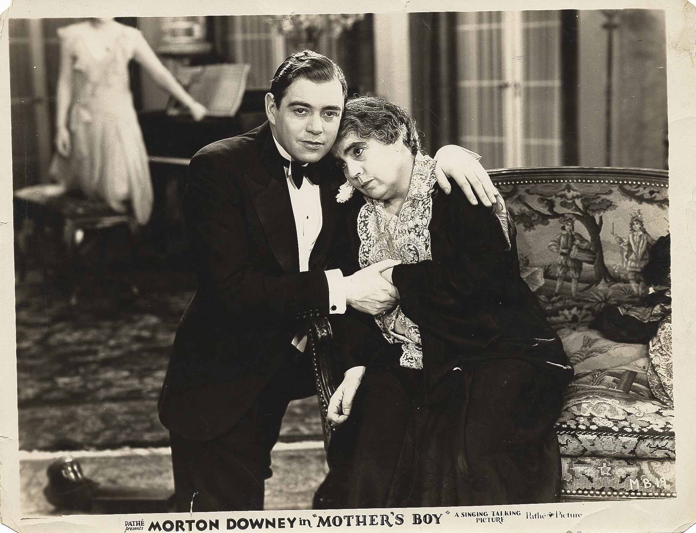
Notes:
IFMD 00-036

Slide 26
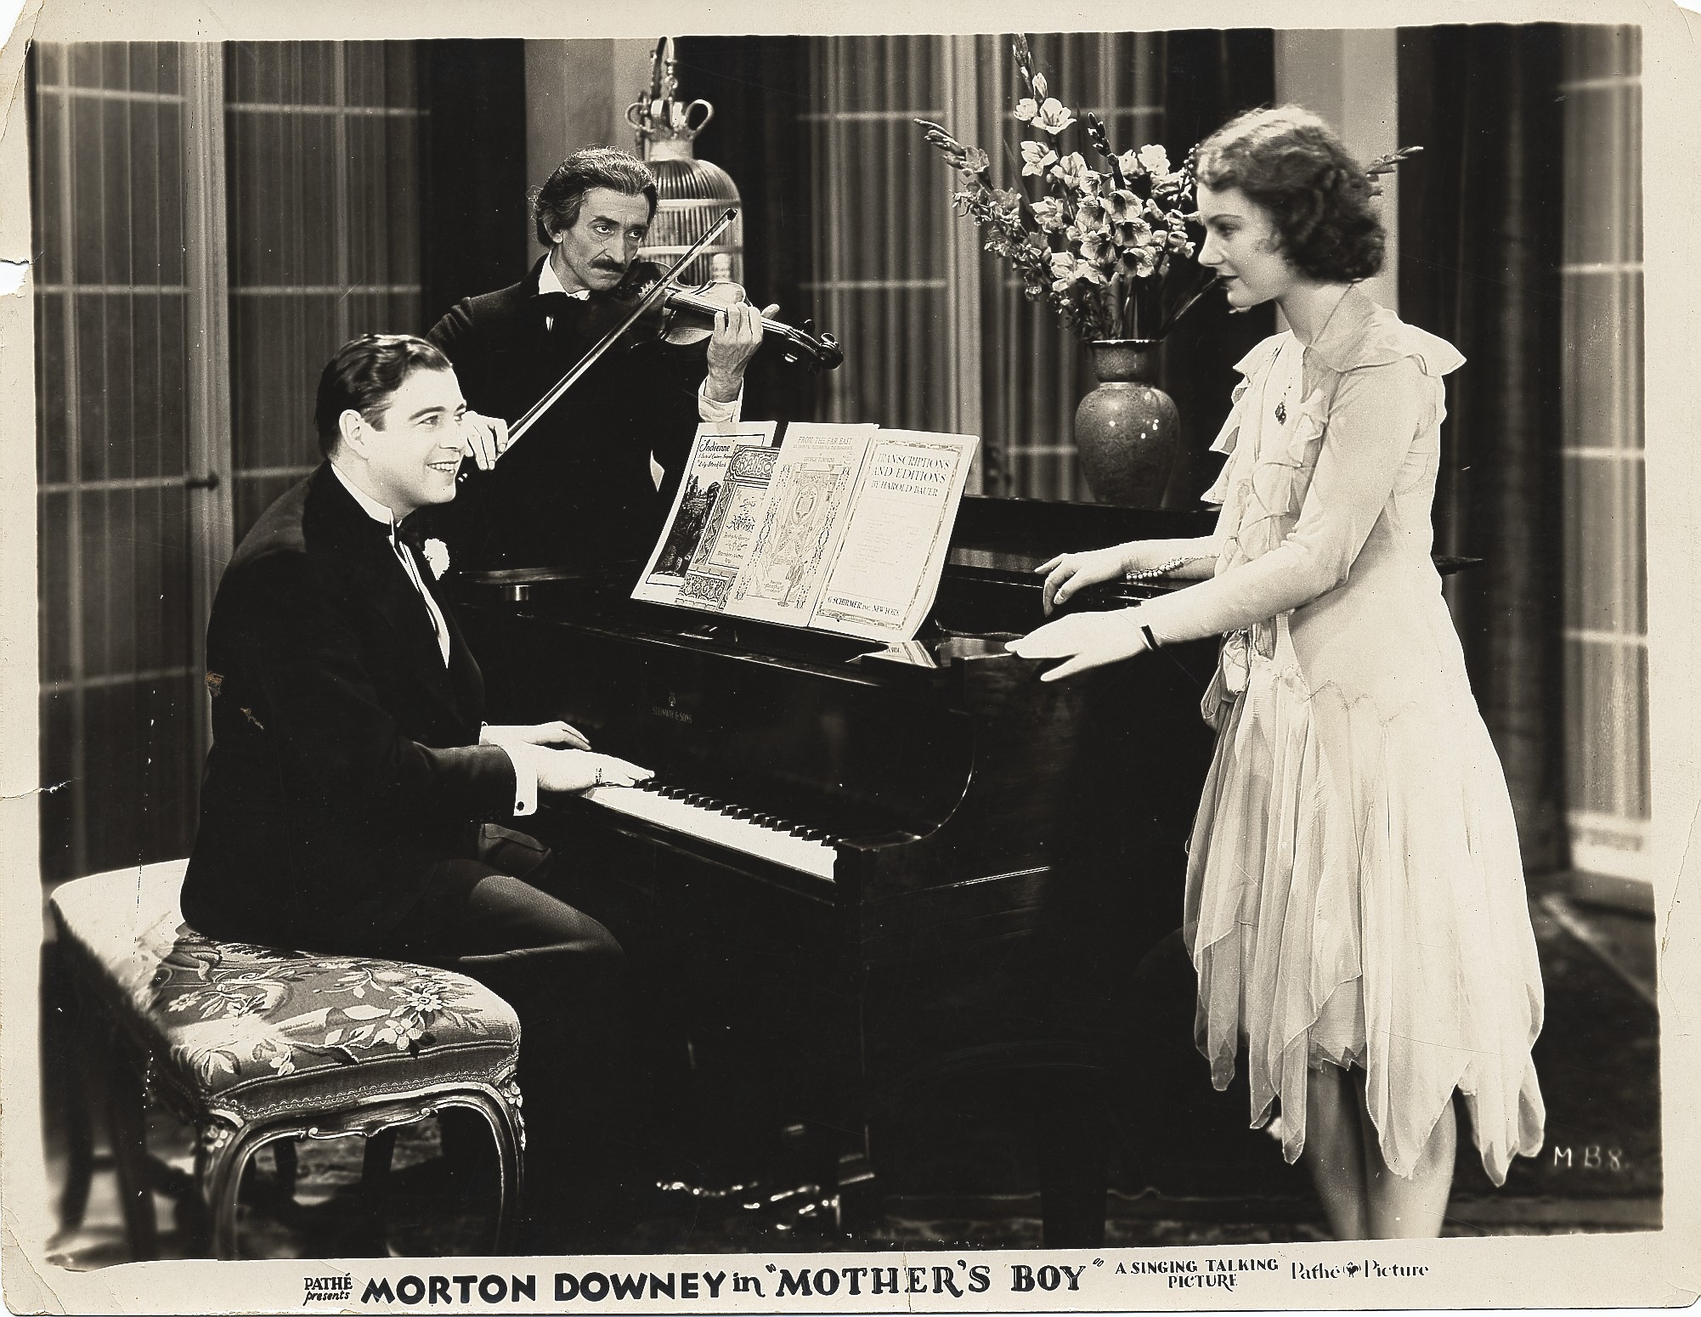
Notes:
IFMD 00-035

Slide 27
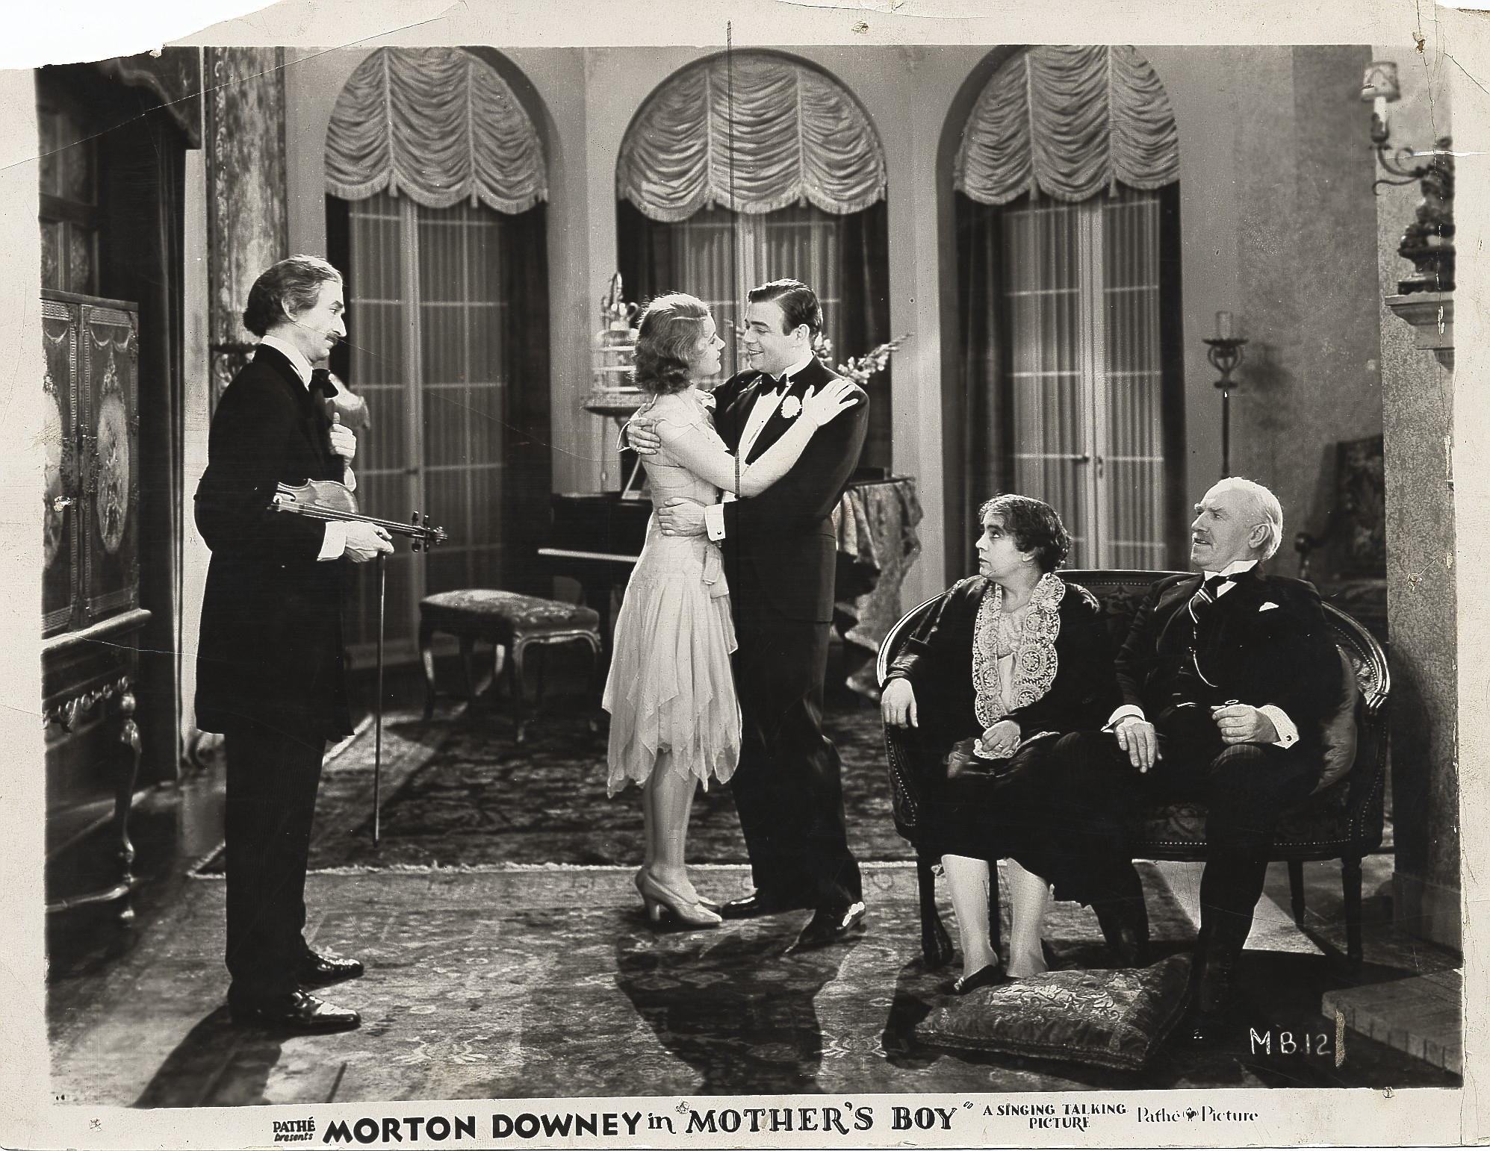
Notes:
IFMD 00-039

Slide 28
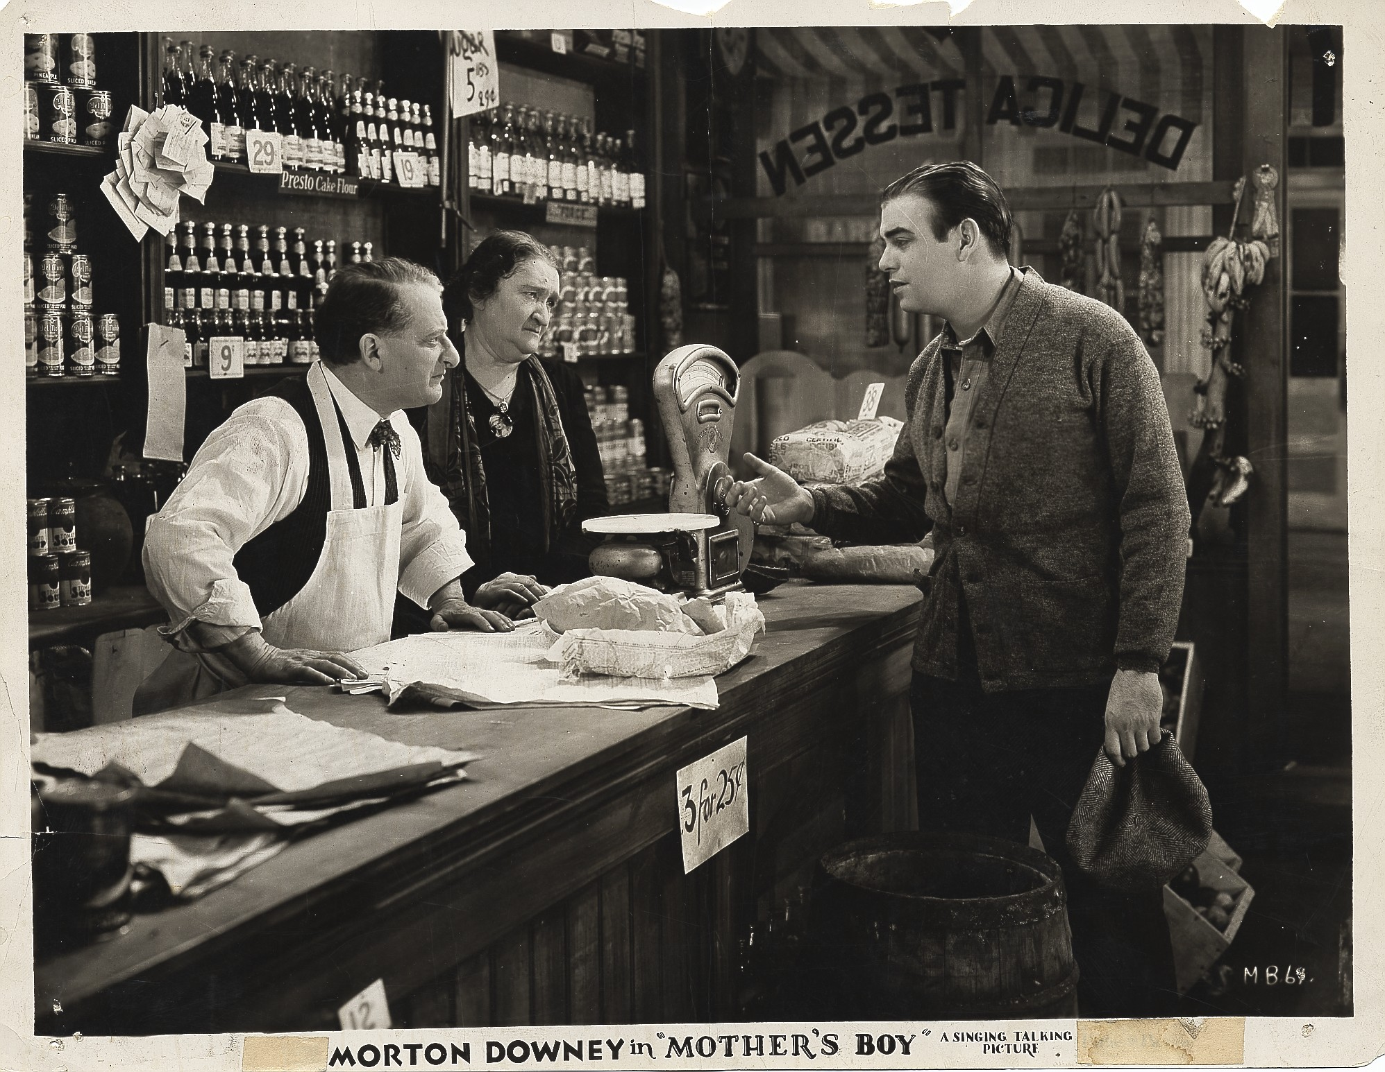
Notes:
IFMD 00-042

Slide 29
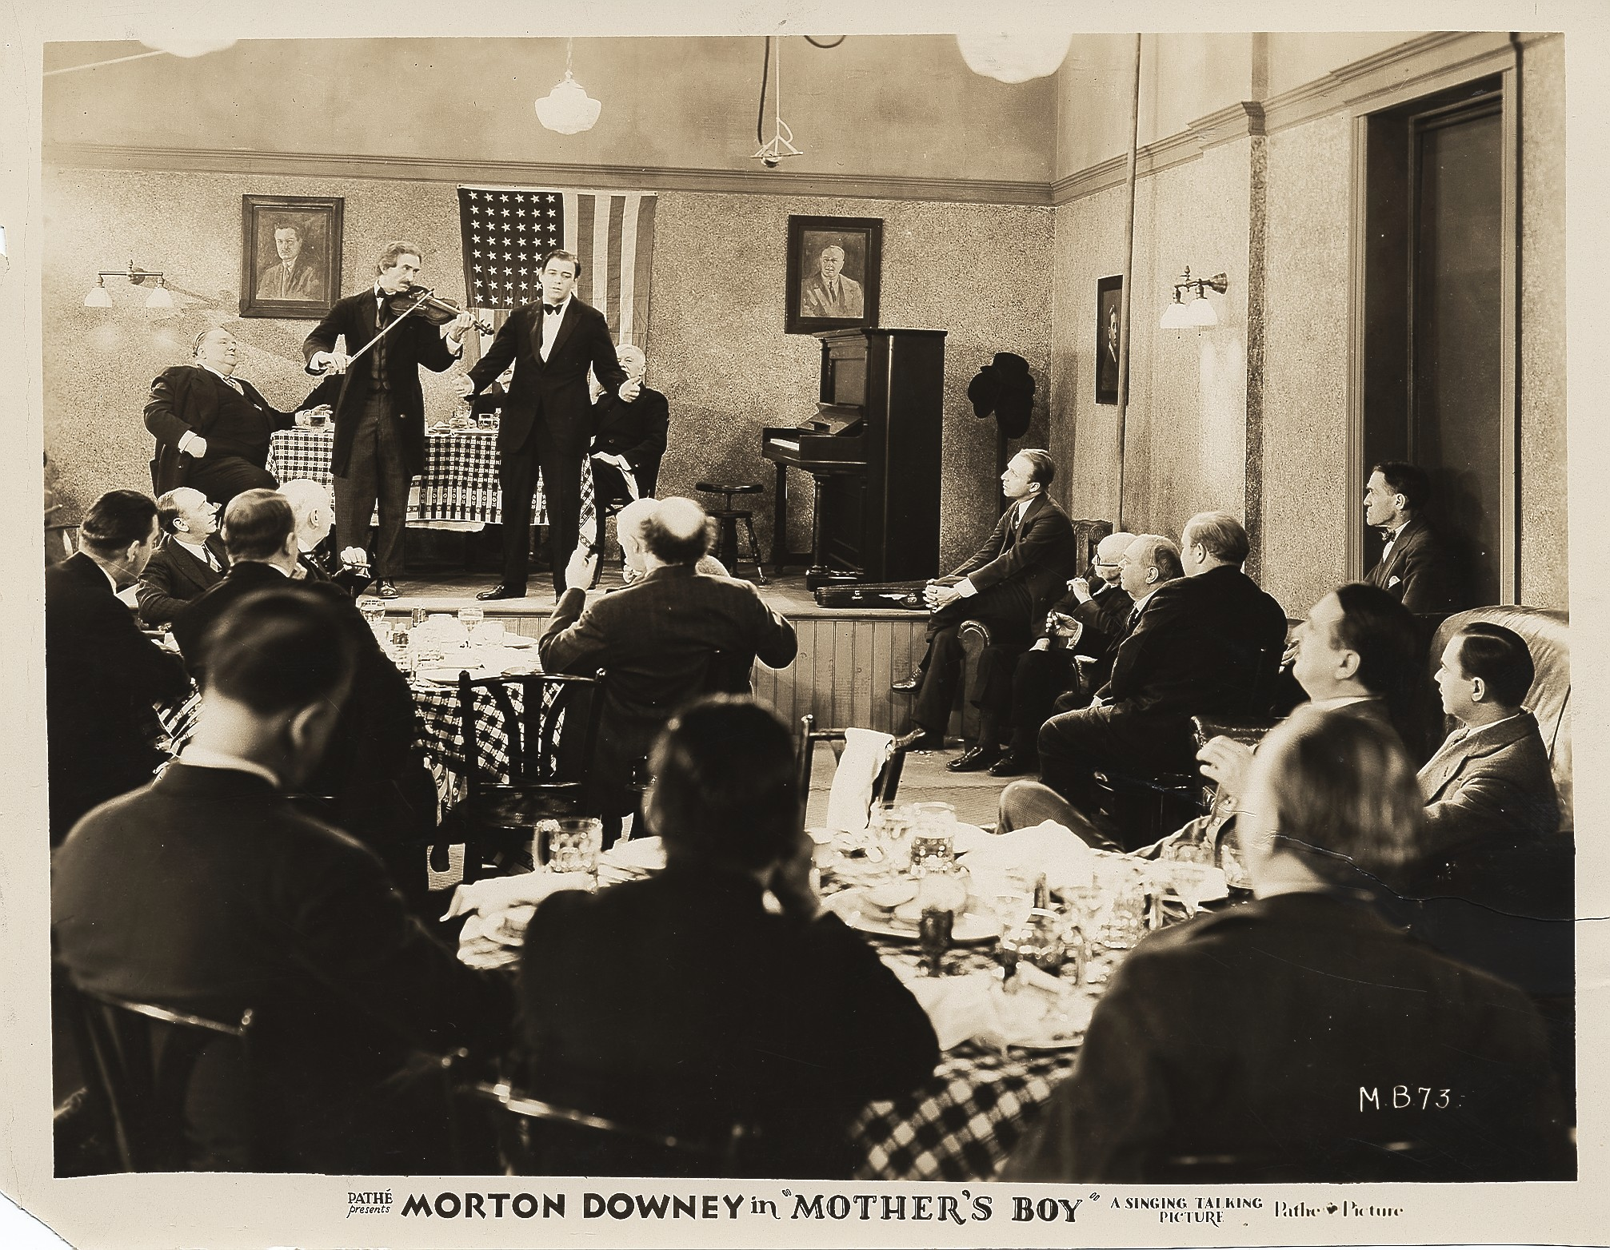

Slide 30
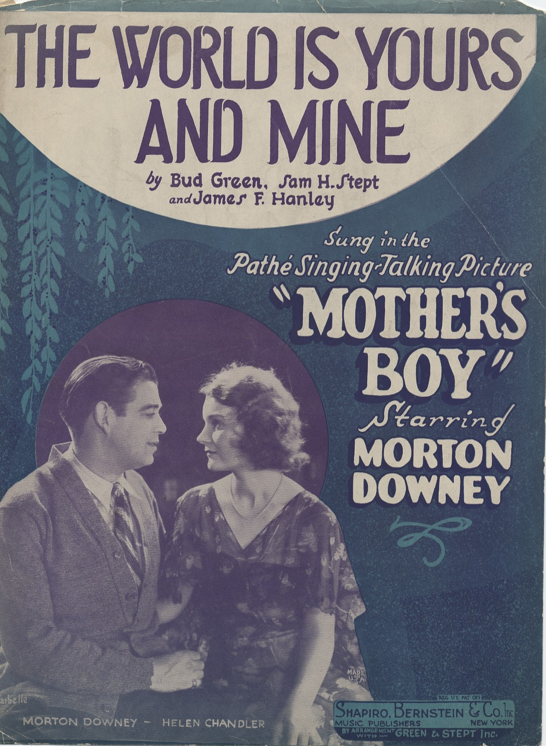

Slide 31
1929

Slide 32
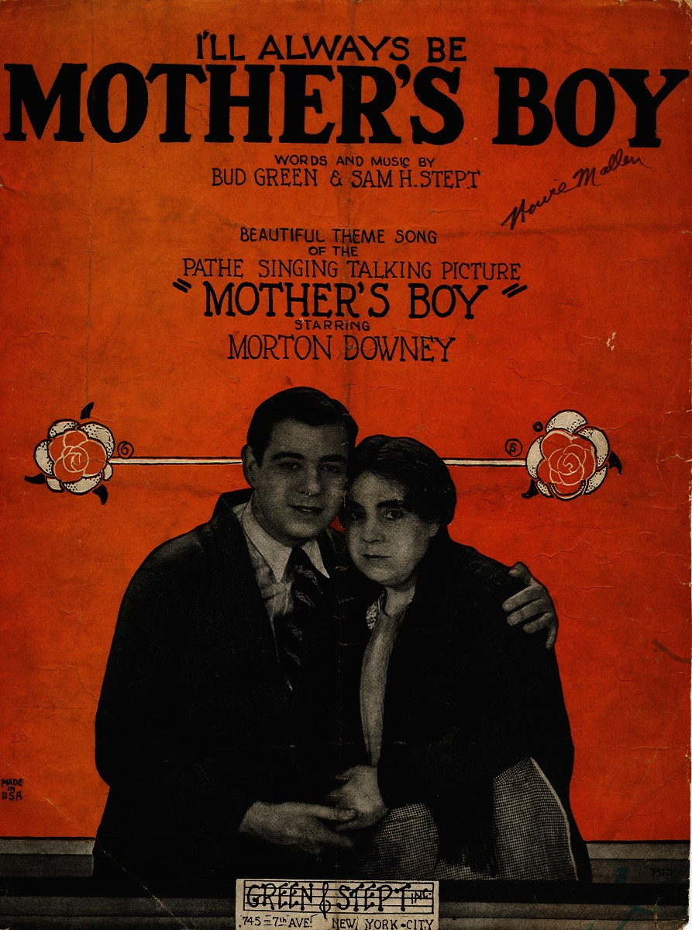

Slide 33
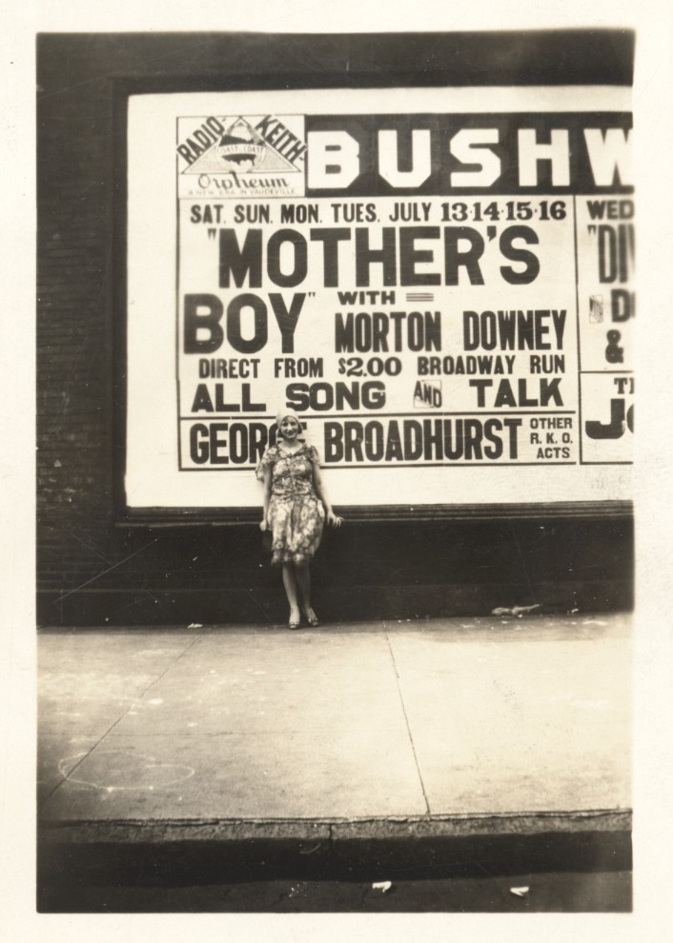

Slide 34
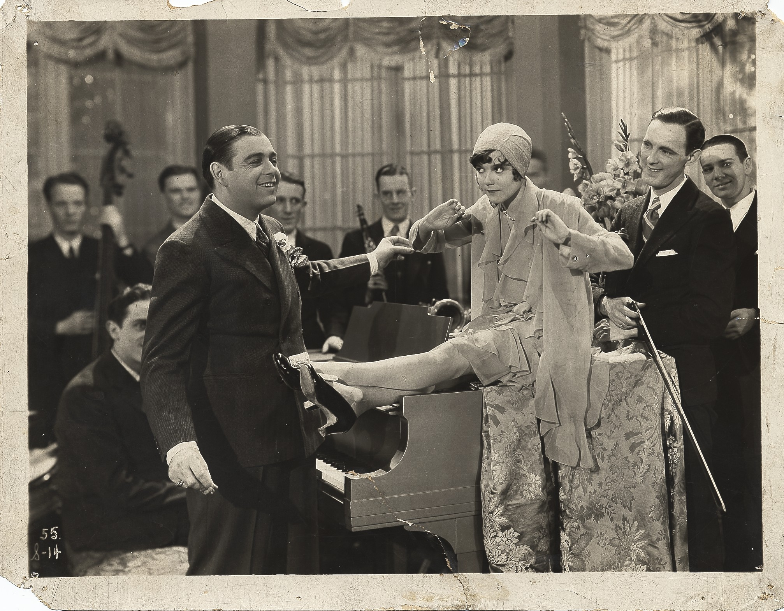
Notes:
IFMD 00-049

Slide 35
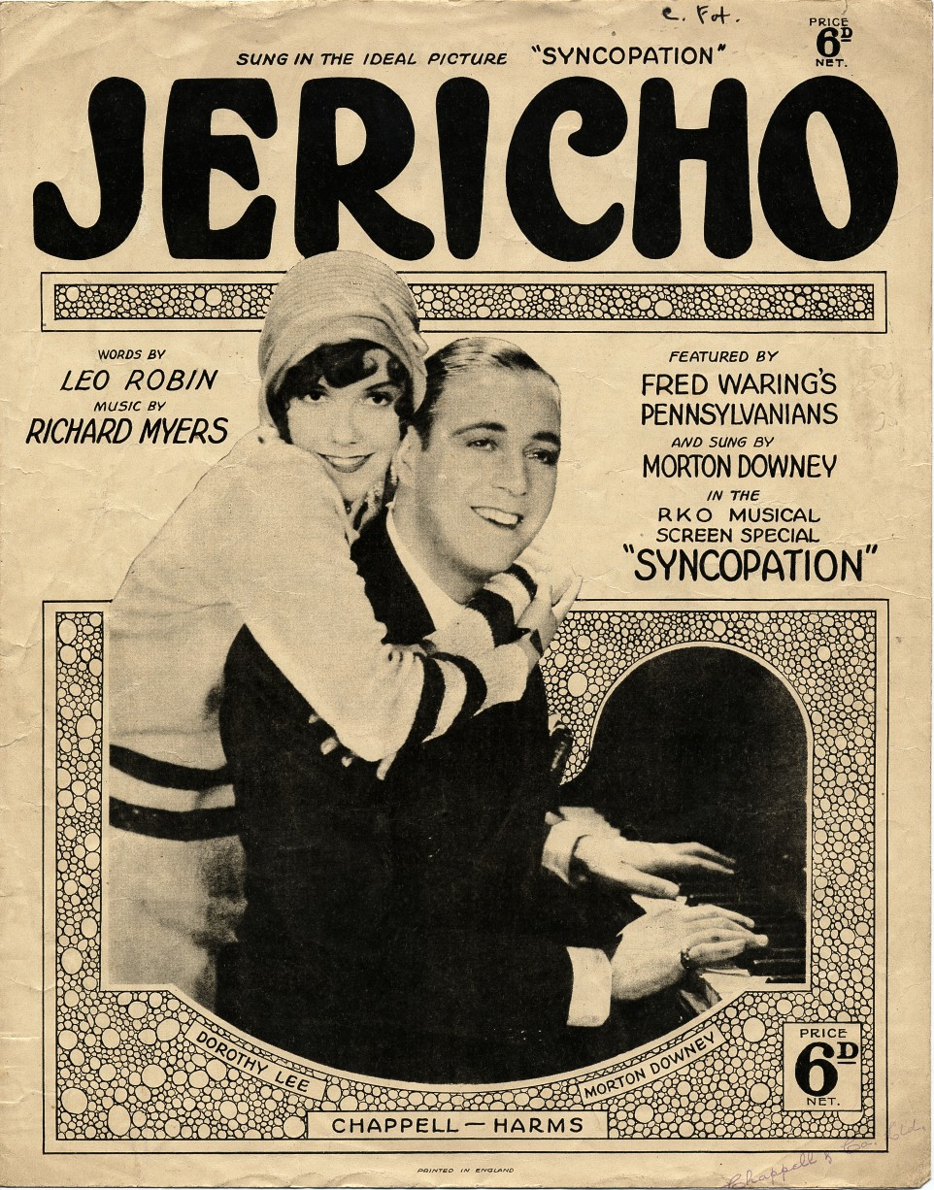

Slide 36
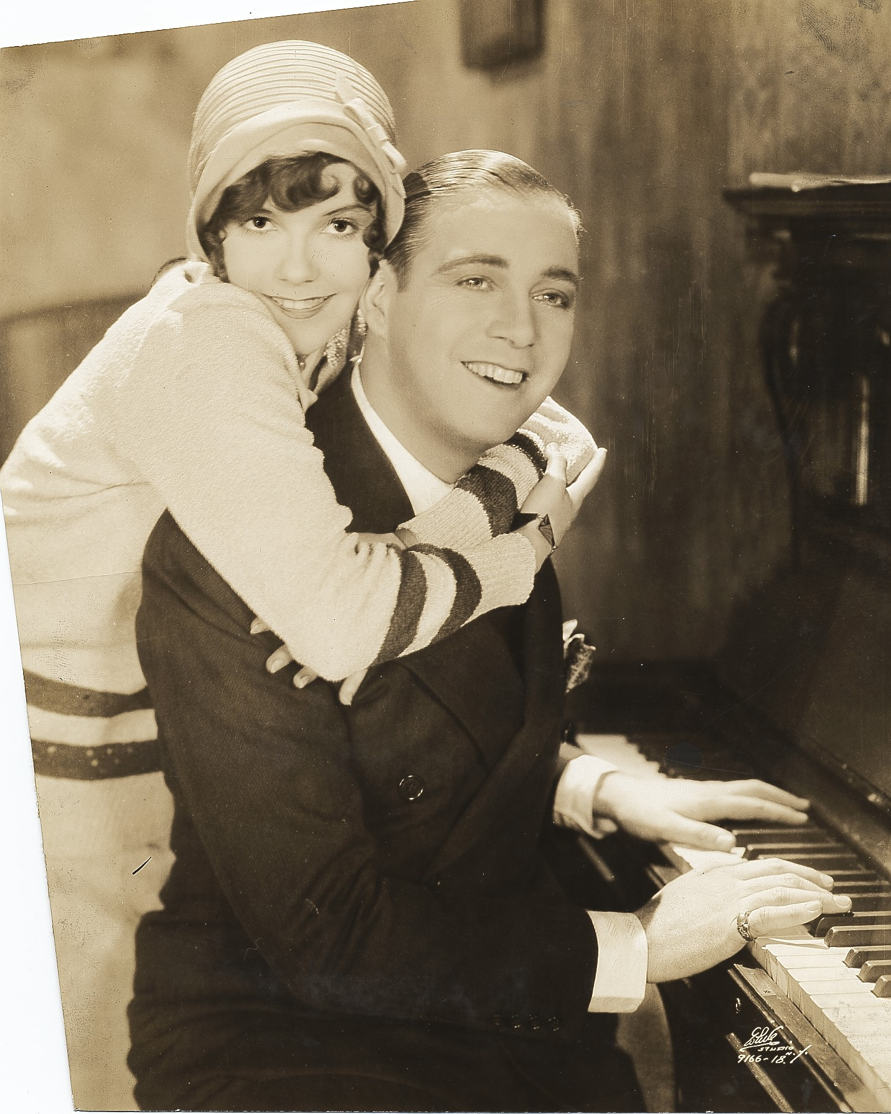

Slide 37
Radio
1928 First broadcast in London
1930-31 CBS; 15 minutes, 4 times a week, 7:00
1931-32 CBS; The Camel Quarter Hour, 7:45
1933-51 Blue Network
1943-45 Mutual; 15 minutes, weekdays at noon
1945-47 NBC; 15 minutes, 3 times a week, 11:15
1948-50 CBS; 30 minutes, Saturday at noon
1950-51 The Coke Club

Slide 38
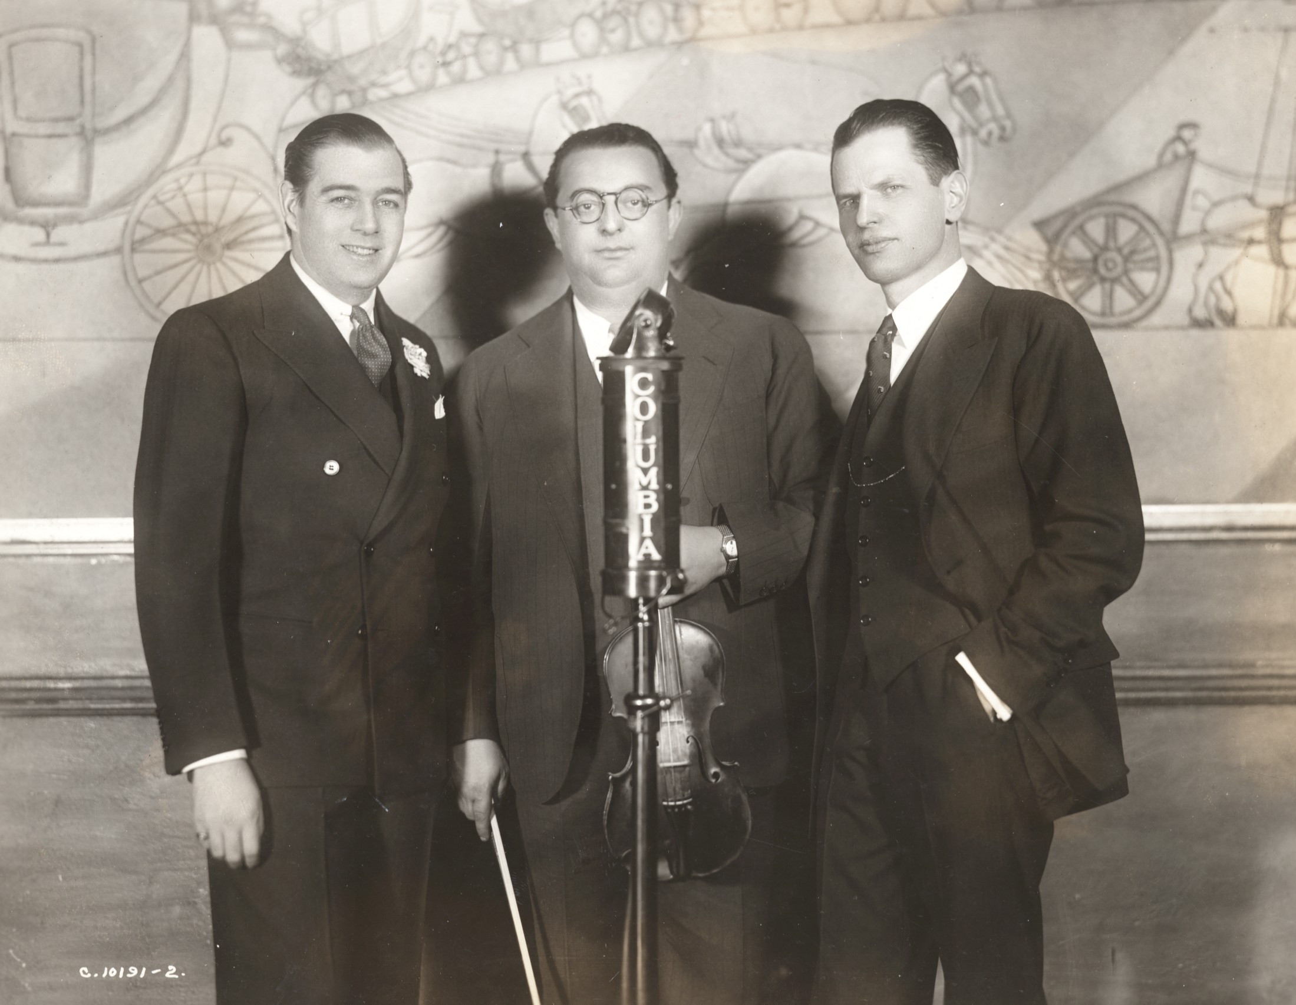

Slide 39
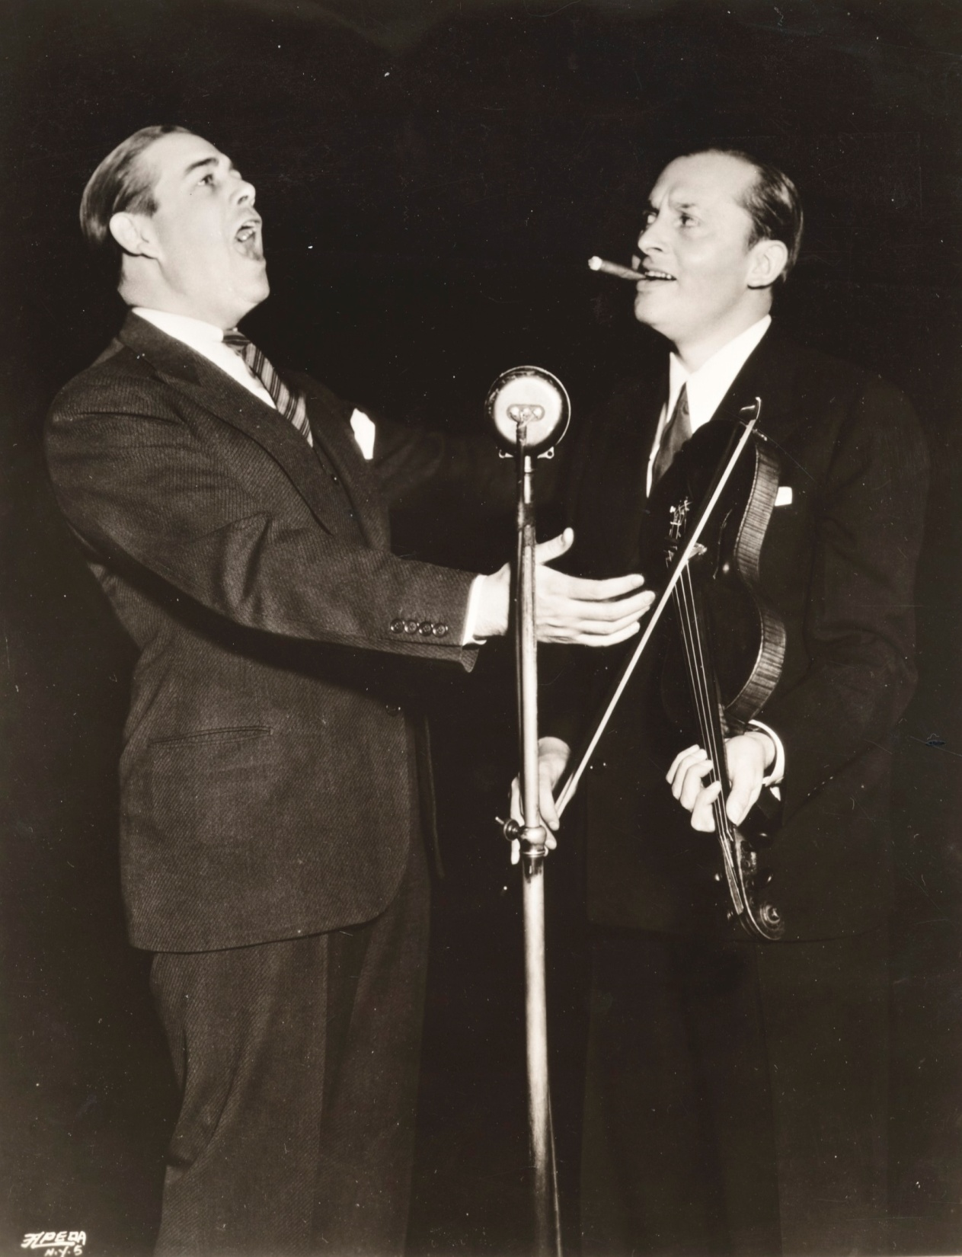

Slide 40
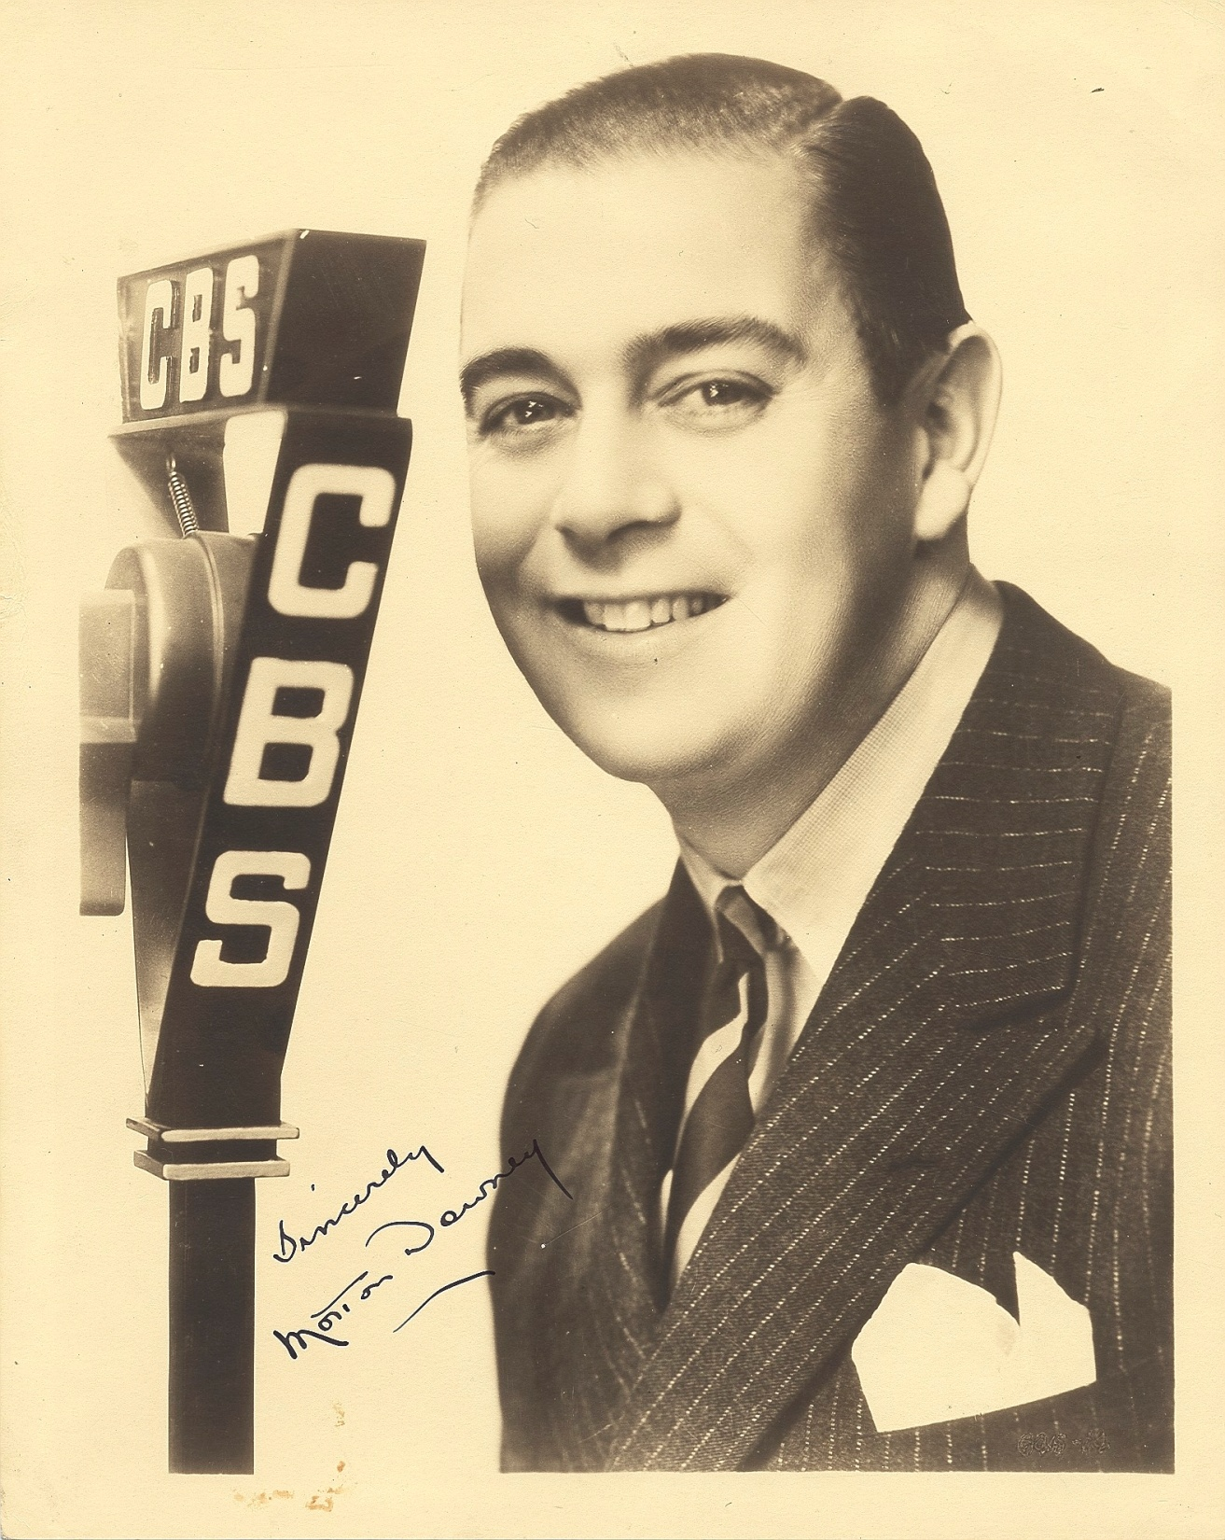

Slide 41
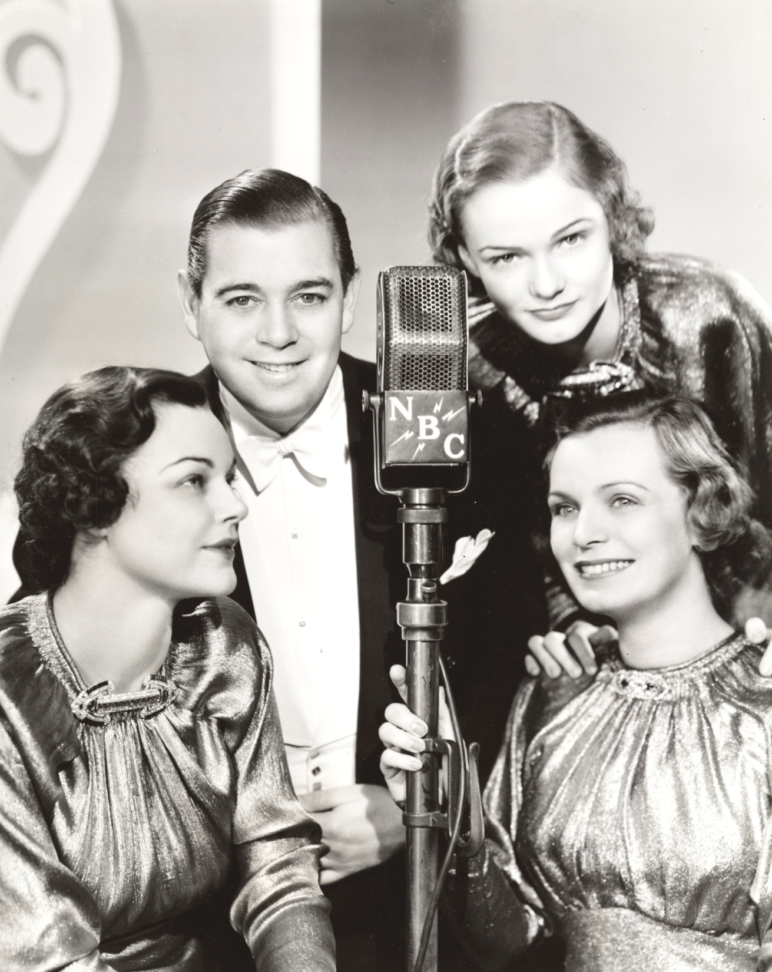

Slide 42
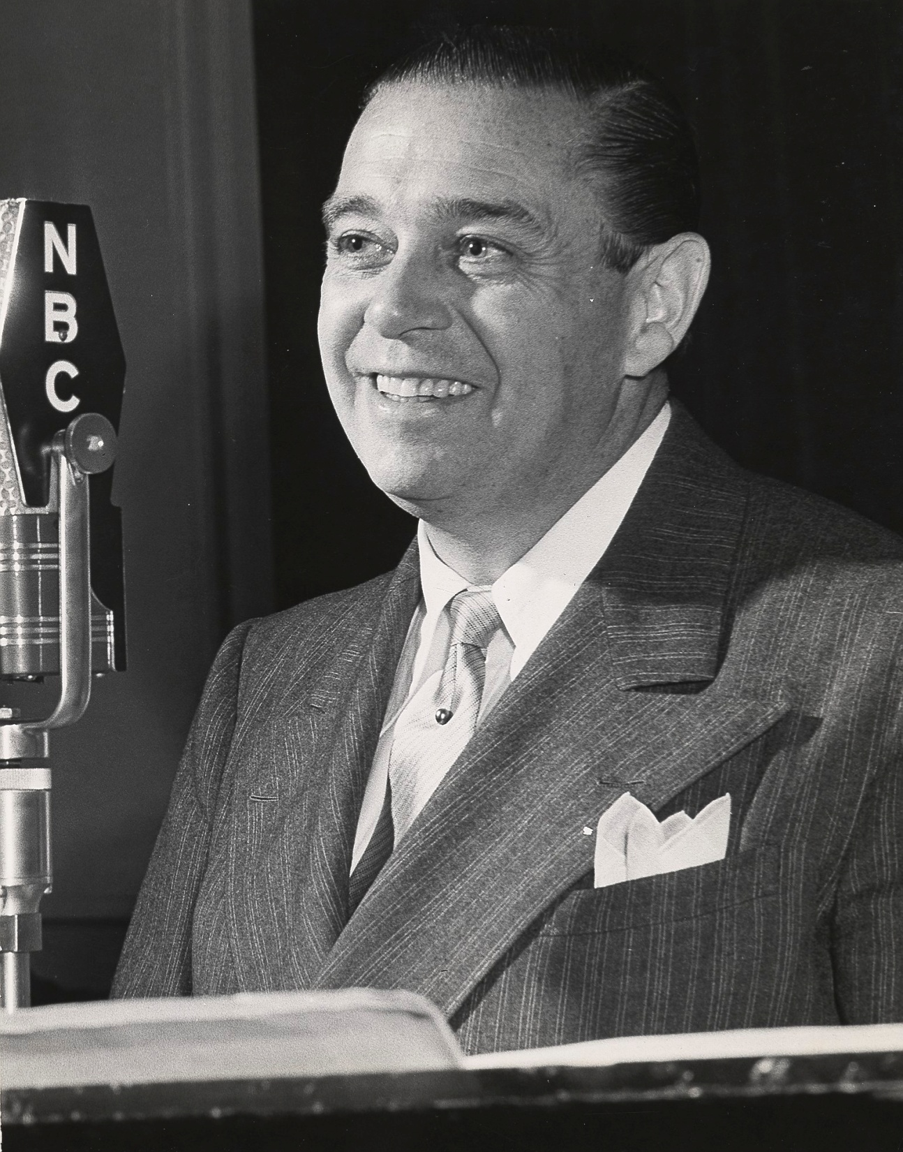

Slide 43
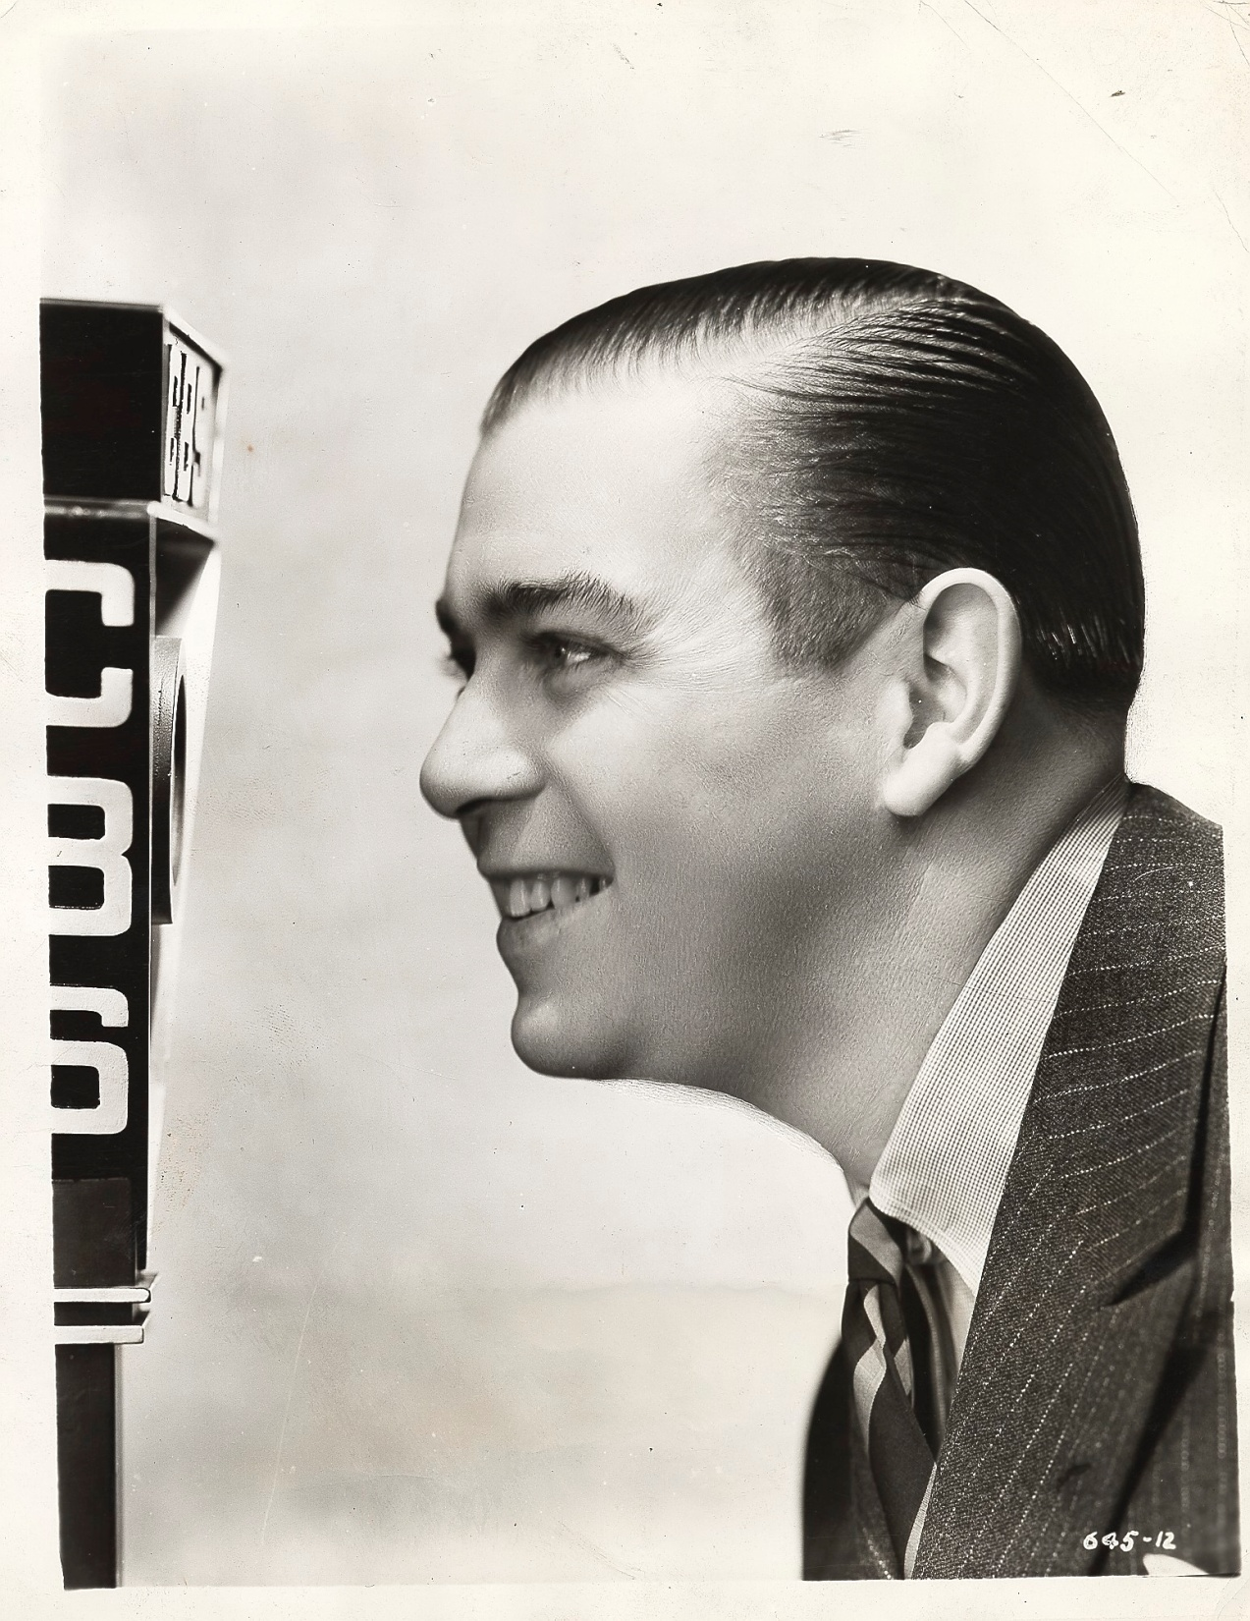
Notes:
IFMD 00-069

Slide 44
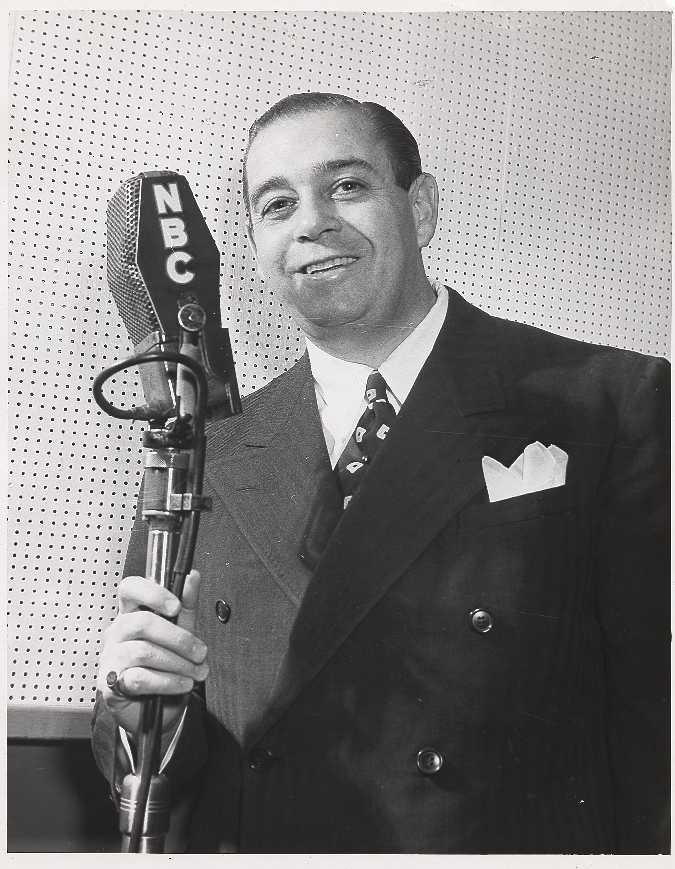

Slide 45
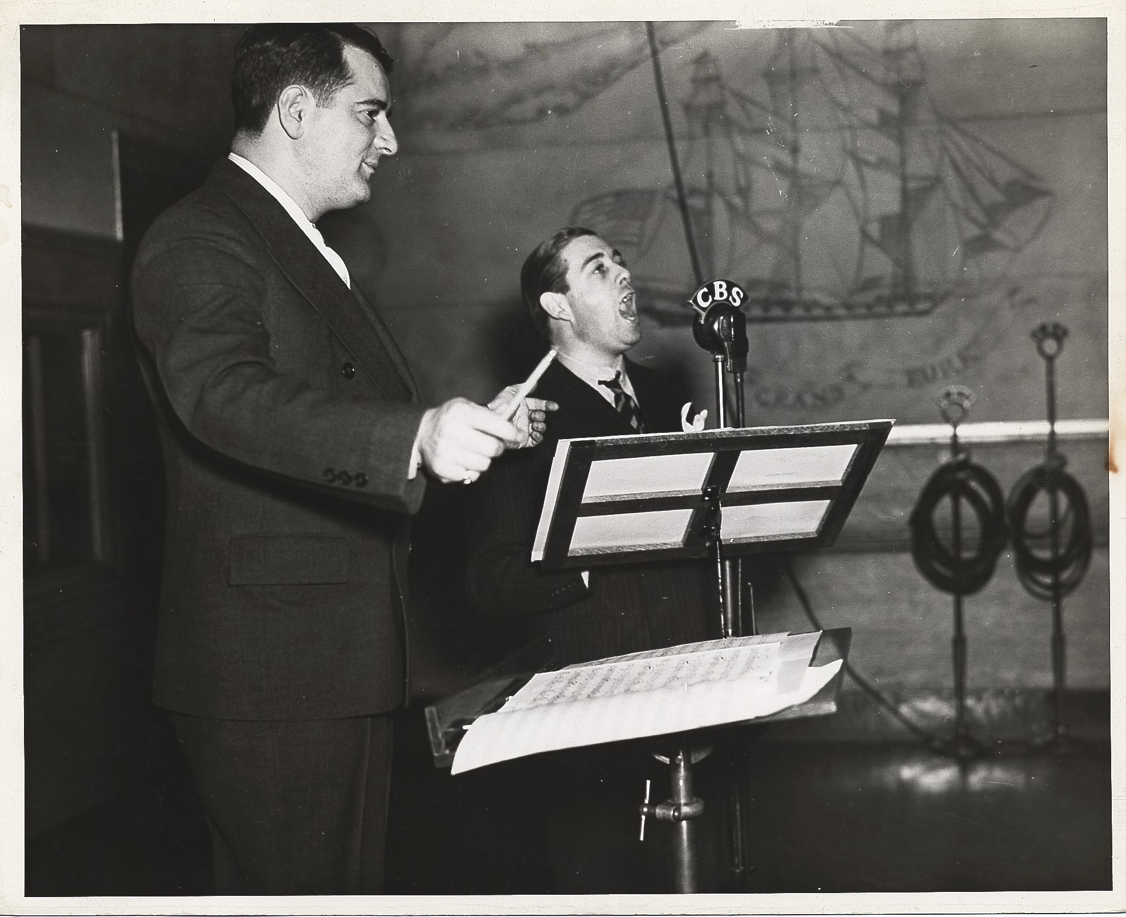

Slide 46
Composer
Notes:
We’re on the March 1933…Now you’re in my Arms…1931

Slide 47
Notes:
Wabash Moon 1931…On My Way Out…1944

Slide 48
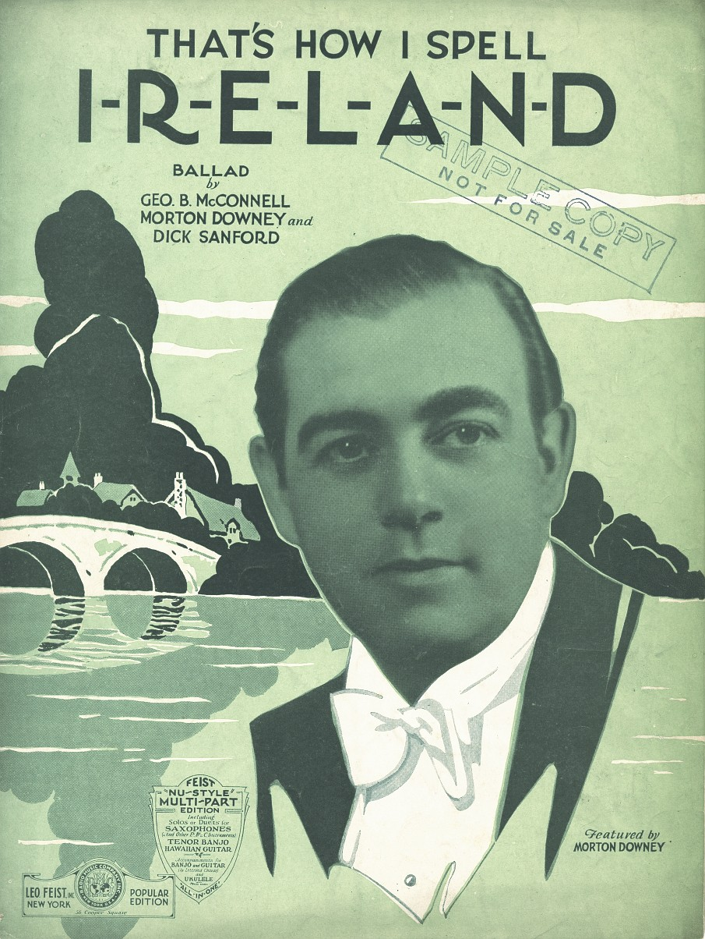
Notes:
1931

Slide 49
Art Deco Sheet Music
Art Deco Period between 1925-1939
Sheet music Art Deco design features:
Geometric Shapes
Futuristic
Sweeping Curves
Colors of Orange, blues & yellows
Colors generally cooler and metallic

Slide 50
Art Deco 1928

Slide 51
1930

Slide 52
Art Deco 1931

Slide 53
Art Deco 1931

Slide 54
Art Deco 1931

Slide 55
Art Deco 1931

Slide 56
Art Deco 1931

Slide 57
Art Deco 1932

Slide 58
Art Deco 1932

Slide 59
Art Deco 1933

Slide 60
Art Deco 1934

Slide 61
1931 - 1935 Songs 1931

Slide 62
1931

Slide 63
1931

Slide 64
1931

Slide 65
1931

Slide 66
1932

Slide 67
1932

Slide 68
1933

Slide 69
1934

Slide 70
1935

Slide 71
Correspondence & Advertising

Slide 72
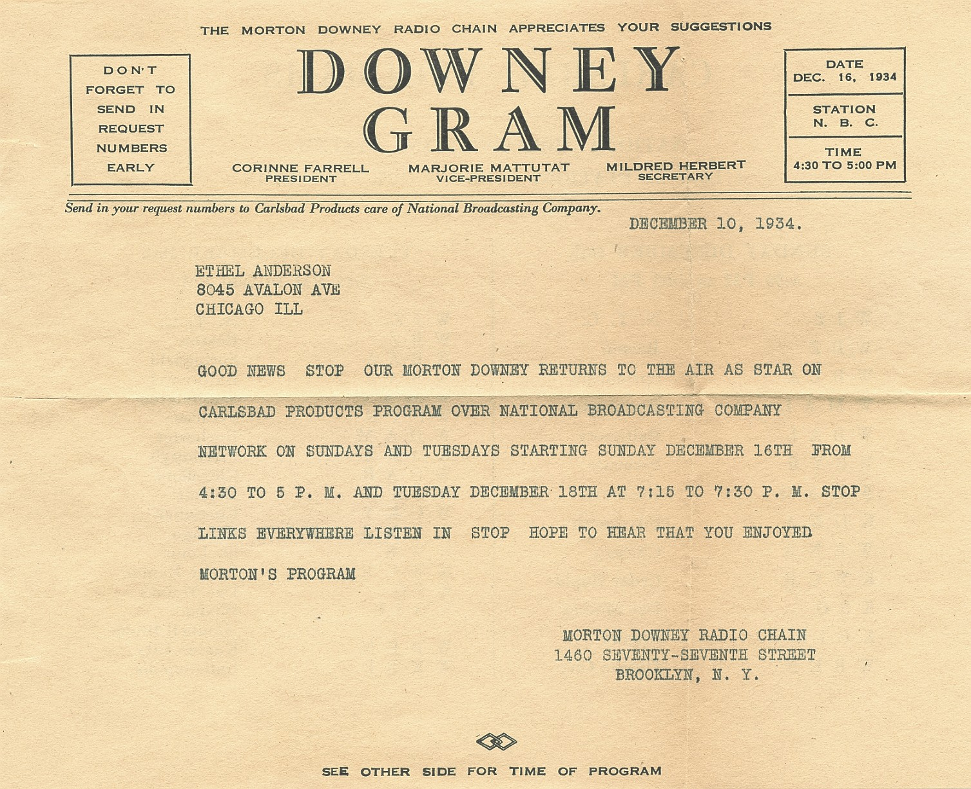

Slide 73
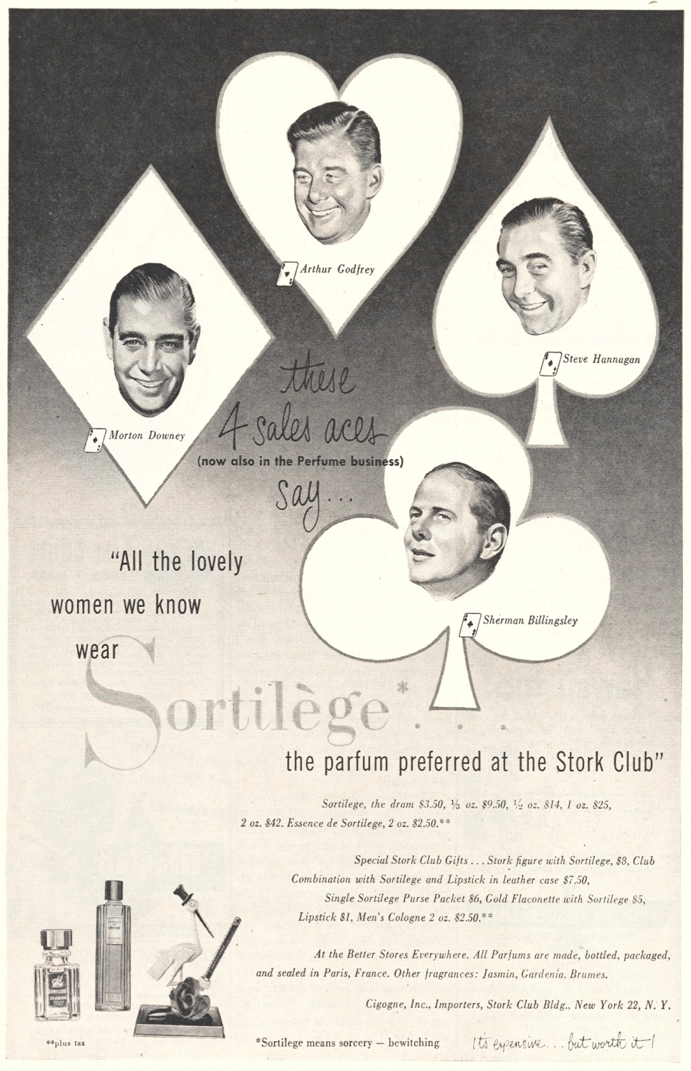
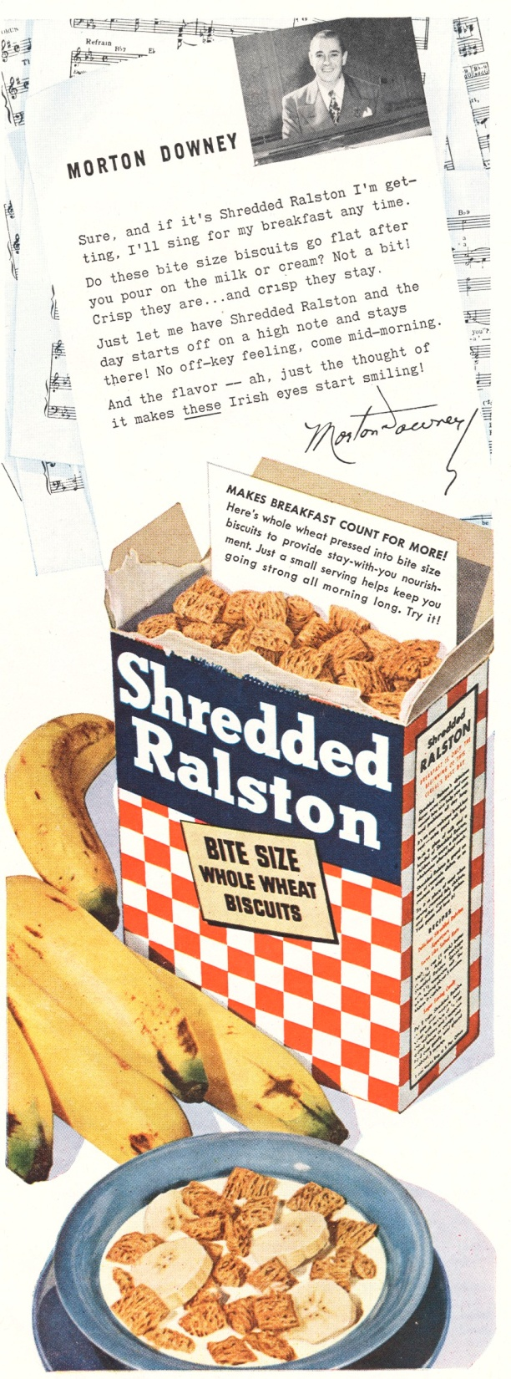

Slide 74
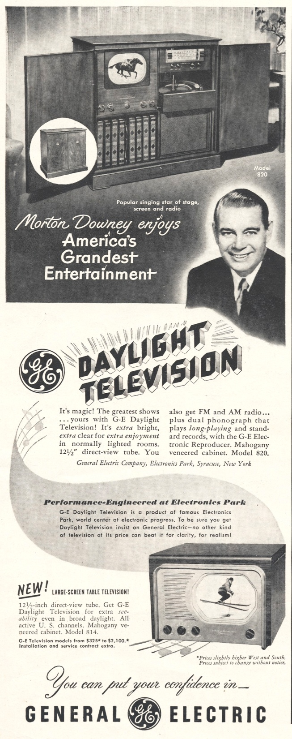
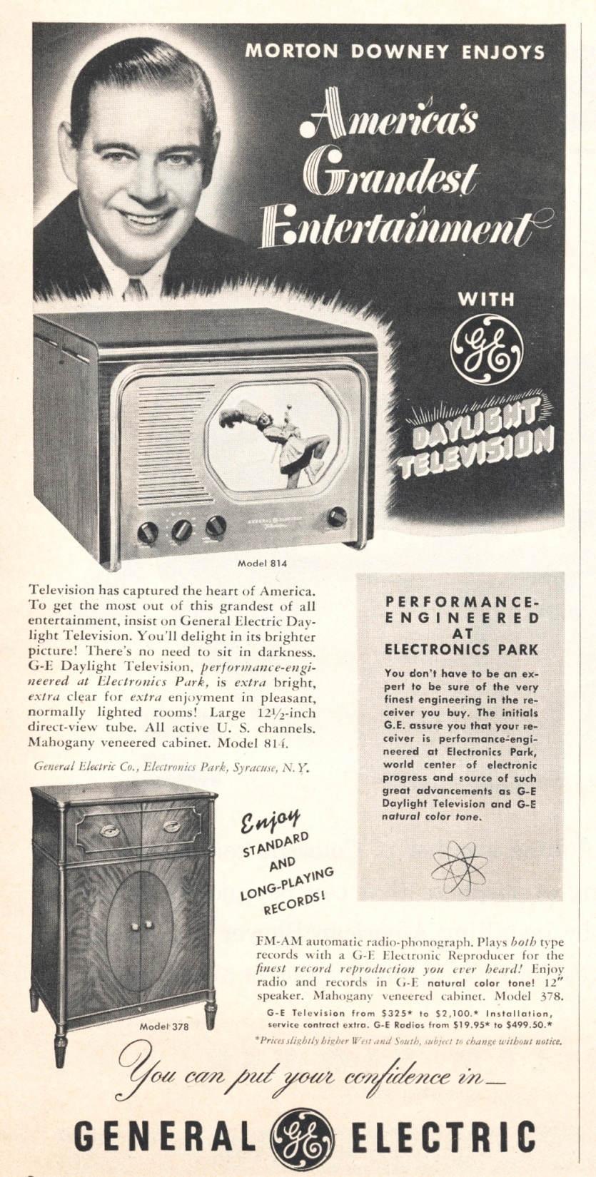

Slide 75
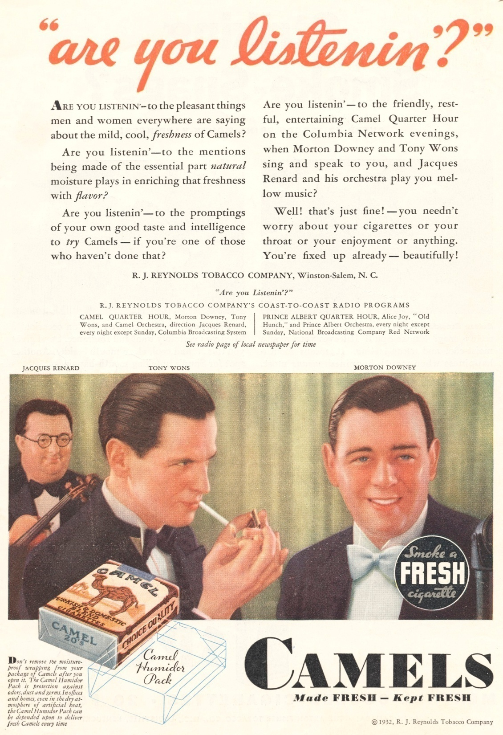

Slide 76
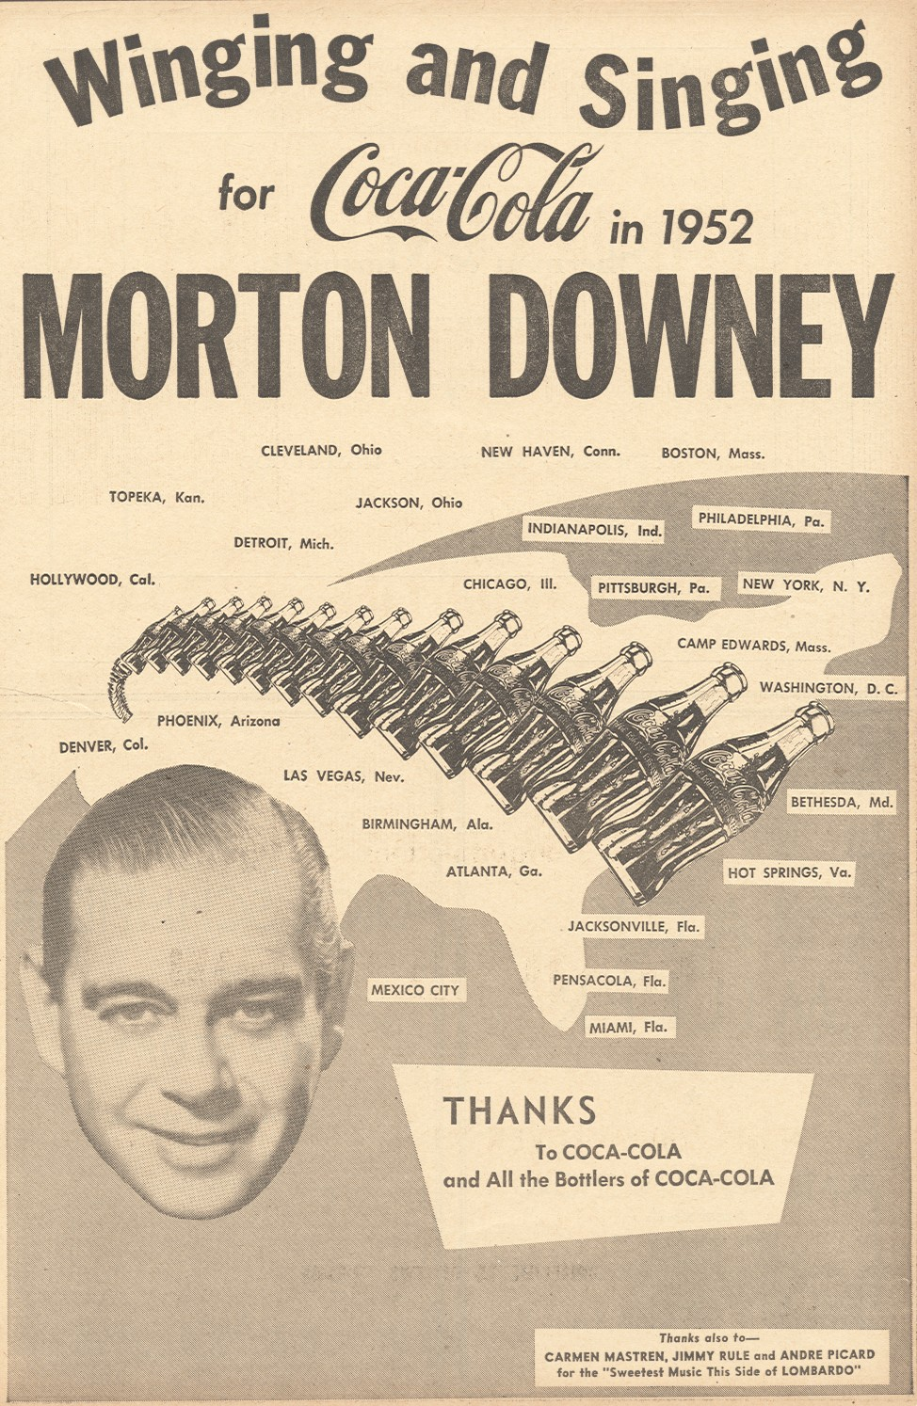
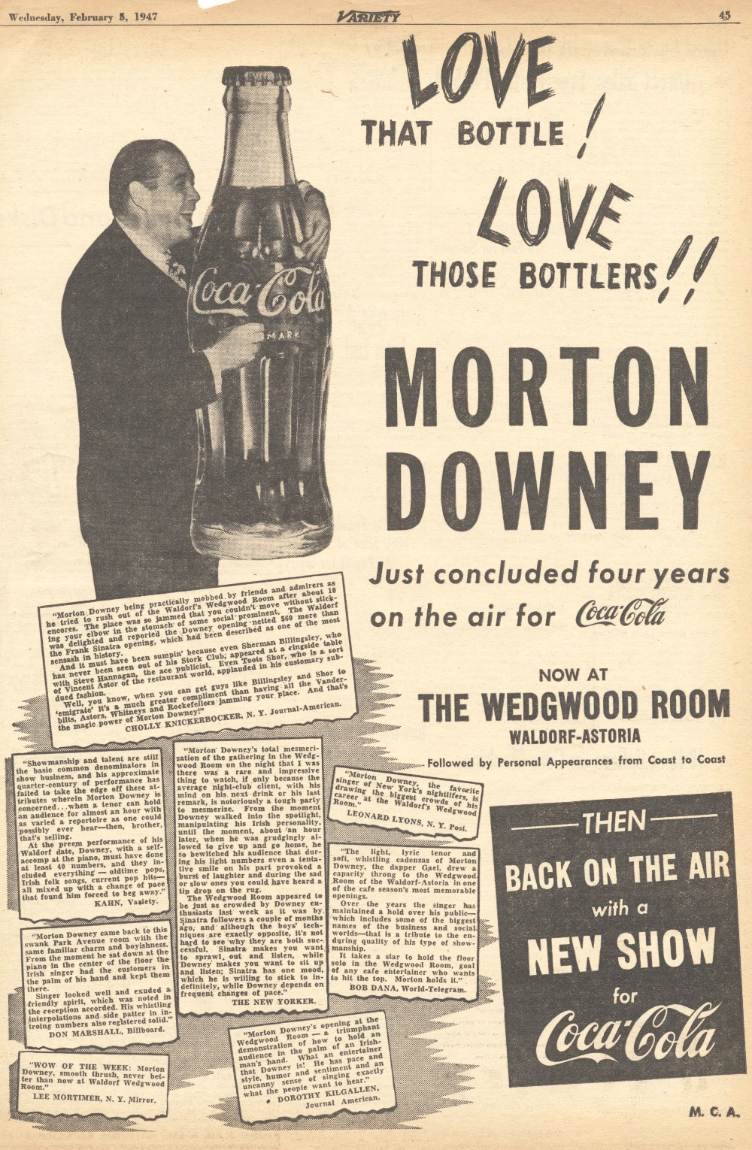

Slide 77
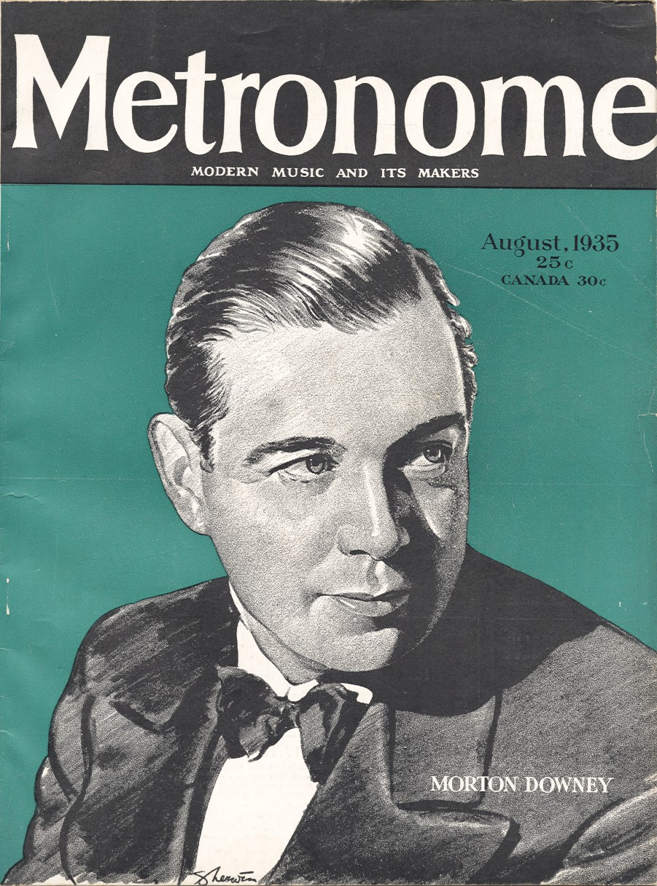

Slide 78
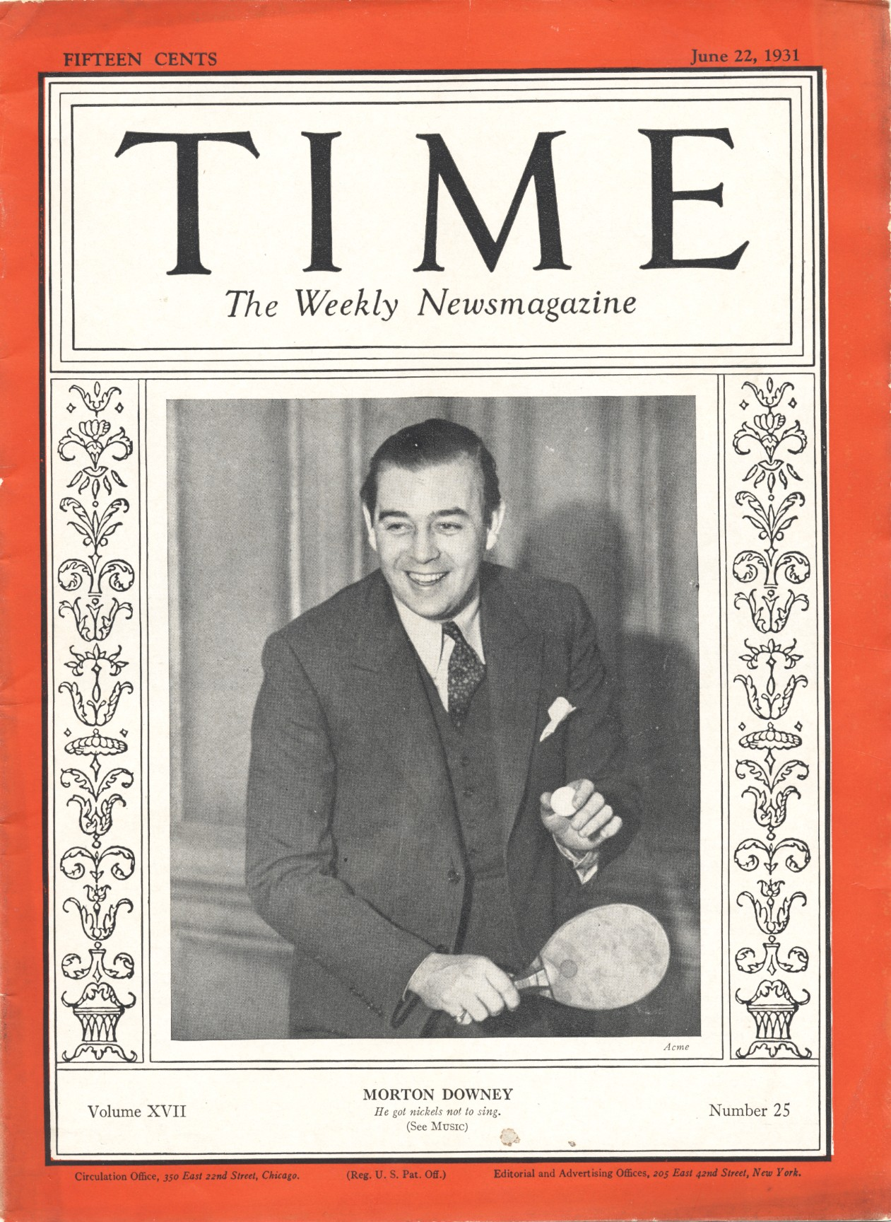

Slide 79
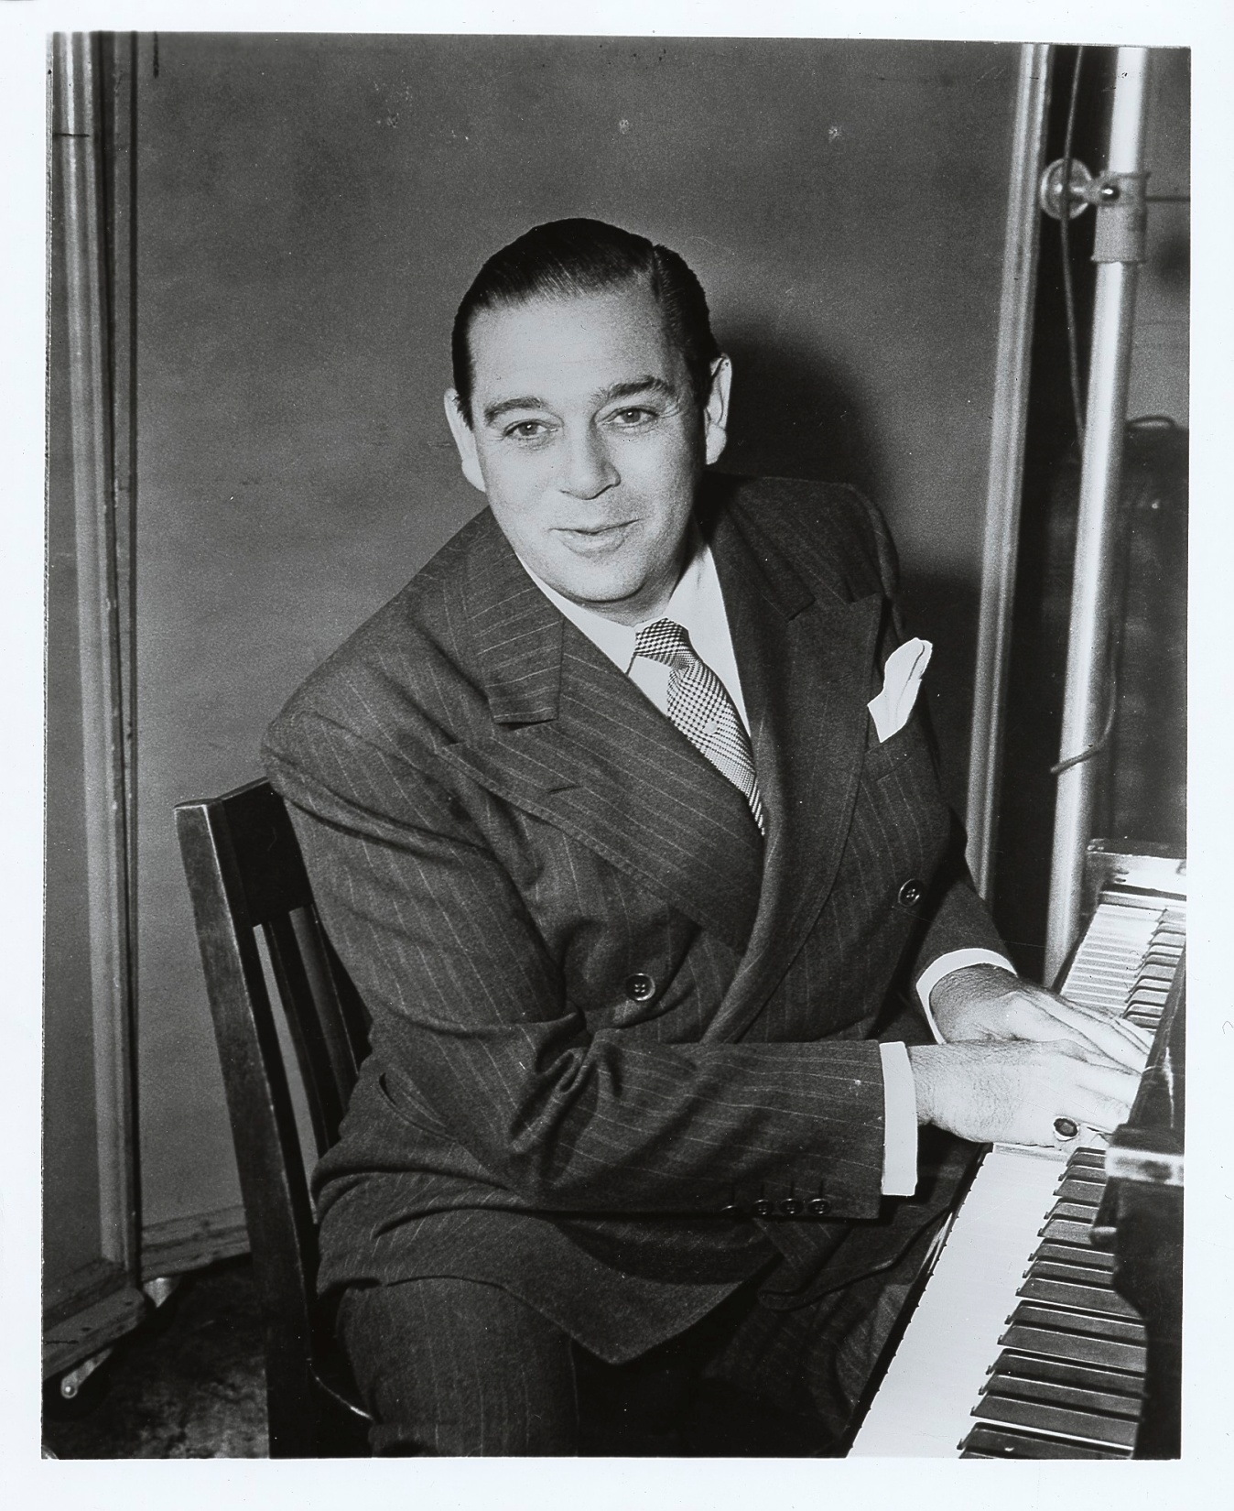

Slide 80
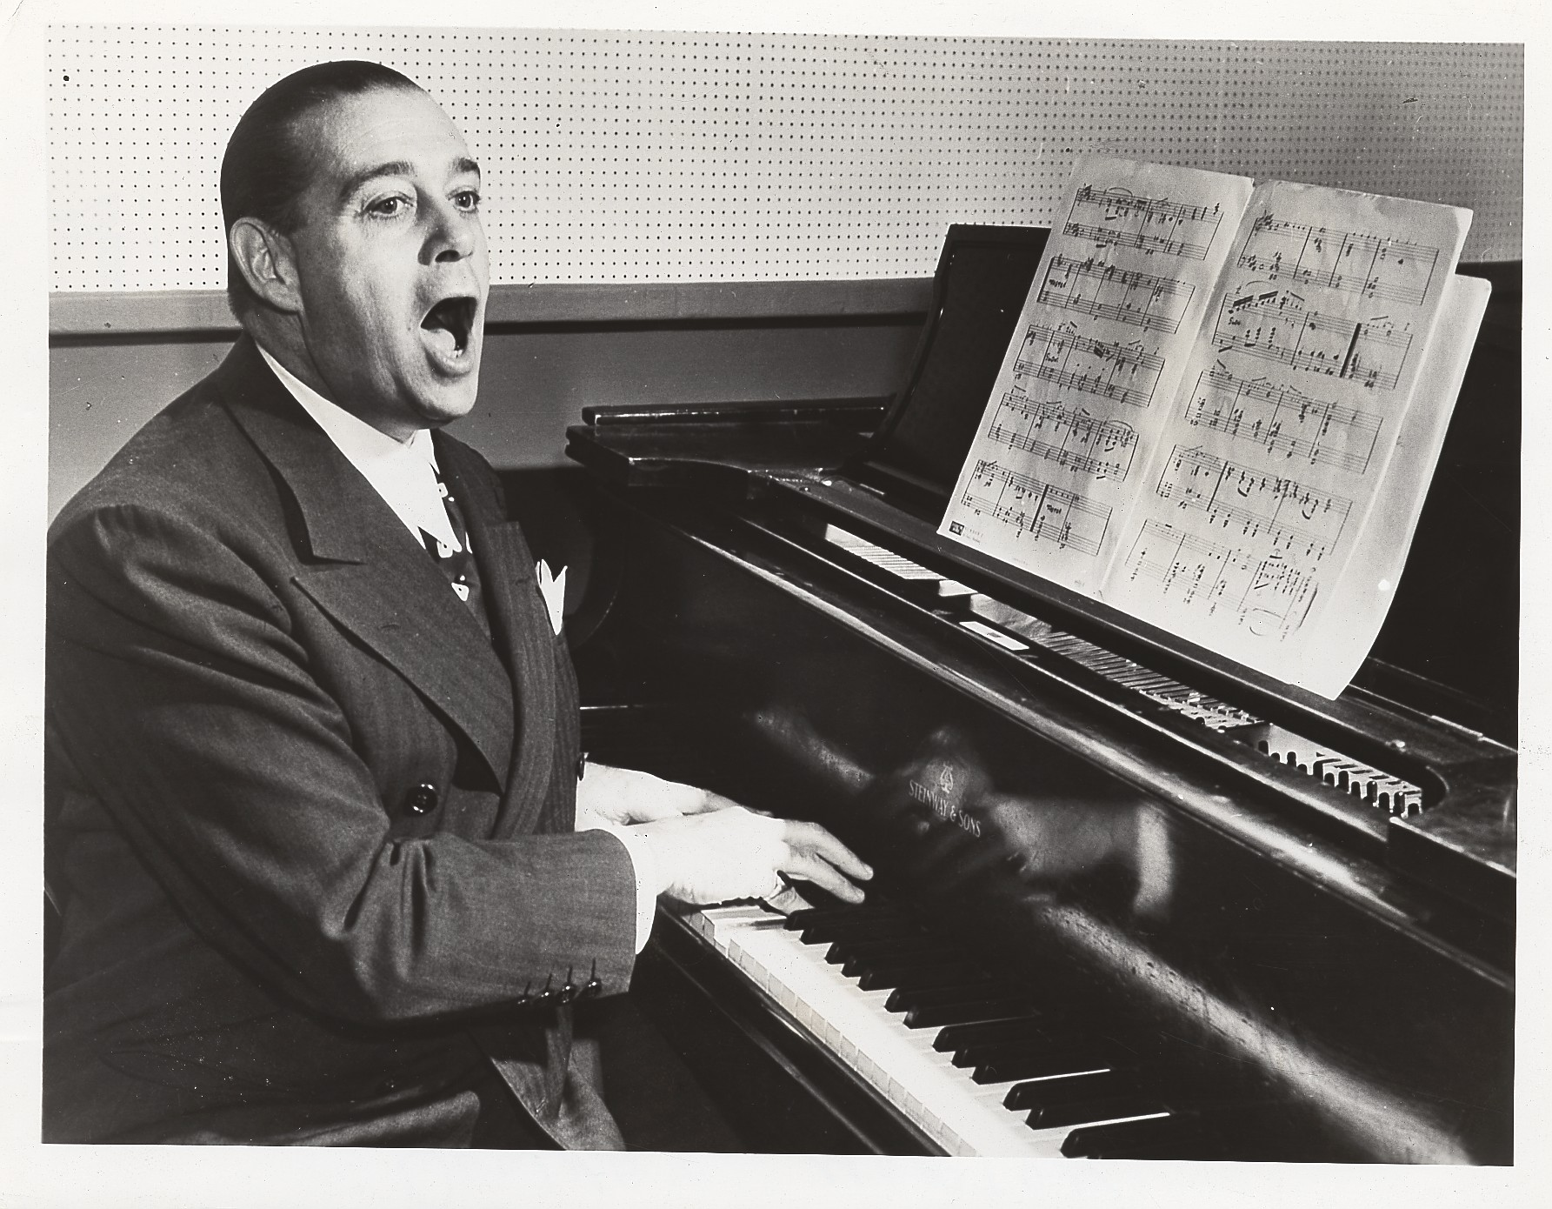

Slide 81
1935-1947 Songs

Slide 82
1936

Slide 83
1937

Slide 84
1946

Slide 85
1947

Slide 86
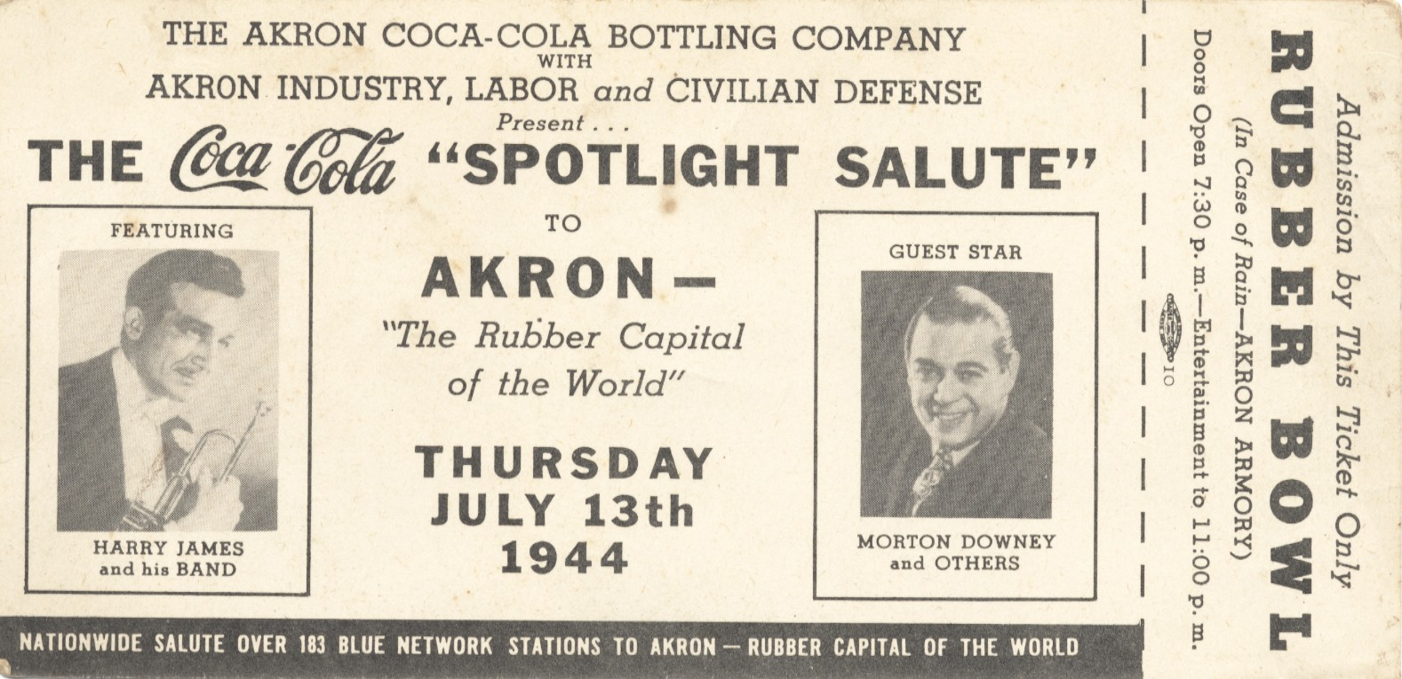

Slide 87
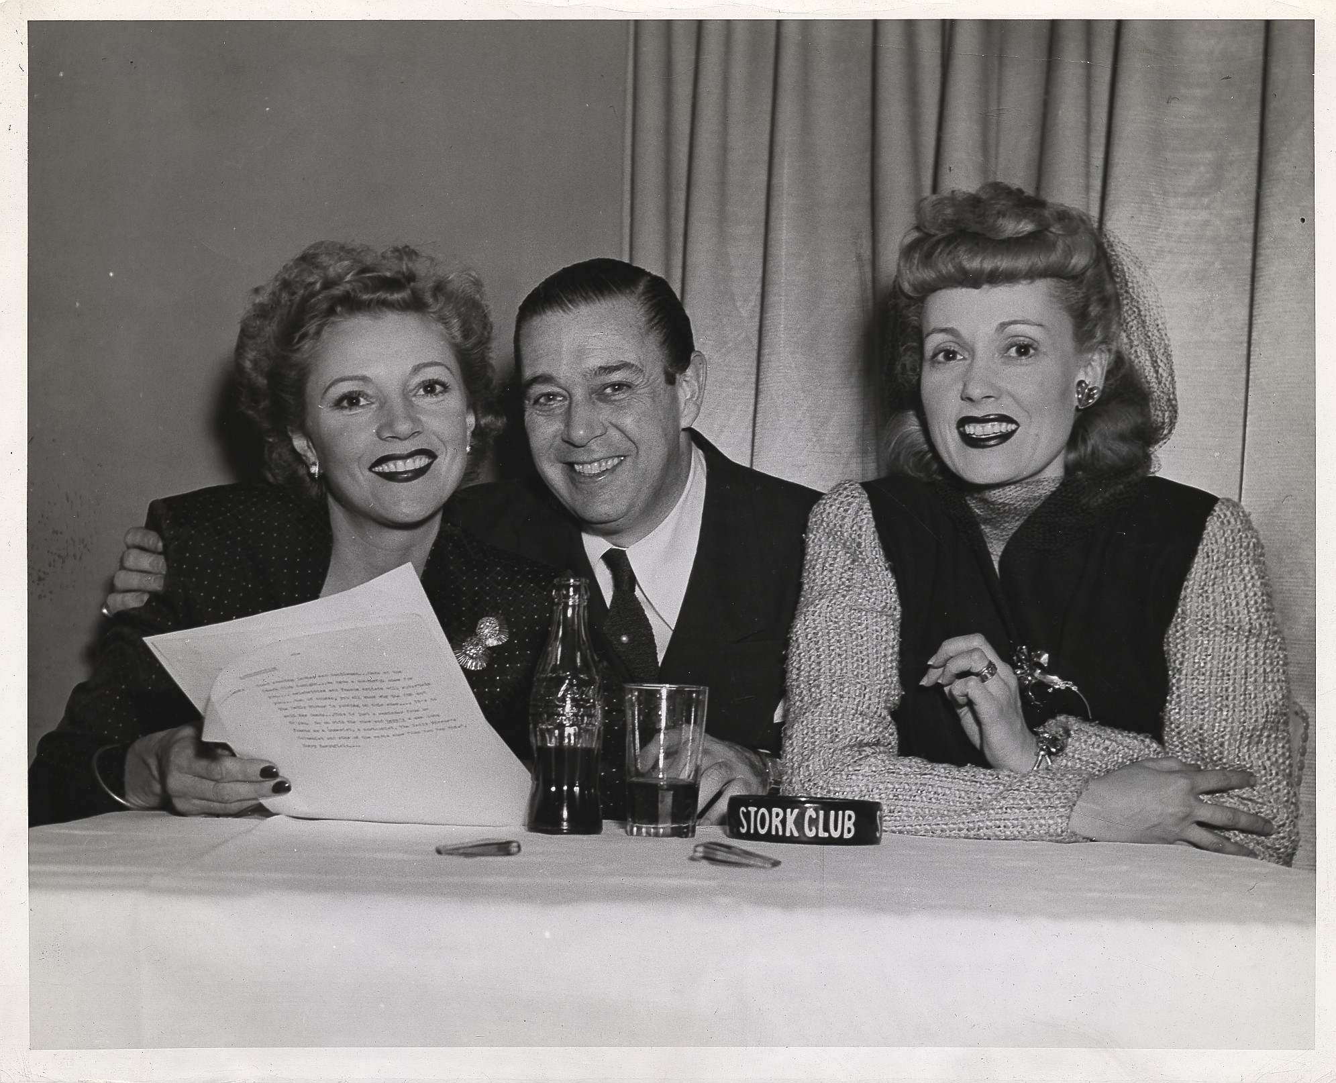
The Stork Club
Notes:
Ashtray and Coca Cola…great marketing

Slide 88
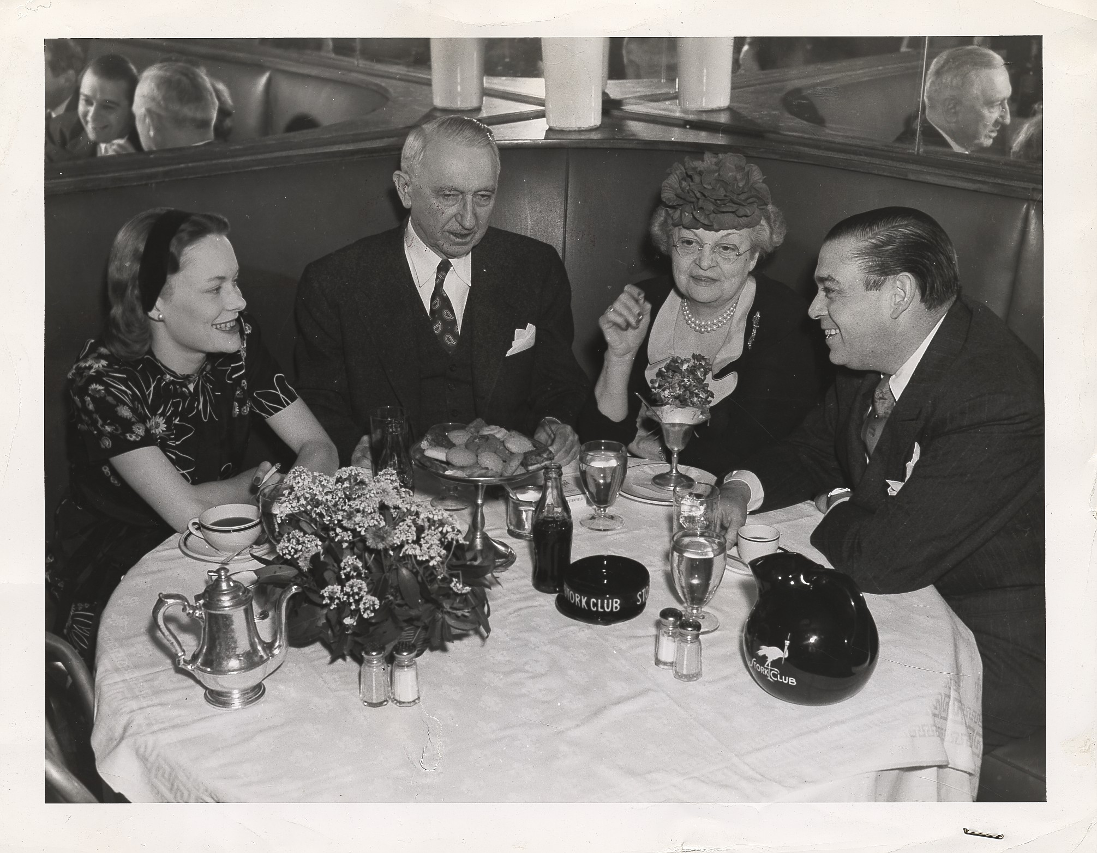
Notes:
Georgia Senator Walter George, his wife and daughter-in-law @ Stork Club

Slide 89
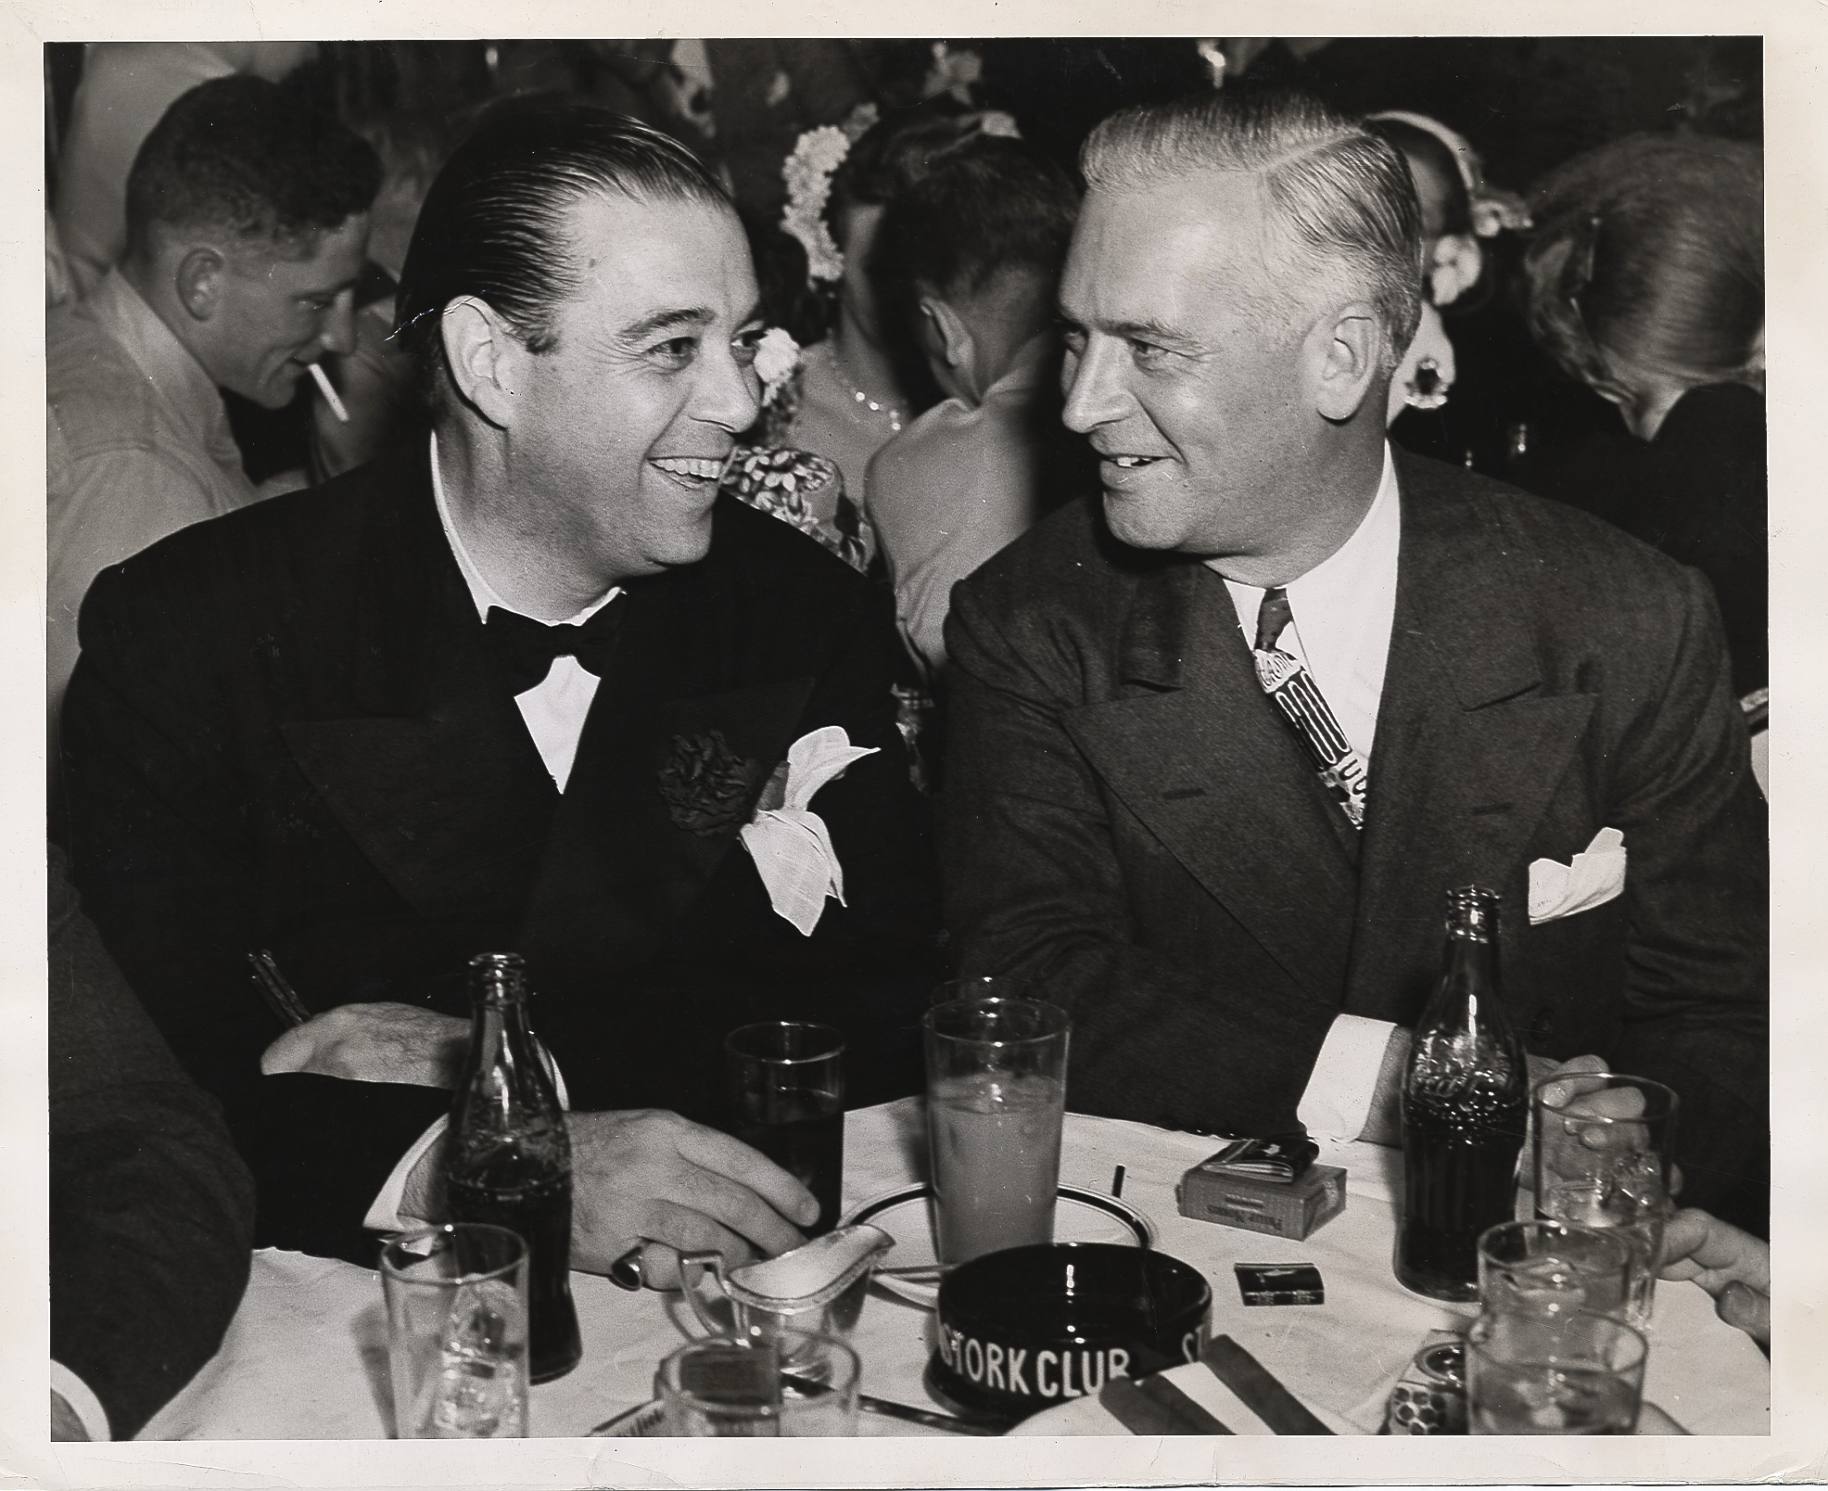
Notes:
Illinois Governor Dwight Green @ Stork Club

Slide 90
Recordings
(First Commercial Recording: “Midnight Rose”) under pseudonym Morton James 1923
Hit Singles
The Lonesomest Girl in Town 1926
Carolina Moon 1928
I’ll Always Be in Love With You 1929
Wabash Moon 1931
Auf Weiderseh’n, My Dear 1932
They Didn’t Believe Me 1934
Spring Will Be A Little Late This Year 1944
The Old Lamplighter 1946

Slide 91
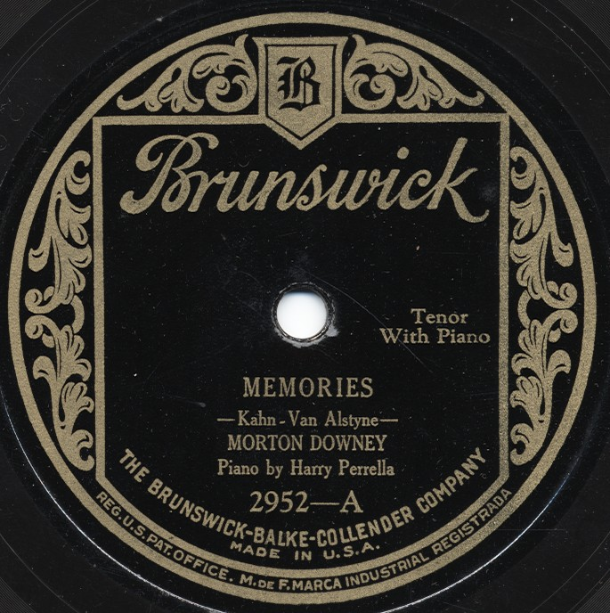
Recordings

Slide 96
Irish1929

Slide 97
1934

Slide 98
1935

Slide 99
1936

Slide 100
1945

Slide 101
1945

Slide 102
1949

Slide 104
1955

Slide 106
Family
Feb. 1929 Married Barbara Bennett
Children
Michael Joseph Downey
Dec. 1932 Sean Morton Downey (Morton Downey Jr.)
Nov. 1934 Lorelle Ann Downey
Nov. 1935 Anthony Patrick
Aug. 1938 Kevin Peter Downey
Oct. 1950 Married Margaret Boyce ("Peggy") Schulze Hohenlohe, 29.
1970 Married Ann Trainor

Slide 107
Notes:
Margaret Bennett and sister Joan Bennett

Slide 109
Notes:
Morton and his wife

Slide 114
By The Numbers
Sang on more than 1,500 Recordings
Claimed to have sung “When Irish Eyes Are Smiling” 10,000 times
Wrote more than 30 popular songs
In 1930’s made $4,500 a week for his radio show
In 1930’s grossed over $250,000 a year from radio work alone
In 1930s was receiving over 95,000 fan letters a week

Slide 115
Morton Downey Titles
The Irish Nightingale
The Irish Thrush
The Irish Troubadour
The Sensational Tenor
The Phenomenal Tenor
Broadways Golden Voiced Tenor

Slide 116
Career Highlights
Was featured performer at the 1939 New York Worlds Fair in Billy Rose’s Aquacade
Did some television work and landed his own show on NBC in 1949.
Sang at the coronation of King George VI
Sang for President Franklin D. Roosevelt
During WWII, sang on U.S.O. tours

Slide 117
Notes:
Doing USO shows

Slide 118
Notes:
USO shows

Slide 120
Morton Downey Sr.
1901-1985

