Slide 1
Audio Analysis & Processing
...in Multi-Media File Formats
Rob Poretti
Cube-Tec North America
Notes:
Thanks Bill for the introduction…Good morning…
Many of you have seen some of my earlier presentations – in particular Dobbin - but today I’ll be presenting updates to our platform, that allows us to work with audio-visual file formats – specifically, common a/v formats associated with video and film archiving. But… I’ll still focus on audio workflows for those multi-media formats…

Slide 2
Audio processing requirements in Multi-Media Files
Audio Analysis & Processing in Multi-Media Formats
Audio quality analysis and reporting.
Derivative signal processing: re-mastering, restoration, up-mixing, loudness (e.g.: CALM Act – Commercial Advertising Loudness Mitigation Act)
Audio stream extraction: to produce audio-only derivatives… e.g.: soundtracks, political speeches
Coming: Video analysis & processing:
Format analysis – file, wrapper & metadata structure.
Content analysis – various video quality metrics.
Transcoding: E.g. JPEG 2000 Lossless Profile -> .H264 AVC
Re-formatting: E.g. Upscale, etc.
Restoration and Re-Mastering: E.g. Dust busting.
Notes:
So what kind of interesting things can we do with multi-media files? Actually, a lot of the same kinds of things that we did with audio-only formats: [CLICK]
Audio quality analysis and reporting. [CLICK]
Audio signal processing: re-mastering, restoration, up-mixing, loudness control.[CLICK]
We can extract the audio stream – to produce audio-only derivatives… some applications: music soundtracks and political speeches, etc. [CLICK]
We are also working on a complete set of video tools, that include:
Format analysis – basicall structure compliance.
Content analysis and QA
Transcoding
Re-formatting : E.g. Upscale, etc.
Restoration and Re-Mastering: E.g. Dust busting, color space conversion.
Before we jump in, I’d like to give an overview of our archiving tools… [CLICK]

Slide 3
Cube-Tec Archiving Suite
Audio Analysis & Processing in Multi-Media Formats
Friendly GUI - purpose-built digitization engine.
Import modules for popular legacy media formats.
Emphasis on quality supervision and metadata.
Management & supervision software.
Bi-directionally integrates metadata with Cube-Tec suite.
Easily customizable: Employs Business Process Modeling.
Scalable, distributed, media batch processor.
Simple graphical interface for creating workflow processes.
Powerful decision making and complete reporting .
QUADRIGA
CUBE WORKFLOW
DOBBIN
Notes:
Our software tools, can be broken down to three distinct areas… [CLICK]
QUADRIGA features an easy-to-use but powerful digitization engine. [CLICK]
It includes import modules for most legacy formats. [CLICK]
Historically, QUADRIGA’s focus is on quality supervision and metadata capture during ingest. [CLICK]
Cube-Workflow integrates the suite by creating metadata driven workflows. It allows job tracking and supervision of all work processes as well as media file status throughout the entire preservation life-cycle. [CLICK]
It allows us to create workflows with metadata derived from any data source This Metadata flows through the rest of the suite via web-service processes. [CLICK]
Cube Workflow uses Business Process Modelling as its underlying framework. This makes it easily customizable. [CLICK]
Lastly, we have Dobbin –an automated batch processor that handles numerous post-ingest processing functions. [CLICK]
It is both a media and metadata processing engine and integrates a number of these functions with our other tools. [CLICK]
It’s power is in it’s simplicity - the ability to create complex workflows in a standardized and intuitive fashion. [CLICK]

Slide 4
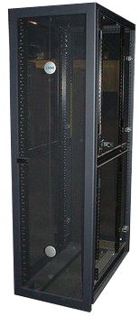
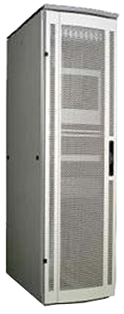
Integration
Audio Analysis & Processing in Multi-Media Formats
Legacy
Database
QUADRIGA
DOBBIN
AUDIOCUBE
Web Services
CUBE WORK-FLOW
Asset
Management
System
Notes:
The tools can operate as standalone applications, but are designed to work together - we use web-services to interact and communicate bi-directionally. [CLICK]
Metadata can be imported or exported directly to QUADRIGA or via Cube-Workflow… [CLICK]
Metadata can be manually entered, created automatically or imported/exported from external sources. [CLICK]
Now into some details… [CLICK]

Slide 5
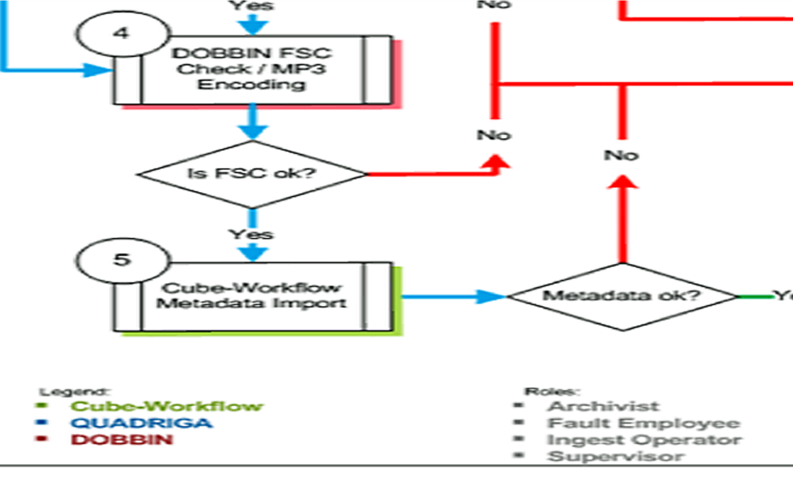
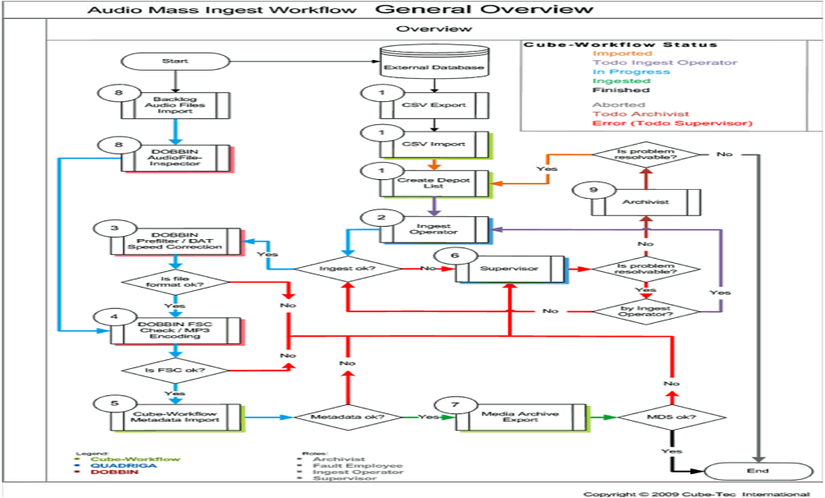
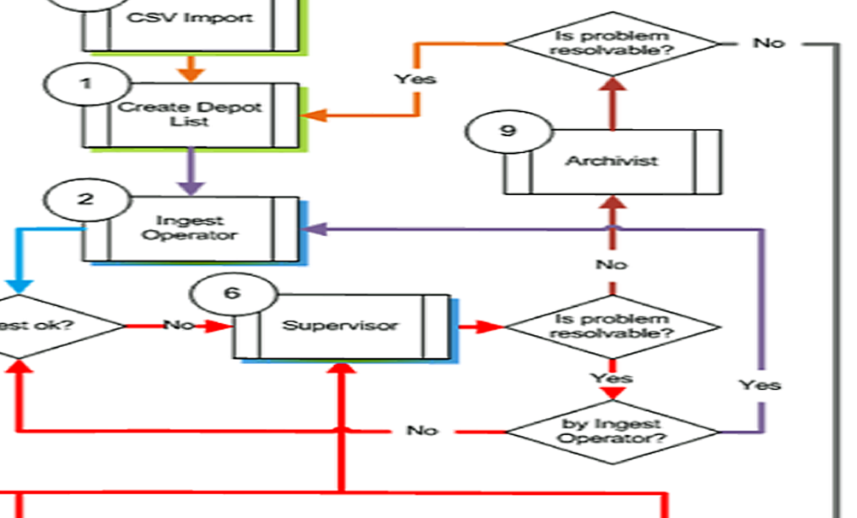
Audio Analysis & Processing in Multi-Media Formats
Cube-Workflow
Fully integrated into existing IT infra-structures, including cataloguing systems and external storage systems…
Collaboration environment - supports structured/unstructured communication for definable roles through ad-hoc messaging.
Ensures that team members have access to all necessary information available throughout the work-process, streamlining workflows and error detection.
Notes:
Cube-Workflow can be fully integrated into existing IT infra-structures, including database systems and external storage systems… It can be used as a connecting link between your existing cataloguing systems and our various software tools. [CLICK]
It provides a collaboration environment that supports communication tools for definable roles, using a bi-directional messaging system. Administrators, supervisors and operators have the ability to know the status of each object within the preservation life-cycle . [CLICK]
Cube-Workflow ensures that each member of the archive group has access to all necessary information, throughout a process. This provides a streamlined workflow, preventing operating errors by defining clear decisions when conflicts arise. [CLICK]

Slide 6
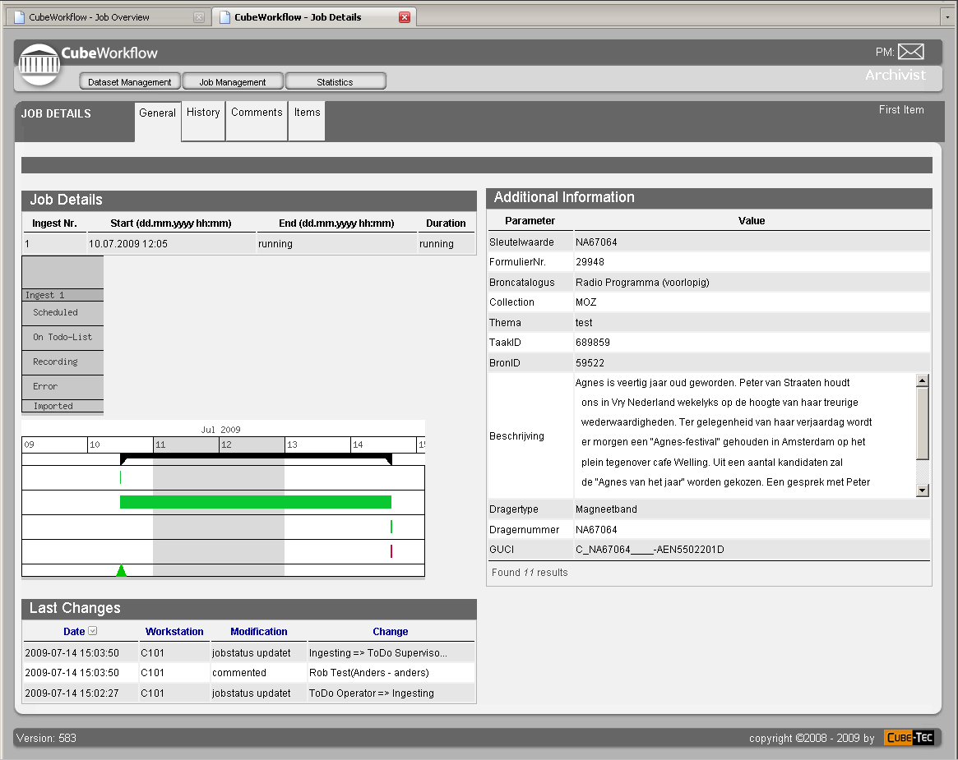
Custom Designed for your Facility
Audio Analysis & Processing in Multi-Media Formats
Exchanges process information with Dobbin and QUADRIGA. Process chains can be dynamic and adaptive.
Underlying engine defined by Business Process Modeling. Easy to modify – easy to extend.
Internet client – easily customizable and updateable. Simplifies deployment and accessible via the internet.
Notes:
Cube-Workflow exchanges process service information with both Dobbin and QUADRIGA. This provides real-time status information of all activities even when they are dynamic or adaptive... [CLICK]
Cube-Workflow’s is easy to modify, using technologies that allow any custom requirement.[CLICK]
And, the user interface uses any internet browser – once again, easy to customize. It also simplifies deployment and accessibility. [CLICK]

Slide 7
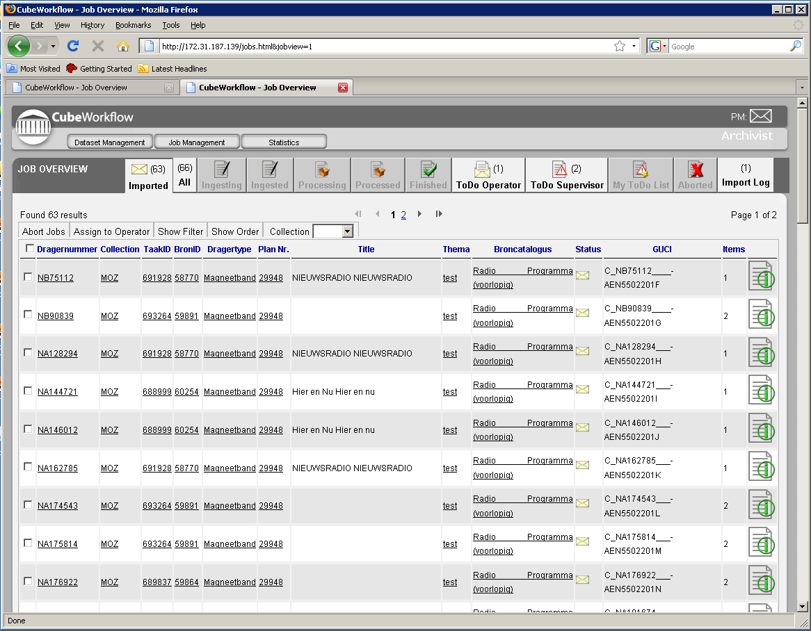
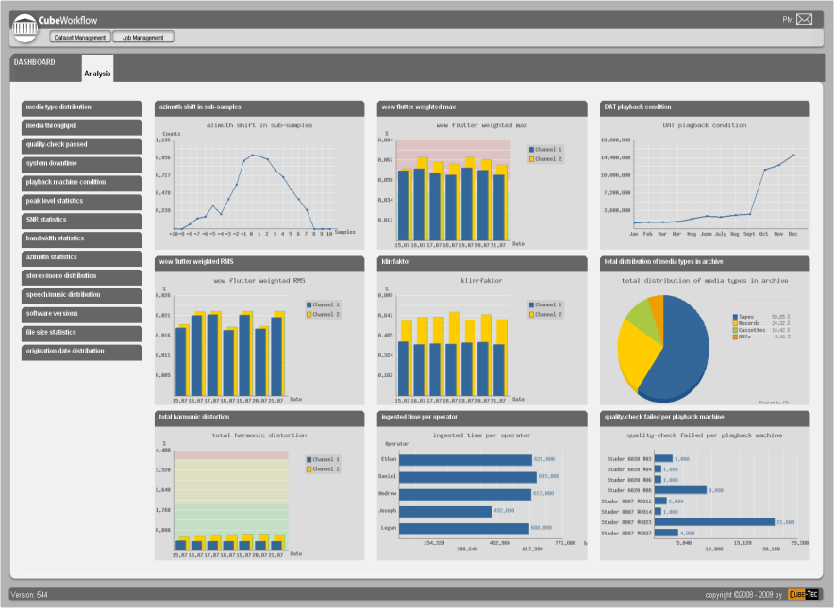
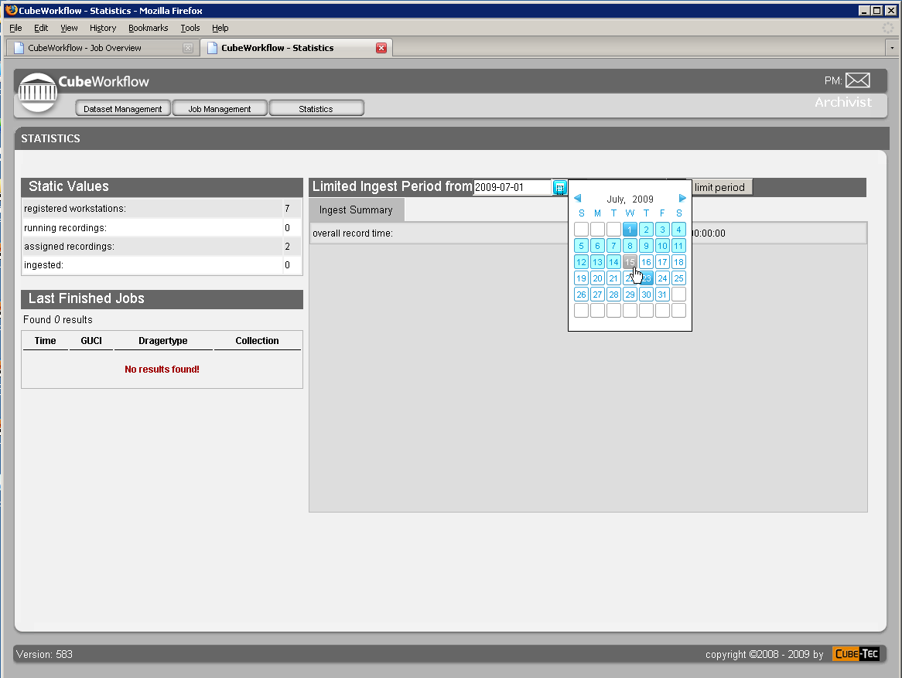
Driven by Metadata
Audio Analysis & Processing in Multi-Media Formats
Cube Workflow generates work-order processes for QUADRIGA and Dobbin systems.
Manages the migration of media assets from local storage to a trusted digital repository.
Time-line based statistical information can be viewed in the Cube-Workflow Dashboard.
Notes:
Cube Workflow generates work-order processes for the entire Archive team. This includes pick-lists for operators, metadata-rich ingest documents for QUADRIGA and post-processing activities for Dobbin. [CLICK]
It manages the migration of media assets from local production storage to a digital repository as well as other storage locations - like web-servers. [CLICK]
Time-line based metrics are collected by QUADRIGA and Dobbin can be viewed in the Cube-Workflow dashboard. [CLICK]

Slide 8
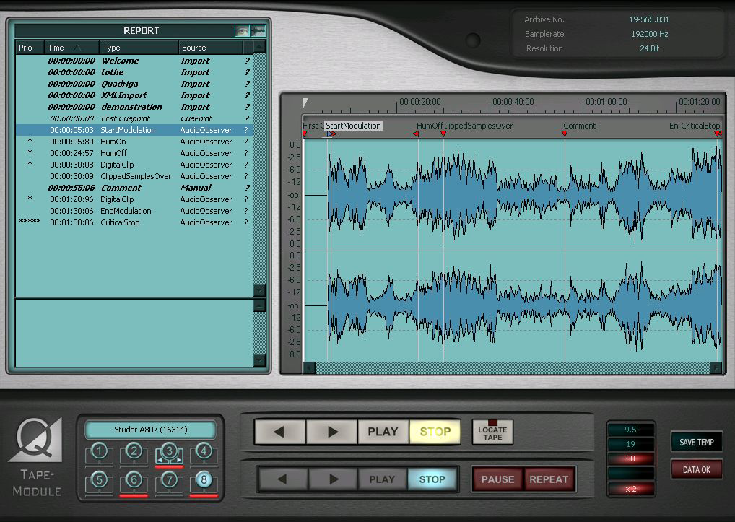
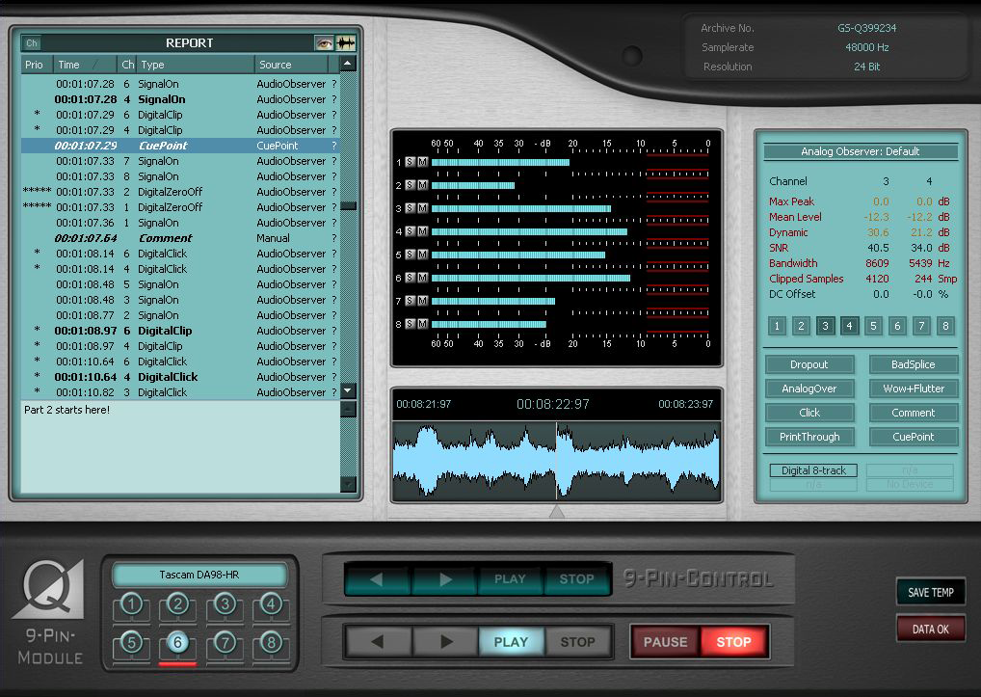
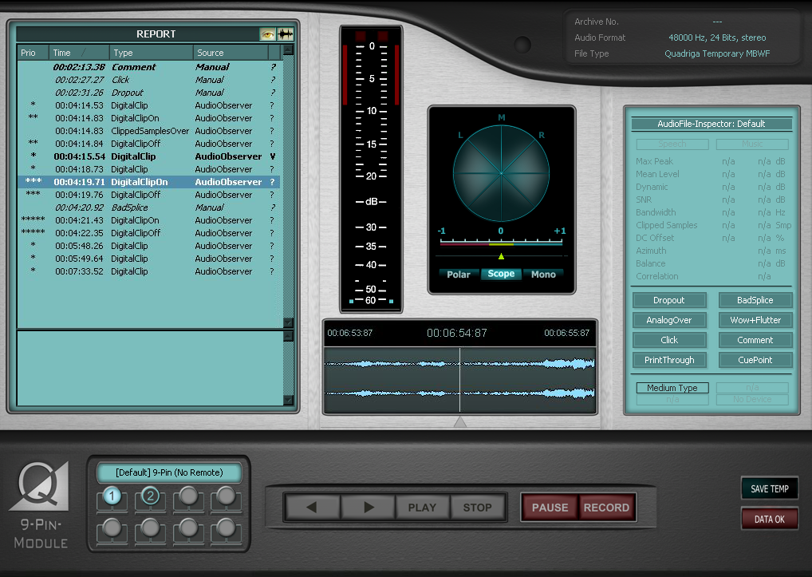
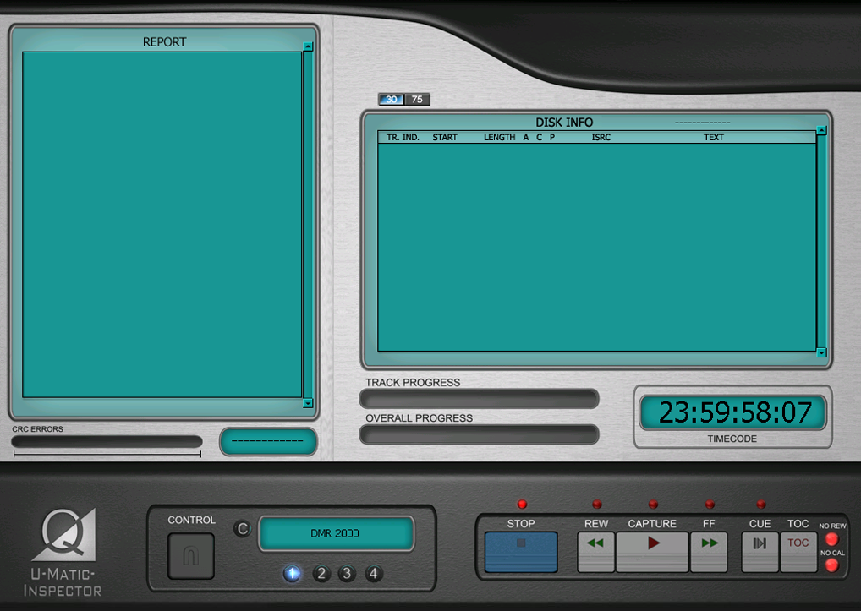
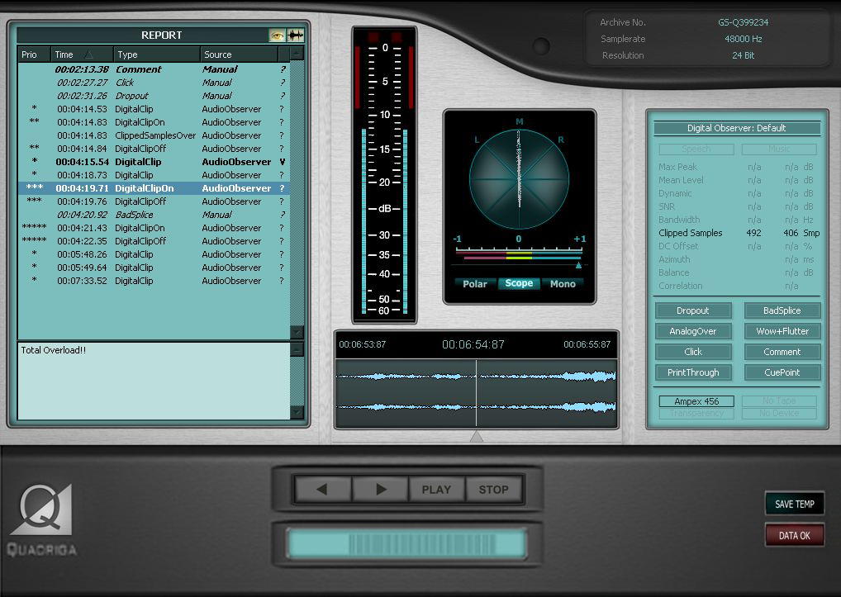
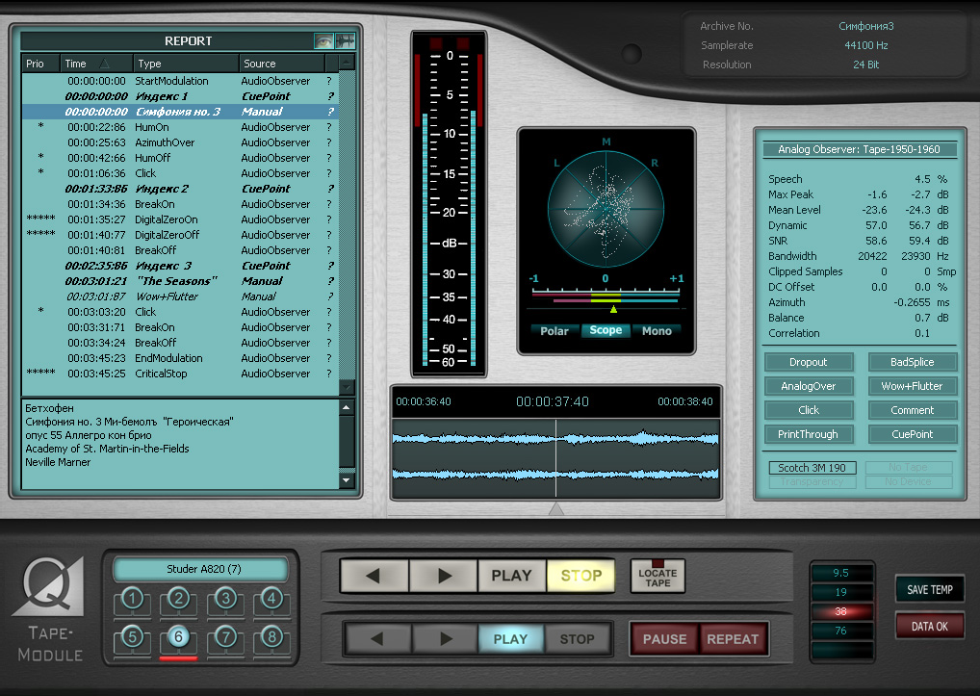
QUADRIGA
Audio Analysis & Processing in Multi-Media Formats
Efficient, purpose-built ingest system.
One workstation can provide up to eight parallel ingest streams simultaneously.
Media stream supervision and complete quality analysis.
Sophisticated transport and monitoring systems built for various media formats
Integrated workflows with Cube-Workflows and Dobbin.
Notes:
QUADRIGA is a mature, purpose-built digitization system. [CLICK]
With the QUADRIGA approach, we can have one workstation provide up to eight independent parallel ingest streams simultaneously. [CLICK]
We have the possibility of complete media-stream supervision and quality analysis. [CLICK]
Each system is custom configured for any media format. We have QUADRIGA versions for reel formats, multi-channel, cassette, DAT, U-Matic and BWF file formats. [CLICK]
QUADRIGA is completely integrated with other Cube-tec products for a complete archiving solution. [CLICK]

Slide 9
QUADRIGA: State-of-the-Art Ingest
Audio Analysis & Processing in Multi-Media Formats
Multi-Machine Recording
Eight parallel ingest streams w/integrated monitoring, transport control and quality supervision.
Multi-Speed Recording
1/2x to 4x recording w/playback equalization and speed correction . Compensated teal-time monitoring.
Multi-Channel Recording
Mono, stereo or multi-channel formats – with requisite monitoring , metering and analysis displays.
Dual-Direction
Ingest ½ track or ¼ track stereo open reel or cassette formats in one pass. Real-time corrected monitoring.
Multi-format
Ingest up to 192kHz/24bit recording and store as BWF, MBWF, WAV, RF64. Dynamically switch between formats.
Observation
Automatic error detection and real-time analysis of both analog (content) and digital borne artifacts.
Integration
Standard interfaces like ODBC, SQL, and XML, to connect to catalog systems as well as Dobbin or CWF.
File Security
Guarantees media file integrity and metadata integrity. Supports FSC, MD5 and SHA-1/2.
Automated Reports and Self Logging
BWF Coding History is automatically maintained. Automatic quality analysis reports and process logs.
Scalable
Seamless scalable from a single stream, “single-box” solution - up to any size “preservation factory”.
Notes:
QUADRIGA supports parallel ingest of up to eight streams simultaneously with integrated monitoring and transport control. [CLICK]
We support from ½ speed to 4x recording with accurate playback equalization and pitch correction – as well as proper real-time monitoring and automatic metadata for post-processing adjustments. [CLICK]
QUADRIGA can ingest mono, stereo or multi-channel sources up to 8 tracks - with appropriate monitoring functions and analysis displays. [CLICK]
We can ingest ½ track mono or ¼ track stereo open reel and cassette formats in one pass – all with real-time, reverse-corrected monitoring during capture. [CLICK]
Ingest up to 192 kHz/24 bit recordings and store as WAVE, RF64, BWF or MBWF formats. QUADRIGA can dynamically switch between formats on the fly. [CLICK]
Our observation tools provide automatic error detection and real-time audio analysis of both analog and digital borne artifacts. [CLICK]
QUADRIGA uses standard interfaces like ODBC, SQL and XML, to connect to asset management or cataloging systems - as well as Cube-Workflow and Dobbin. [CLICK]
We support the File Security code as well as file based checksums like MD5 and SHA. [CLICK]
QUADRIGA automatically maintains the BWF Coding History throughout ingest and post-preservation activities. Quality analysis reports are automatically generated at ingest. [CLICK]
Provides a ”single-box” solution or can grow to a “preservation factory”, completely integrated with third party systems. [CLICK]

Slide 10
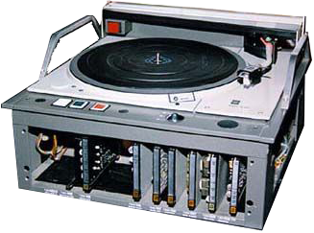
QUADRIGA Connectivity
Audio Analysis & Processing in Multi-Media Formats
USB
RS-422
RS-232
Notes:
A QUADRIGA system is normally installed on a DELL Workstation [CLICK]
The PC communicates with playback devices via USB using Machine Control hardware. [CLICK]
QUADRIGA Machine Control connects through various protocols to those devices… [CLICK]
[CLICK] to advance…

Slide 11
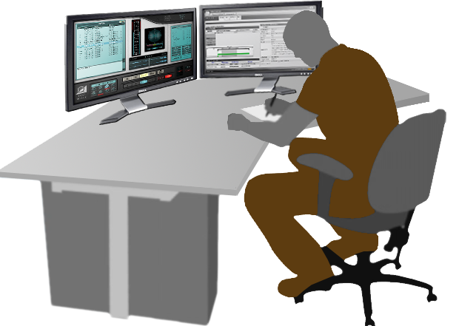
Operator Managing 8 Parallel Ingest Streams
Audio Analysis & Processing in Multi-Media Formats
Notes:
To maximize ingest time, a single operator can manage as many as 8 transport systems simultaneously. [CLICK]
At Sound and Vision, 4 operators ingest 32, DAT and open reel tape streams - simultaneously – all with automatic quality supervision. [CLICK]

Slide 12
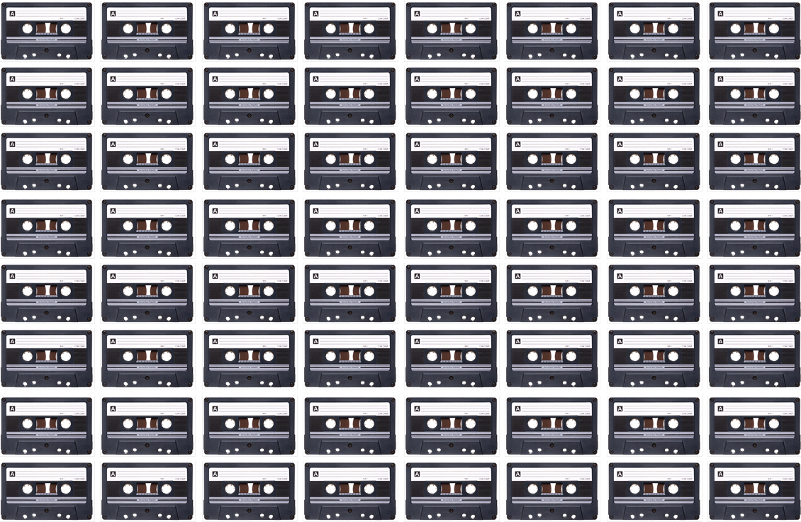
Single Operator up to 64 Ingest Streams
64x
Audio Analysis & Processing in Multi-Media Formats
16 Tape Decks under one operator control…
2x Speed + Simultaneous FWD/REV =
Notes:
We also have a specialized Cassette Transfer System... One operator can handle as many as 16 cassette decks...
With double-time and simultaneous forward/reverse ingest, thats the equivalent of 64 times real-time. [CLICK]

Slide 13
Dobbin: Automate… Anything.
Audio Analysis & Processing in Multi-Media Formats
Dobbin is a master of media file and metadata automation.
A suite of software tools, that allow for the creation of adaptive, dynamic and automated processes.
Delegates jobs to a powerful distributed processing engine. Easily scalable.
Generates metadata rich reports with live links to media assets.
Easy to use tools and the ultimate in flexibility. Drag n’ drop your workflows to connect processes using virtual audio, logic or metadata wiring.
Trigger jobs from file creation, file movement, metadata criteria, statistical analysis, external applications or manually.
Notes:
Dobbin is a master of media processing and metadata automation. [CLICK]
A suite of software tools that allow for the creation of dynamic, adaptive, and automated processes. [CLICK]
It delegates jobs to a powerful distributed processing engine. Dobbin is easily scalable in a similar fashion as web server farms. [CLICK]
Dobbin generates metadata rich reports with live links to media assets. [CLICK]
The tools are easy to use and are both flexible and comprehensive. Drag n’ drop your workflows and connect processes using virtual media, logic or metadata wiring. [CLICK]
Jobs can be triggered manually or triggered from file creation, file movement, metadata criteria, statistical analysis – even through external 3rd party applications. [CLICK]

Slide 14
The Dobbin Tool Set
Audio Analysis & Processing in Multi-Media Formats
Content Analysis
Automatic quality analysis for analog and
digital errors for audio and video file formats.
Comprehensive logging and reporting.
Processing
Comprehensive media re-mastering,
restoration and re-formatting tools,
for most audio and video formats.
File Conversion
Convert or re-wrap most media formats. (BWF,
AIFF, SD-II, WAV, MXF, DCP, MAP, etc.) Integrate
metadata for any supported format.
File Security
FSC , MD5, and SHA cryptographic hash tools.
Container/wrapper integrity analysis.
File-based & Psycho-Acoustic Correlators.
Media File En/Decode & Transcoding
mp2/3, (HE)AAC, DD(AC3), AC3, Dolby-E, WMA, FLAC, Wavpack, PCM.
MPEG-2, MPEG-4, MPEG TS & PS, Apple ProRes, J2K, WMV.
MXF OP1a/Atom, MXF AS-02, QT, DPX, IAP, MAP, DCI formats.
Utilities & Tools
Complete workflow logic tools.
System and media schema rule generator.
Integrates 3rd party applications and scripts.
Notes:
Dobbin has over 40 process elements available…
Dobbin provides complete automatic quality analysis for both analog and digital errors. You can drive downstream workflows based on the analysis results.
Digital Error Checker can identify: Digital Zeros, Block Repeating, Digital Clicks, Sample Holds, Digital Clips.
Audio File Inspector can indentify: Analog Clicks, Hum, Analog Overs, Drop-outs, Non-Audio, Mono/Stereo, Bandwidth… [CLICK]
We have world-class media re-mastering and re-formatting tools as well as state-of-the-art automated restoration.
Re-Sampling, Bit-resolution, re-formatting with Dither, File Reversing, Peak Normalization, Loudness Analysis and Loudness Management Tools. [CLICK]
We can convert and re-wrap most media formats. We also can merge metadata for any format.
PCM File Converter, Multi-channel Down-mixing, DDP Conversion, Metadata Merging, Un-Sealing. [CLICK]
Dobbin supports numerous check-sum and integrity checkers. We can also provide file correlation at the sample level – or – using psycho-acoustic models.
MD5, SHA-1, SHA-2, DDP and FSC Generators/Checkers, and my favorite – the Psycho-Acoustic Correlator. [CLICK]
We support a wide range of media file CODECs for creating derivatives and transcoding to most formats.
Dobbin also handles wrapped or packaged formats like MXF and DCP.
mp2 & 3, AAC/ aac Plus, WMA / WMA 9 Pro, FLAC, MLP, Dolby Digital, and DTS. [CLICK]
Finally, we have a complete set of logic tools for automated conditional branching driven by metadata or quality analysis. We can also integrates 3rd party applications and scripts. [CLICK]

Slide 15
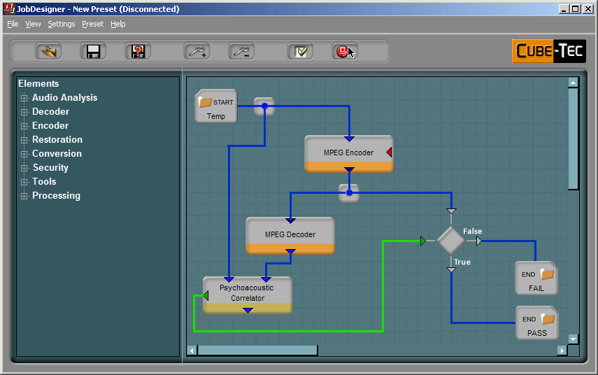
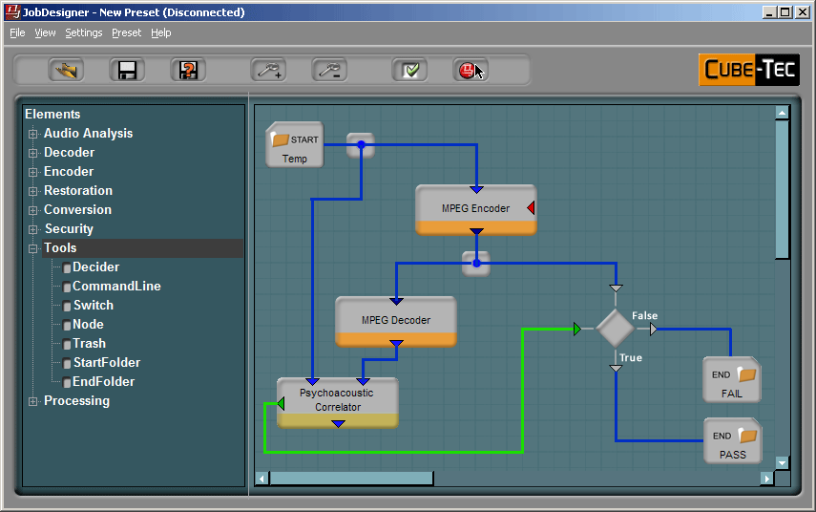
Create Powerful Workflows …Simply
Audio Analysis & Processing in Multi-Media Formats
The Job Designer
Drag and drop your workflows. Connect processes using virtual audio/video, logic or metadata wiring.
Performs syntactic wiring check.
Test newly created jobs with a single file.
Trigger jobs from: - file creation - file movement - metadata criteria - statistical analysis - external applications - manually.
Notes:
The Dobbin Software Suite begins with the Job Designer. [CLICK]
The Job Designer allows you to design sophisticated workflows by using a simple drag-and-drop interface. Processes are connected using “virtual” media, logic or metadata wiring. [CLICK]
Dobbin can perform a complete syntax integrity check. Before running a batch, you can also test newly created jobs using a single file. [CLICK]
Jobs can be triggered from a file creation, from file movement, via metadata criteria, from analysis results, through external applications or simply manually starting them. [CLICK]

Slide 16
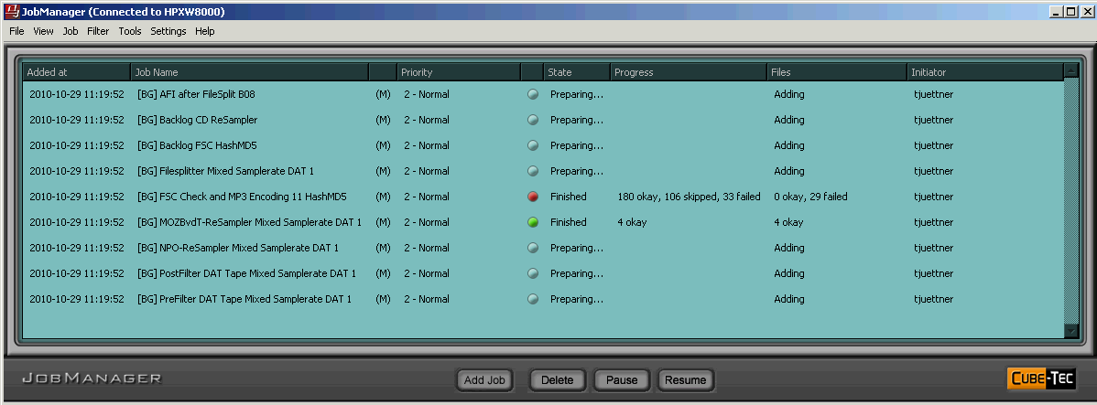
Supervise Concurrent Jobs
Audio Analysis & Processing in Multi-Media Formats
The Job Manager:
Real- time status of each job’s progress.
Re-prioritize job queue on-the-fly. Accurate job-time estimates.
Re-order, sort and filter job list, by various criteria.
Complete logging of all workflow processes.
Messaging service to Cube-Workflow for on-line updates
Notes:
The Job Manager‘s role, delegates jobs created in the Job Designer, to Dobbin processing units. [CLICK]
It facilitates real-time monitoring of each job’s progress. [CLICK]
It allows you to re-prioritize the jobs on-the-fly, and provides accurate job estimates. [CLICK]
Jobs can be re-ordered, sorted or filtered by numerous criteria. [CLICK]
It logs and timestamps all workflow processes. These logs can be accessed by Dobbin’s reporting functions. [CLICK]
Cube-Workflow users benefit from a bi-directional messaging system for complete on-line updates. [CLICK]

Slide 17
Automated Drill-Down Reporting
Audio Analysis & Processing in Multi-Media Formats
The Result Viewer:
Complete reporting with drill-down capability and integrated waveform displays.
Sorting and intelligent filtering of all events. Events displayed on graphical timeline along with audio image.
Uses web technologies – available at any connected PC. Exchanges process service information with other Cube-Tec products.
Notes:
Optimization efficiency requires automation – but validating results requires streamlined interfaces, so that operators can detect potential errors quickly. [CLICK]
The Result Viewer offers complete reporting with drill-down capability and integrated waveform displays. [CLICK]
It offers sorting and intelligent filtering of all events on a graphical timeline along with an audio image. [CLICK]
The Result Viewer uses web technologies and can be deployed to any networked PC. It also exchanges service information with other Cube-Tec products. [CLICK]

Slide 18
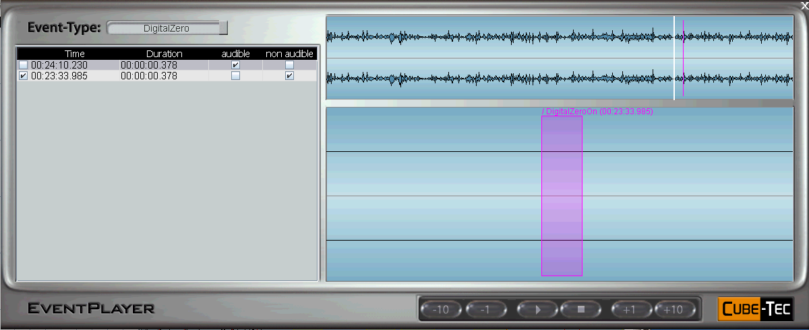
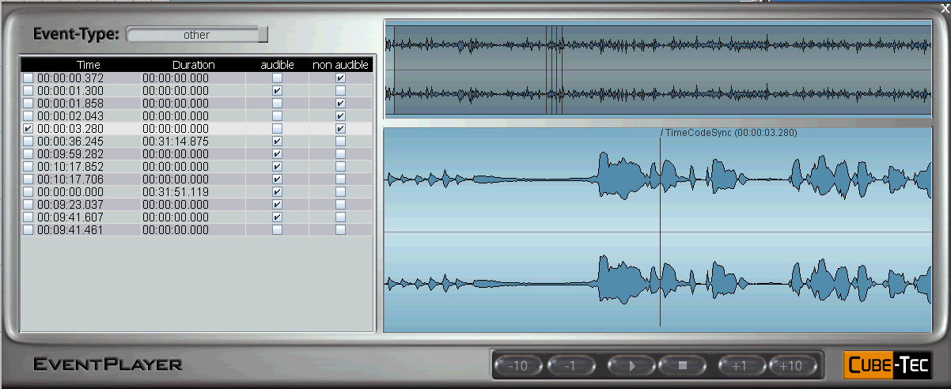
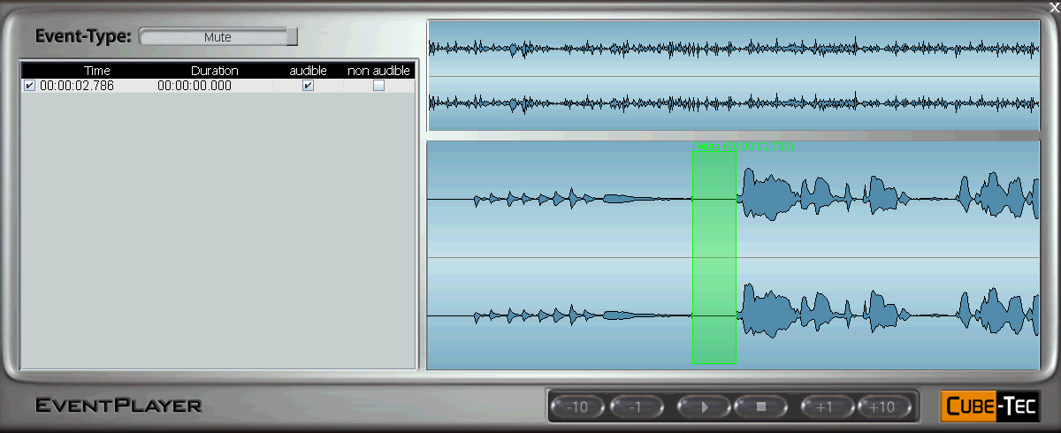
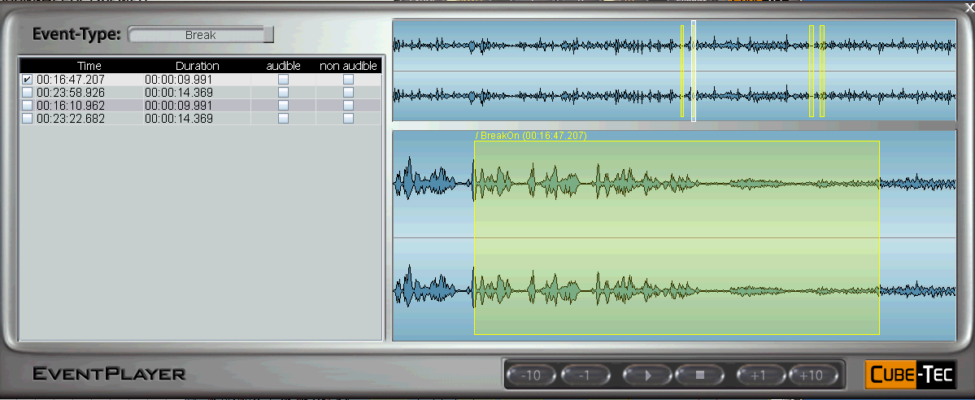
View Your Results… and then Listen to Them!
Audio Analysis & Processing in Multi-Media Formats
The Event Player:
Launch the BWF Event Player from Result Viewer - includes integrated event list, waveform and transport control.
List can re-populate with any event-type and each item can be used to locate with pre-roll.
Built in sample-rate converter provides audio playback on any computer sound card.
Notes:
The Event Player can be launched from the Result Viewer by double clicking on any media file. The Event Player includes an integrated event list, waveform display and transport functions for auditioning. [CLICK]
The event list can be filtered to specific events and quickly auditioned with simple locating functions, complete with pre-roll and post roll. A few examples….[CLICK] [CLICK] [CLICK]
Event Player includes a built in sample-rate converter to allow audio playback on any computer sound card, regardless of the source sample-rate. [CLICK]

Slide 19
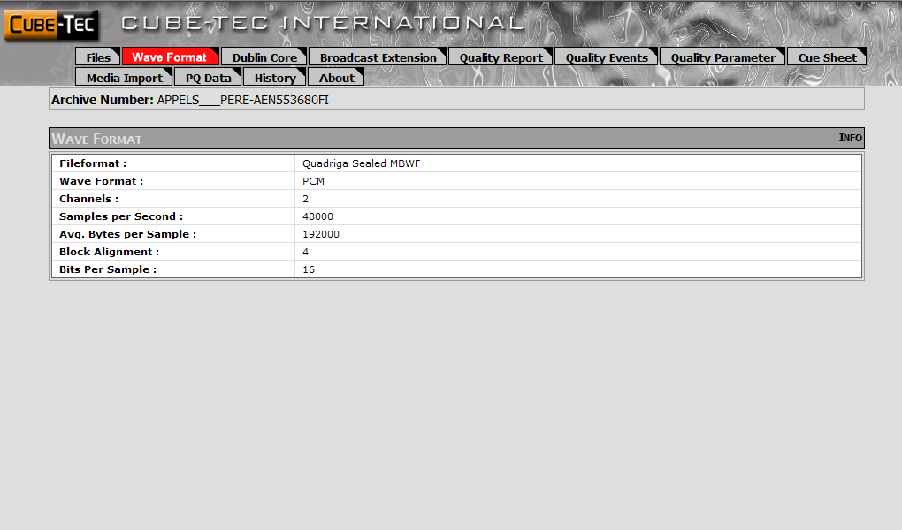
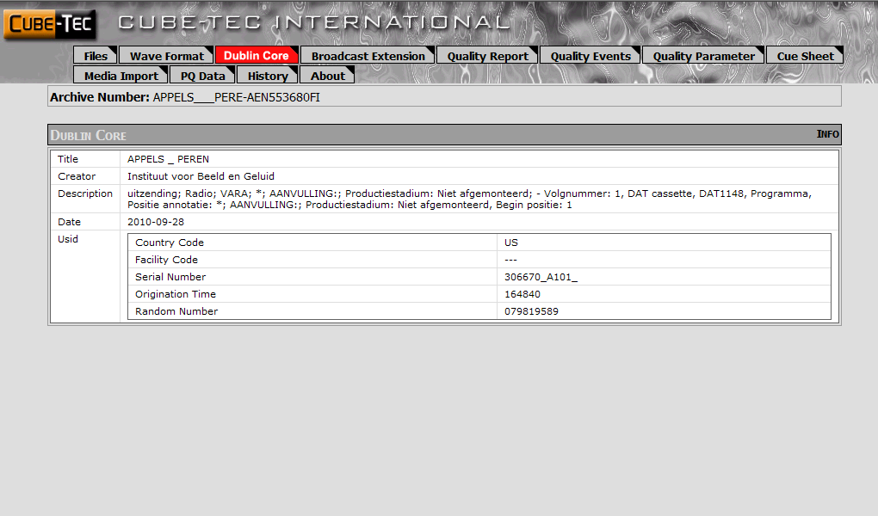
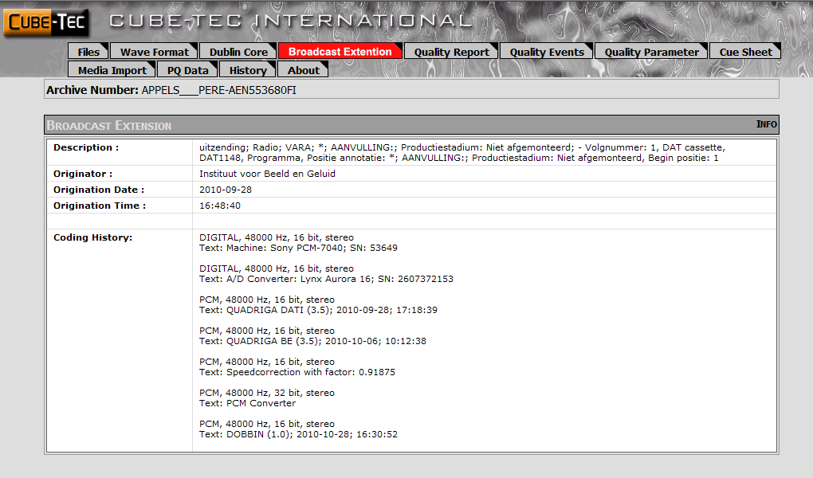
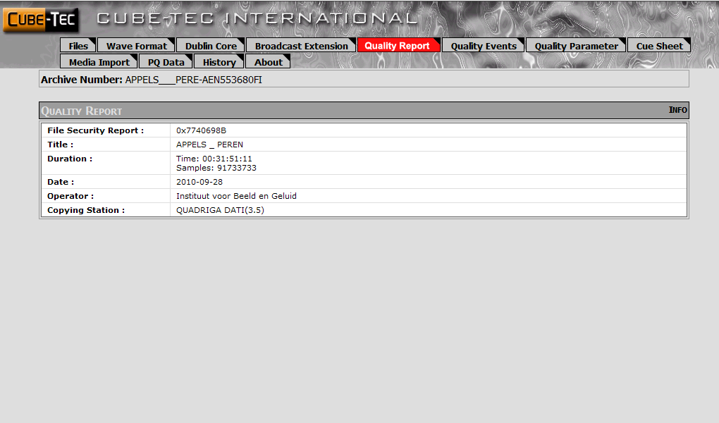
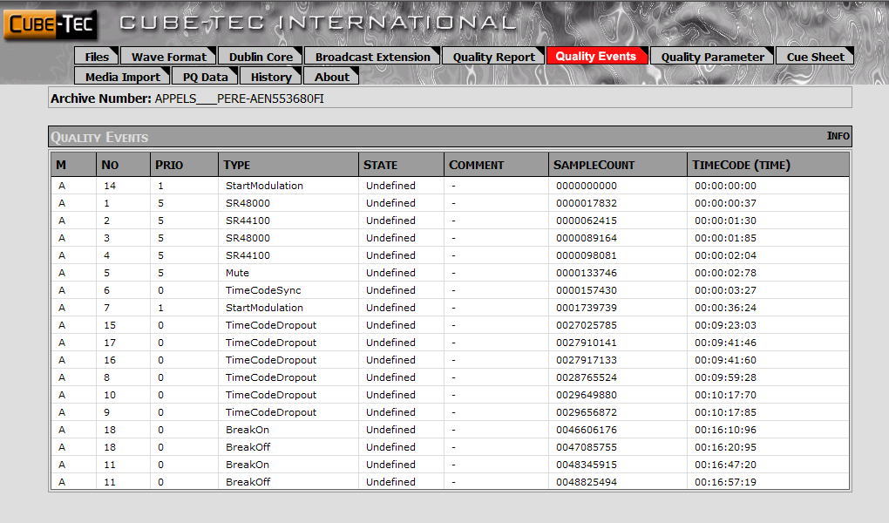
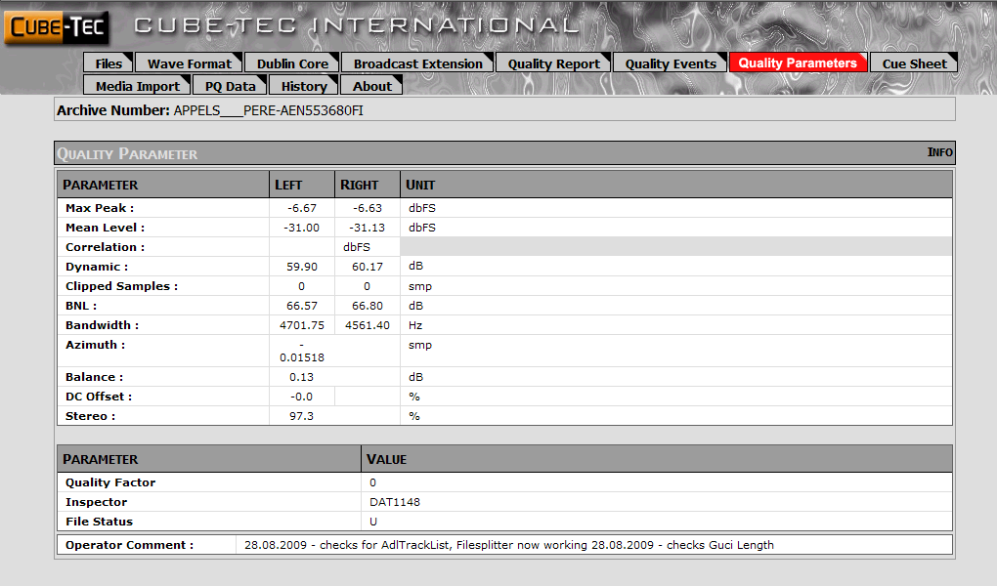
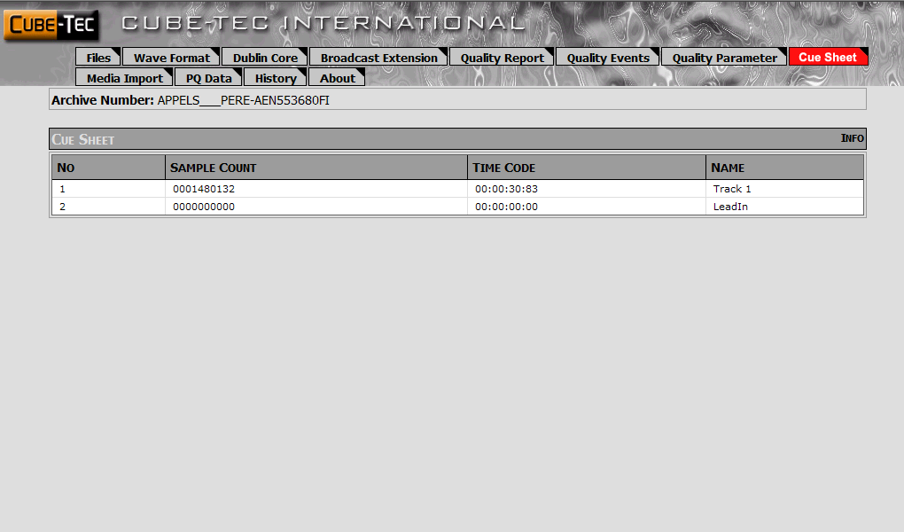
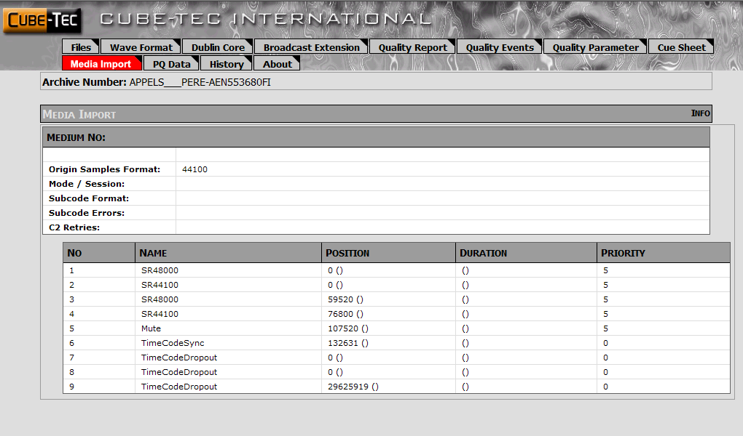
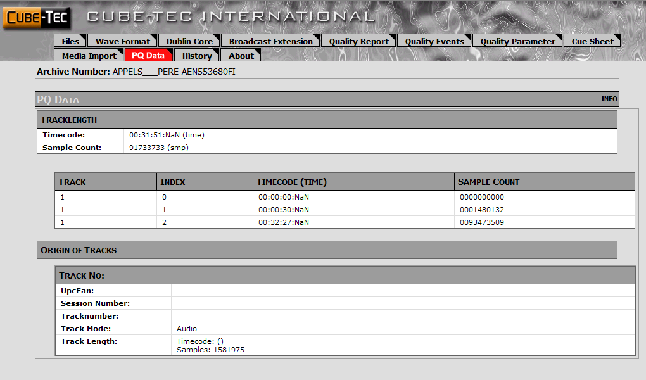
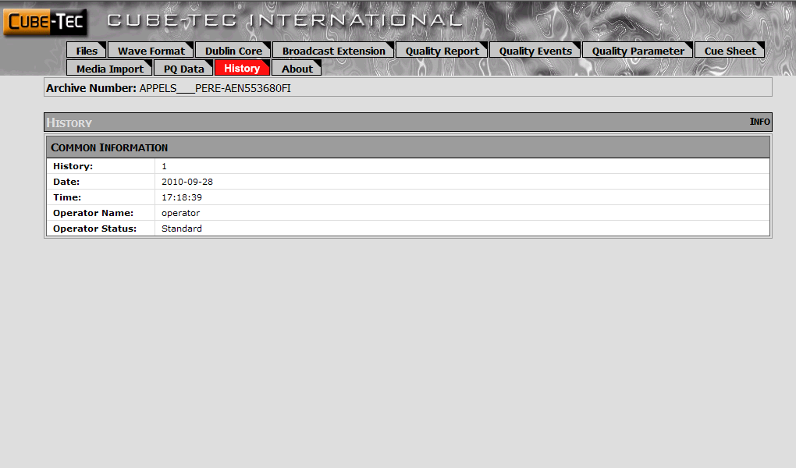
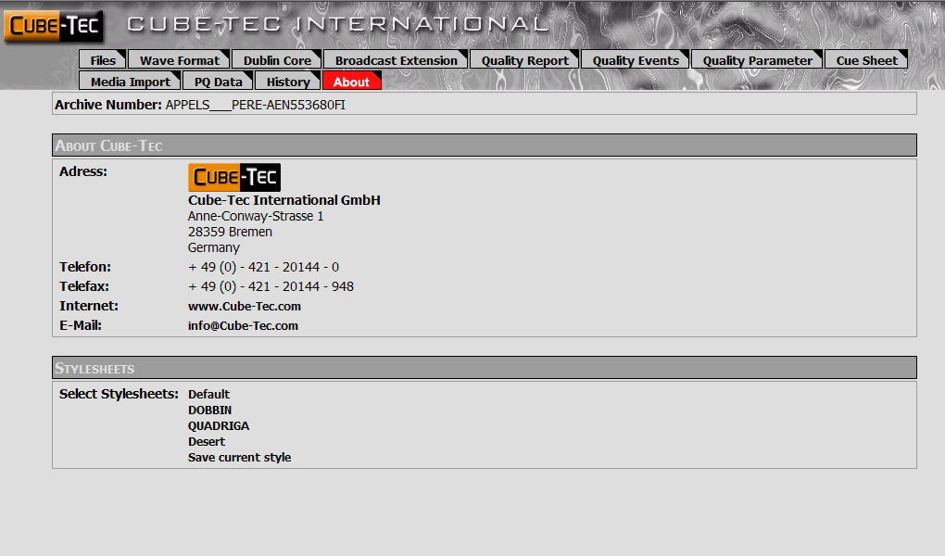
Transform Your Data
Cube-Tec International – Technical Overview
Report System:
XML reports are styled using XSLT. Templates are provided for viewing and printing. Easily customizable.
Reports can display a wide range of information and can include connection to external data.
Can be stored as intranet resource for archive group stakeholders.
Result Viewer, Event Player and Reports can be installed on any PC.
Notes:
XML reports are styled and transformed using XSL. We provide templates for viewing and printing and they are easily customizable by any web developer. [CLICK]
The reporting system can include connections to external data sources. Examples rotating on the screen are the wave format, Dublin Core data, BEXT chunk information, various quality tabs, cue sheets, Media Import information, History, etc.[CLICK]
Reports can be stored as an intranet resource for archive group stakeholders. [CLICK]
The Result Viewer, Event Player and Reporting system can all be installed on any network PC… [CLICK]

Slide 20
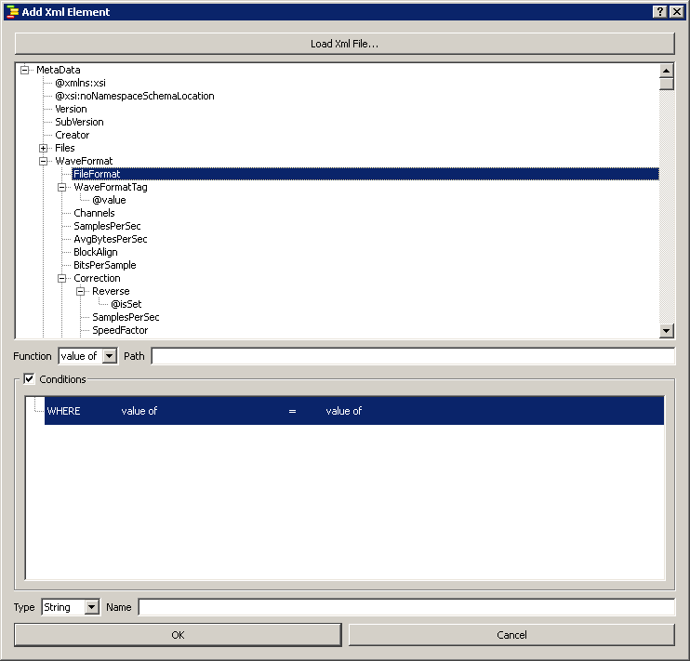
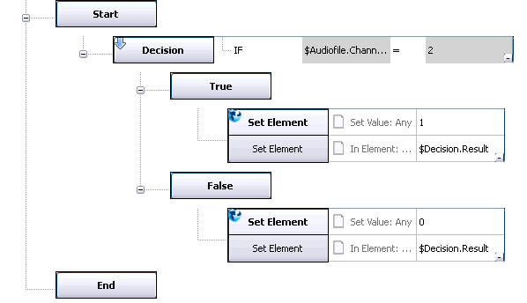
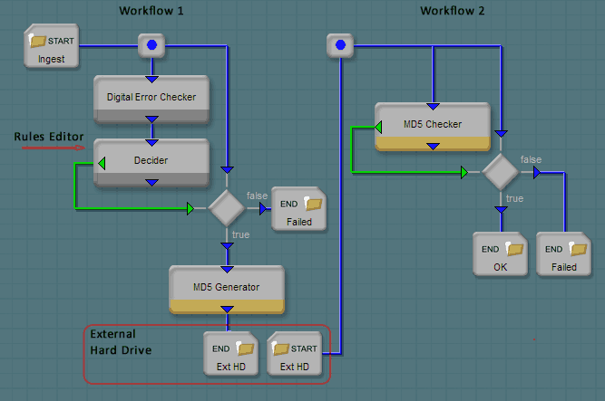
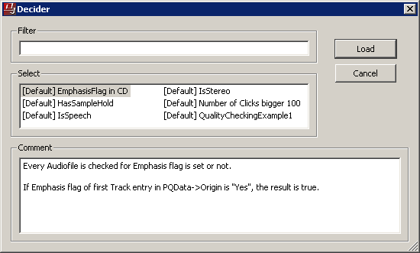
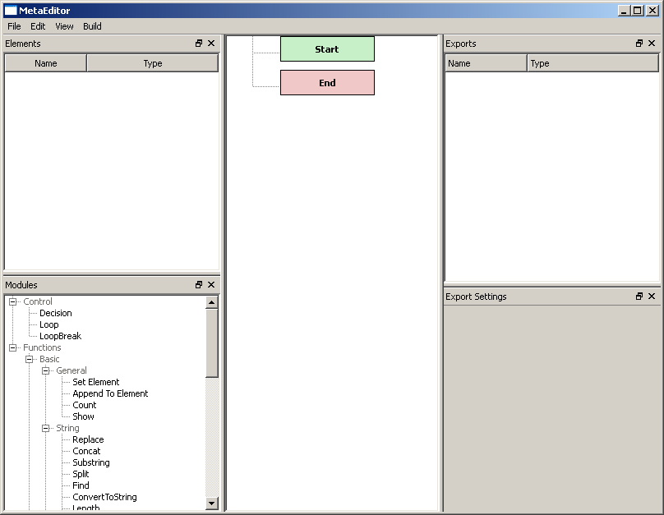
Build In Your Intelligence
Audio Analysis & Processing in Multi-Media Formats
The Rule Editor:
A utility for creating rules used by modules performing decisions.
Completely integrates meta-data schema from the BWF and the complete Cube-Tec software suite.
Drag-and-Drop interface facilitates simple and error-free rule creation.
Rules are loaded and stored into a module from Job Designer.
Rules are the intelligence that drive dynamic and adaptive workflows.
Notes:
The final Dobbin software component is the Rule Editor. [CLICK]
The Rule Editor is a utility for creating the criteria, used by modules that perform workflow decisions – Example: Decider module - a tool used for conditional branching in workflows. [CLICK]
The schemas for the BWF and all of our software are available for rule creation. [CLICK]
The Rule Editor interface is called the Workbench. Simple drag-and-drop techniques are used to define elements and rule logic. [CLICK]
The rules created here are loaded and stored into a module like the Decider, using Job Designer. [CLICK]
Adaptive workflows rely on these rules to make branching decisions . [CLICK]

Slide 21
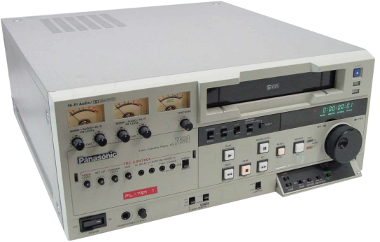
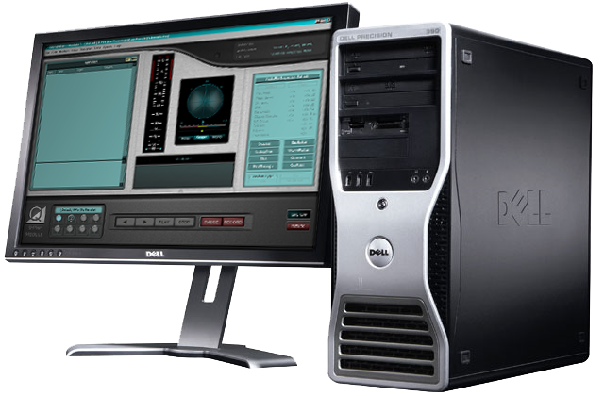
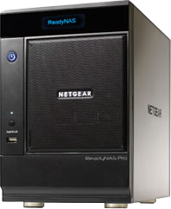
A/V Ingest
Audio Analysis & Processing in Multi-Media Formats
Notes:
We’re going to whip though basic audio-visual ingest activities… [CLICK]
We take our tapes, play them in a playback device… [CLICK]
Digitized in some kind of ingest workstation… [CLICK]
… and eventually we have some audio/video files ion a storage system – SAN, NAS, server… [CLICK]
… organized in some kind of folder structure… [CLICK]
So lets start with a simple workflow where we analyze the audio stream of an mp4 file… [CLICK]

Slide 22
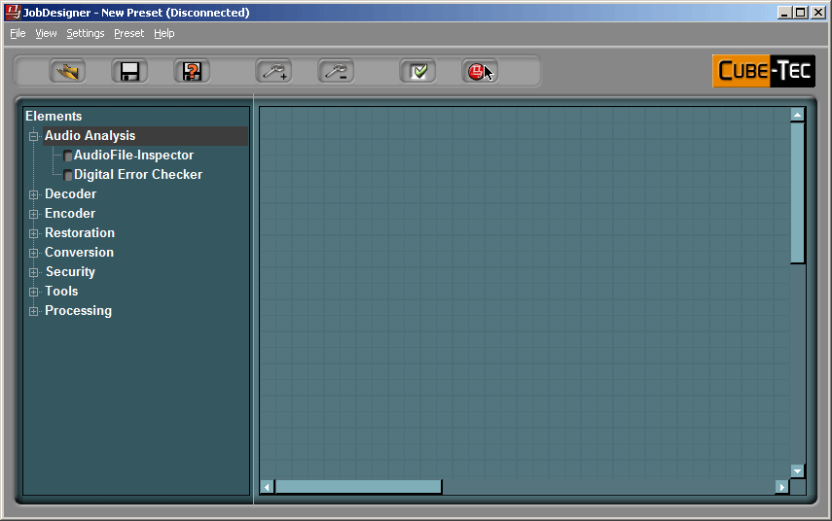
Audio Analysis
Audio Analysis & Processing in Multi-Media Formats
DeMuxer module is used to demux A/V file into it’s elementary audio (blue) and video (yellow) streams.
The blue audio pin is routed to the Audio File Inspection module.
Actual Use: We’re interested in the analysis report so remuxing the streams is not required.
AUDIO STREAM
VIDEO STREAM
Notes:
The mp4 DeMuxer module is used to split the A/V file into it’s elementary audio and video streams. Blue is audio and bright yellow is video. [CLICK]
The blue audio pin is routed to the Audio File Inspector module.
This shows a basic interconnect model…[CLICK] but in actual use, we’re only interested in the analysis report. [CLICK]

Slide 23
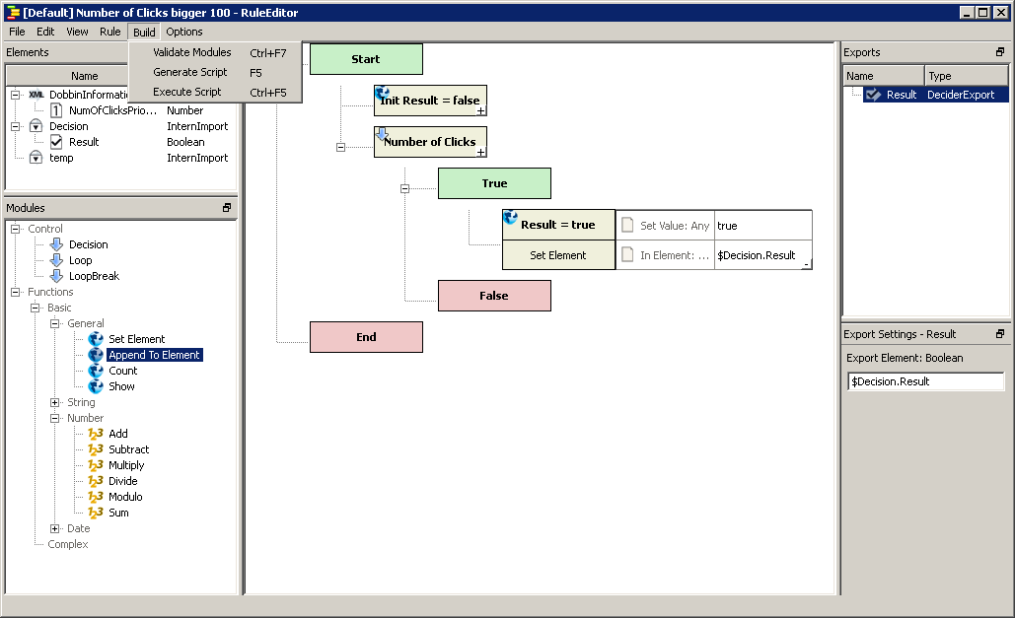
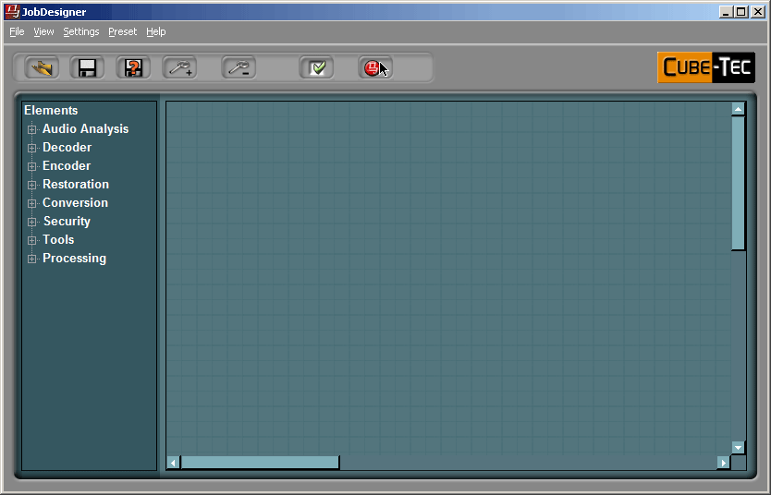
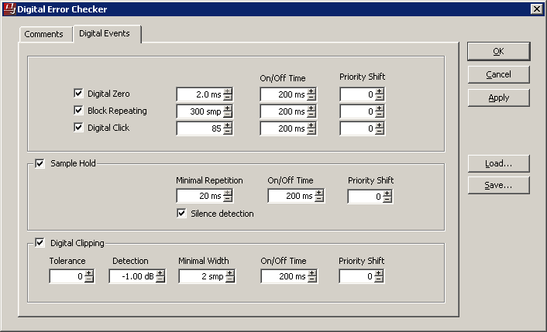
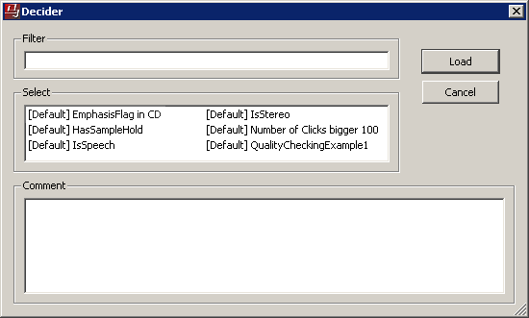
Auto-Restoration
Audio Analysis & Processing in Multi-Media Formats
Digital Error Checker analyzes files for clicks.
The Rule Editor is used to define the test criteria for conditional processing: are there clicks?
The Decider module compares the rule criteria against the analysis report and routes the media accordingly.
Files are either DeClicked or simply encoded downstream.
[Default] Number of Clicks > 1
Tests each file to see if there are more than 1 clicks. Returns true.
Notes:
A similar but more complex scenario: Digital Error Checker analyzes files for clicks. [CLICK]
The Rule Editor is used to define the test criteria for conditional processing: are there clicks? [CLICK]
The Decider module compares the rule criteria against the analysis report and routes the media accordingly. [CLICK]
Files are either DeClicked or simply encoded downstream. [CLICK]

Slide 24
Audio Analysis & Processing in Multi-Media Formats
In a joint effort, Grass Valley and Cube-Tec have developed an interface between the K2 AppServer and the Dobbin Audio Rendering Farm.
This interface provides direct access to the audio tracks stored on K2, without the need to unwrap the MXF container first.
Result: a highly efficient read / write exchange for the audio essence.
Notes:
Last November we announced a direct interface between the Grass Valley K2 AppServer and Dobbin: [CLICK]
This interface gives us direct access to the audio tracks stored on K2, without the need to unwrap the MXF container: [CLICK]
This allows for a very efficient read / write exchange for the audio essence. [CLICK]

Slide 25
Loudness Control
Audio Analysis & Processing in Multi-Media Formats
A connection is made to a Grass Valley K2 Server.
Two separate processing chains are created – one for audio (left) and one for video (right).
After some Denoising, the Loudness Assimilator manages the audio level.
The new audio is re-encoded then the streams are re-muxed and output to a streaming server.
Notes:
The database symbol is the K2. A connection is made to a Grass Valley Server. [CLICK]
Once again, two separate processing chains are created – the left for audio and the right for video. [CLICK]
After some Denoising, the Loudness Assimilator manages the audio level. [CLICK]
The new audio is re-encoded then the streams are re-muxed and output to a streaming server. [CLICK]

Slide 26
Up-Mixing
Audio Analysis & Processing in Multi-Media Formats
Based on channel count, the Decider branches to an up-mix processing chain or standard branch.
Stereo files are up-mixed, loudness processed and then encoded with AAC.
The new audio is sent to a streaming server.
Notes:
Media metadata is extracted with the Media Info module. Based on channel count, the Decider branches to an up-mix processing chain. [CLICK]
Mono and stereo files are up-mixed, loudness processed and then encoded with AAC. [CLICK]
The new audio is sent to a streaming server. [CLICK]

Slide 27
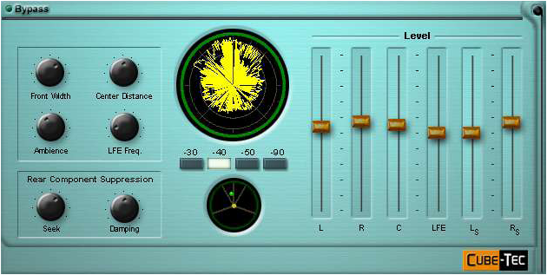
Up-Mixing for Surround
Audio Analysis & Processing in Multi-Media Formats
GUI - Surround Up-Mix VPI (Virtual Precision Instrument) VST plug-in for Windows, is compatible with Dobbin FPU.
Presets from VPI are loadable in the Dobbin Job Designer.
Many of Dobbin’s restoration and re-mastering FPU’s allow this functionality.
Notes:
Loudness Assimilator metadata includes old & new loudness specifications for EBU R128 and ITU 1770 standards. [CLICK]
A Loudness curve chart can also be displayed as histograms - displaying continuous loudness over file duration. [CLICK]

Slide 28
Loudness Normalization for file-based TV Workflows
Audio Analysis & Processing in Multi-Media Formats
The recent CALM act requires loudness normalization for all television broadcast.
Automated loudness processing can be an integral part of a complete QC process.
Track layout is analyzed, checked for conformity against metadata and then configured for appropriate processing.
Conditional branching is required depending on the source audio format and QC results.
Notes:
The recent CALM act requires loudness normalization for all TV broadcast. [CLICK]
Automated loudness processing should be part of a complete QC process. [CLICK]
First the track layout is analyzed, checked for conformity against metadata and then configured for appropriate processing. [CLICK]
The results of audio format analysis and quality checks can drive the branched workflows. [CLICK]

Slide 29
MXF Wrapped Dolby
Audio Analysis & Processing in Multi-Media Formats
Media Info/Cube-Workflow determines the audio stream format – Decider routes accordingly.
Files are decoded and then CALM compliant loudness processing is performed.
Metadata is merged and then essences are wrapped using a specific MXF flavour.
Cube-Workflow
Notes:
An MXF file is unwrapped and then pass to MediaInfo for analysis. The Decider modules uses the audio stream format to determine workflow branching. [CLICK]
Appropriate decoding is performed and then the Loudness Assimilator performs CALM compliant audio processing as required. [CLICK]
Finally, the Metadata Merger inserts a metadata payload and wraps essences to the output folder. [CLICK]

Slide 30
Loudness Assimilator
Audio Analysis & Processing in Multi-Media Formats
Loudness Assimilator metadata includes old & new loudness specifications for EBU R128 and ITU 1770 standards.
A Loudness curve chart can also be displayed as histograms - displaying continuous loudness over file duration. (Cube-Workflow Dashboard)
Notes:
This is an example report showing Loudness metadata including old & new loudness for both the EBU and ITU standards. [CLICK]
However metadata is collected over time. The Cube-Workflow Dashboard can also show a Loudness curve chart as histograms - displaying continuous loudness over file duration.
I have one more example to show… Cube-Tec has developed its audio technologies over the past 20 years and as we move our software to handle multi-media formats, we’re not going to re-invent the wheel for video and film. So instead we are partnering with world-class technology providers in those markets, in order to quicky integrate video capabilities into our products.[CLICK]

Slide 31
Video Restoration
Audio Analysis & Processing in Multi-Media Formats
With over 20 years of research and development the Digital Vision Optics (DVO) software tools have become one of the most revered toolsets in the post production industry. Known for presenting the best image manipulation tools for restoration, enhancement and format conversion, they were previously available only on the Nucoda and Phoenix platforms.
Now, they are available as Dobbin FPU’s by Cube-Tec.
“Fully automatic and highly accurate film dirt and dust concealment and video drop-out removal system, that will automatically remove a high degree of visible imperfections without introducing artifacts.”
DUST
Notes:
One partner example is Digital Vision. With over 20 years of research and development in image processing technology, DVO software tools have become one of the most important toolsets in the post-production industry. [CLICK]
These world-class tools, were previously available only on their proprietary platforms. [CLICK]
They are now available as Dobbin FPU’s. [CLICK]
DVO Dust is the first of these tools… it’s a Fully automatic film dirt and dust concealment and video drop-out removal system. Here is a very simple workflow. [CLICK]

Slide 32
DVO Dust:
Audio Analysis & Processing in Multi-Media Formats
“Dust busting” manually is hugely time consuming and expensive.
DVO Dust works automatically and intelligently, it can turn in excellent results around ten times faster than a manual operator - without the artifacts some algorithms leave behind.
Notes:
Dust busting is a time consuming and therefore expensive production process. [CLICK]
DVO Dust’s algorithm can produce better results at about 10 times the speed of a manual operator. [CLICK]

Slide 33
?
Finnish Broadcast
Thank-You!
Rob Poretti
Cube-Tec North America
Notes:
Thank-you... [CLICK]
Any questions?
Thank-you... You can reach me at r.poretti@cube-tec.com. [CLICK]

