Slide 1
Accessing the Florida Folklife Collection with Omeka
William Chase, Sound Archivist
State Archives of Florida

Slide 2
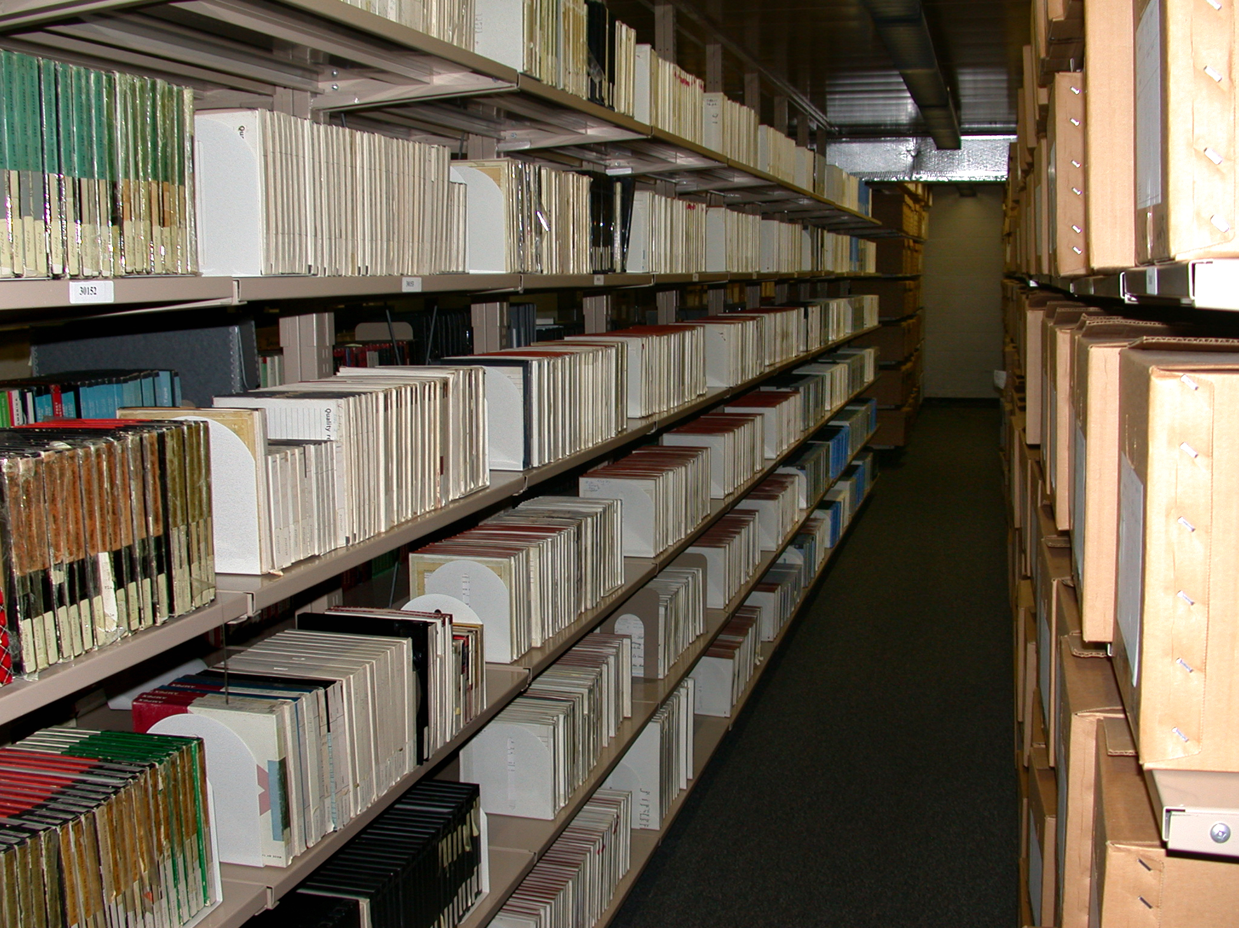
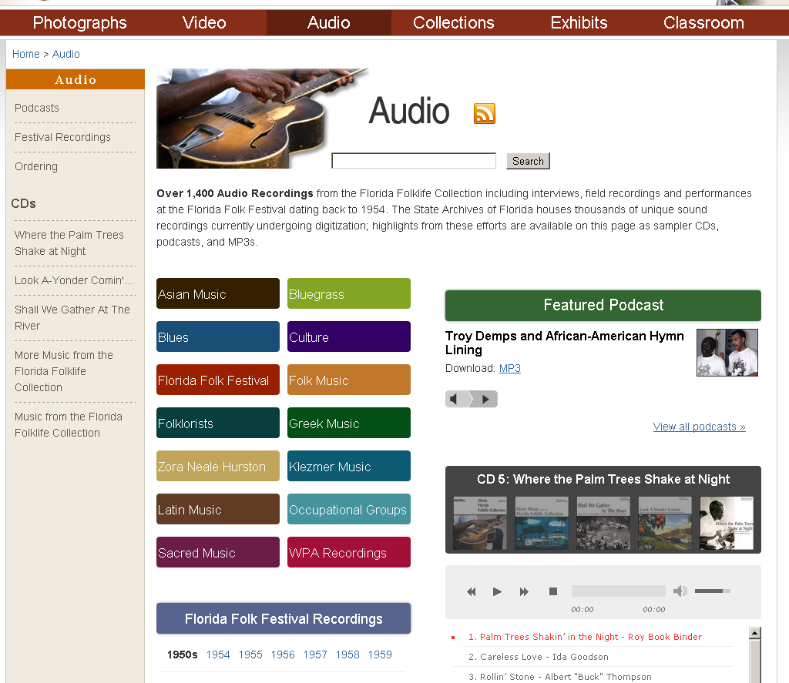
Overview
Florida Folklife Collection
History
Highlights
Florida Memory Program
Online access to the collection
Omeka
Reasons for migration
Advantages and challenges

Slide 3
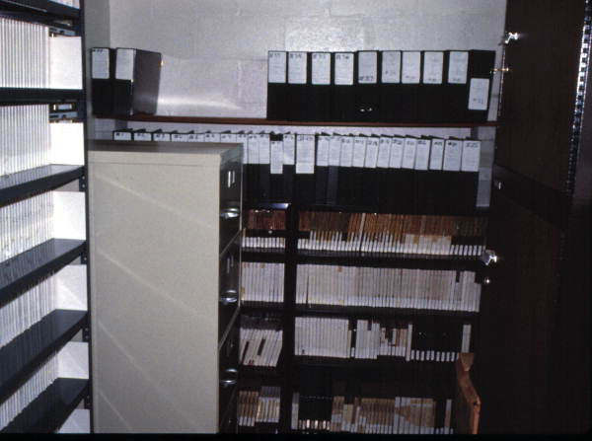
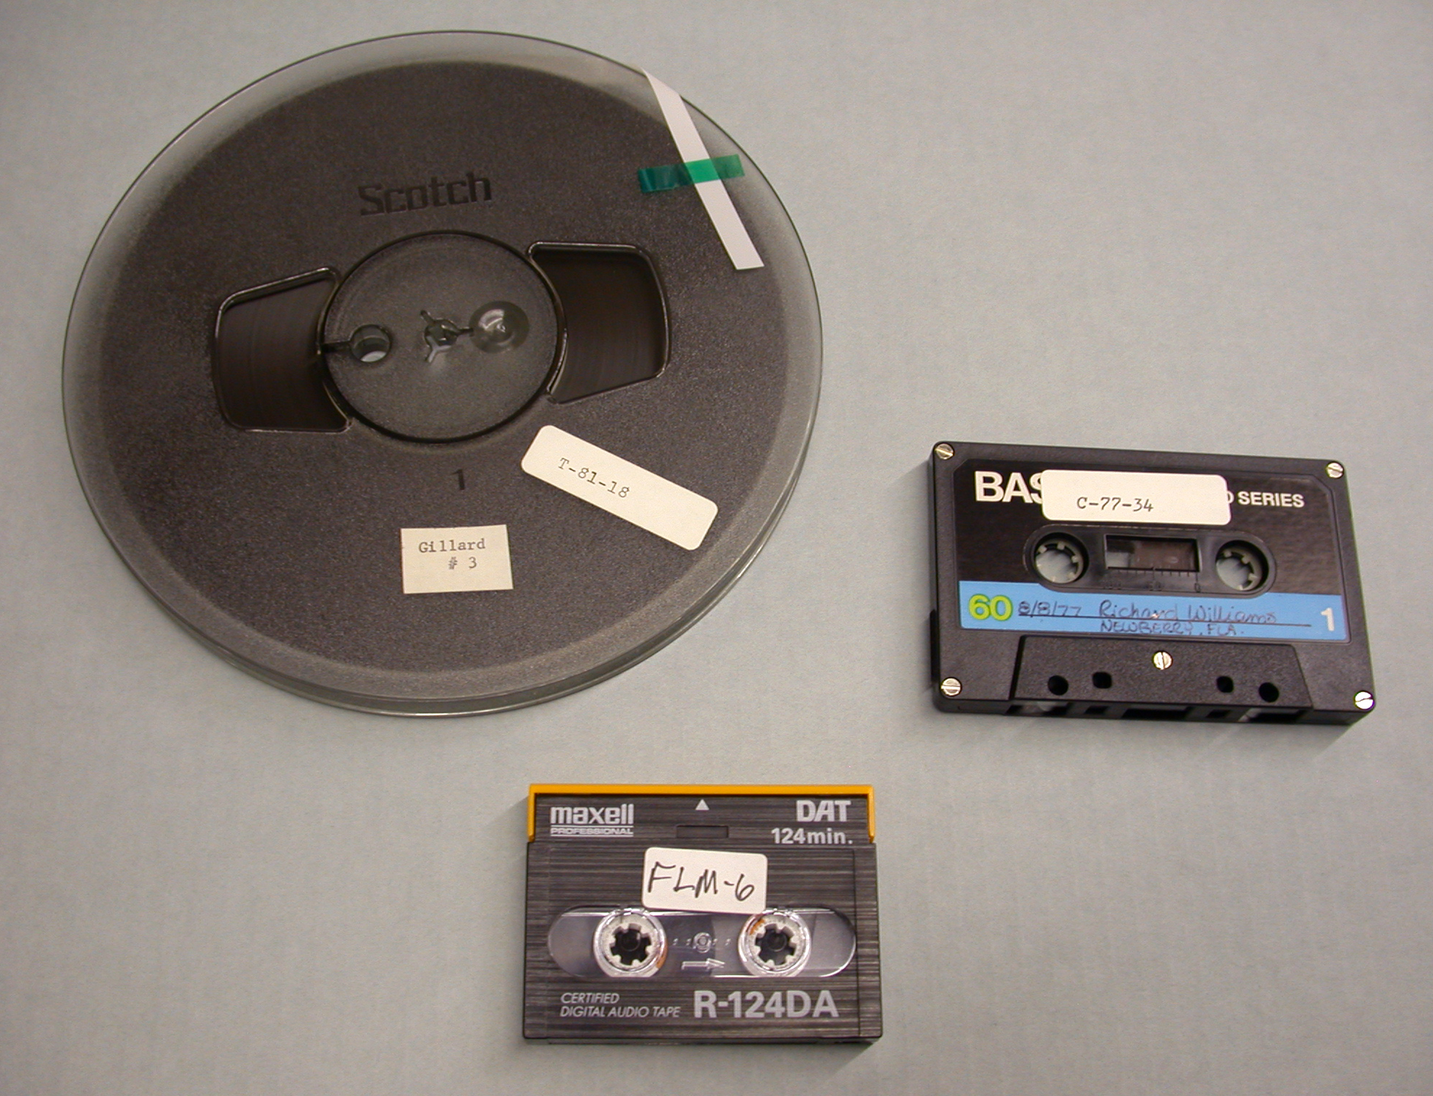
About the Florida Folklife Collection
Florida Folklife Program established in 1976
Collection accessioned by State Archives in 1995
Over 5,000 audio recordings
Open reel tape
Analog cassette
DAT
Optical disc

Slide 4
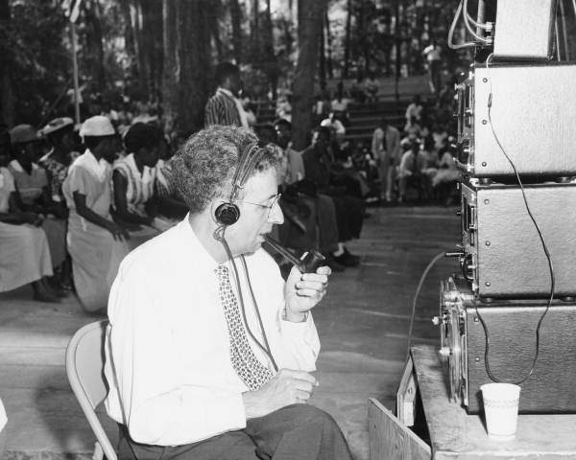
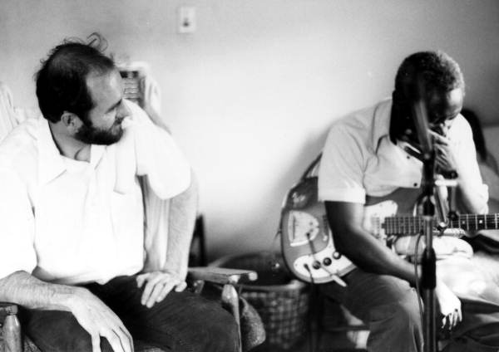
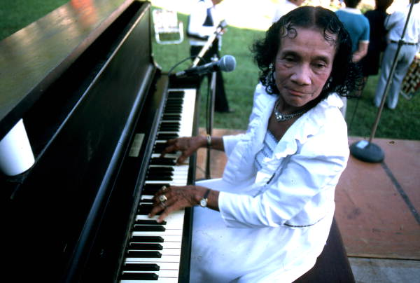
Highlights from the Florida Folklife Collection
Florida Folk Festival Recordings
1954-2006
Florida Record Project - Drop on Down in Florida
Ida Goodson Recording Project
Sacred Steel fieldwork

Slide 5
Florida Memory Program
Began in 1999 as online access point
for the Florida Photographic Collection
Finding aids for archival collections
Other collections digitized
Confederate Pension Records
Call and Brevard Family Papers
Spanish Land Grants
Online exhibits
Educational Units
Florida History Timeline
Awards and Recognition
AFS Brenda McCallum Prize
SAA Philip M. Hamer and
Elizabeth Hamer Kegan Award
FLA Special Web Site Award
Florida Memory then and now: 2011, 2012

Slide 6
Creating Online Access
Funding from the Institute of Museum and Library Services and the Library Services and Technology Act
In-depth, item-level cataloging of sound recordings, photos, and video
Digitization of media
Searchable online database, educational units, exhibits, and other outreach materials

Slide 7
Florida Folklife Database
Keyword search
Customized controlled vocabulary
Search limiters
Item type (Sound, Still Image, Moving Image)
“Has MP3”

Slide 8
Florida Folklife Database
Item-level
description
Hyperlinked
personal, geographic,
and subject terms
Embedded MP3
Ordering
information tab
Social media share
icons

Slide 9
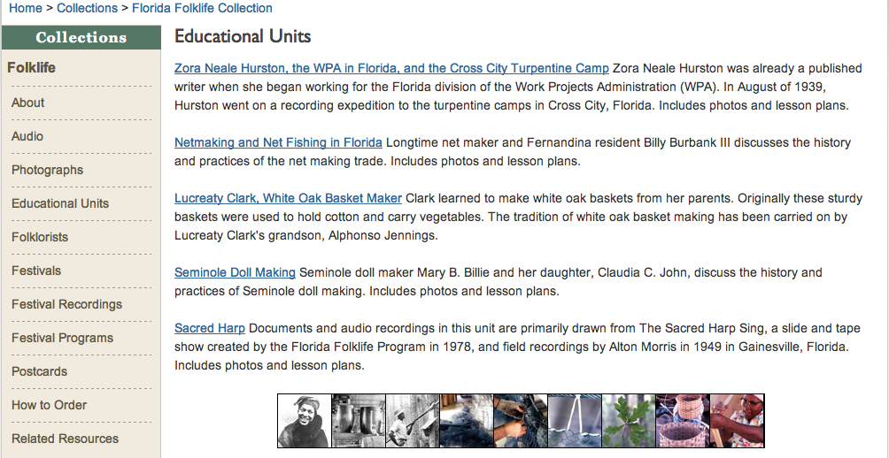
Folklife Educational Units
Incorporate audio, text, and images into lesson plans

Slide 10
Florida Memory Audio Page
Search Box
Category
Highlights
Podcasts
Sampler CDs
Florida Folk
Festival Recordings
RSS Feed

Slide 11
Migration to Omeka
Reasons to change publishing platforms
Unify collection databases
Update interface and site design
Desire for flexible, open-source software
Decision-making process
Consultation with Division of Library and Information Services and IT staff, FSU faculty
Comparison with other content management systems

Slide 12
Migration to Omeka
Advantages
Challenges
Easy to use out of the box
Straightforward content creation and management
Customizable
Useful plugins
CSV Import
SolrSearch
Strong support community
Scalability issues – built for smaller collections
Default search engine did not provide relevant results
Search engine cannot search site pages – only collection items
New server caused a decrease in Google Analytics site visitor statistics

Slide 13
Conclusion and Acknowledgments
Future considerations
Enhancing site searchability
Expanding audio page to include other collections
Incorporation of MyOmeka plugin
Acknowledgments
ARSC Conference Travel Grants Committee
Jody Norman, Jamie Madden, and Florida Memory Staff
Photo Credits
Florida Photographic Collection
Beatrice Queral
Audio
“Apple Farm Blues” - Moses Williams, recorded May 29, 1982 at the Florida Folk Festival

