Slide 1
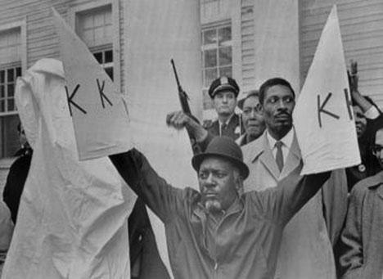
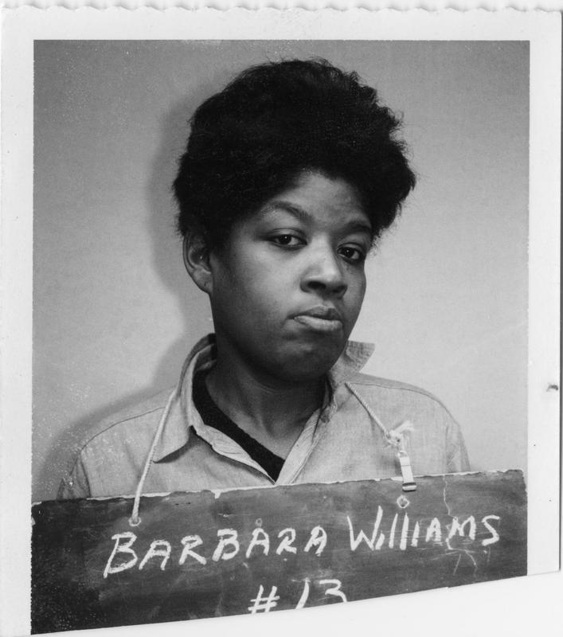
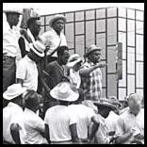
Project South: The Civil Rights Movement in Sound
Franz Kunst
ARSC 2012
May 17, 2012

Slide 2
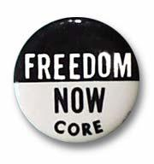
About the Project
States and Groups Surveyed:
Alabama, South Carolina & Georgia (SCLC/Southern Christian Leadership Conference)
Arkansas & Washington, D.C. (SNCC/Student Nonviolent Coordinating Committee)
Louisiana (CORE/Congress of Racial Equality, Freedom Labor Union, Deacons for Defense)
Mississippi (Mississippi Freedom Democratic Party, NAACP)

Slide 3
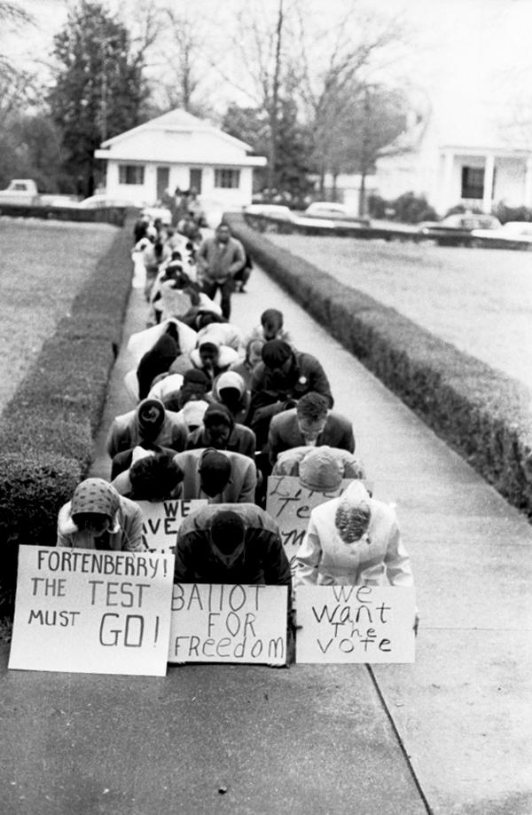
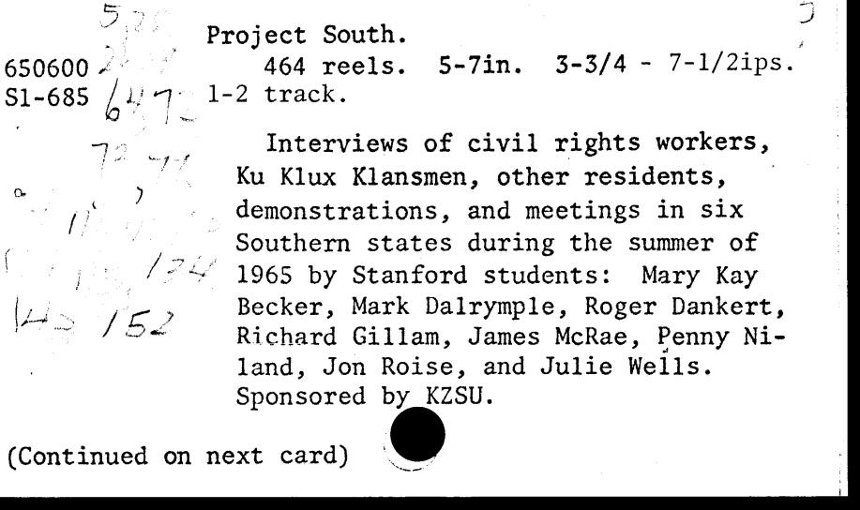
Digitization and Rediscovery
Voting rights demonstration in McComb, Mississippi, 1962. M319-338bv

Slide 4
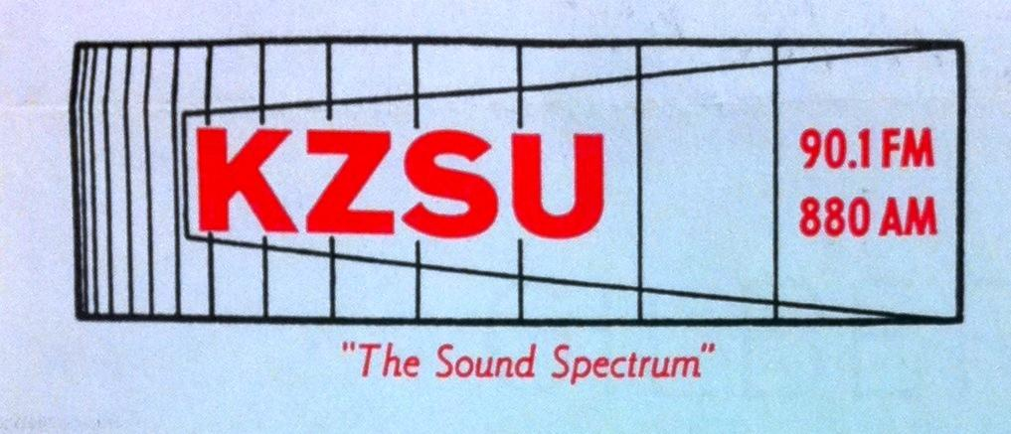
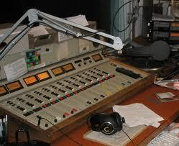
KZSU CR65 opening
"McComb Election Story," narrated by Ralph Peer, Spring 1965.
Excerpted from tape no. S6 [ARS0022_b04_650500_S6_01]
1:39
Notes:
track 1.

Slide 5
Collection Overview By The Numbers
KZSU's Project South tapes sold to the Archive of Recorded Sound in 1966 for $1500.00
464 tapes currently held as a series in the Stanford Speech Collection (ARS0022)
458 edited transcripts produced in 1969 by two original participants and a staff of typists
Transcripts become part of Special Collections SC066, KZSU (Radio station : Stanford) Project South, 1965
Transcripts described in finding aid and now individually scanned and available digitally
Tapes available to researchers able to visit Stanford
Original open reel tapes (mono, half-track at 3.75 ips and 7.5 ips) digitized by Stanford Media Preservation Lab in 2009 using two Studer A807 machines
867 BWF files recorded 24bit/96KHz, stored on servers and in Stanford Digital Repository
MODS records created with index card metadata
330 hours of recordings, 200 of which are are interviews
Approximately 89 digital files cannot be associated with a transcript
Future plans: transcribing rest will be difficult and costly. Release form documentation in process by University Archives. Future accessibility of sound files to be determined

Slide 6
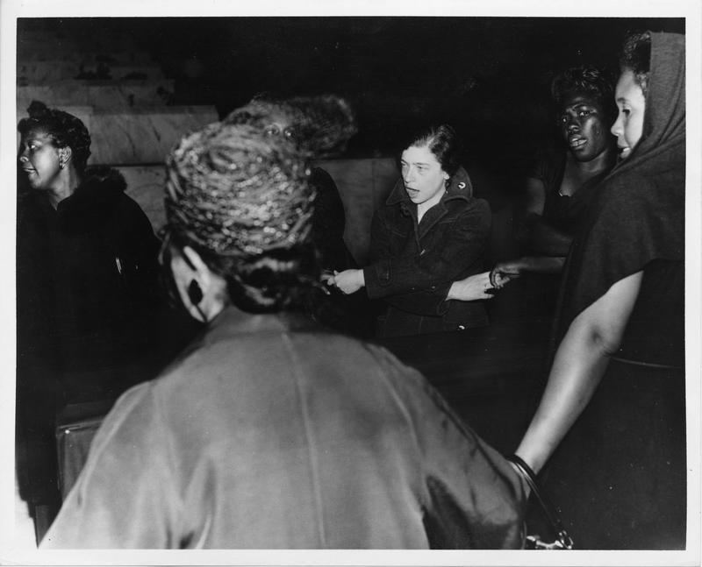
Selma-Montgomery Freedom March
Recorded by Ralph Peer, March 1965.
Excerpted from tape no.S3
[ARS0022_b15_650600_S3_P1_a_sh]
2:08
Black and white females hold hands in a circle and singing. March 20th, 1965, 9-37-0-2-34-1-1

Slide 7
Project South quotes
“Several of the two-man interview teams recorded parts of the Jackson, Bogalusa, Greensboro, Crawfordsville and West Point demonstrations, and also gathered various other ‘action tapes’ of civil rights workers canvassing voters, conducting freedom schools, or participating in demonstrations. Finally, the interviewers recorded many mass meetings and gathered much material on the orientation sessions of the MFDP in Hattiesburg, Mississippi, and of SCLC in Atlanta, Georgia...This material may prove to especially valuable because it concerns a transitional period between the first ‘freedom summer’ of 1964, the high tide of civil rights, and the ‘Meredith March’ of 1966 during which Stokely Carmichael first voiced the compelling cry of ‘Black Power.”
Richard Gillam, report accompanying transcripts 1969
“The work of the groups they headed or worked for, their assessment of problems encountered in the field, and their views of the impact the movement had on established Southern society and themselves form the substance of these interviews...”
Microfilm Corporation of America. New York Times Oral History Program in Microform advance booklet, 1977

Slide 8
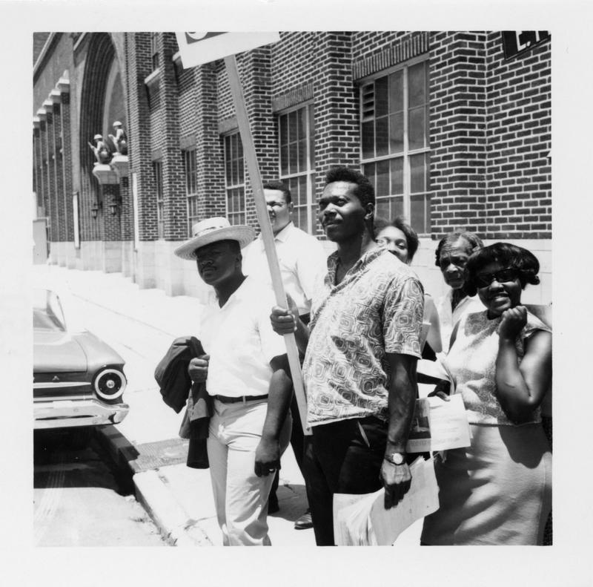
Bogalusa march
Recorded by Julie Wells, July 8th, 1965.
Excerpted from tape no. S43a
[ARS0022_b16_650600_S43_a_sh]
"oh freedom" and march description :58
unknown speaker :36
Wells falls behind march, Black marcher shot? 1:30
Demonstrators crossing East Pearl Street with males identified as Rhodes in hat and Hatchett holding placard and Guyot. 99-185-0-30-1-1-1

Slide 9
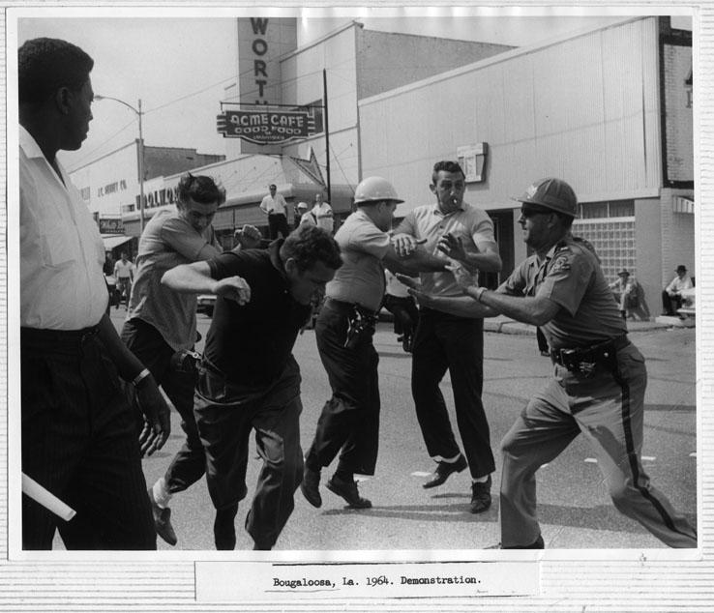
Bogalusa march
Recorded by Rich Holloman July 11th-13th,1965.
Excerpted from tape no. S49a [ARS0022_b16_650600_S49_aX]
Holloman verbally accosted by bystander :18
Louis Lomax :32

Slide 10
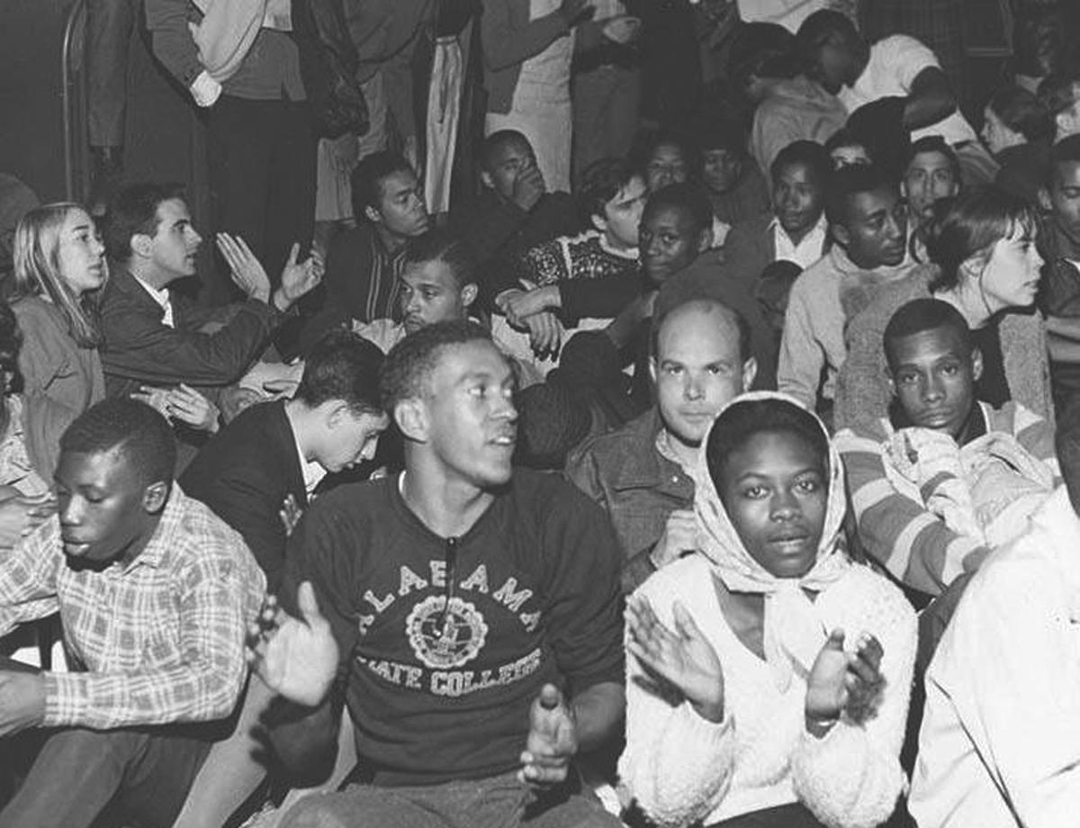
Songs
"Governor Wallace" Uncredited performing group, no date.
Excerpted from tape no. S154a
[ARS0022_b16_650600_S154_a_sh] 2:25
Singing from Bogalusa march recorded by Rich Holloman July 11th, 1965.
excerpted from tape no. S49a [ARS0022_b16_650600_S49_aX] :59
Montgomery March

Slide 11
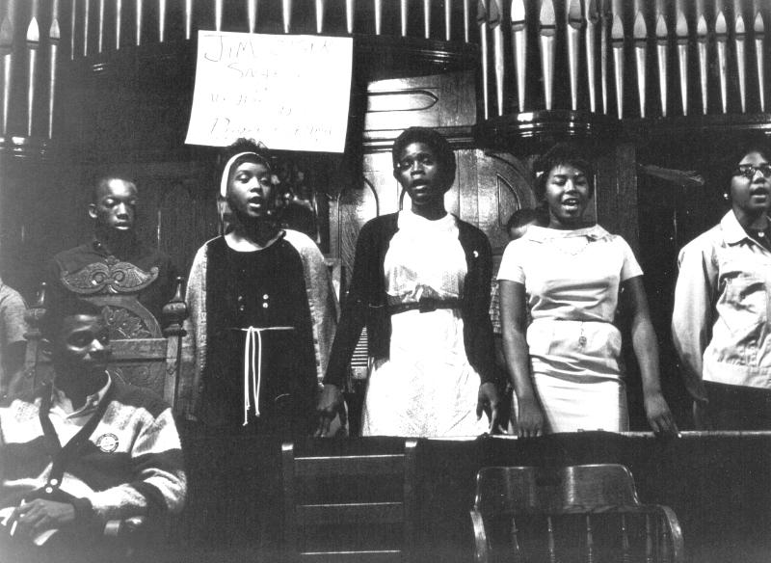
Songs
"Governor Wallace"
credited to James Orange of The Freedom Singers, but based on Jewell and the Rubies' 1963 hit "Kidnapper."
Well I read in the paper
Just the other day
The freedom fighters
are on their way
They’re coming by bus and an airplane too
They would even walk if you would asked them to
So governor Wallace, oh yeah
You never can jail us all
Governor Wallace, oh yeah
Segregation is bound to fall
http://www.pbs.org/wgbh/americanexperience/features/general-article/soundtrack-lyrics/
High-school students leading freedom songs at a mass meeting in Brown Chapel

Slide 12
Sound Vs. Text
“Many efforts were made to ensure accuracy in the following transcriptions, but the reader should be advised that certain errors or omissions were found to be inevitable given material of this complexity... proper names, in particular, were often not clearly audible, or, if audible, were open to various spellings... Similiar differences were sometimes experienced in transcribing Negro dialect which often sounded quite foreign to the ear of the uninitiated northern typists... the reader may refer to the original recording in order that he may personally catch the flavor and meaning of the initial interview.”
Richard Gillam, report accompanying transcripts 1969

Slide 13
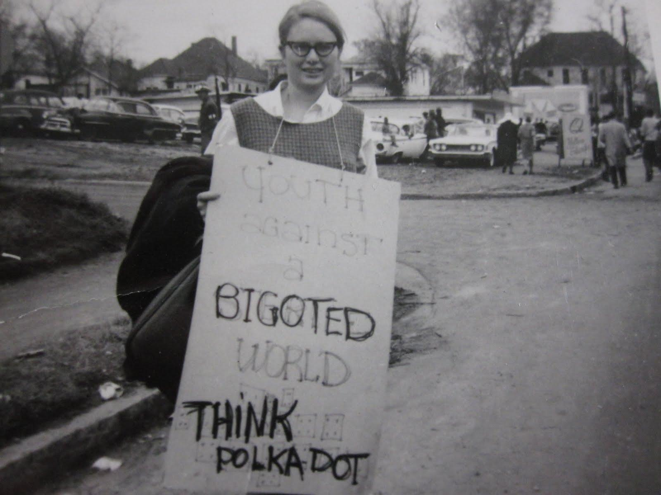
Canvassing
Uncredited canvassers for Little Rock Baptist Church meeting.
Excerpted from tape no. S171a
[ARS0022_b16_650600_S171_a_sh] :55
Jane Stillwater marching in Montgomery

Slide 14
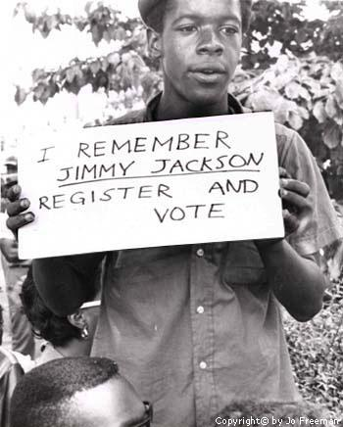
credits and links
Thanks to Hannah Frost, Geoff Willard, Daniel Hartwig, and Andrew Hamilton.
Project South Finding Aid (transcripts only):
Guide to the KZSU Project South Interviews
http://findingaids.stanford.edu/xtf/view?docId=ead/uarc/sc0066.xml
also on the OnLine Archive of California:
http://www.oac.cdlib.org/findaid/ark:/13030/tf7489n969
Archive of Recorded Sound
http://lib.stanford.edu/ars
Photos borrowed from Jo Freeman, Jane Stillwater, the Mississippi State Sovereignty Commission Collection at the Mississippi Department of Archives and History, and Civil Rights Movement Veterans.
One young man remembers Jimmy Lee Jackson, who was killed in February 1965 in Alabama while demonstrating for voter registration. Photo by Jo Freeman.

Slide 15
Collection Overview By The Numbers
KZSU's Project South tapes sold to the Archive of Recorded Sound in 1966 for $1500.00
464 tapes currently held as a series in the Stanford Speech Collection (ARS0022)
458 edited transcripts produced in 1969 by two original participants and a staff of typists
Transcripts become part of Special Collections SC066, KZSU (Radio station : Stanford) Project South, 1965
Transcripts described in finding aid and now individually scanned and available digitally
Tapes available to researchers able to visit Stanford
Original open reel tapes (mono, half-track at 3.75 ips and 7.5 ips) digitized by Stanford Media Preservation Lab in 2009 using two Studer A807 machines
867 BWF files recorded 24bit/96KHz, stored on servers and in Stanford Digital Repository
MODS records created with index card metadata
330 hours of recordings, 200 of which are are interviews
Approximately 89 digital files cannot be associated with a transcript
Future plans: transcribing rest will be difficult and costly. Release form documentation in process by University Archives. Future accessibility of sound files to be determined

