Slide 1
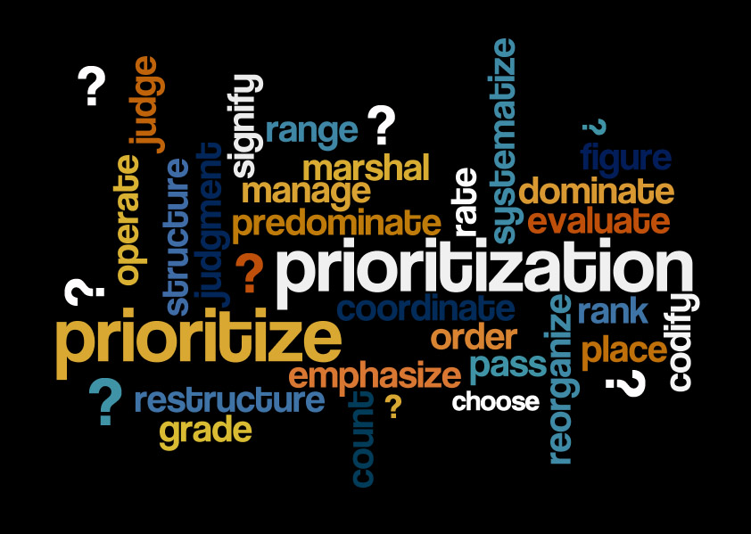

Slide 2
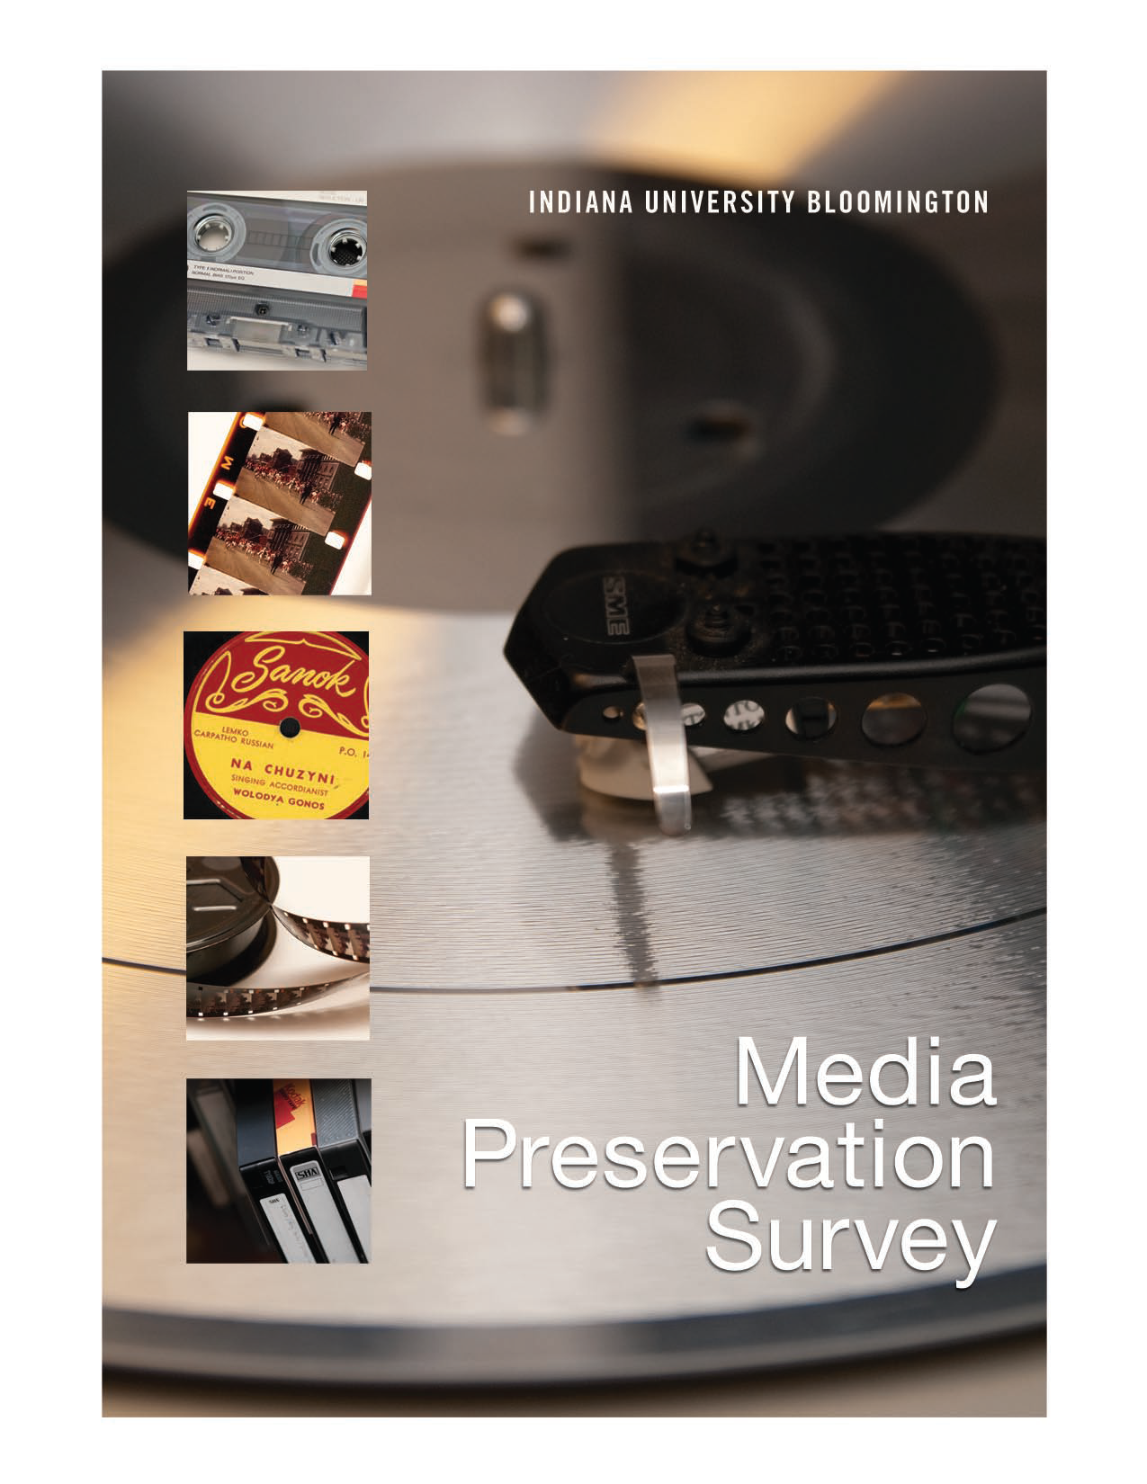

Slide 3
Indiana Numbers
More than 560,000 audio, video, film objects
  364,000 audio (64%)
  125,000 video (22%)
  78,000 film (14%)
80 units
50+ formats

Slide 4
“…it is alarming to realize that nearly all recorded sound is in peril of disappearing or becoming inaccessible within a few generations.”
--National Recording Preservation Board in “Capturing Analog Sound”

Slide 5
“in the mid- to long-term there is a major risk that carrier degradation combined with playback obsolescence will defeat the efforts of archivists…”
--International Association of Sound and Audiovisual Archives

Slide 6


Slide 7
Strategies
Indiana Media Preservation and Access Center
(IMPAC)
Audio preservation transfer
Video preservation transfer
Film conservation and digitization

Slide 8
Why Prioritize?
Recommendation 2.2: Appraisal of
Audio Collections for Preservation
“Devise means to assist collection managers in conducting comprehensive appraisals of audio holdings with the goal of establishing priorities for preservation.”
--The Library of Congress National Recording Preservation Plan, page 21

Slide 9
Why Prioritize?
560,000+ media objects
Known degradation—limited time window
Known obsolescence issues—limited time window
Known high (and low) research value
Political reasons
No guarantees with funding, the economy, will
Not everything can/will be preserved
Parallel process that does not slow digitization

Slide 10
Data Collection
Research Value
Score
Condition/Risk
Score
Combined Score
Collection Ranking
Curatorial Review
Prioritization
Ranking

Slide 11
Research Value
Value of media collections
Research value
Instructional value
Experiential value
Production value

Slide 12
Research Value
MediaRIVERS
Media Research and Instructional Value Evaluation and Ranking System
Developed by NEH-funded Sound Directions Project and MPI
Campus stakeholder group: Music Library, University Archives, Lilly Library, Archives of Traditional Music, AAAMC, Digital Library Program

Slide 13
Research Value
MediaRIVERS
Points-based scoring system
Benefits from curatorial-level knowledge and expertise
Software development begins June with AVPS

Slide 14
MediaRIVERS
Manuscripts antecedents
Historical Society of Pennsylvania
Philadelphia Area Consortium of Special Collections Libraries
Columbia University
University of Virginia
Mellon-funded

Slide 15
Condition/risk
Preservation issues--degradation
Condition
Obsolescence
Characteristics that impact risk

Slide 16
MediaSCORE
Media Selection: Condition, Obsolescence, and Risk Evaluation
Developed by MPI with AudioVisual Preservation Solutions (AVPS)
Audio, video, and film formats

Slide 17
MediaSCORE Scale
4.5-5: Extreme danger-digitize immediately
I’m begging my director for money tomorrow
3.5-4.49: Danger ahead-digitize near-term
I’m writing a grant in the next year
2.5-3.49: Caution, moderate risk-digitize soon
I’m actively planning for digitization

Slide 18
MediaSCORE Scale
1.5-2.49: Lower priority, digitize medium term
0.6-1.49: Low priority, digitize within 10-15 years
0-0.5: Safe, not in need of digitization

Slide 19
Selection Process
Curatorial Review
Publicity needs
Timeliness—anniversaries, events
Access restrictions and donor agreements
Current technical capabilities
Final selection decisions

Slide 20
Process
Meeting between MPI team and unit staff
Analysis of risk, condition, and obsolescence
Analysis of research and instructional value
Validity within unit

Slide 21
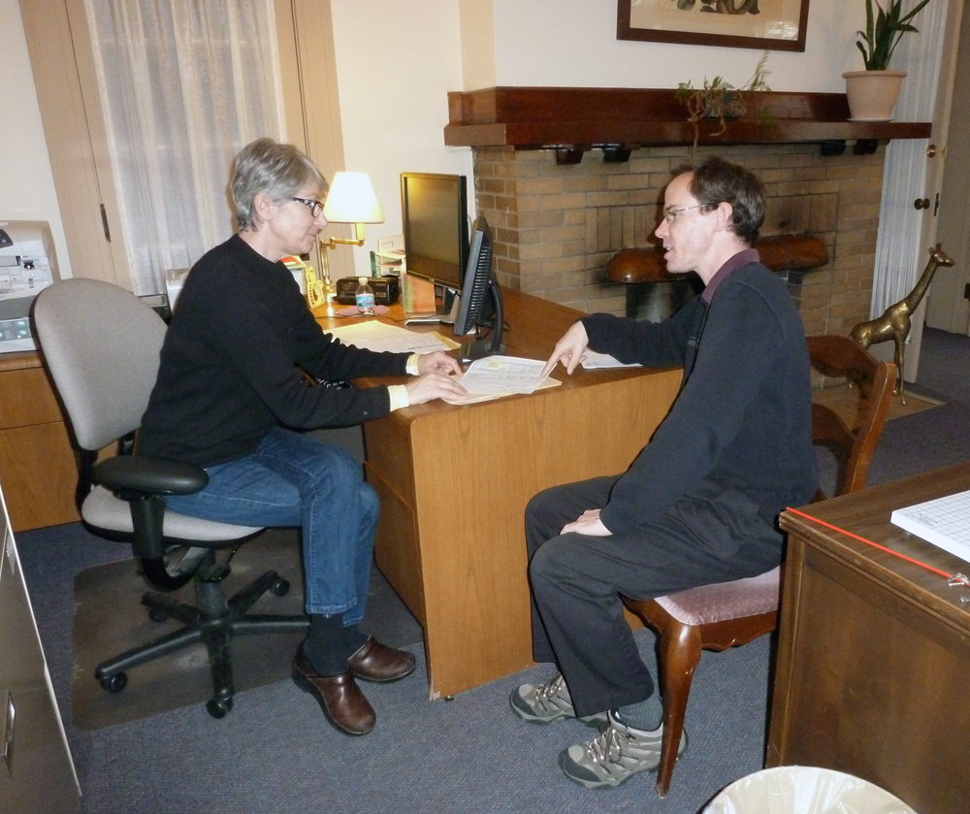
Initial meeting

Slide 22
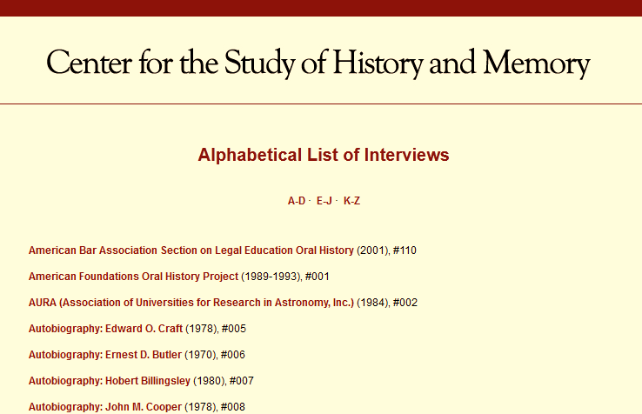
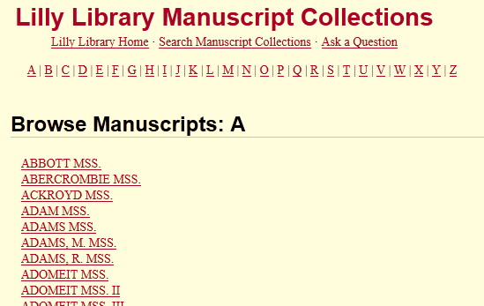
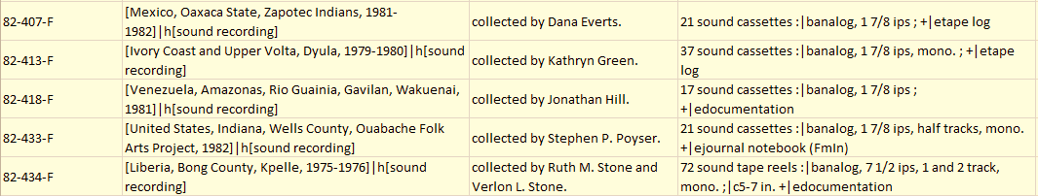
Defining collections
Archives of
Traditional Music

Slide 23
Law Library
(1,500 items)
Public Health Library
(250 items)
Named Lecture
Symposium
Event
Court Proceedings
Moot Court
Miscellaneous
Dance
Exercise
Other
Center for Disability Information and Referral
(1,800 items)
Neal-Marshall Black Culture Center Library
(300 items)
Produced at IU
Produced elsewhere
Dept. of Astronomy
(40 items)
African-American Studies
Journalism
The Arts
High priority
Low priority

Slide 24
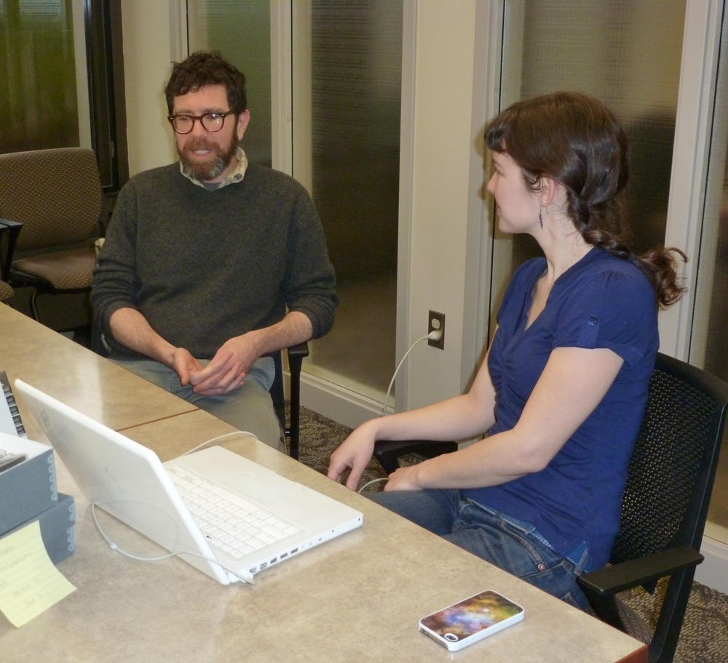
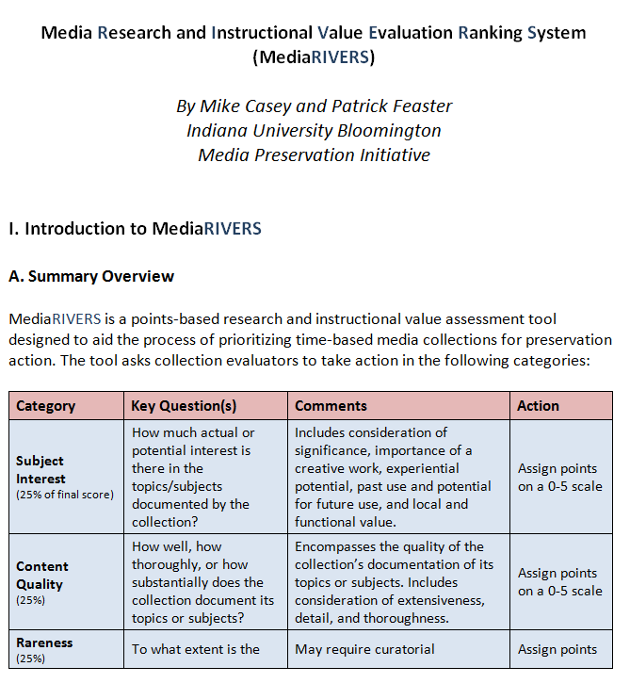
Ranking by value

Slide 25
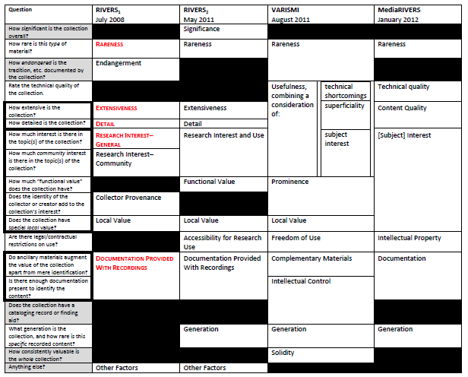

Slide 26
Value Assessment Fields
25%
25%
25%
15%
10%
Subject Interest
Content Quality
Rareness
Documentation
Technical Quality
Generation
IP Status

Slide 27
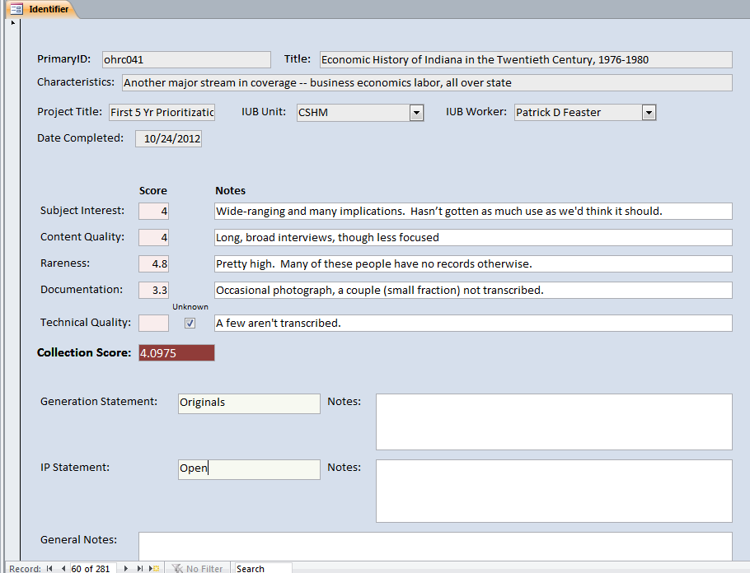
MediaRIVERS

Slide 28
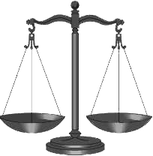
Ranking by value
Law Library
Named Lecture 3.775
Symposium 3.2
Event 3.225
Court Proceedings 2.775
Moot Court 1.825
Miscellaneous 2.925

Slide 29
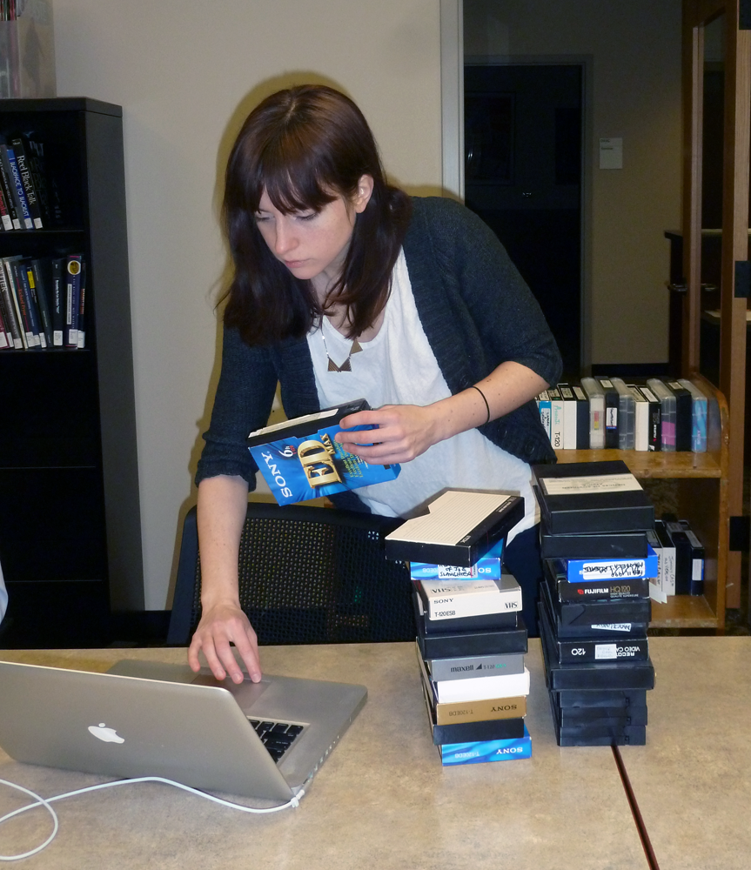
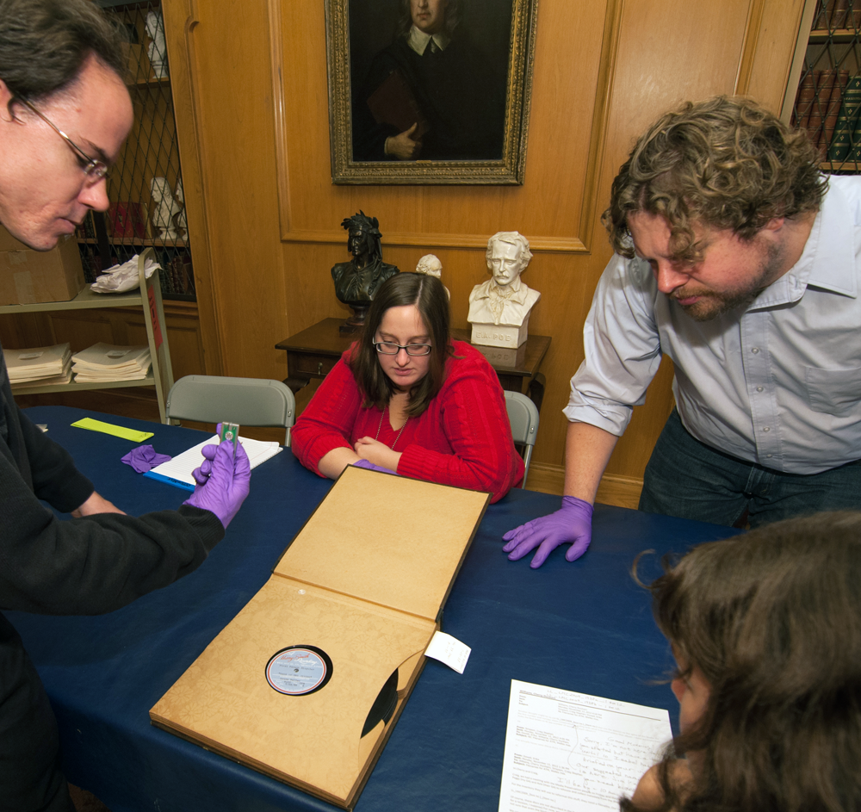
Physical inspection

Slide 30
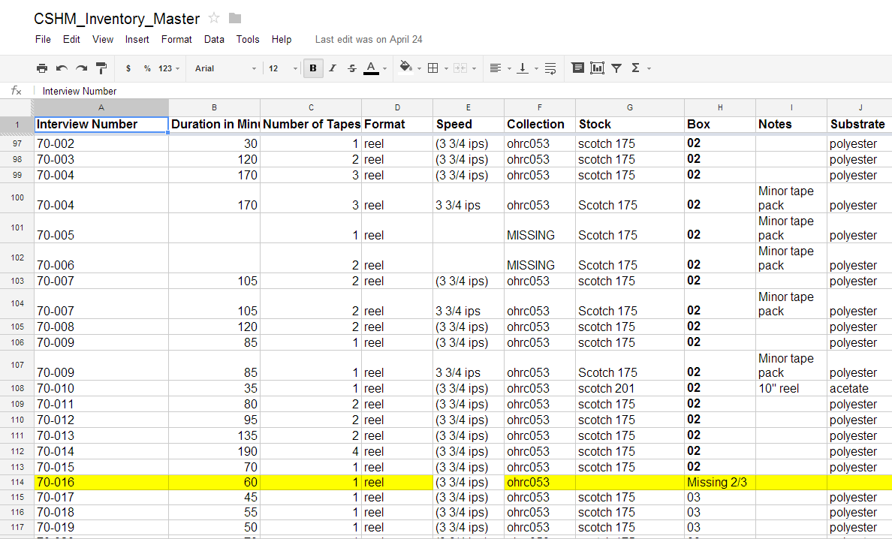

Slide 31
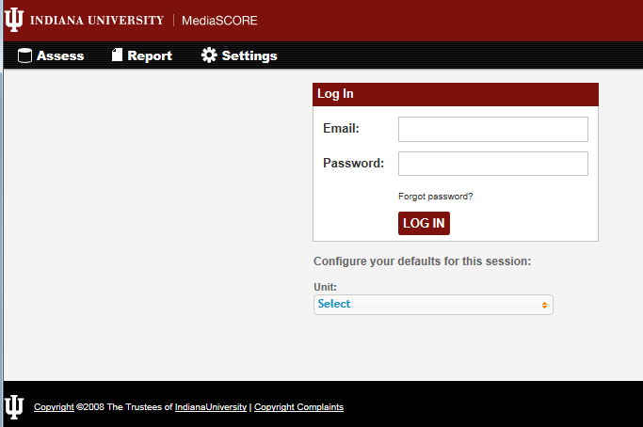
MediaSCORE

Slide 32
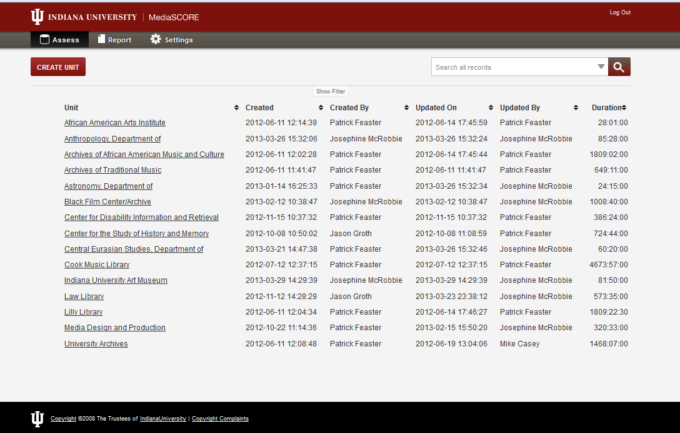
Units | Collections | Asset Groups

Slide 33
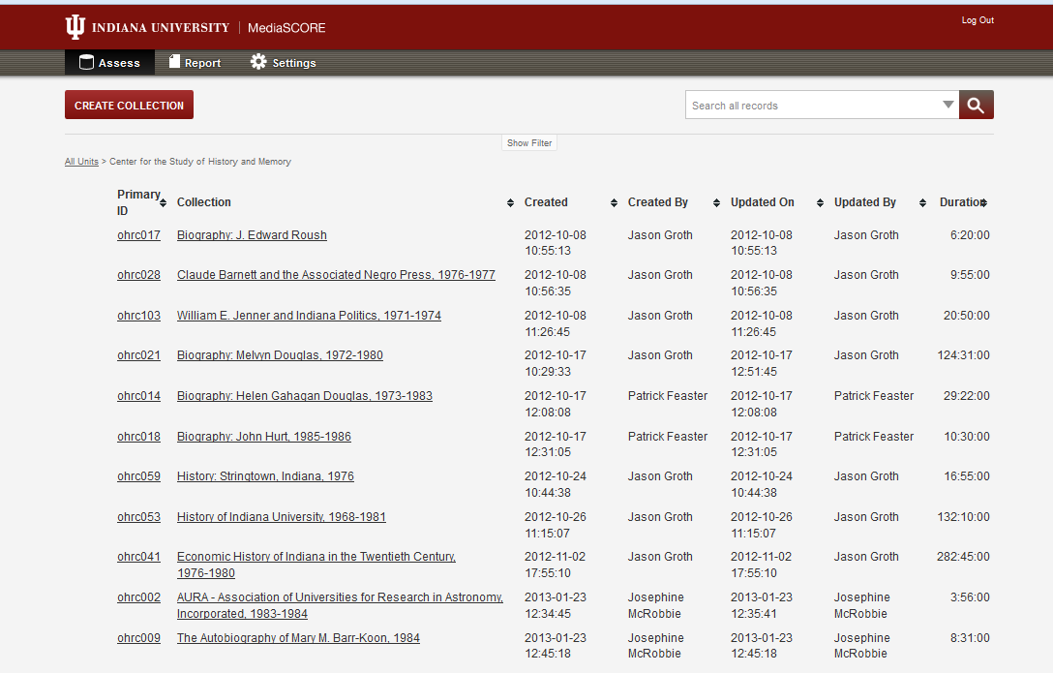
Units | Collections | Asset Groups

Slide 34
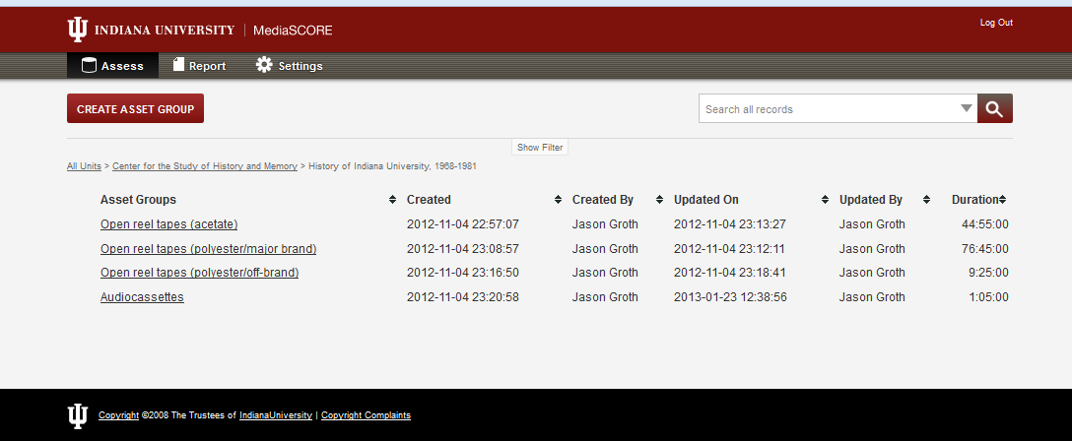
Units | Collections | Asset Groups

Slide 35
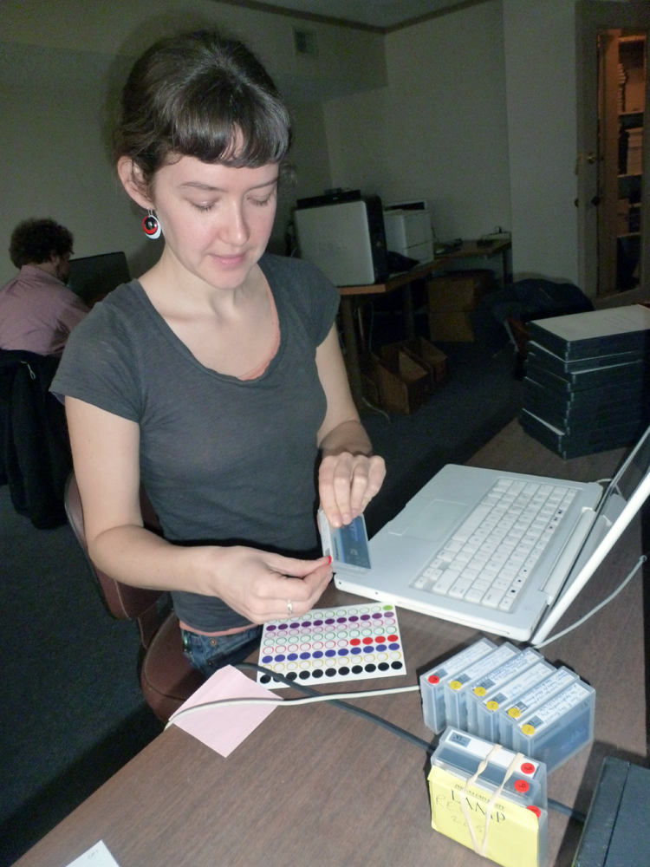
Stickering
Thin tape
Sticky-shed polyester
Vinegar syndrome acetate
Other acetate
Off-brand; soundtrack (film)
Non-Type I audiocassette
II
III
IV

Slide 36
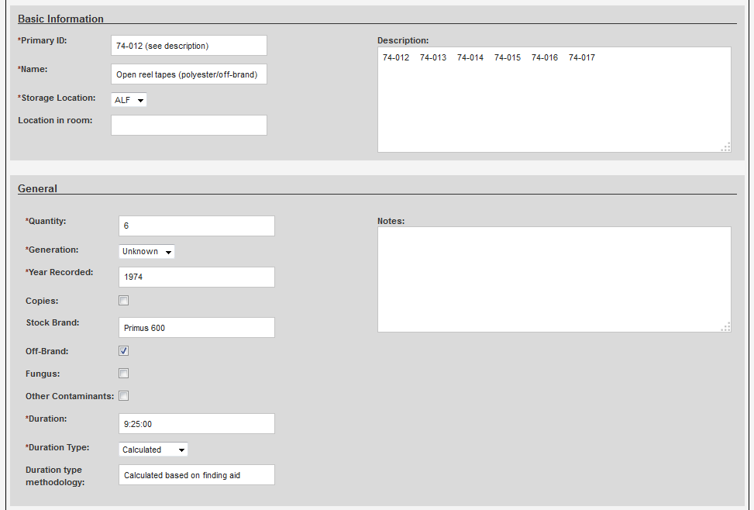

Slide 37
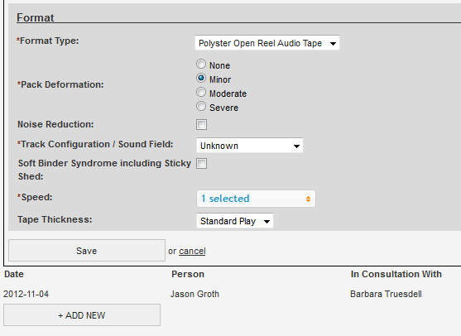

Slide 38

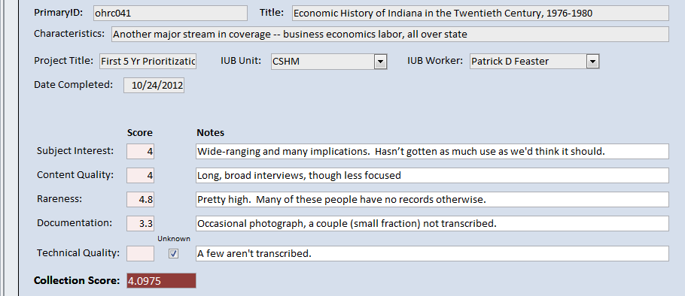
MediaSCORE
+
MediaRIVERS

