Slide 2
Hawaiian Music in Australia

Slide 3
The 1920s Hula and hapa-haole

Slide 4
Ukulele Lullaby Queenie & David Kaili Parlophone A-2364 (1927)

Slide 5
Shoo the Hoodoo Away Queenie & David Kaili Parlophone A-3053 (1930)
Queenie & David Kaili’s stage show, c1933

Slide 6
The 1930s
The Hawaiian Clubs

Slide 7
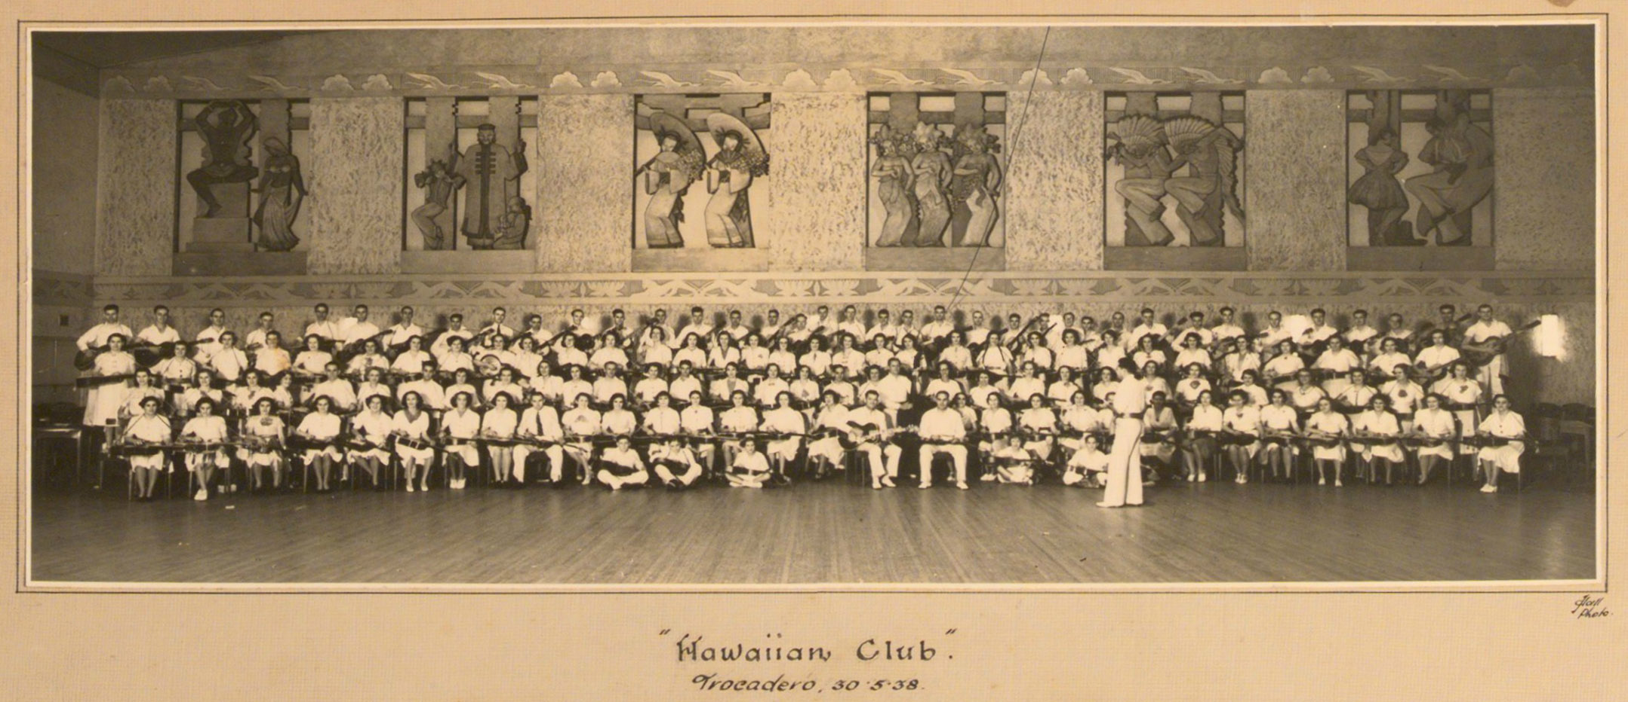
The Hawaiian Club Members 1938
Picture courtesy Powerhouse Museum, Sydney. Photographer unknown.

Slide 8
When Its Night-time in Nevada
The Singing Stockmen with The Hawaiian Club
Regal Zonophone G-23524 (1937)
L-R: Jango Kahn - steel guitar,
Les Adams - guitar,
Buddy Waikara - bass,
Johnny Wade - ukulele,
Jack Saunders - guitar

Slide 9
Aloha Oe
The Hawaiian Club Quartet
Regal Zonophone G-23807 (1939)
L-R, Eric Kahn - bass,
Norm Scott - ukulele,
Neville Kahn - steel guitar,
Johnny Wade - guitar & vocals

Slide 10
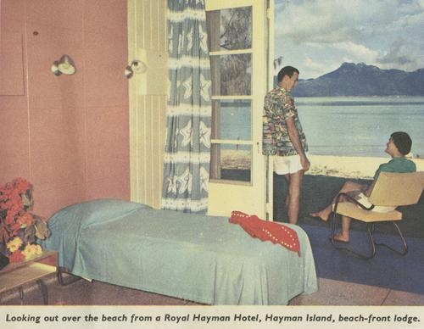
The 1940s & ’50s
State Library of Queensland picqld-2006-11-24-10-24

Slide 11
Where the Blue Gums Turn Red in the Sunset
Keith Branch & his South Sea Islanders
Regal Zonophone G-25131 (1947)
Seaplane at Hayman Island, owned by Barrier Reef Airways, May 1951
StateLibQld 1 115392

Slide 12
Magnetic Island Johnny Wade & His Hawaiians Columbia DO-3342 (1950) Pack Up a Dream and Head for Hayman Island John O’Connor & George Watson’s Hawaiians Royal Hayman Hotel (1950)
Hayman Island 1963 NAA B4498 150G8

Slide 13
I Lost my Heart on Hayman Island
Johnny Wade & His Hawaiians
Columbia DO-3852 (1956)
Hayman Island 1963 NAA1500, K10602

Slide 14
Aloha

Slide 15
Aloha
Full versions of the songs and more can be found at www.nfsa.gov.au/collection/sound/sounds-australia/hawaiian-music-australia

