Slide 1
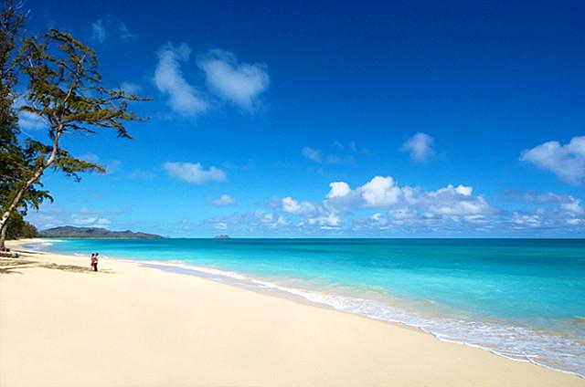
Beyond the Reef:
Tracking the Global Circulation of Hawaiian Music Recordings
Amy K. Stillman
ARSC 2013

Slide 2

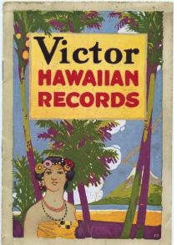
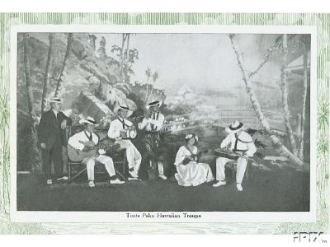
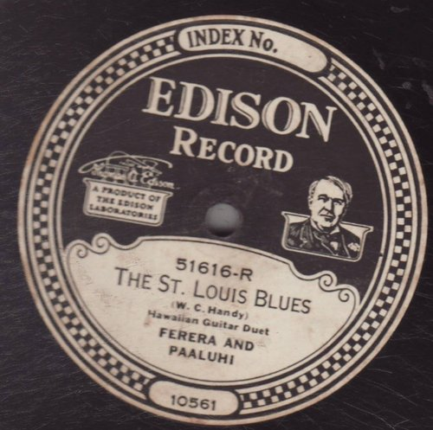
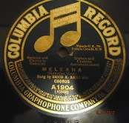
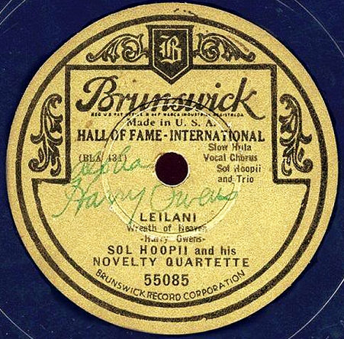
1916 catalogue
centerfold photograph

Slide 3
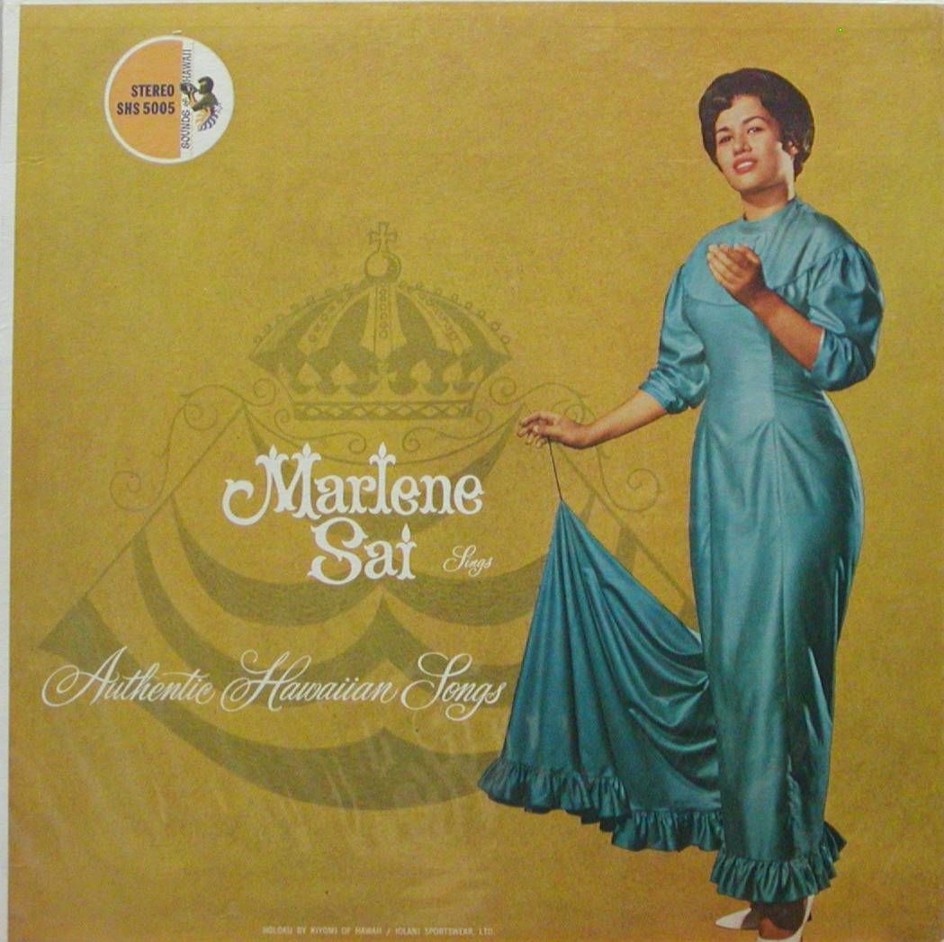
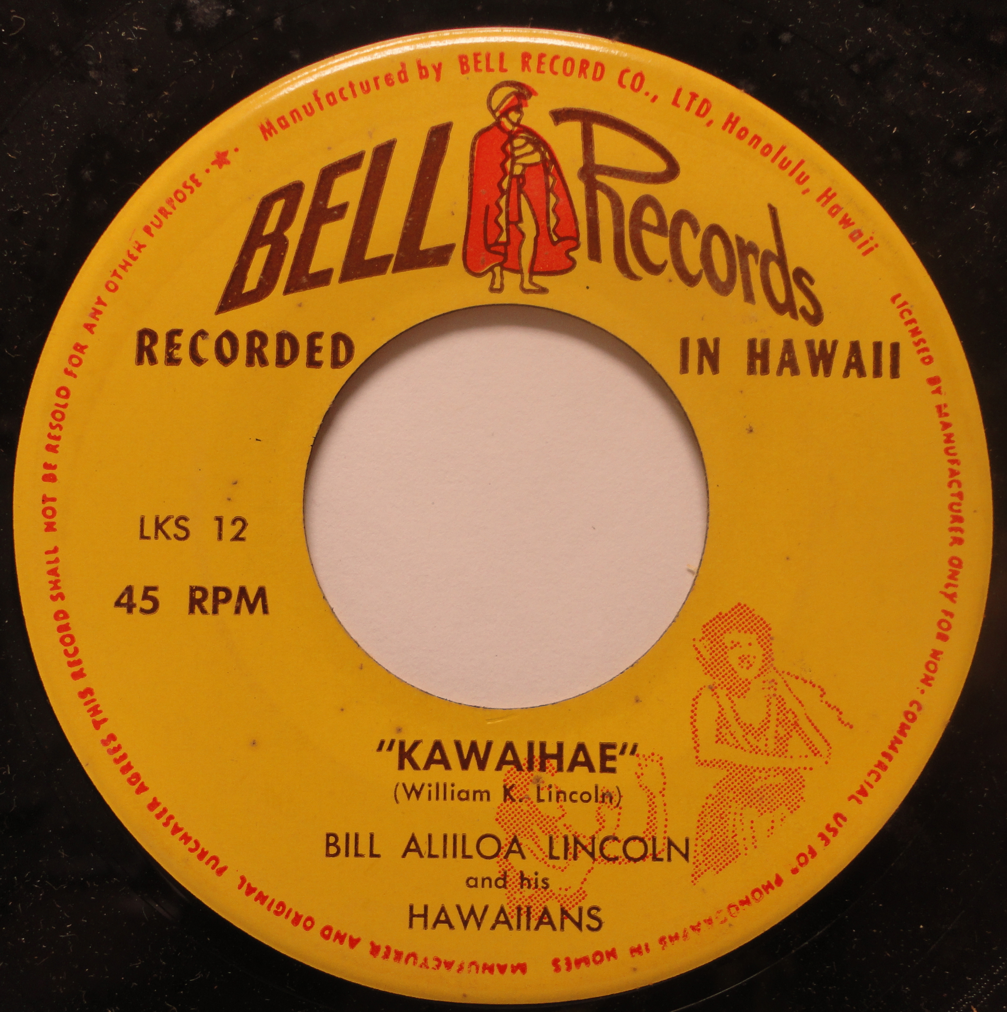
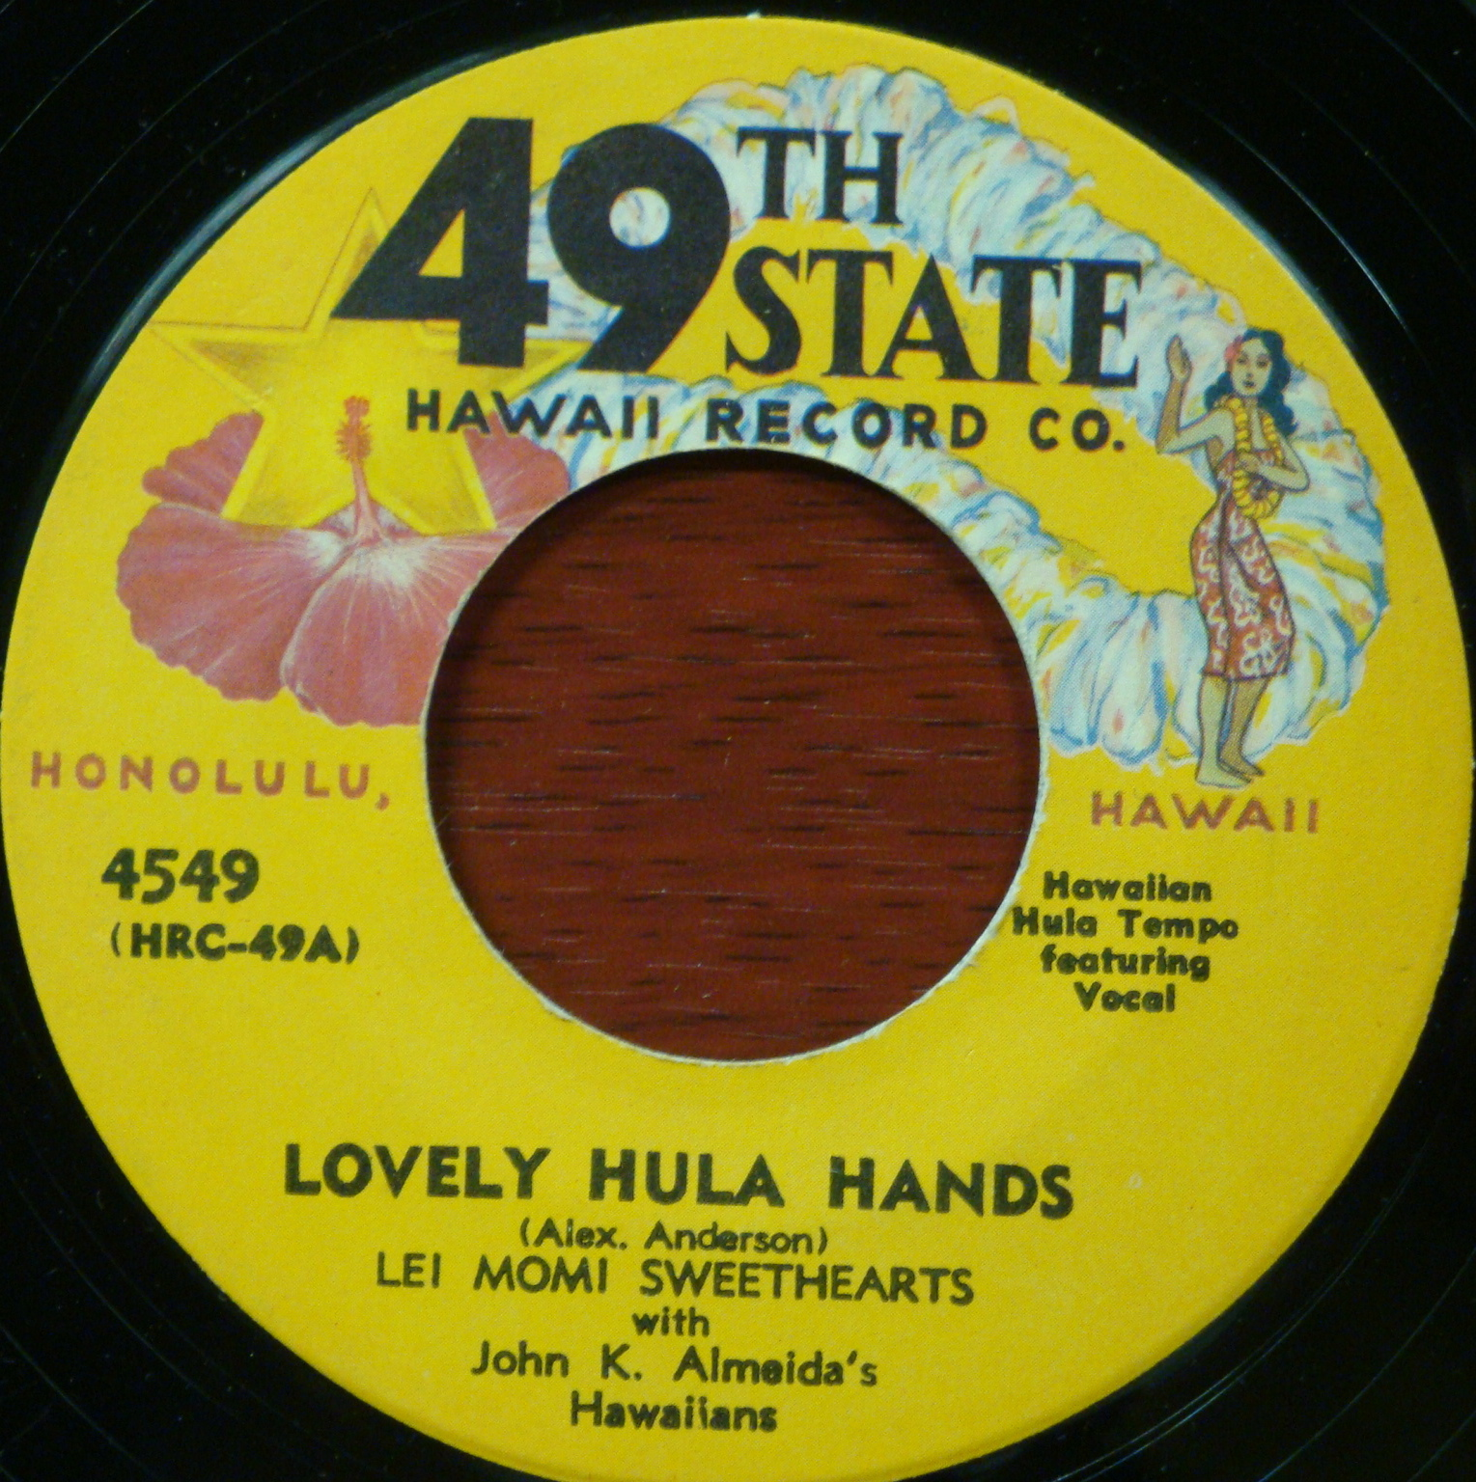
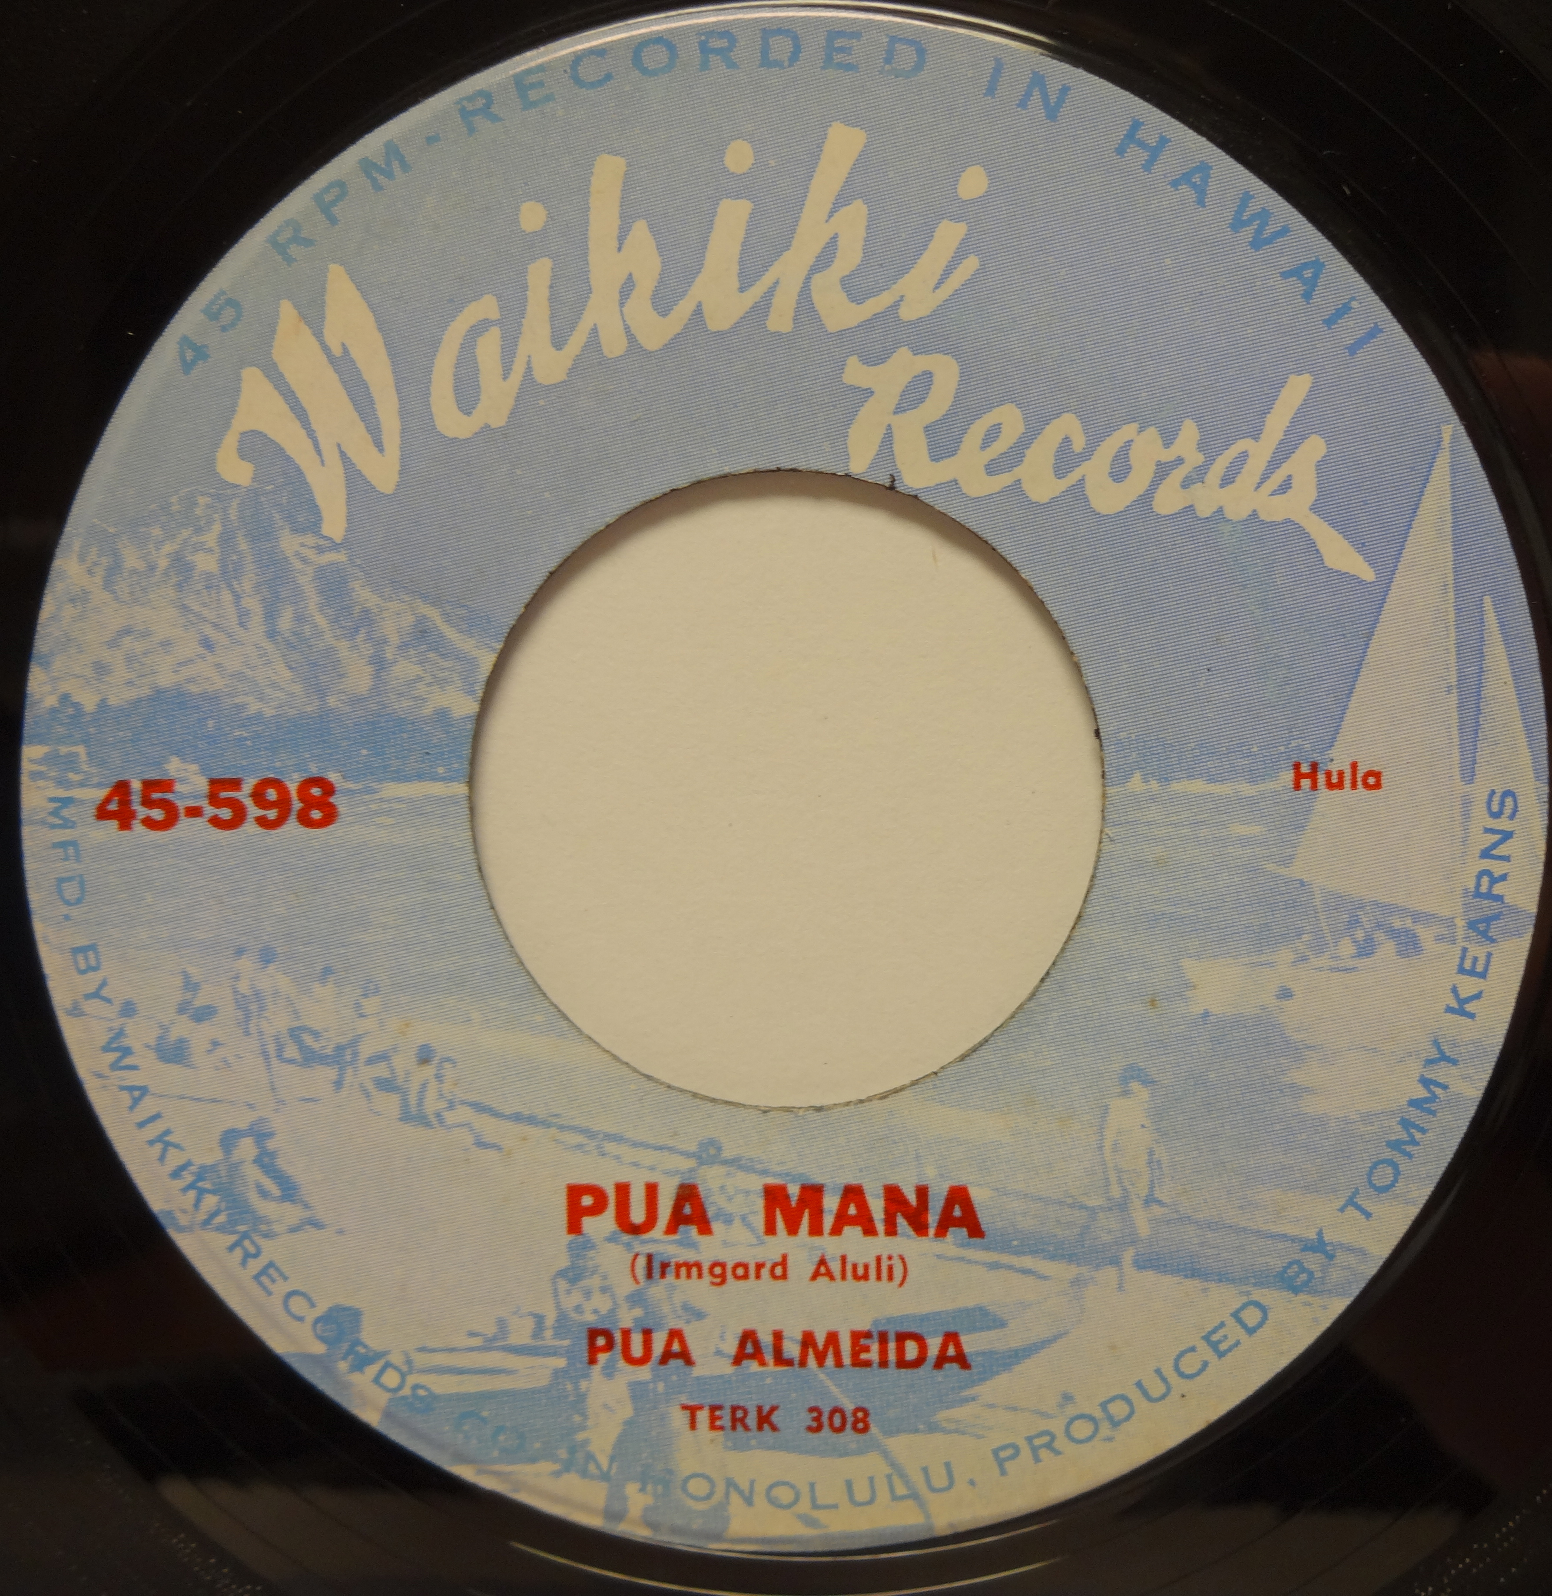
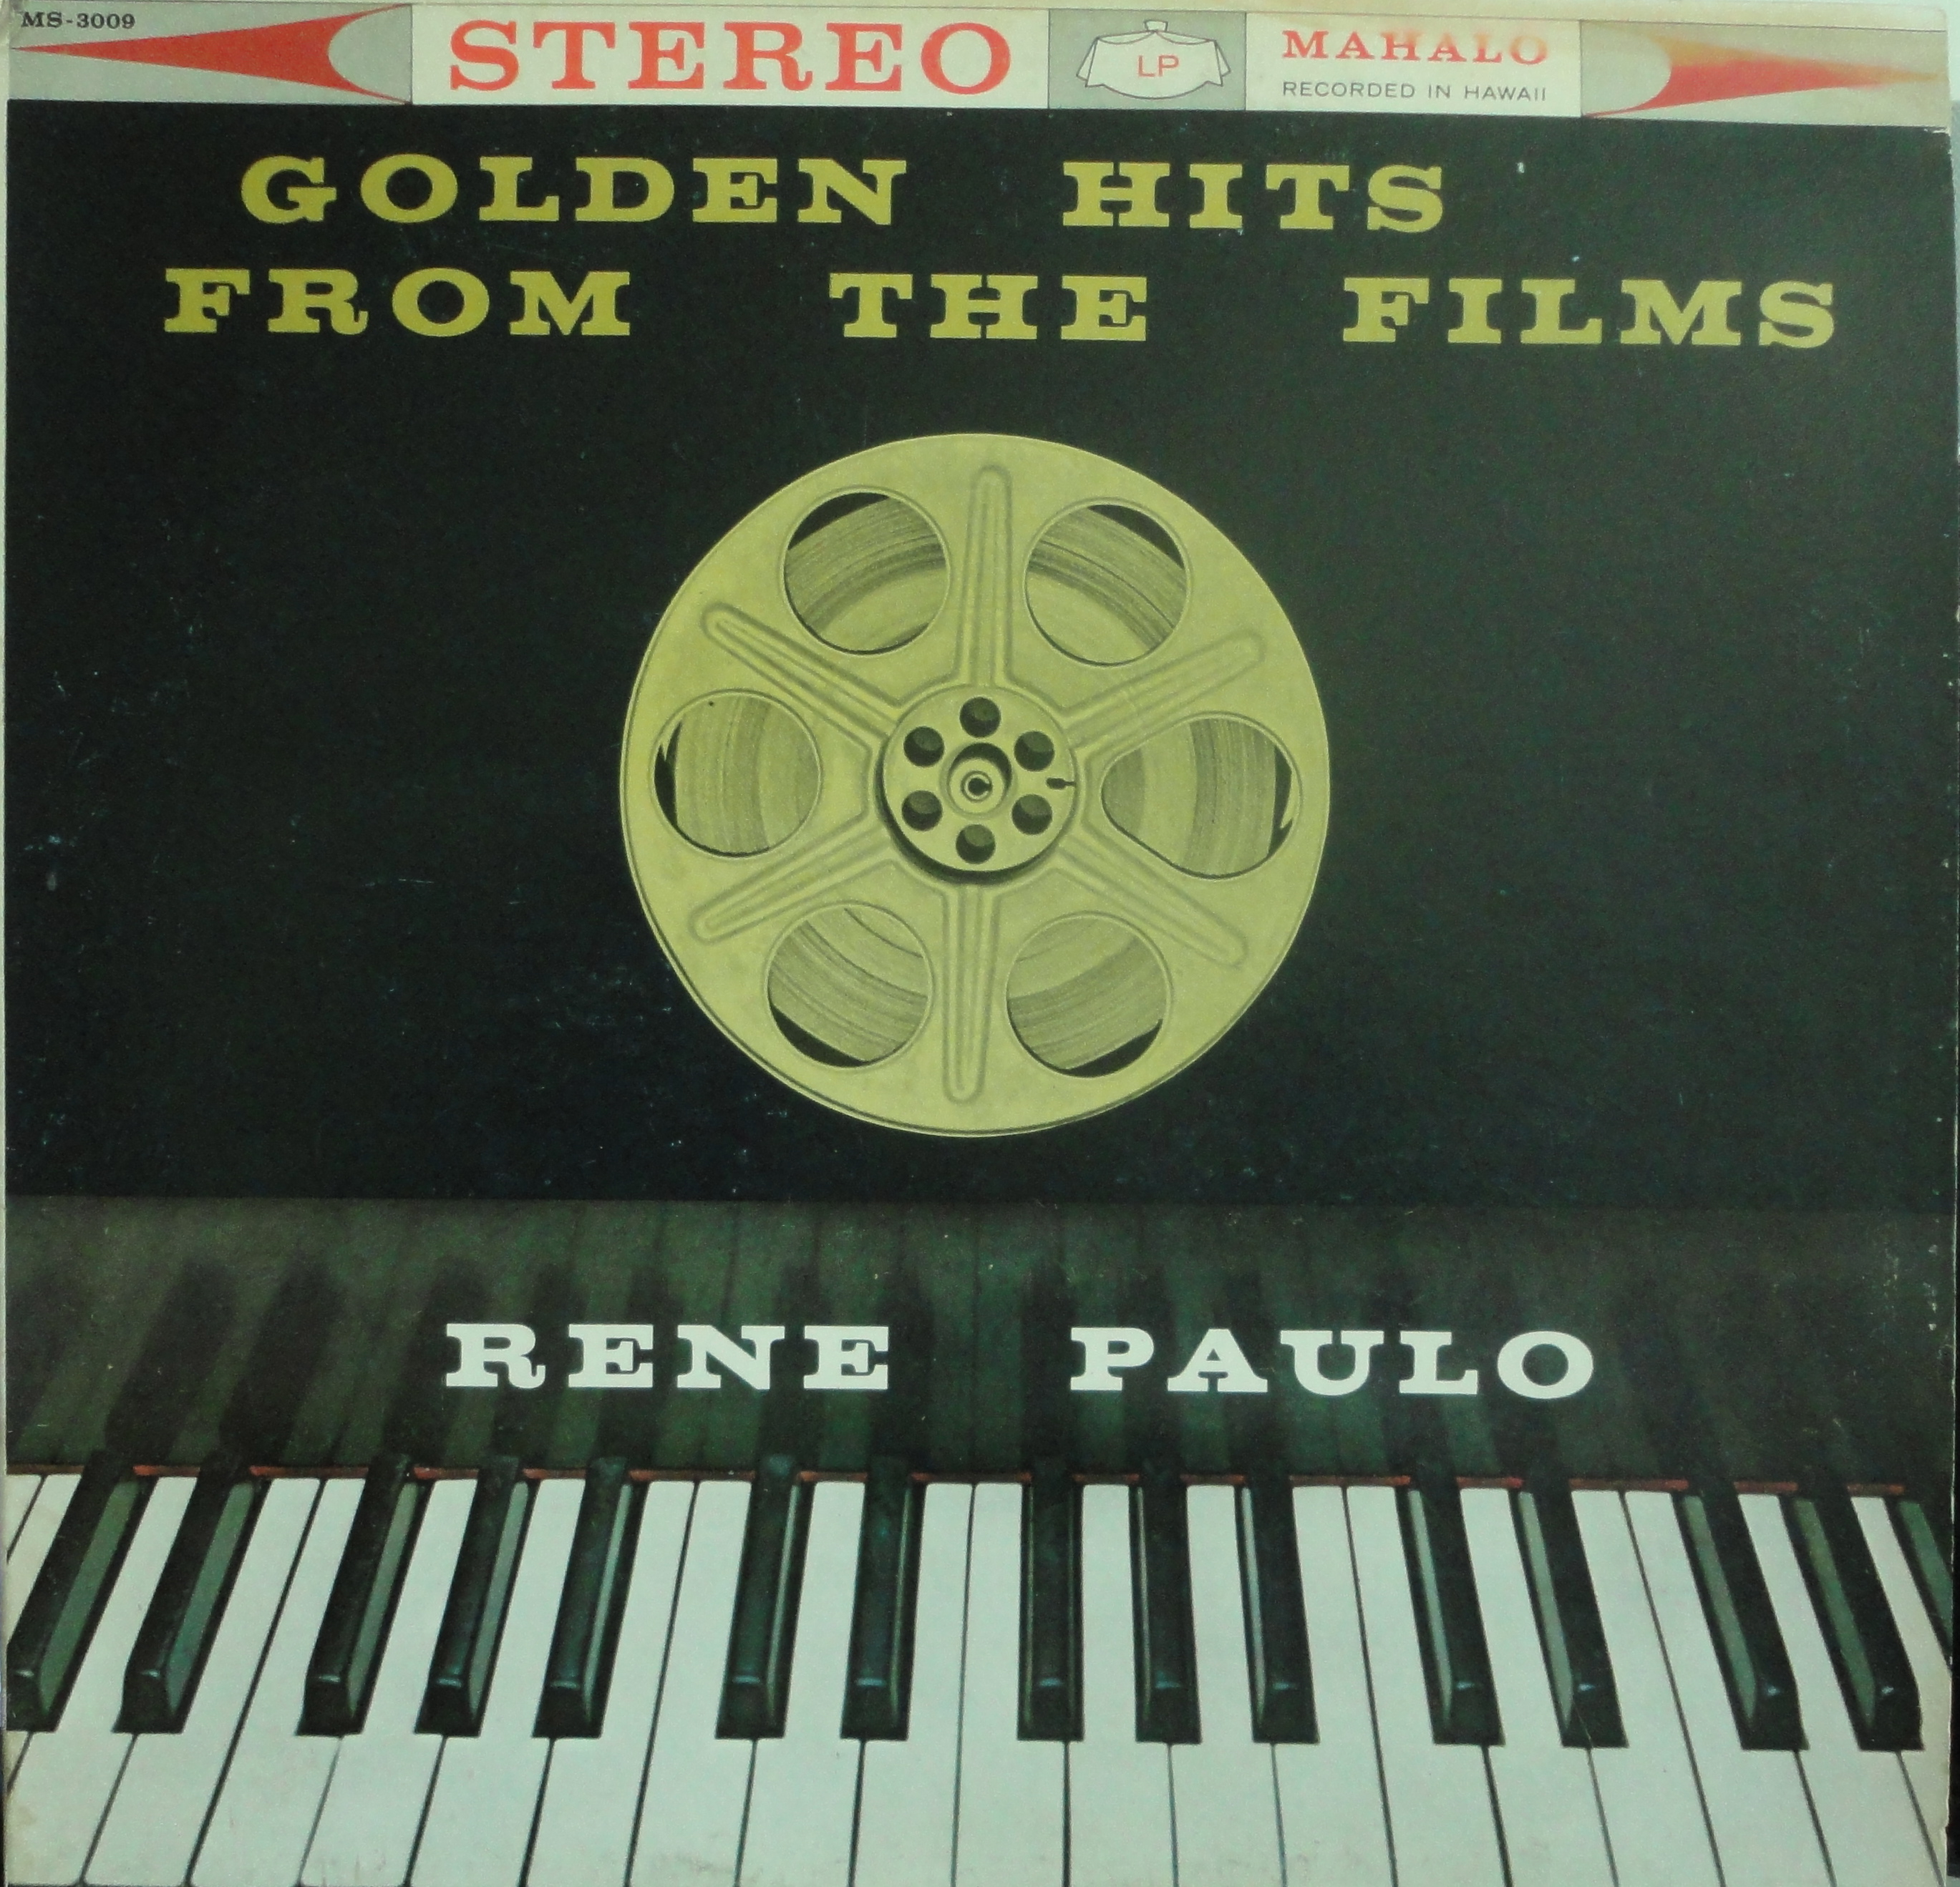
Hawaiʻi-based record labels recording
for a local market

Slide 4
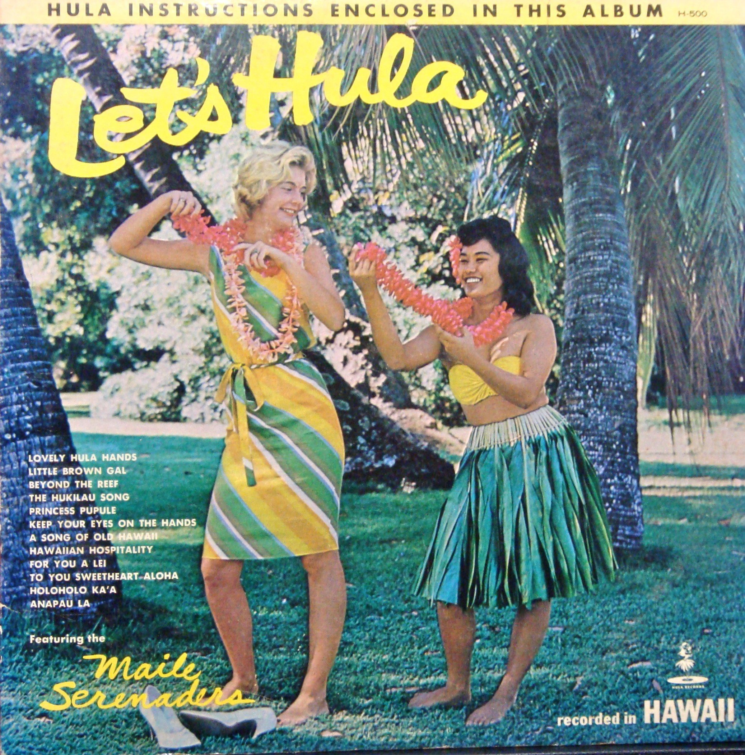
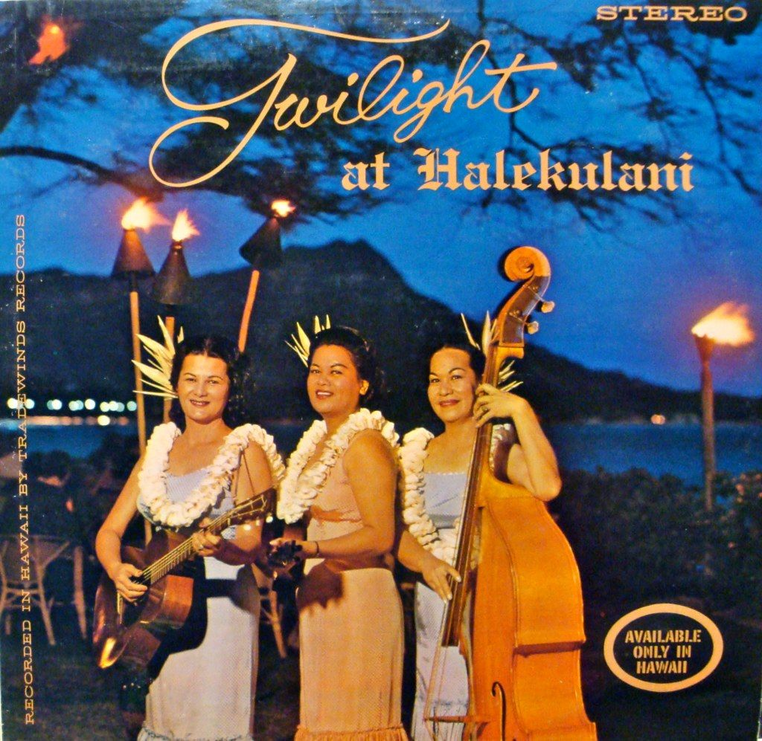
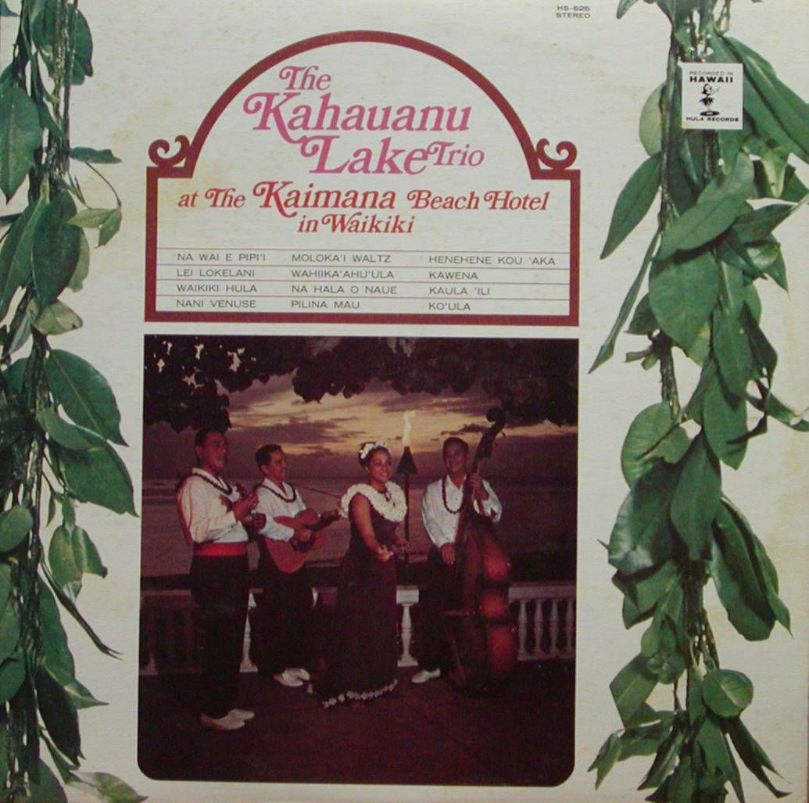
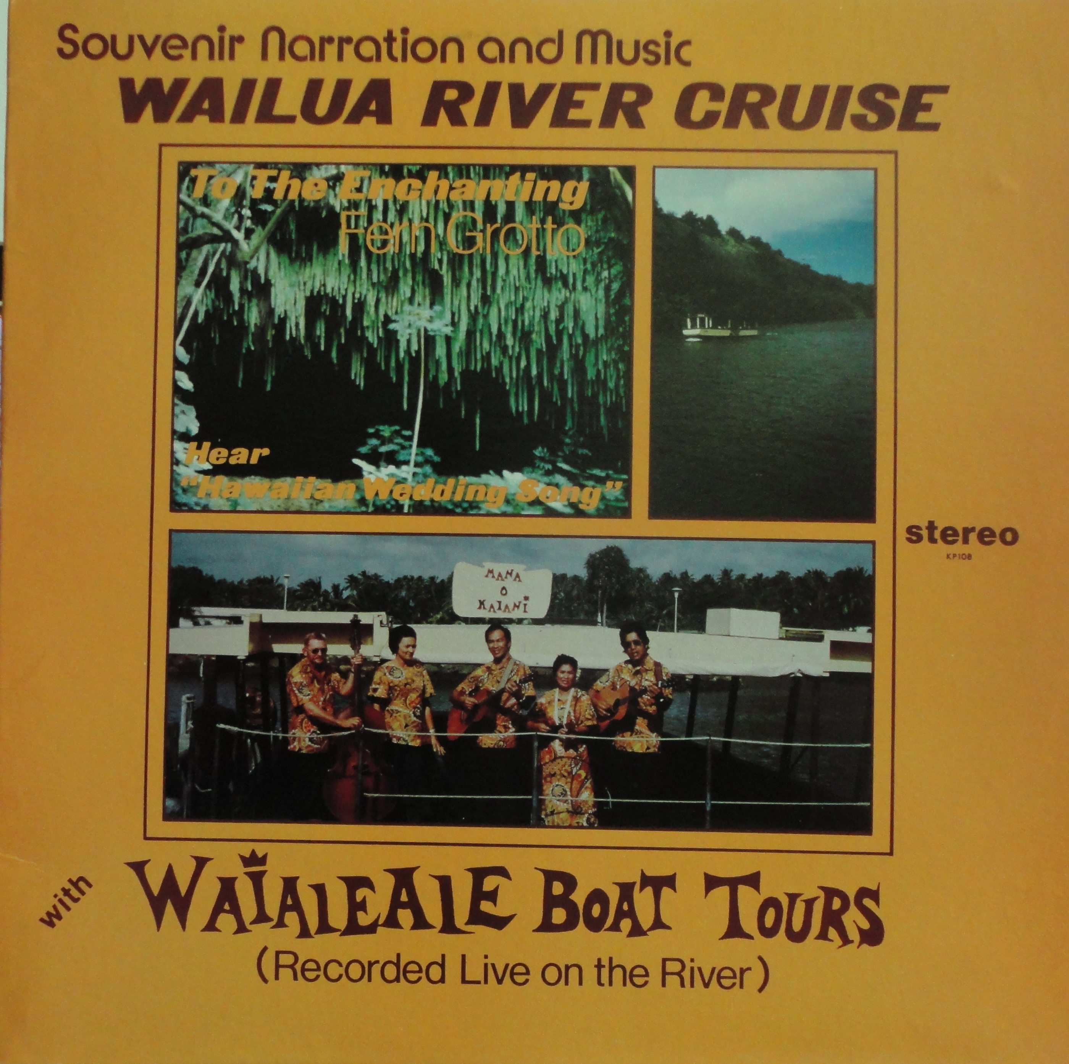
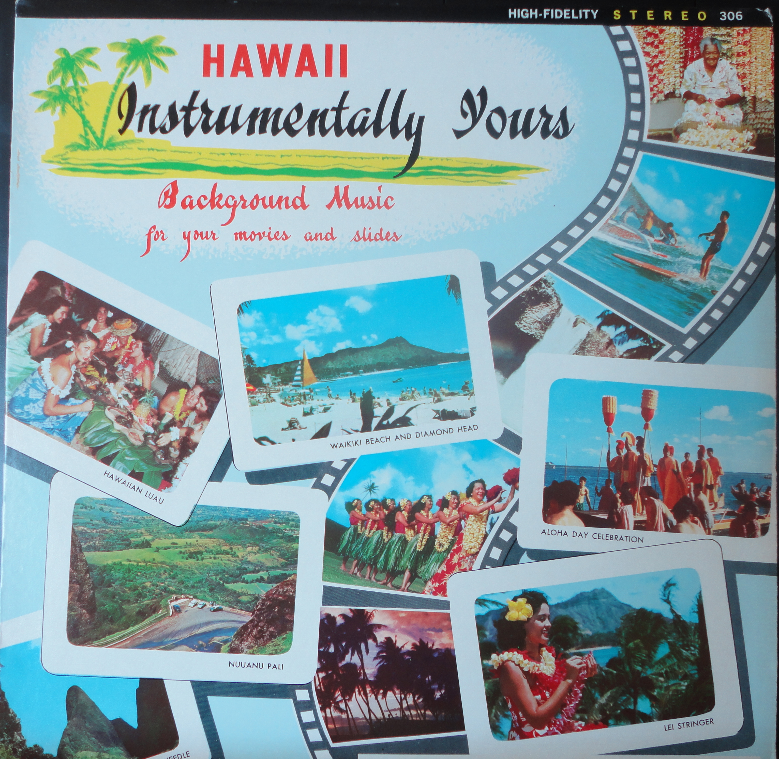
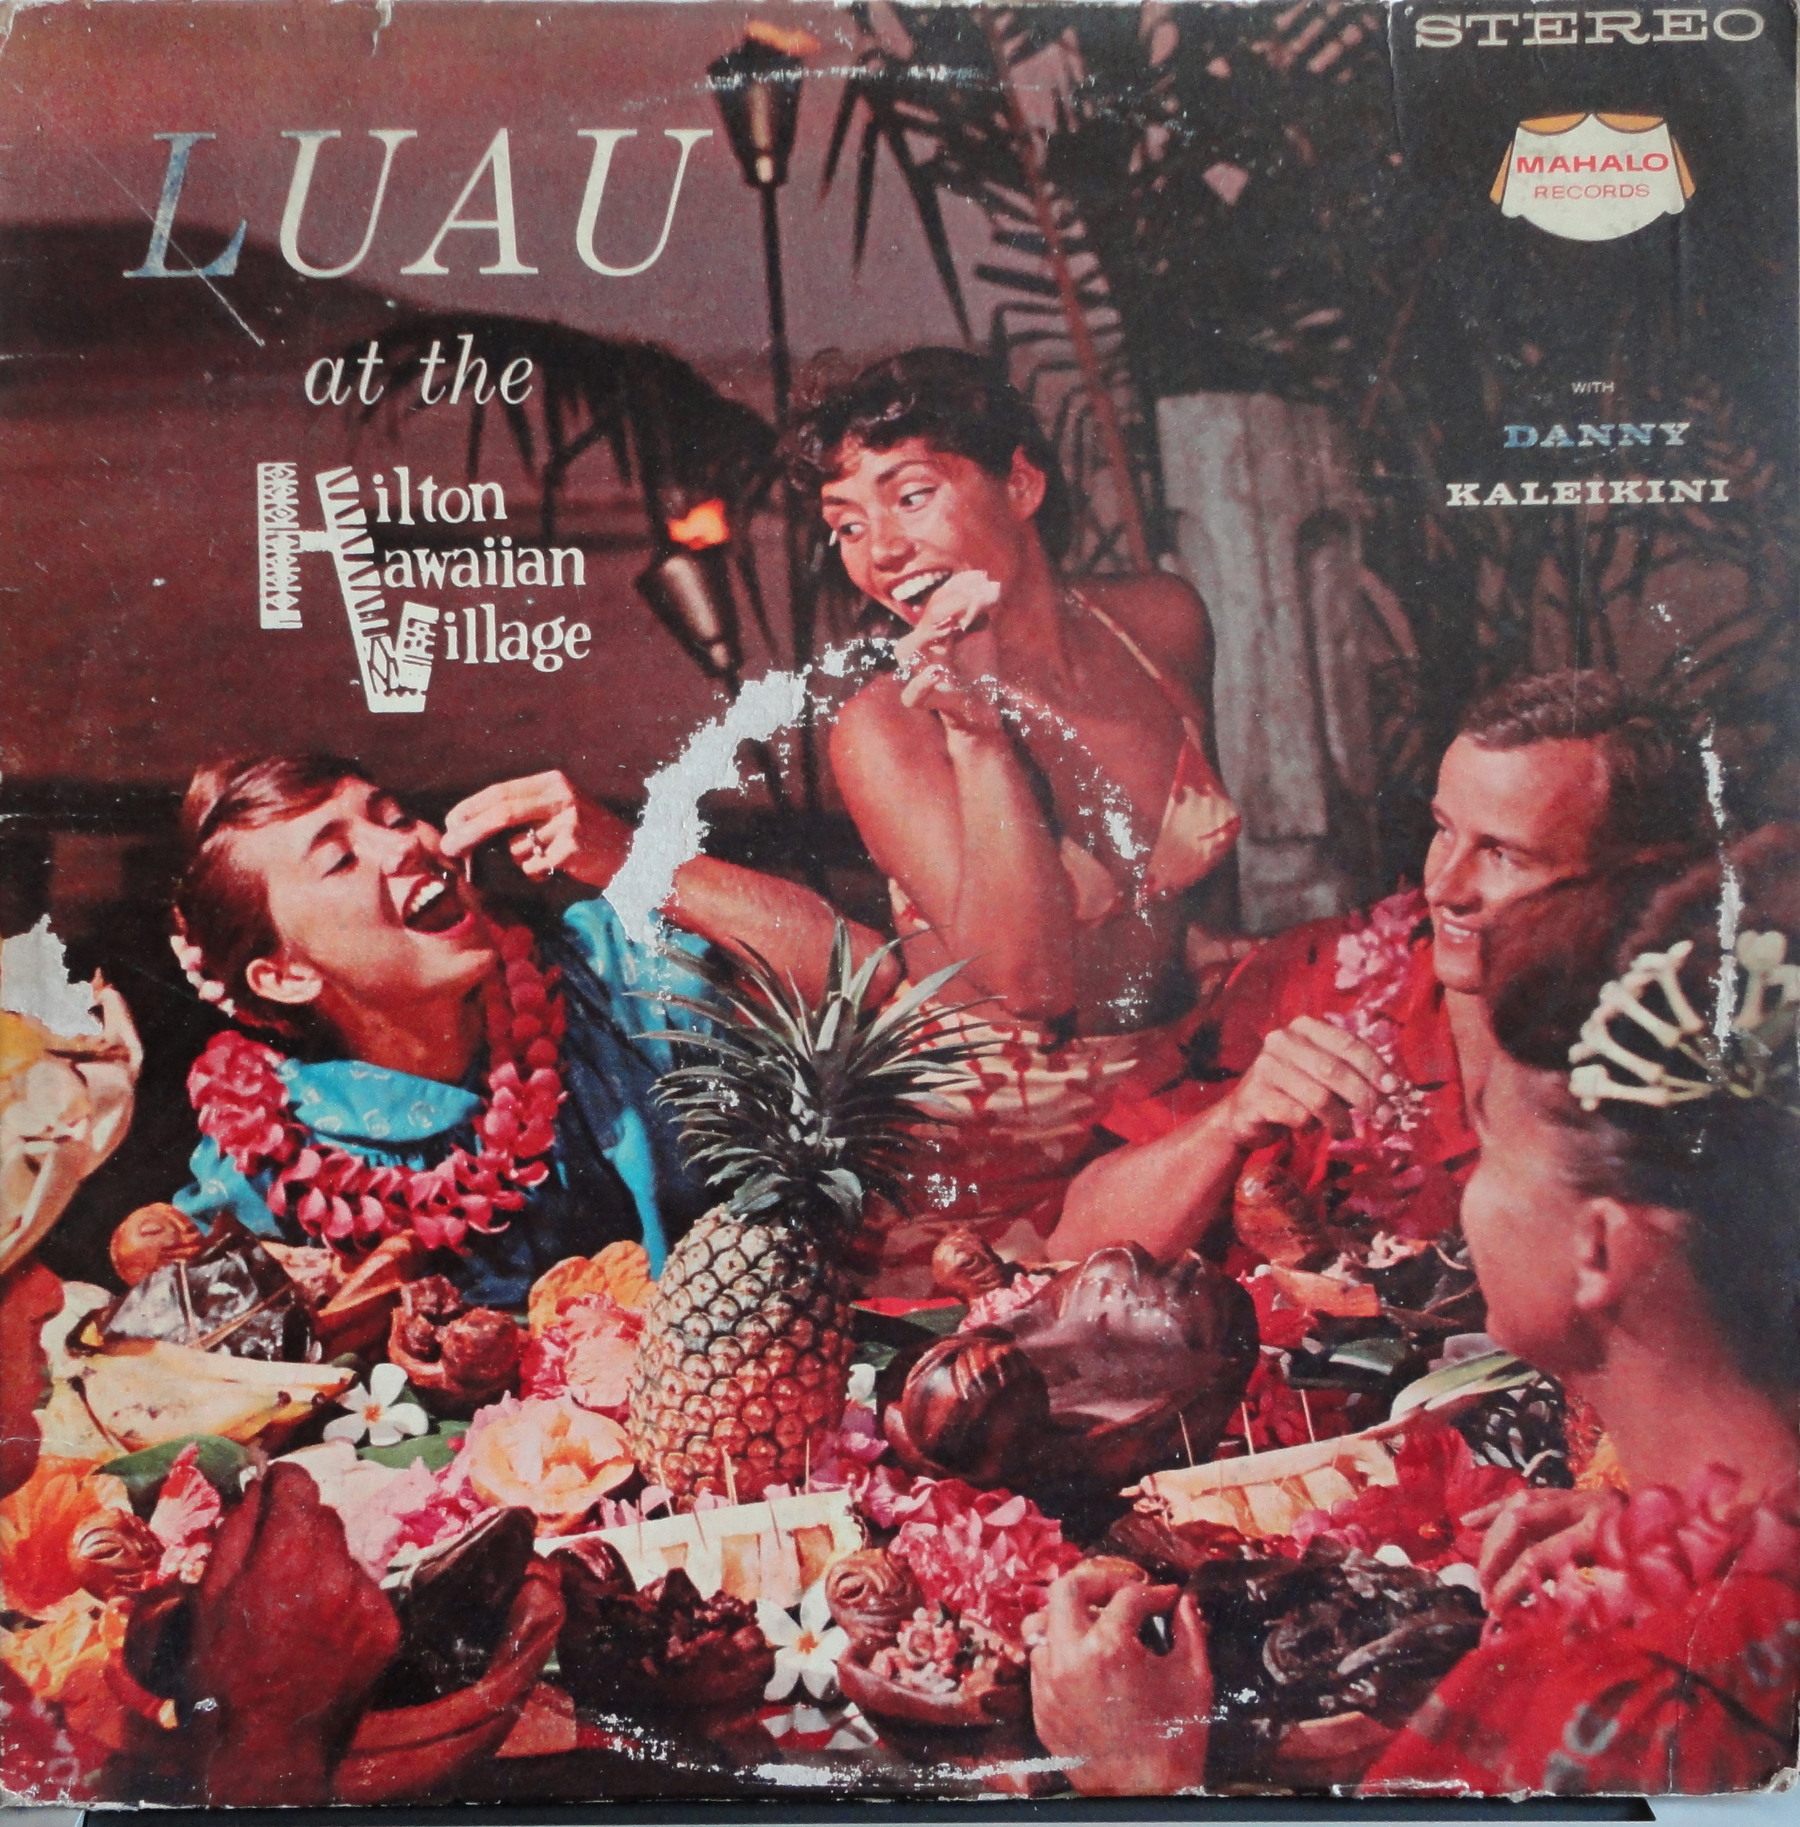
souvenirs of your Hawaiian holiday!
Hawaiʻi-based labels targeting the tourist market.

Slide 5
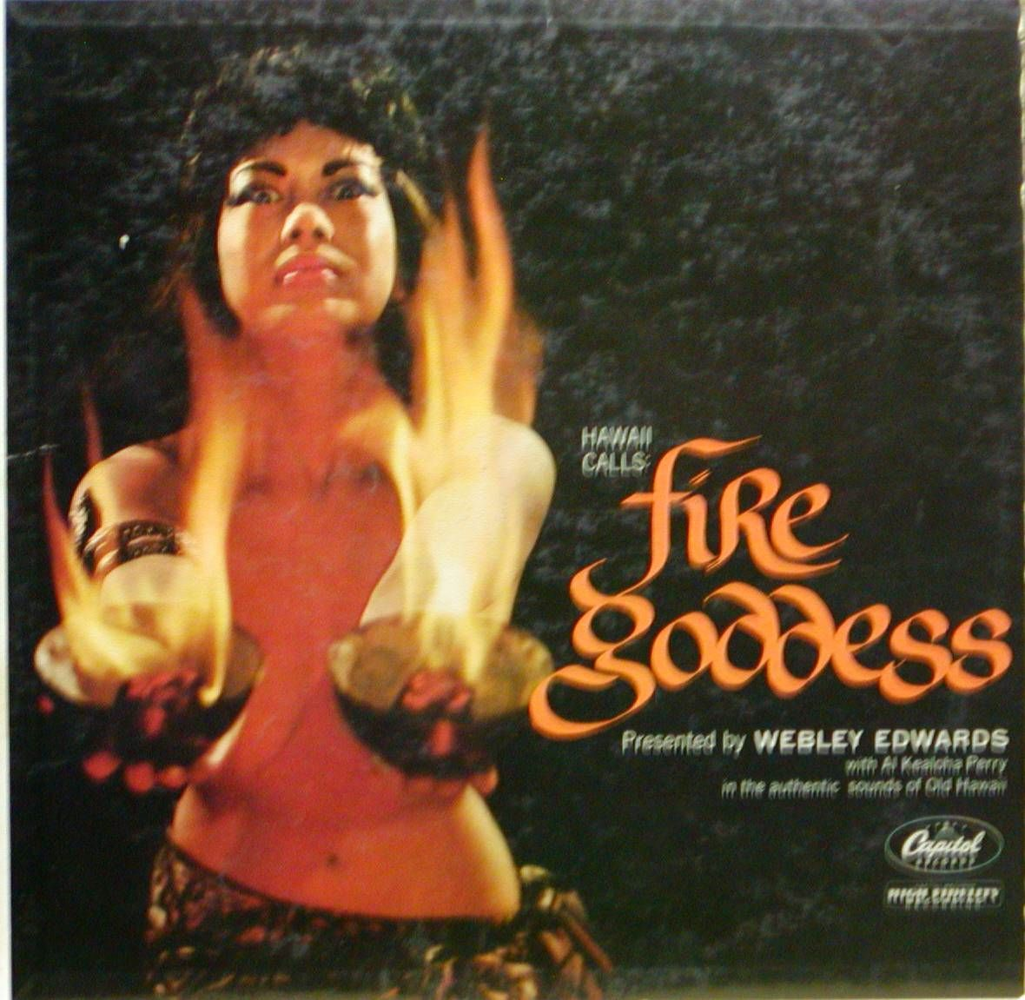
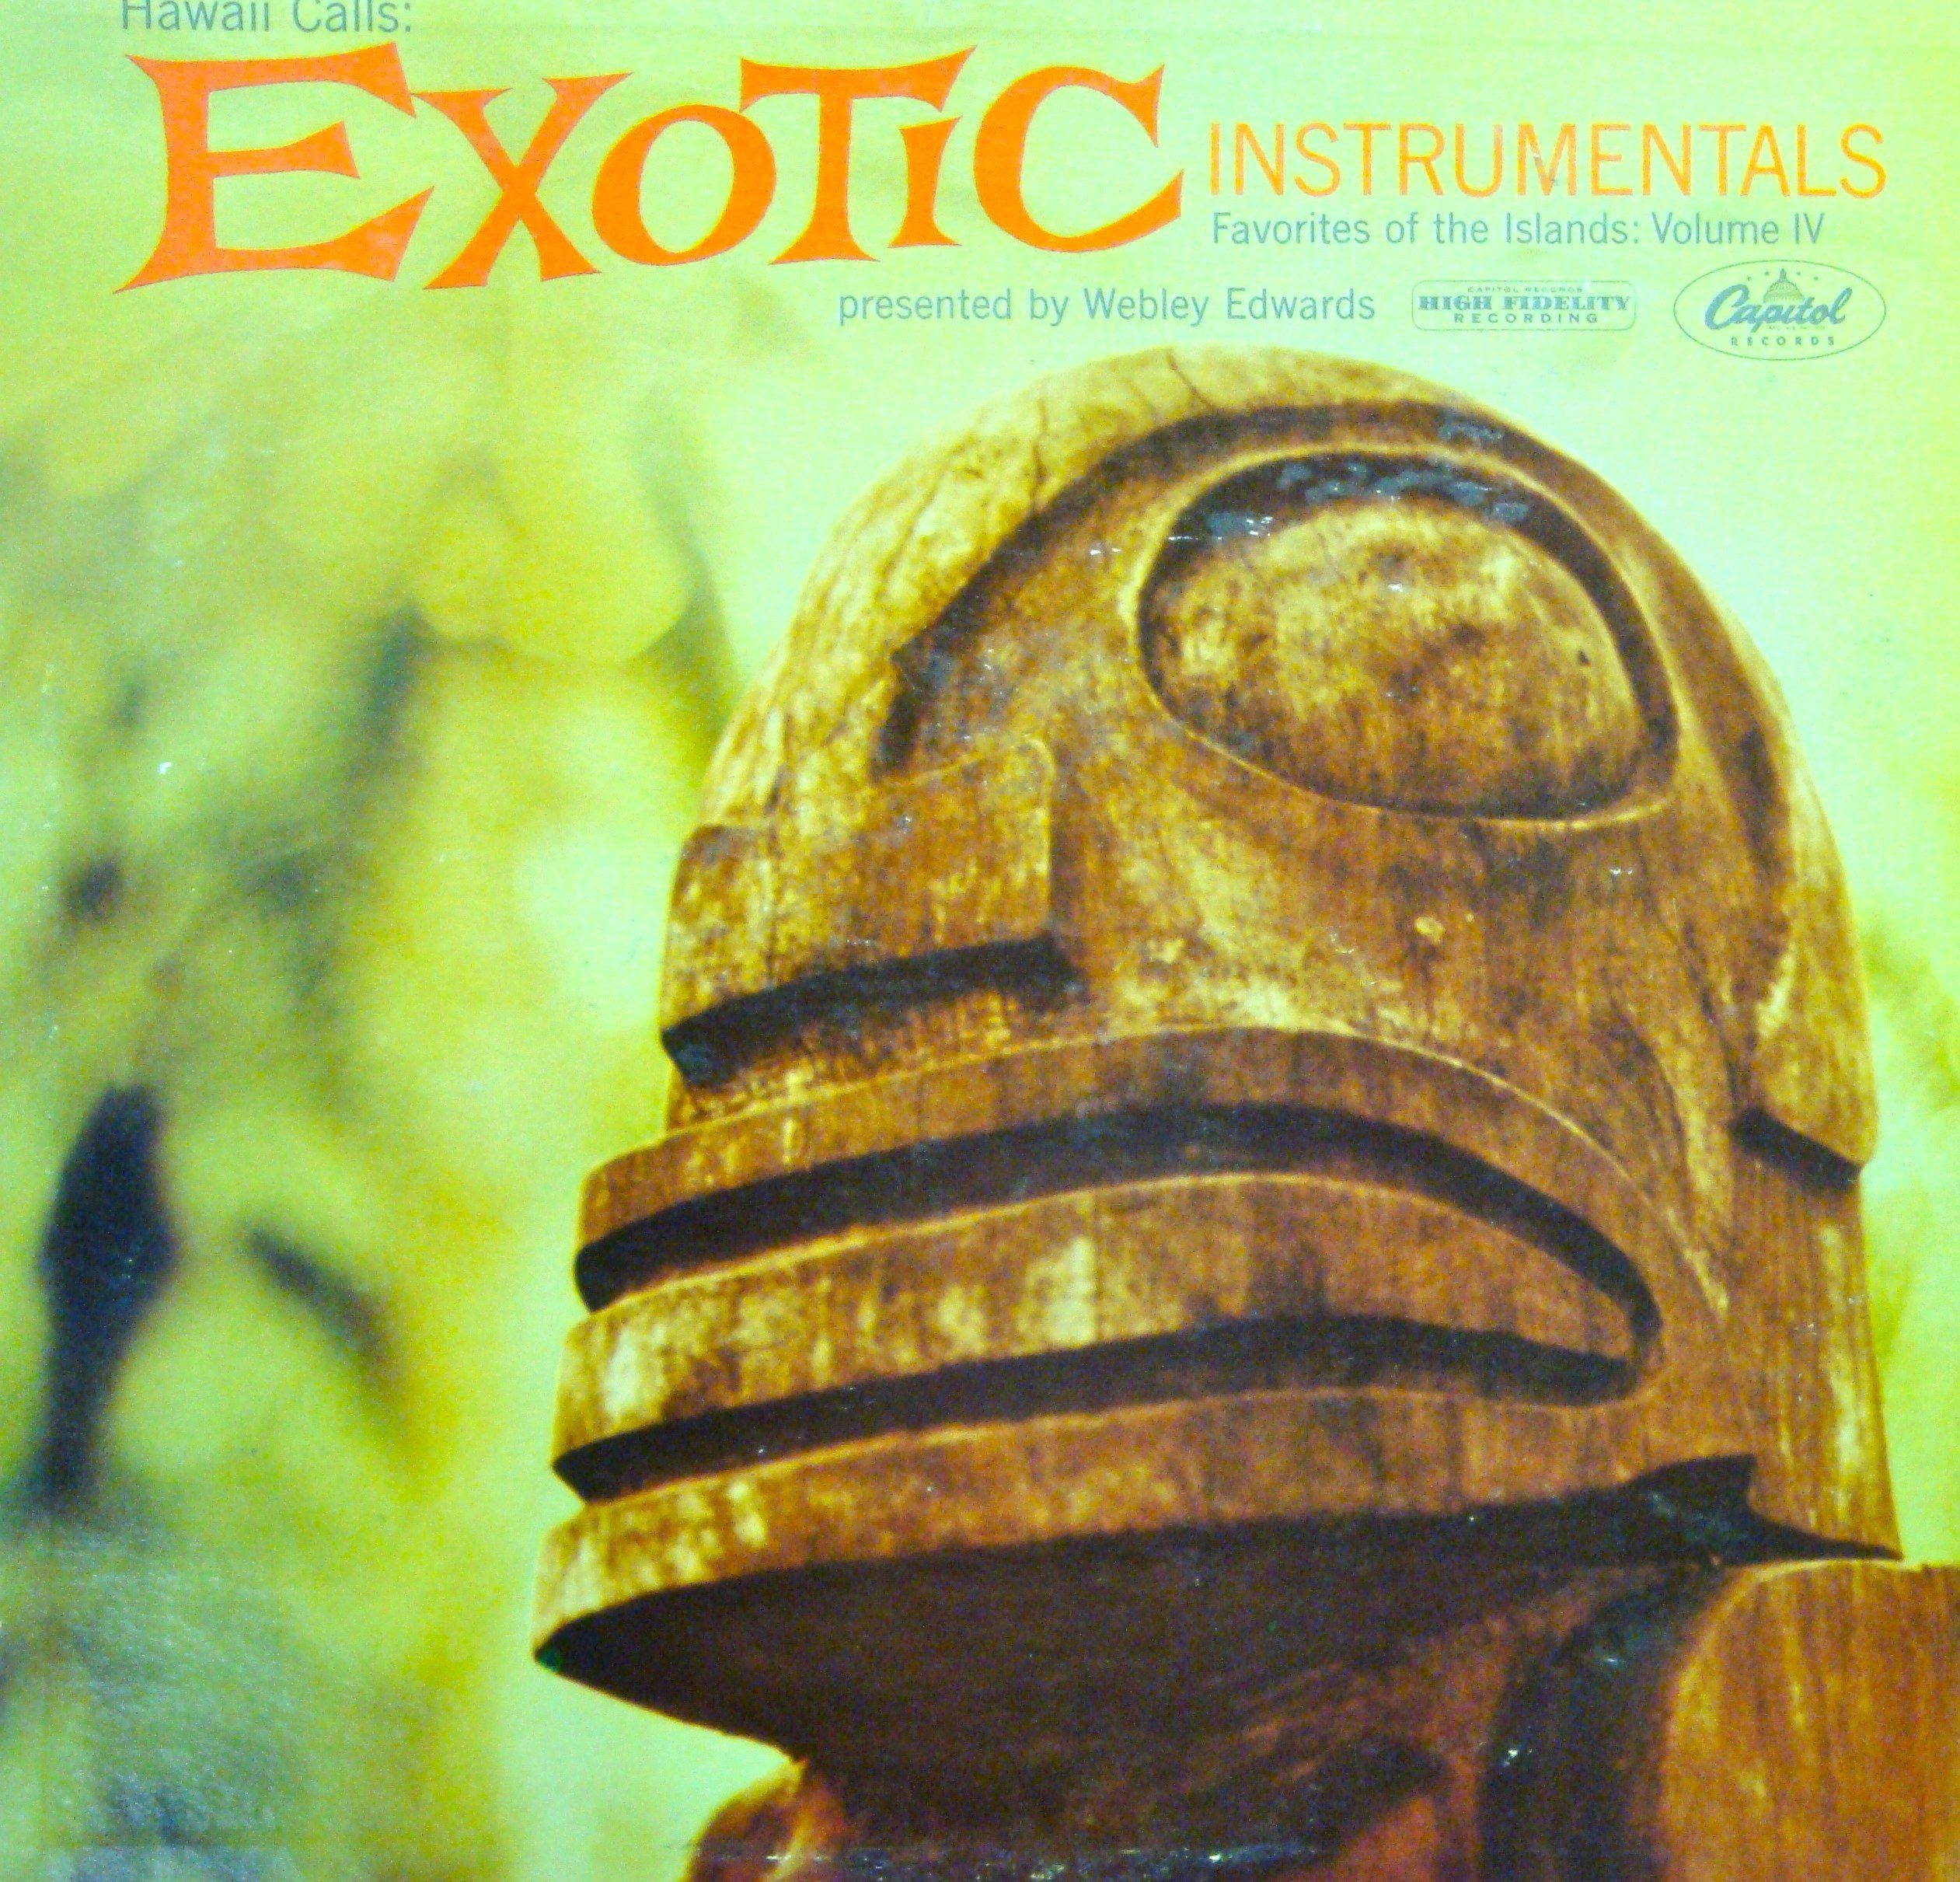
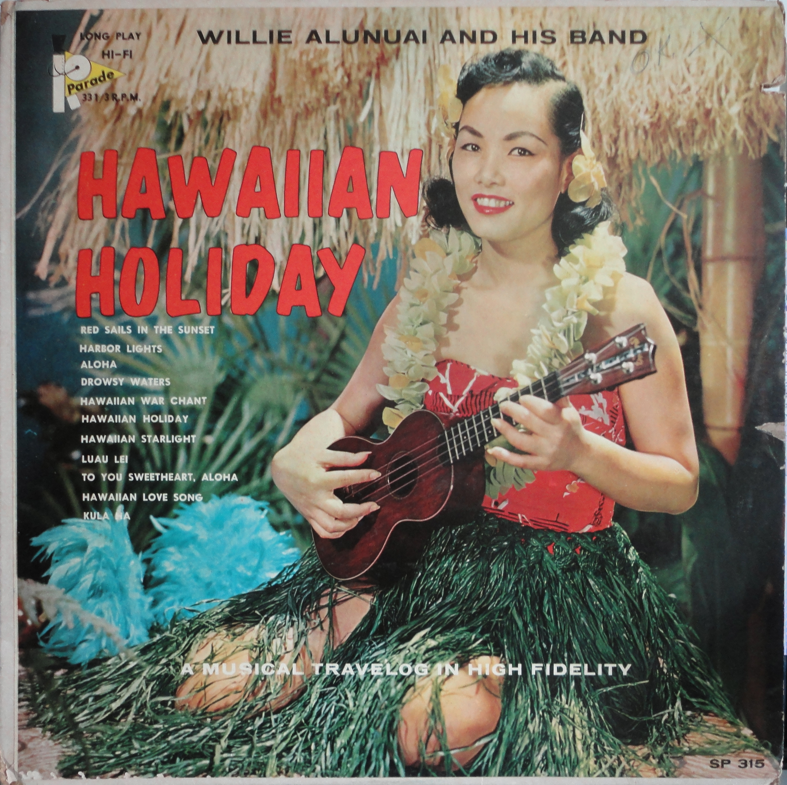
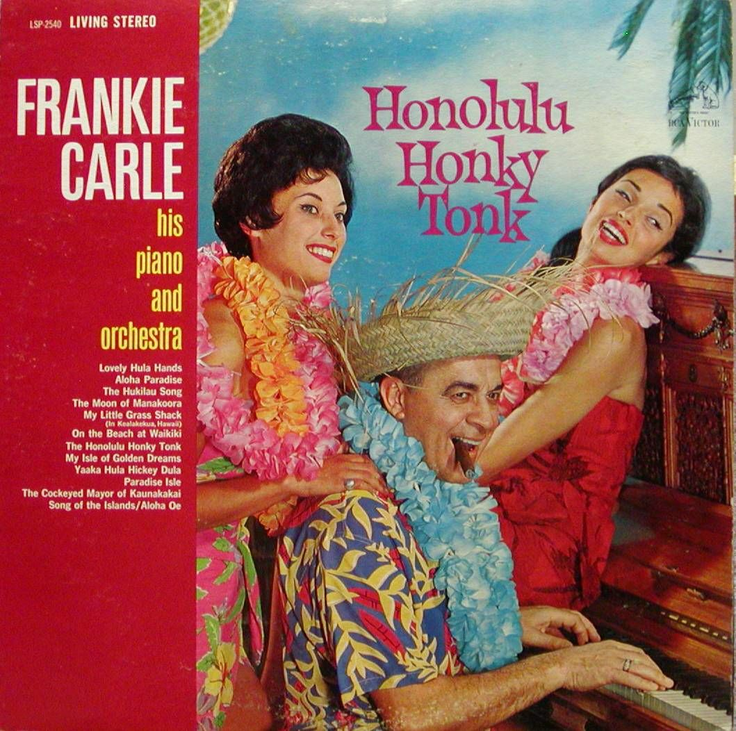
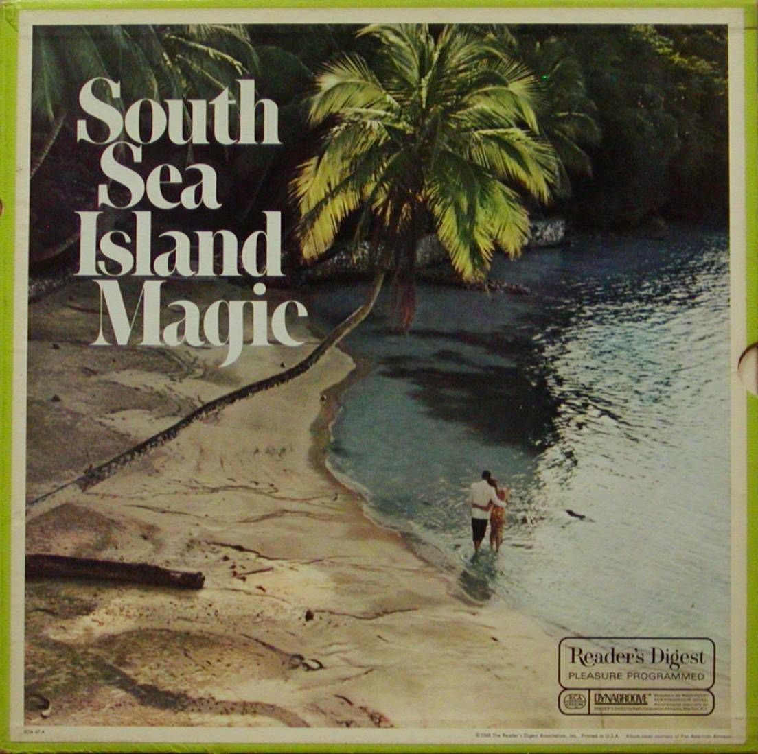
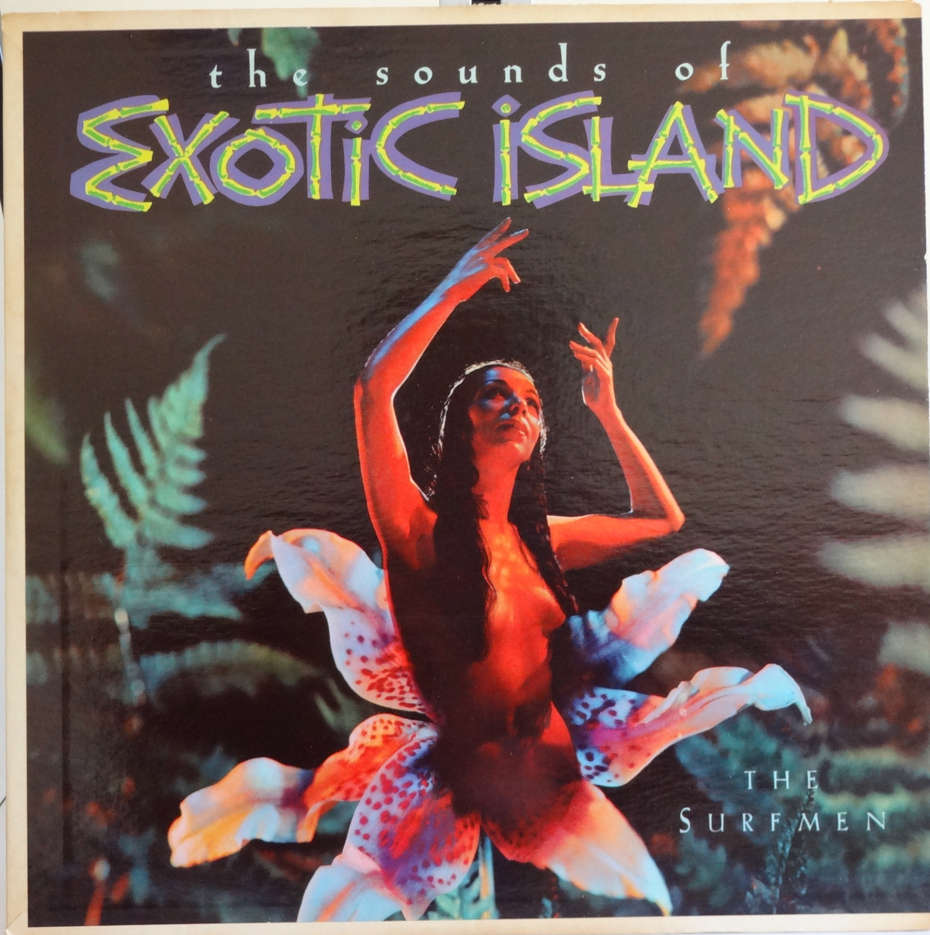
visual AND aural stereotypes and caricatures

Slide 6
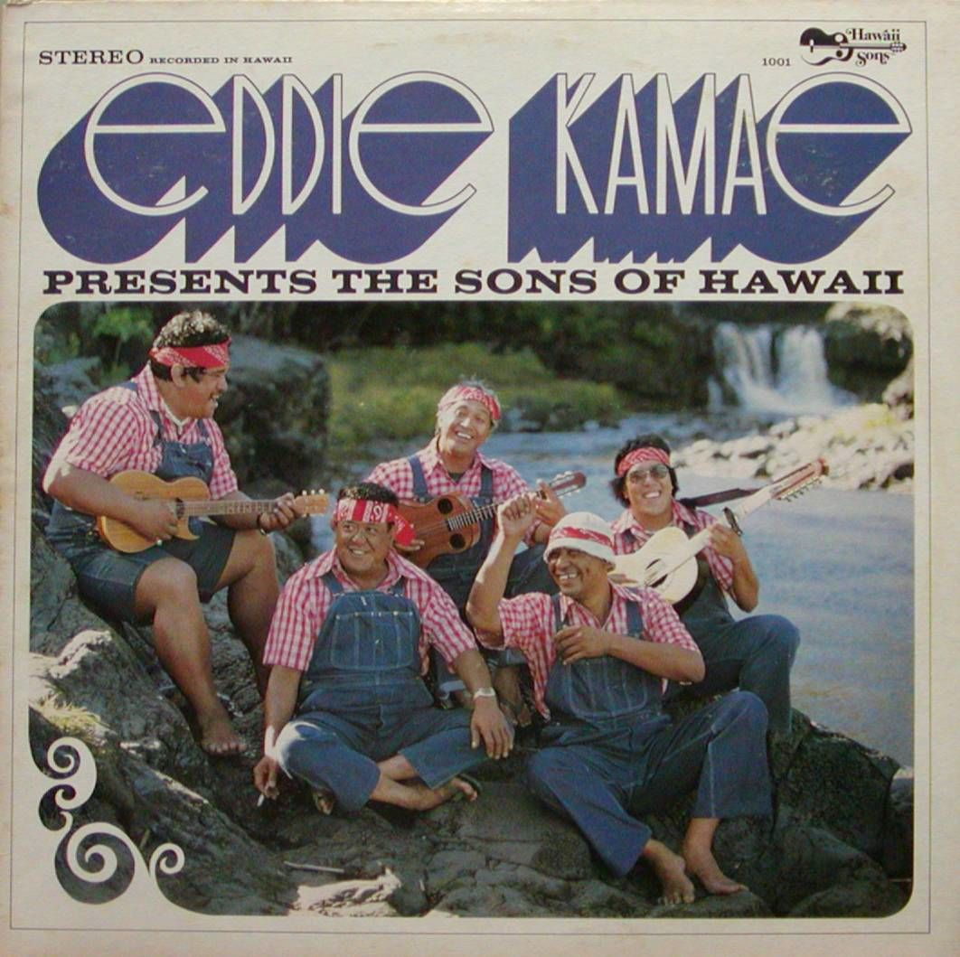
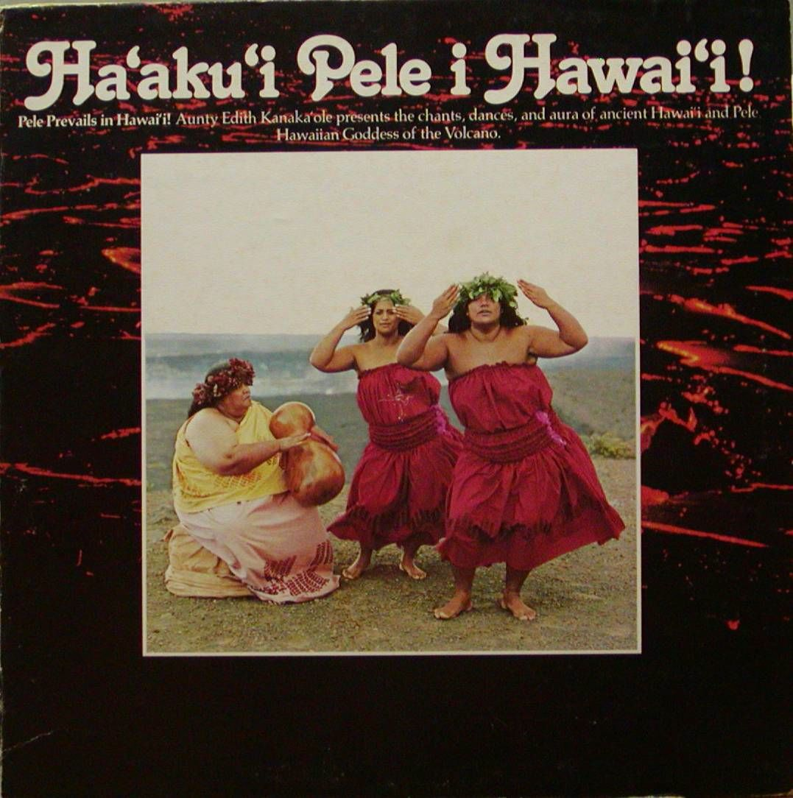
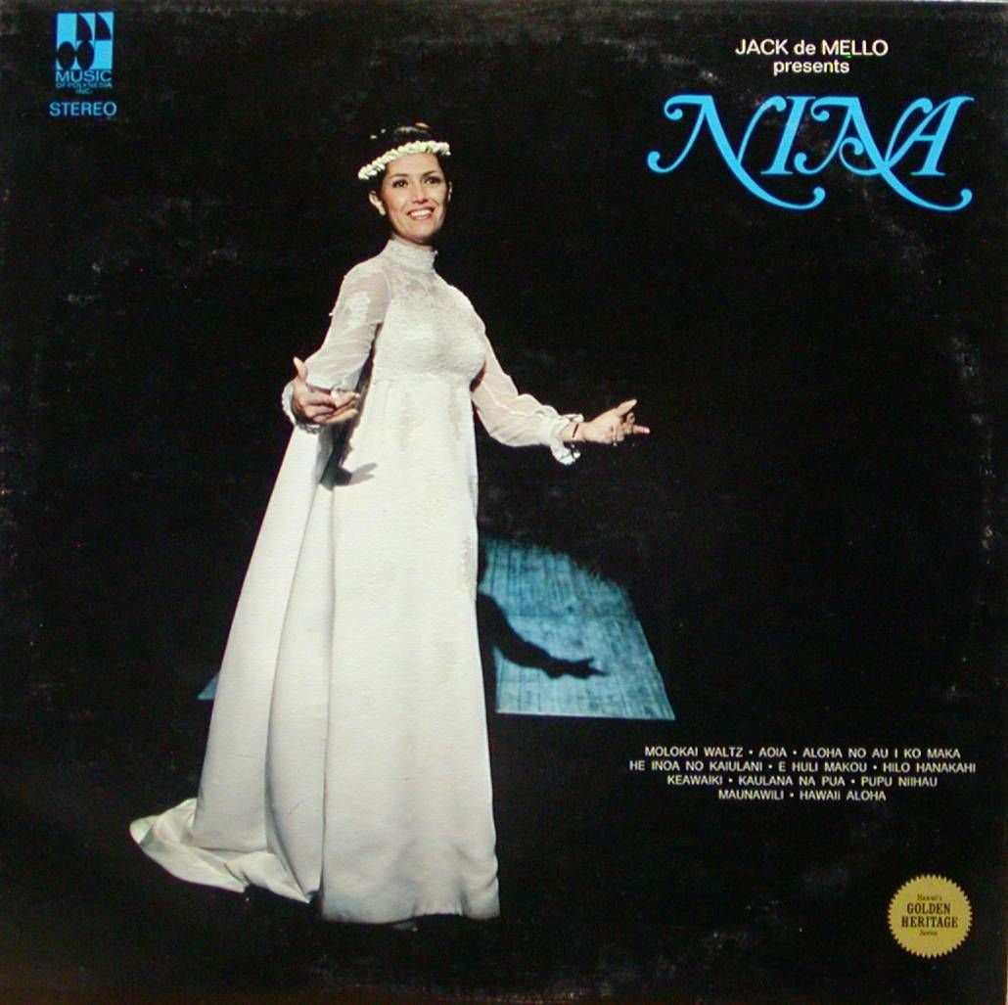
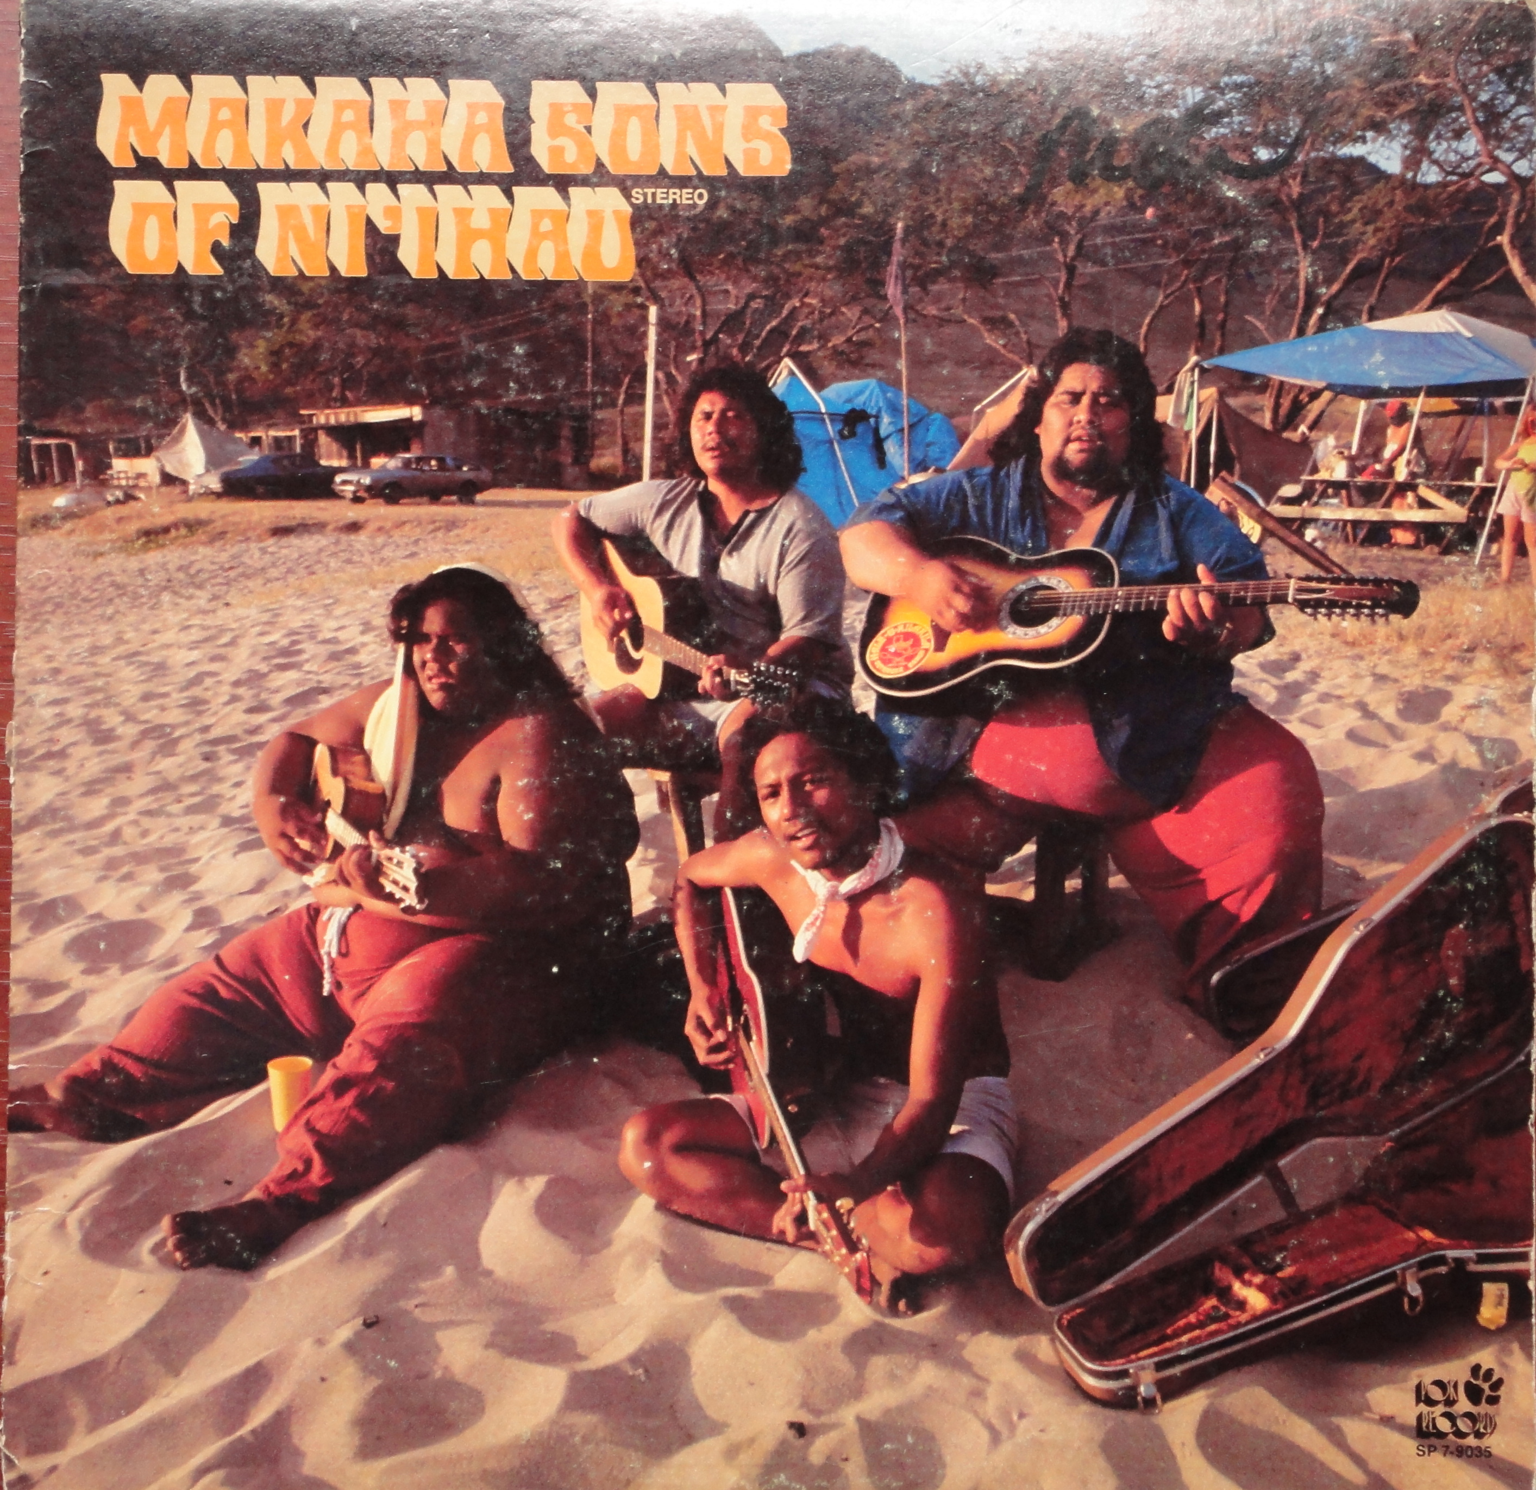
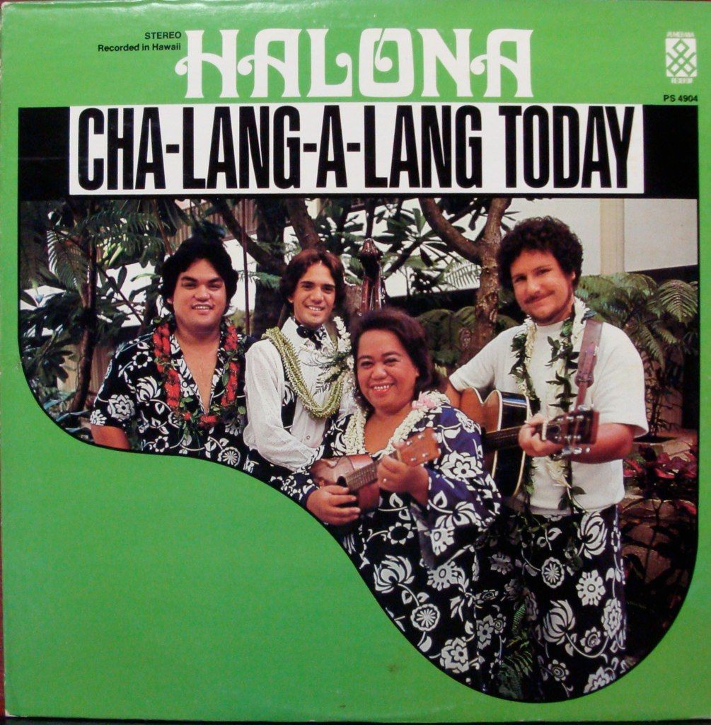
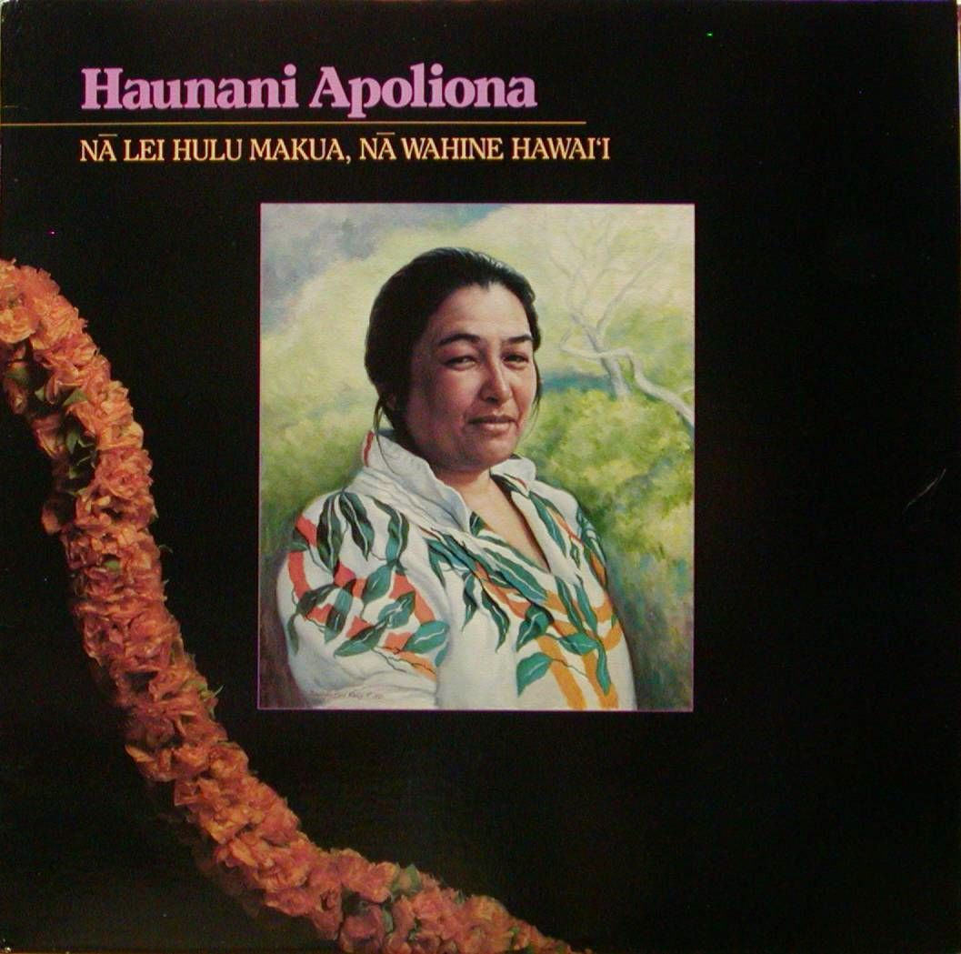

Slide 7
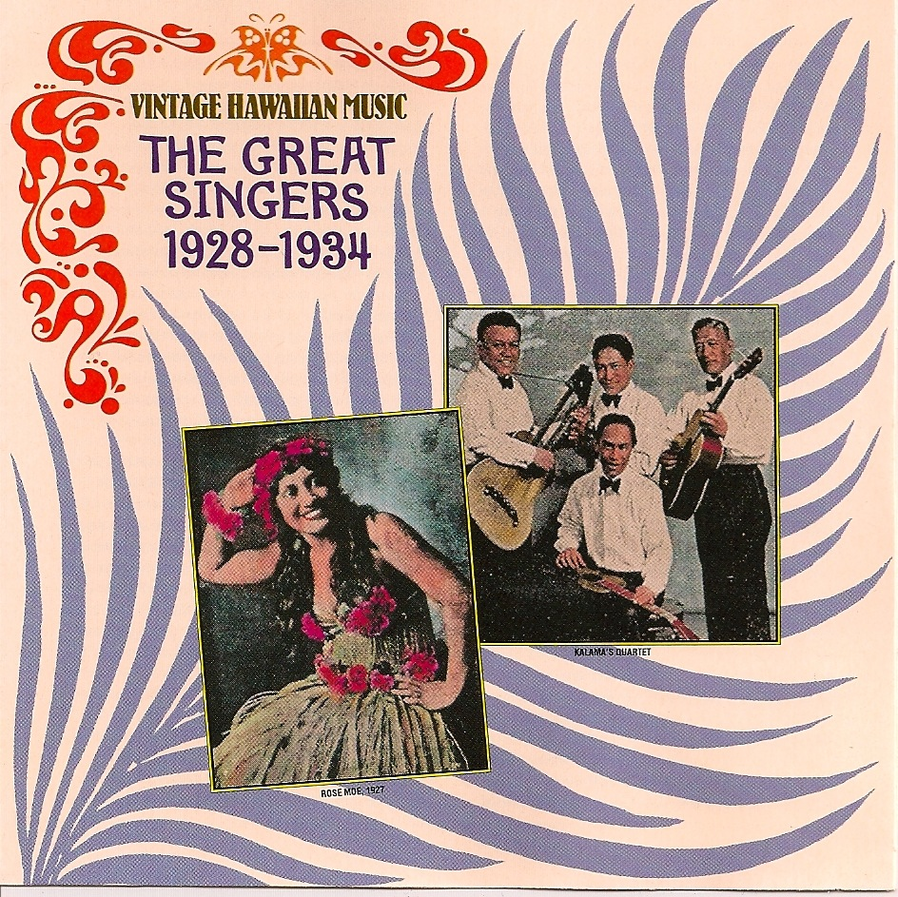
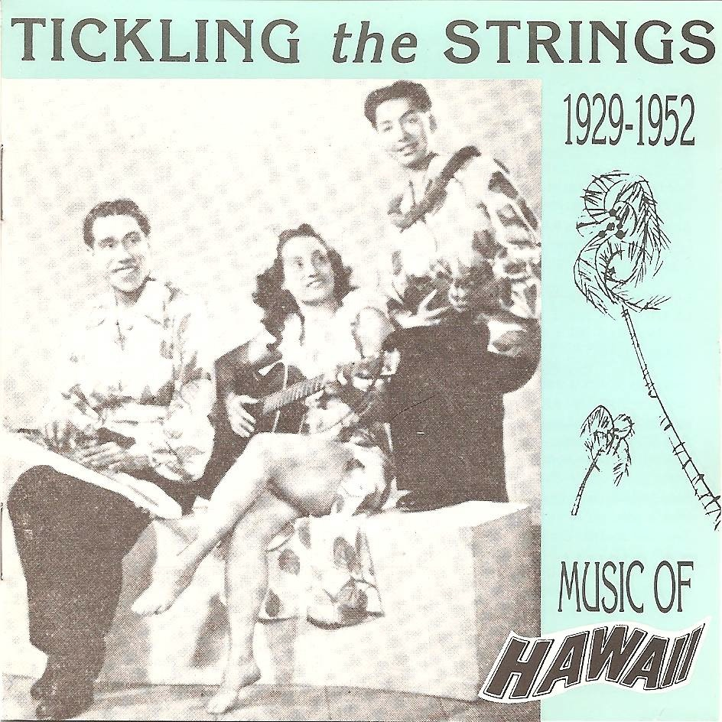
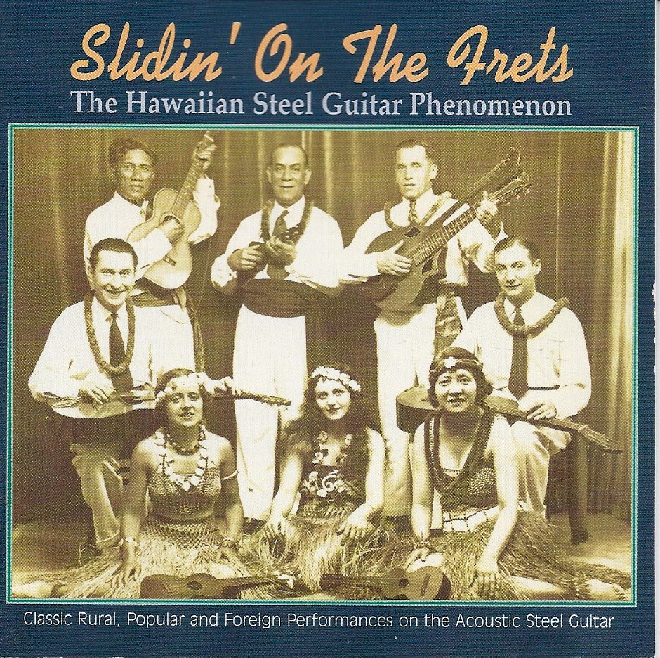
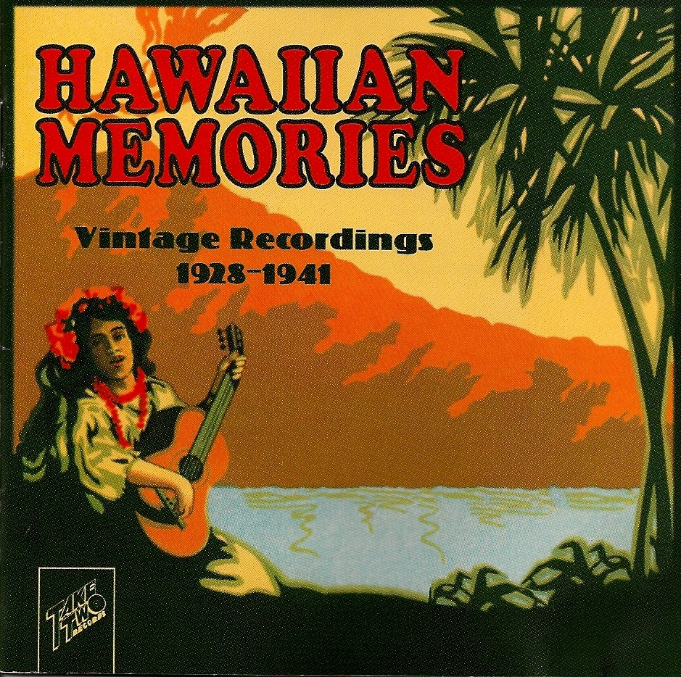
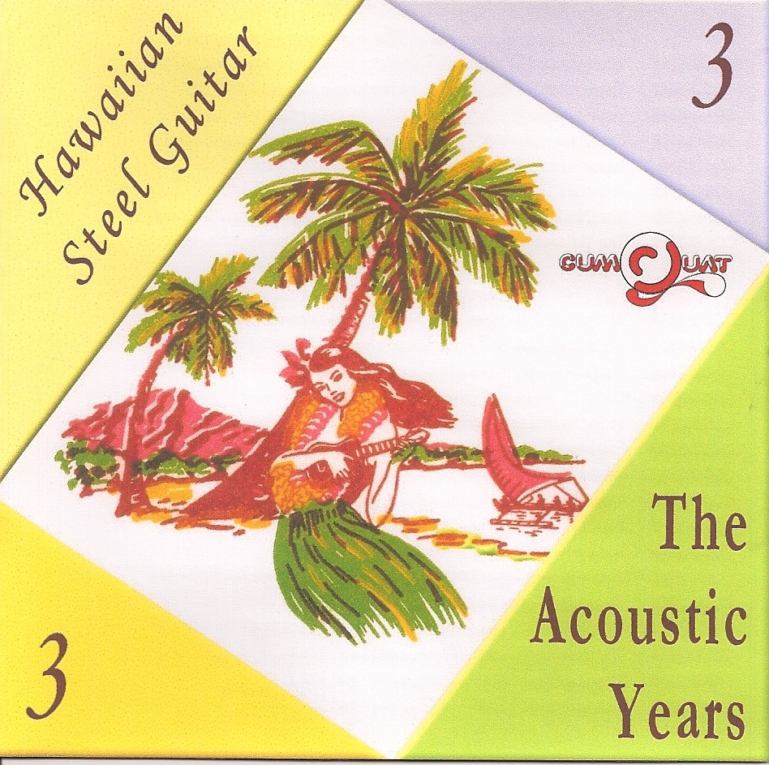
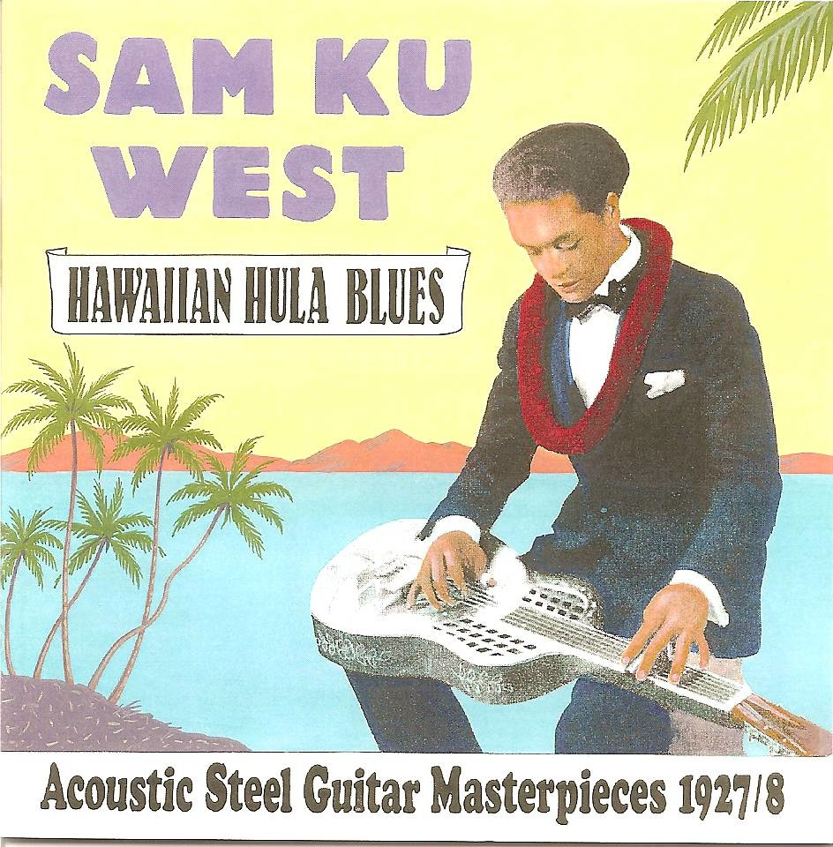
vintage reissues

Slide 9
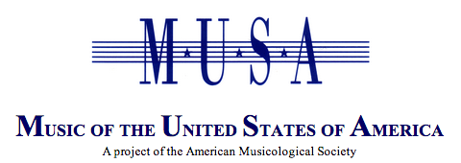
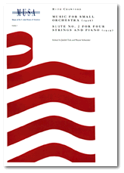
Hawaiian Songs Ancient & Modern
A Critical Edition of Hawaiian Songs
Edited by Amy Ku’uleialoha Stillman

Slide 10
This table appears in “Textualizing Hawaiian Music,” American Music 23 (2005), 77.

Slide 11
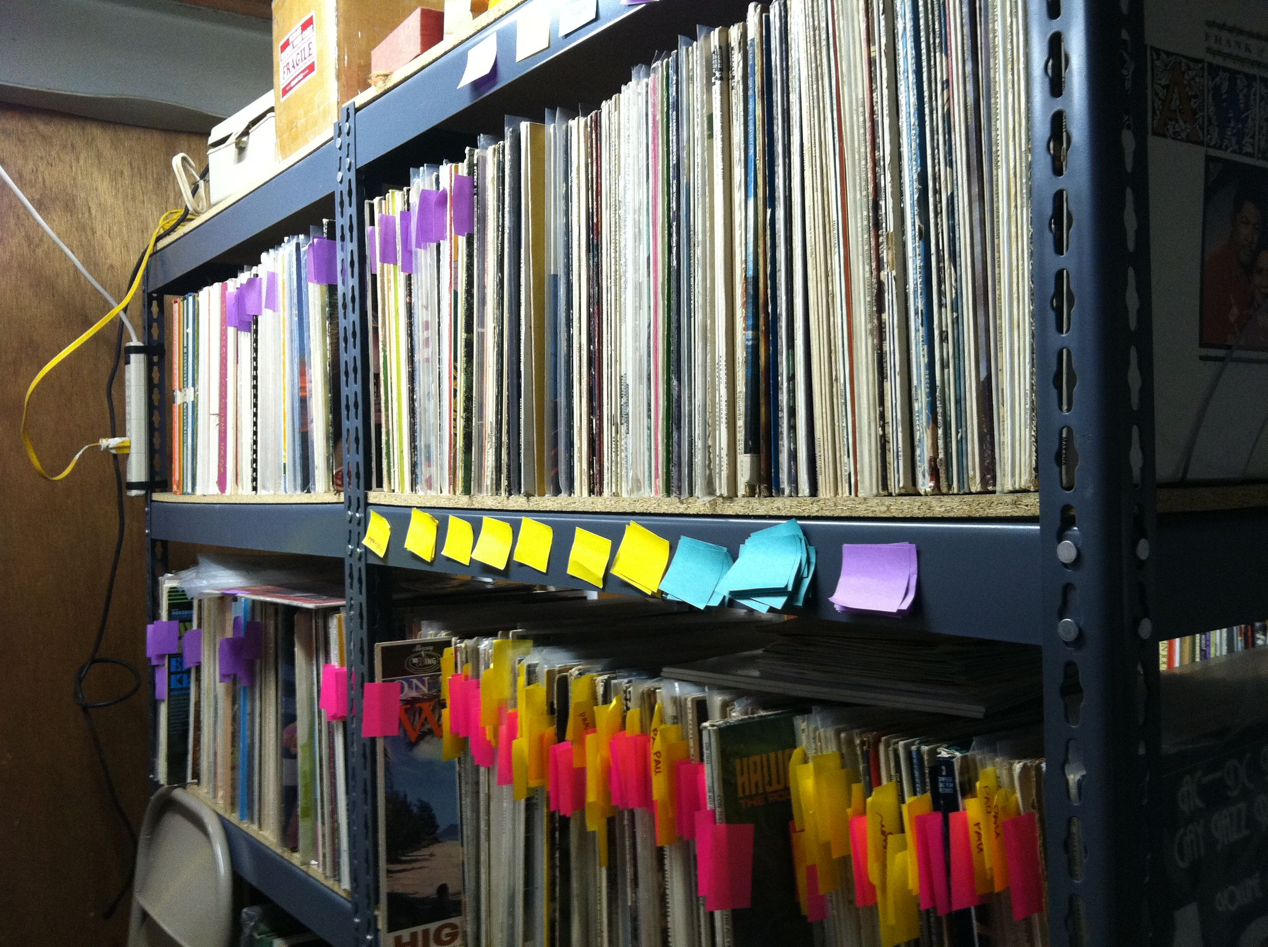
my record collection in my basement

Slide 12
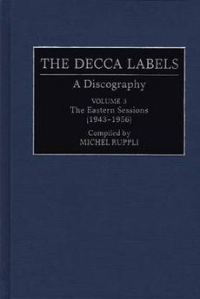
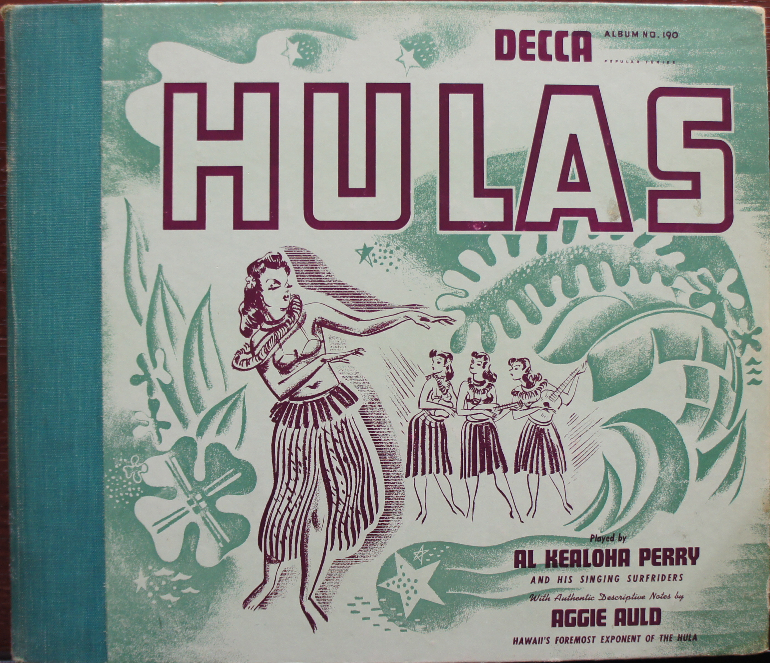
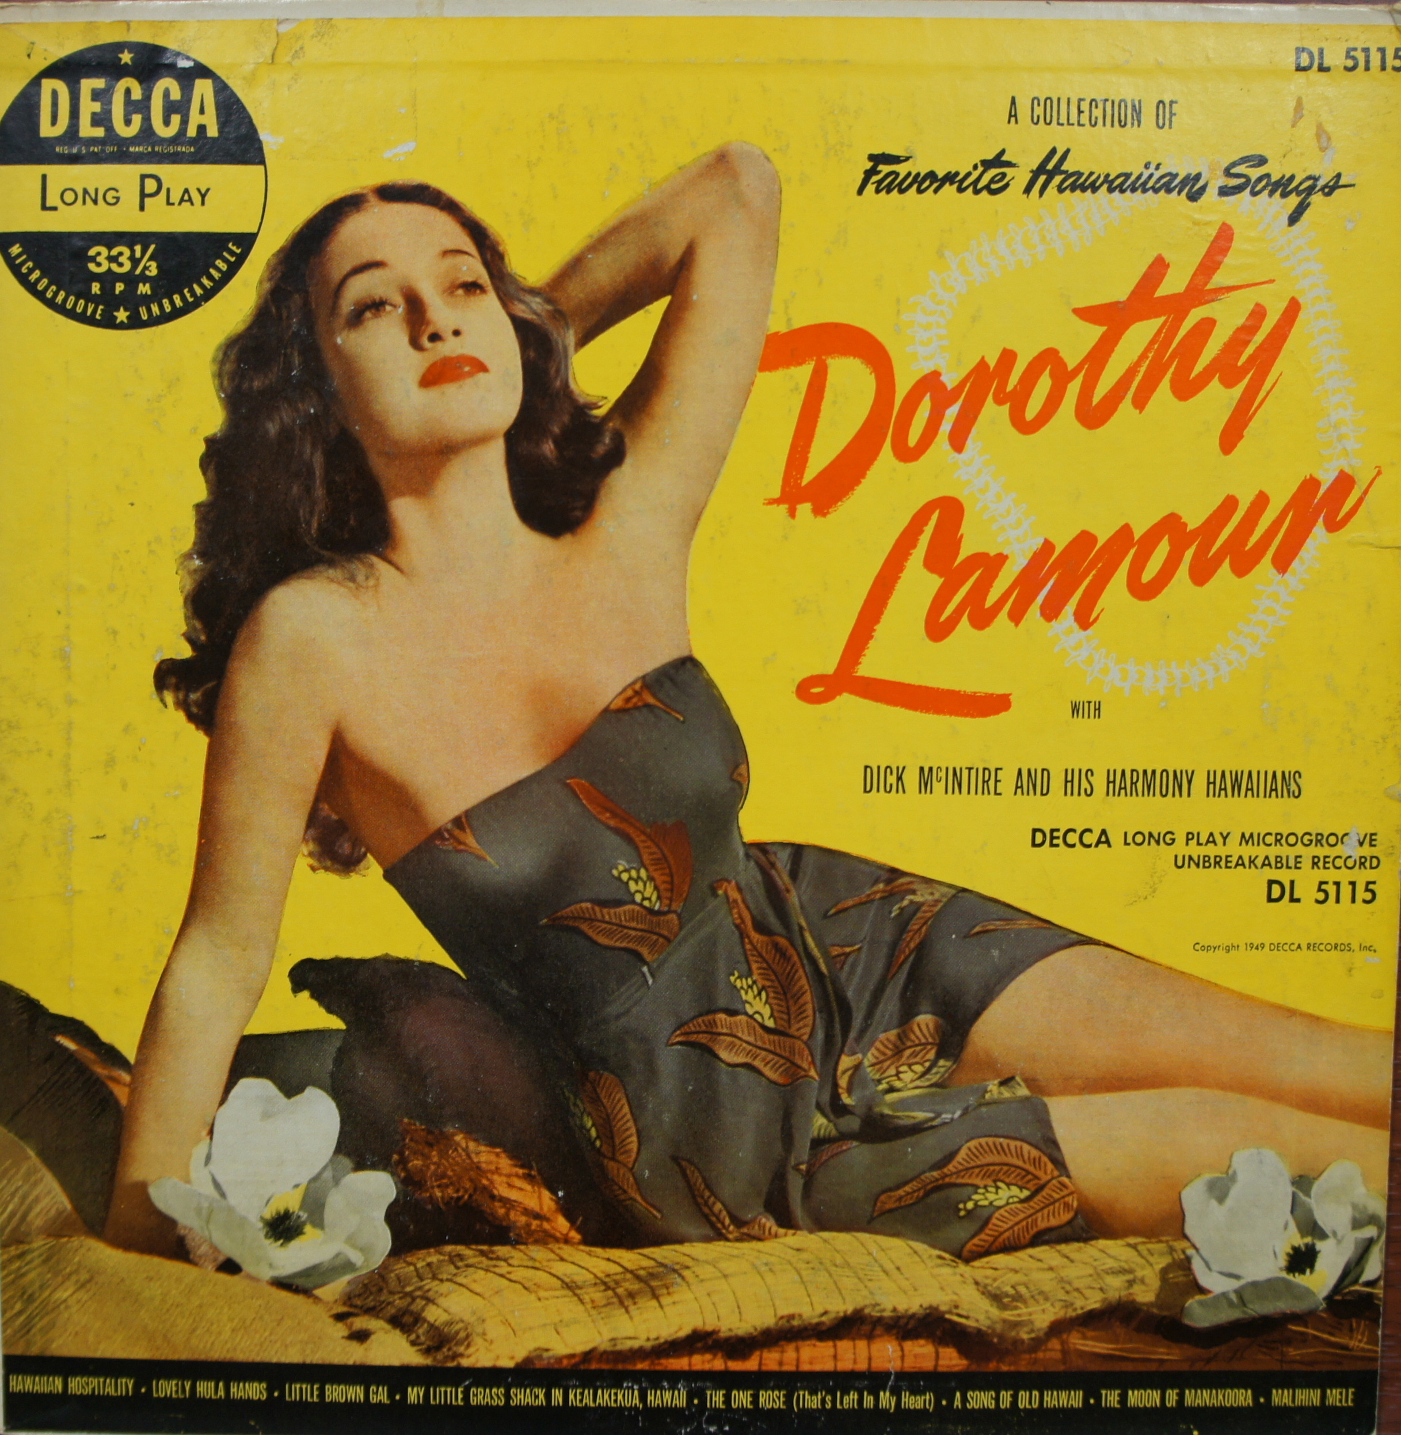

Slide 13


Slide 14
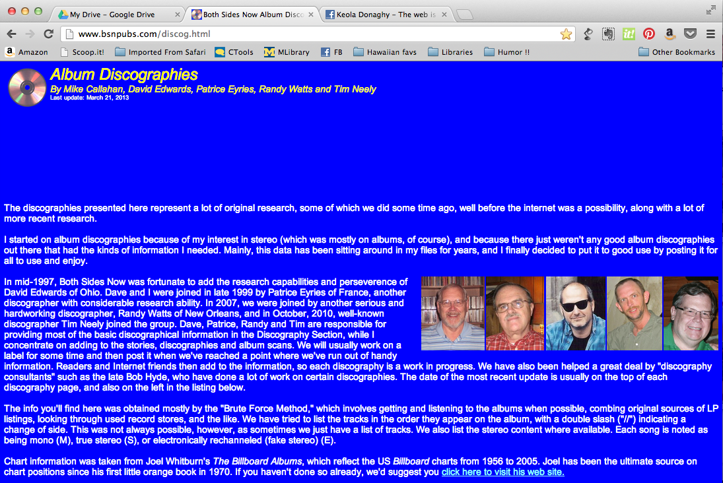

Slide 15
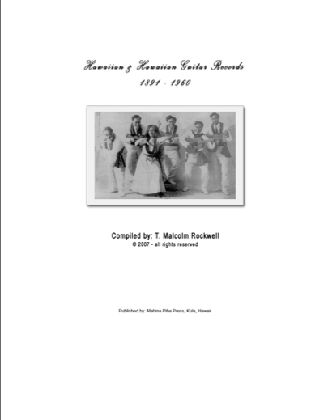

Slide 16
“Kāua i ka Huahua’i / Hawaiian War Chant”

Slide 17
1934: Andy Iona and His Islanders. 78 rpm (Columbia 2962-D [US], Columbia 35524 [India], Air Chief Philharmonic FT 14 [US], Columbia DC 245 [UK], Columbia DW 4542 [Germany], Columbia J 2434 [Japan], Columbia M 167 [Japan], Regal Zonophone MR 1711 [UK], Regal Zonophone G 2227 [Australia]); 7” LP (Columbia 1-505 [US]). Reissued on Na Moolelo o Mele Hawaii (Omagatoki SC-2126, p1992 [Japan], Tickling the Strings 1929-1952 (Harlequin HQ CD 28, p1993 [UK]), South Sea Island Magic (Rice HSR-517, p1999 [Japan]), Hawaiian Memories: Vintage Recordings 1928-1941 (Take Two TT506CD, p2001 [US]), Jazz Goes Hawaiian (Retrieval Recordings RTR79837, p2003 [Netherlands]), War Chants Galore (Cumquat CQCD 2775, p2005 [Australia]), Hawaiian Treasures (Golden Stars GSS 5418, p2006 [Portugal]); With My Little Ukulele In Hands (Proper PROPERBOX 140 / P1657, p2007 [UK]), Hawaiian (Amuse Media MA-500, n.d. [Korea])

Slide 18
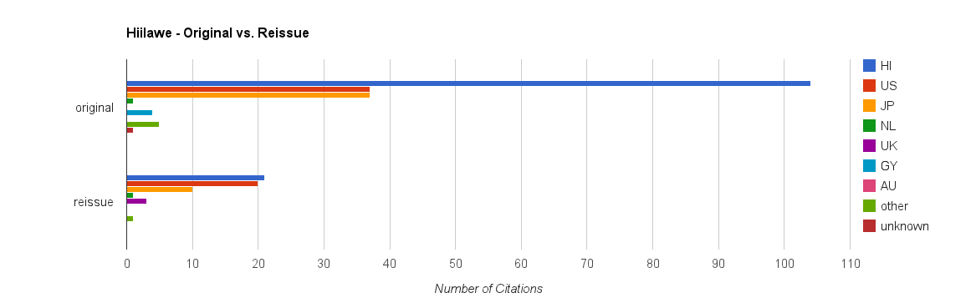
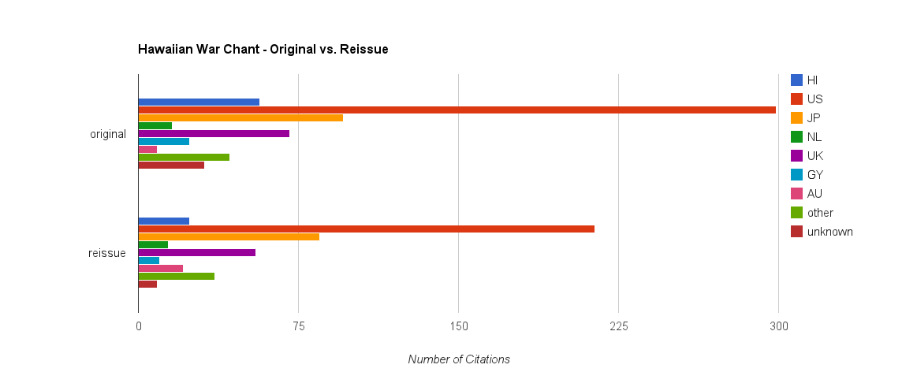
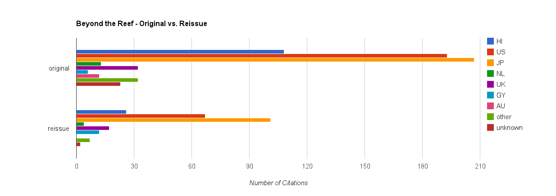

Slide 20
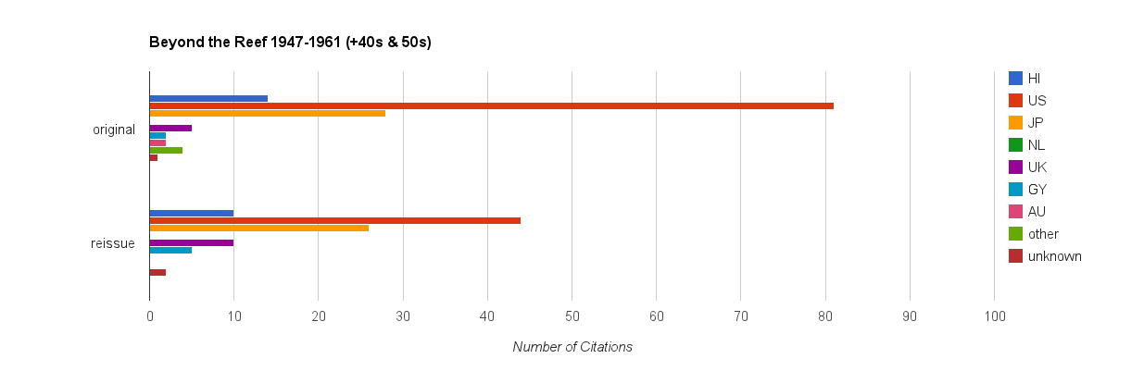

Slide 21
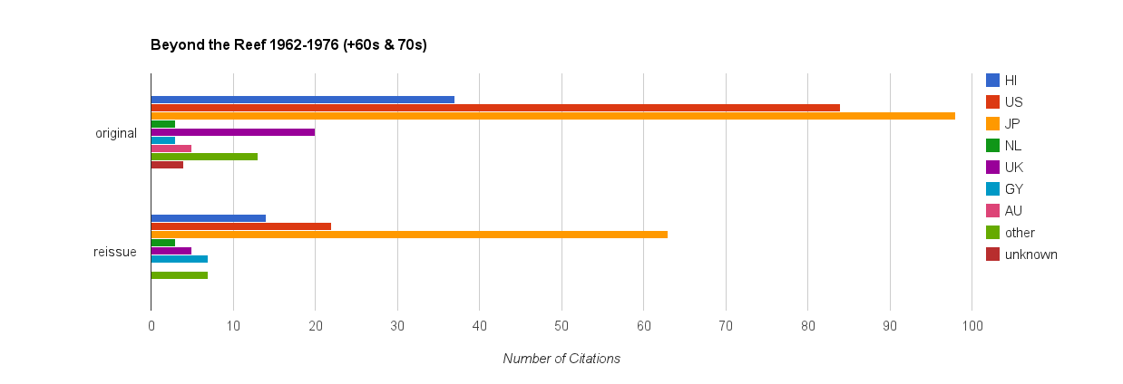

Slide 22
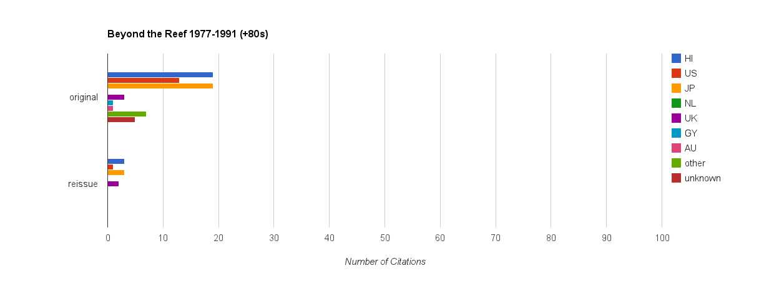

Slide 23
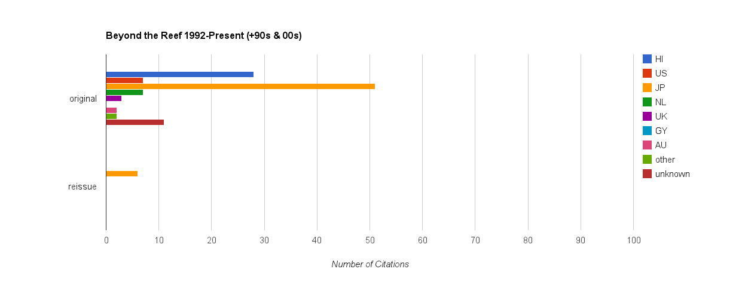

Slide 24

above: a Hawaiian-language hīmeni
below: a Hawaiian-language hula ku’i song

Slide 26


1947-1961 ⬆
⬇ 1962-1976

Slide 27


1977-1991 ⬆
⬇ 1992-present

Slide 28

















Crown CLP-5080 / CST-125, p1958
labels involved:
Modern
Pirouette, Spinorama
Premier, Coronet
Diplomat, Parade
Design, Bravo
Broadway, Omega
Continental
Manhattan
Palace
Power
Silver Seal

Slide 29


Pirouette Records FM-12
Spinorama Records S-12
Johnny Alunuai and his Orchestra

Slide 30

Diplomat Records D-2201
Pirouette Records FM-12
Promenade Records 2201
Terry McKee and his Band

Slide 31
Leni Okehu &
His Surfboarders
Bravo K-105
Harry Kaapuni &
his Royal Polynesians
Coronet CX-43
The Waikiki Surfriders
Design DLP-243

Slide 33
tracking the individual song
crosses national borders
crosses music industry sectors
crosscuts conventional discography rubrics

Slide 34
verifying individual song tracks
requires listening to the tracks
requires access to the recordings

Slide 35




The 49th State Hawaii Record Co.

Slide 36








HanaOla Records / Cord International reissues of 49th State tracks

Slide 37


49th State Hawaii Record Co.
Format | # of issues
10” 78rpm singles; 1 track per side | 268 tracks (HRC-49 through HRC-308)
7” 45rpm singles; 1 track per side | 350 tracks (HRC-49 through HRC-390)

Slide 38


49th State Hawaii Record Co.
Format | # of issues
10” 78rpm LPs; 4 tracks per side | 28 Souvenir Songs of Hawaii Vols. 1-28 (Record Nos. 3301 - 3328); 112 tracks
7” 45rpm EPS; 4 tracks per side | 50 discs (EP-1 through EP-50) 200 tracks

Slide 39


49th State Hawaii Record Co.
Format | # of issues
12” LP | 29 LP-3401 through LP-3429; 348 tracks

Slide 40


Slide 41
49th State Hawaii Record Co.
Total tracks across 5 formats:
1278
Q: How many distinct tracks did the company issue over its lifetime?
A: That is a different number. Stay tuned.

Slide 43
Beyond the Reef:
Tracking the Global Circulation
of Hawaiian Music Recordings
Amy K. Stillman
ARSC 2013

