Slide 1
Minstrelsy on Record: 1890s to 1920s
Tim Brooks
ARSC Conference
May 2014

Slide 2
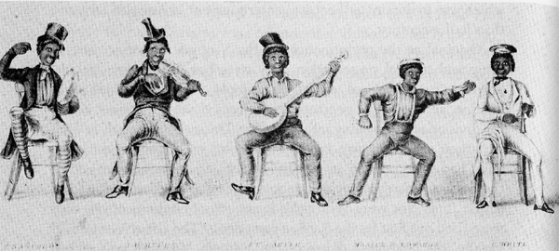
Origins of Minstrelsy 1843

Slide 3
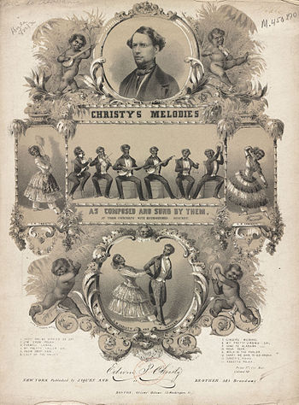
Christy Minstrels

Slide 4
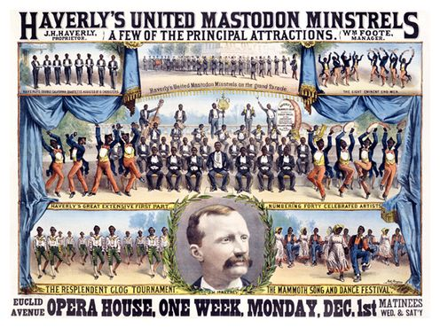

Slide 5
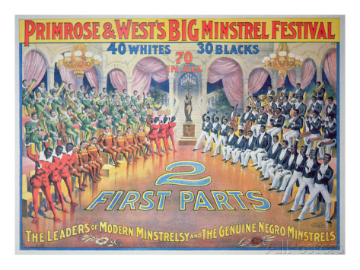
Black Minstrels
Notes:
-

Slide 6
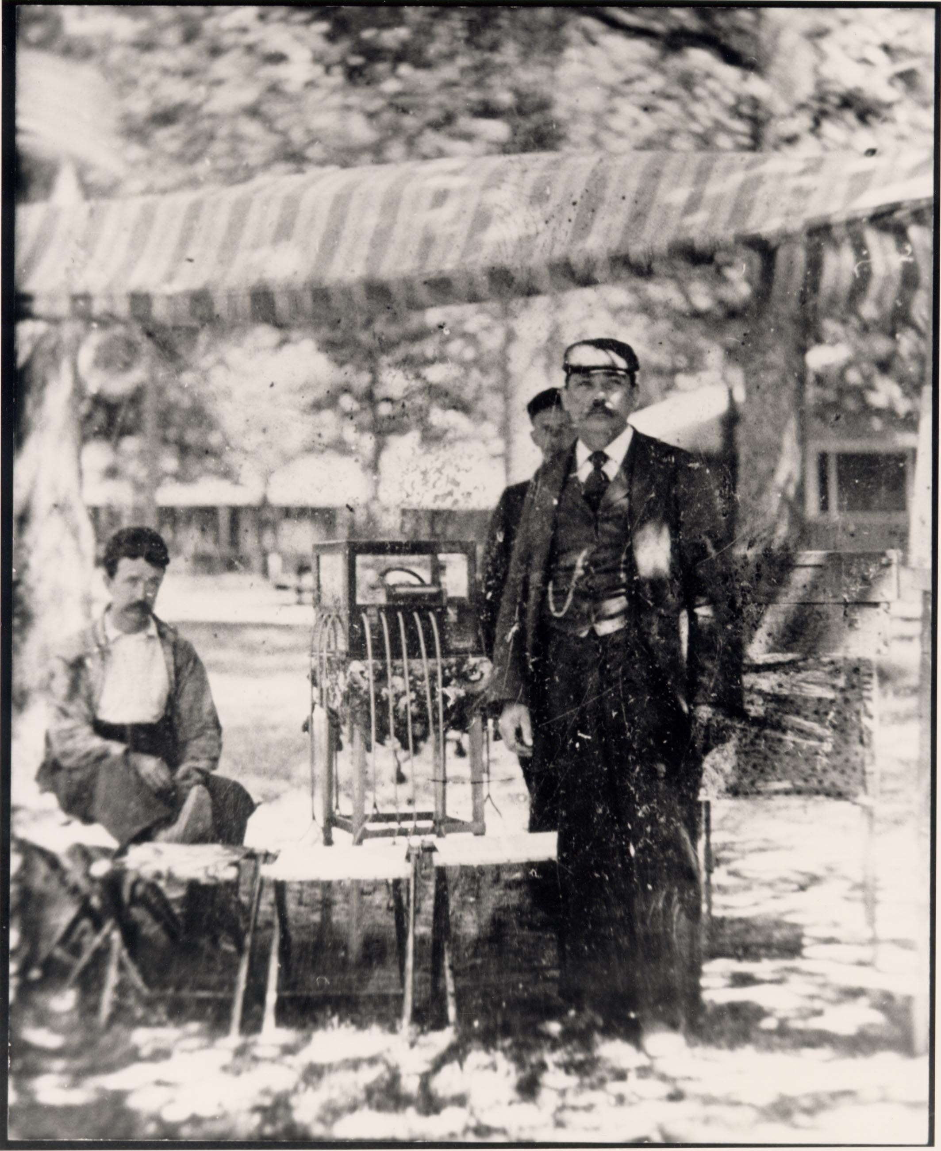

Slide 7
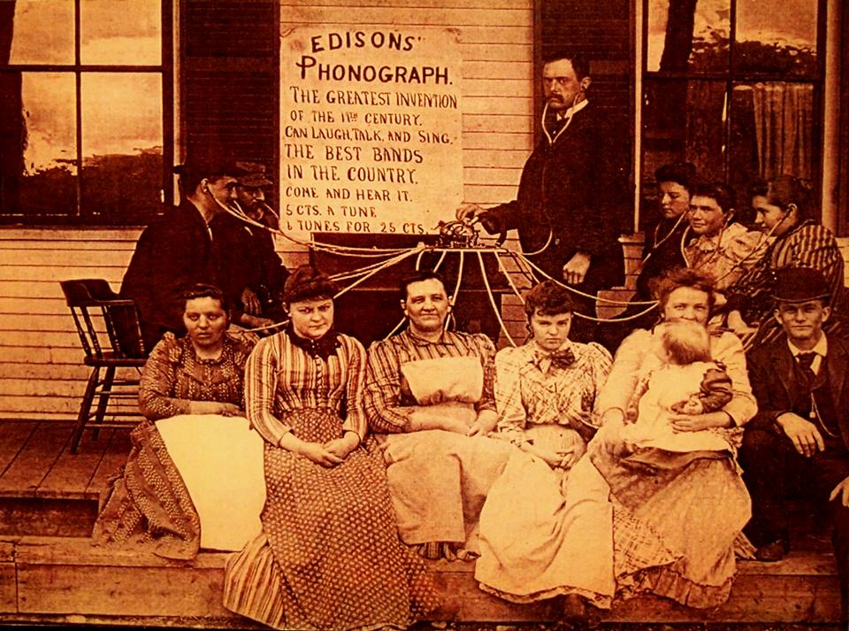

Slide 8
Earliest Minstrel Records
1889: Duffy & Imgrund Band, “The Jolly Minstrel”
1891: Manhasset Quartette, “Minstrel 1st Part: A High Old Time”
1891: Voss’ 1st Reg’t Band, “Five Minutes with the Minstrels”
1893: Minstrels with Banta’s Orch., “Minstrel 1st Part,” Nos. 1 and 2.

Slide 9
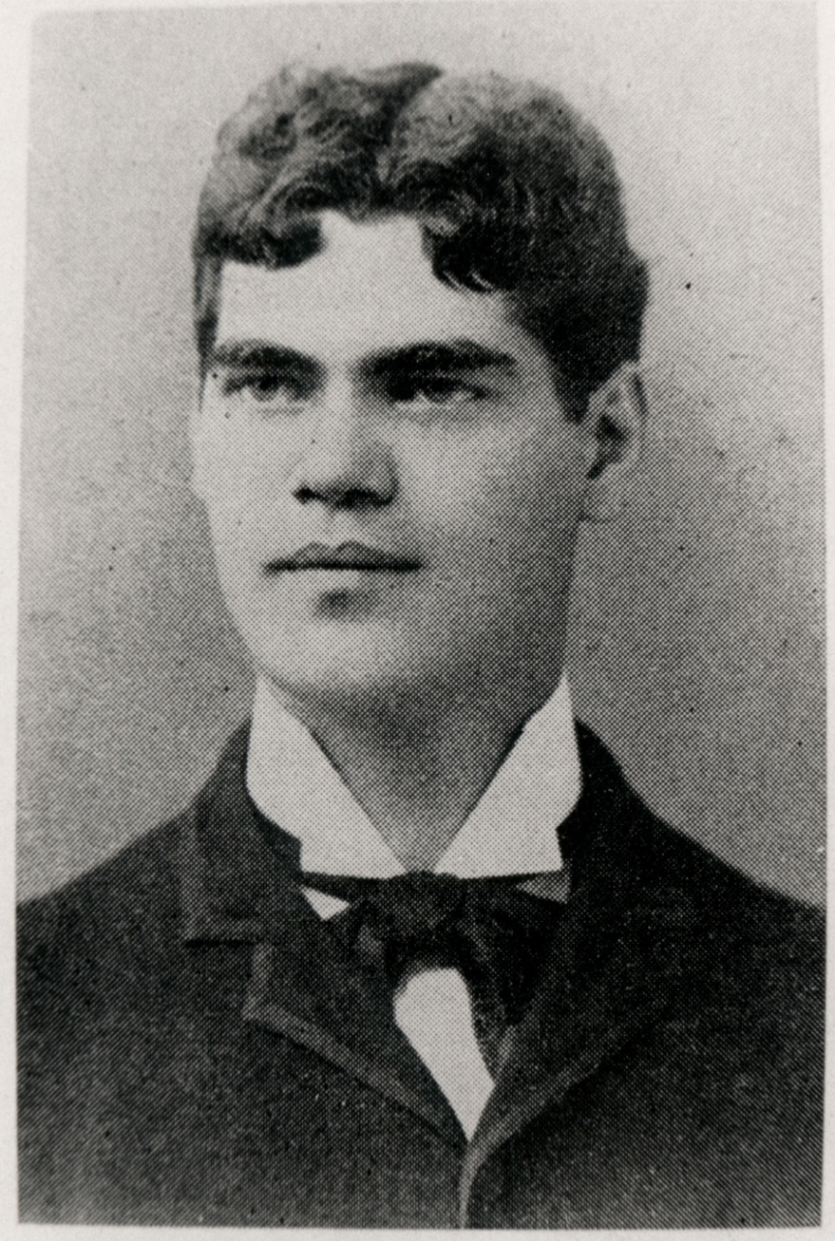

Slide 10
Len Spencer (1867-1914)

Slide 11
Imperial Minstrels An Integrated Troupe
George W. Johnson (1844-1914)
Born a slave
Popular early recording artist
Provided hearty laughter, and his signature “Laughing Song”

Slide 12
Format
“Gentlemen, be seated!”
Introductory Overture by orchestra (loud and fast)
Jokes between interlocutor and endman
Laughter and applause
Featured song by tenor or baritone
Fast closing chorus, with cheers

Slide 13
Imperial Minstrels NJ Repertoire 1894-1895
1893: Two Little Girls in Blue
1893: Sweet Marie
c.1890: The Laughing Song
1888: A High Old Time
c.1880s: Buckle on the Golden Sword
1880: Hear Dem Bells
1880: These Bones Shall Rise Again
1880: Rock Dat Ship
1875: Old Log Cabin in the Dell
1869?: Play on the Golden Harp

Slide 14
Imperial Minstrels on Columbia 1896-1900
1901: Coon, Coon, Coon
1900: Goodbye Dolly Gray
1899: Hello Ma Baby
1897: Mamie Reilly
1893: Two Little Girls in Blue
c.1890: The Laughing Song
1888: A High Old Time
1880: Hear Dem Bells
1880: These Bones Shall Rise Again
1875: Old Log Cabin in the Dell
1851: Old Folks at Home

Slide 15
Spoken Content
“Laughing Song” by Imperial Minstrels (New Jersey cylinder, c.1895-97)
Note delivery, dialect
Compare to same selection, c.1902 (Columbia 13004)

Slide 16
Popularity of Minstrel Records Explodes
1894: New Jersey cylinders
1896: Columbia Records begins production
1897: Edison enters field
1898: Debut on disc records – Berliner, Victor
1900s: All labels jump in, 100s issued
1913: High water mark
34 listed in Victor catalog alone

Slide 17
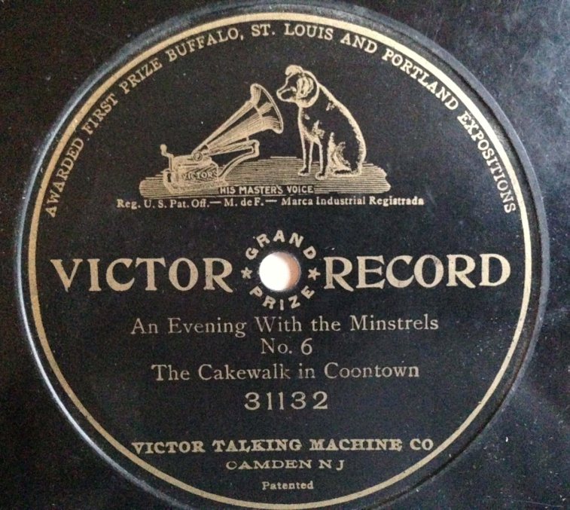
A Complete Minstrel Show?
1903: full half hour show on a multi-disc set
“An Evening with the Minstrels” on Victor and Columbia
Included olio
Best seller

Slide 18
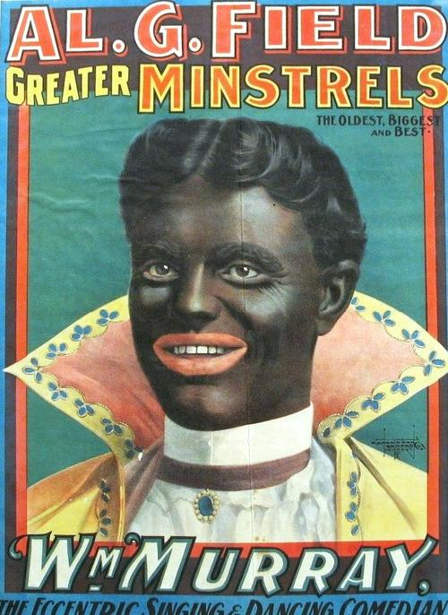
Notes:
-

Slide 19
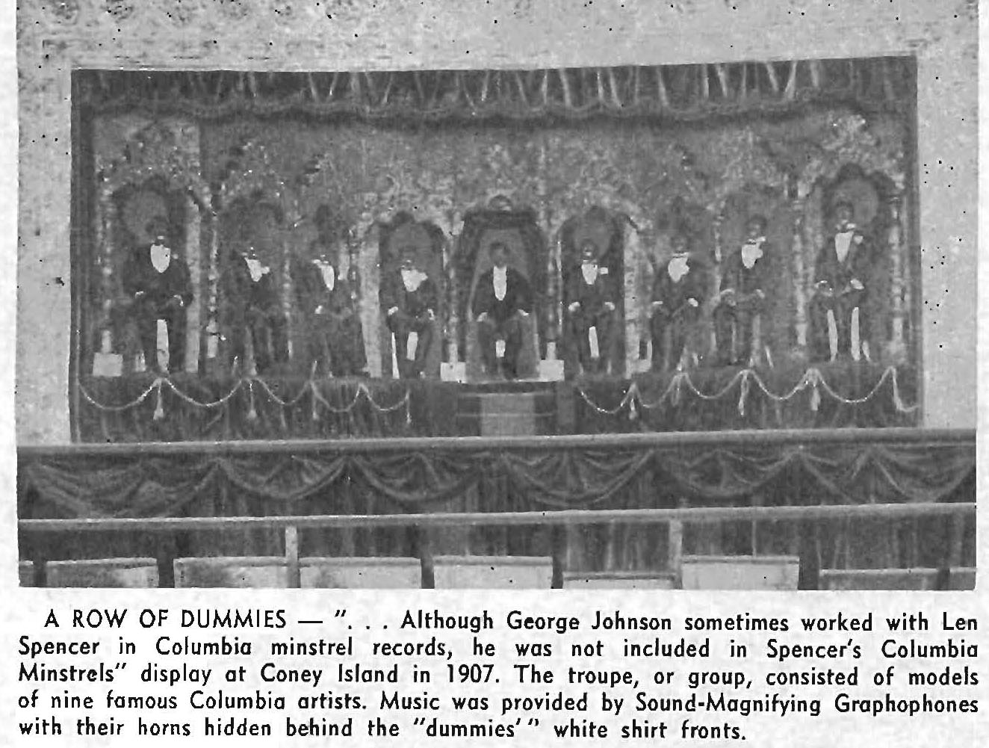
Coney Island, 1907

Slide 20
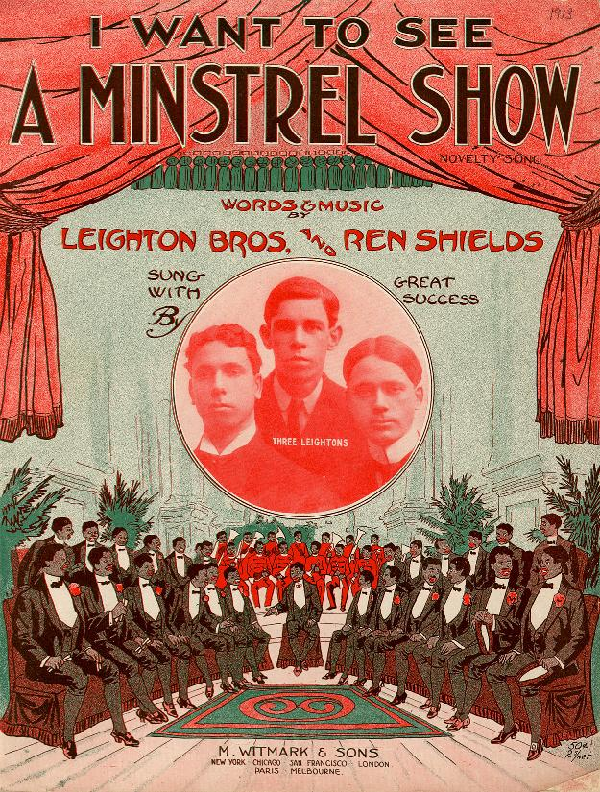
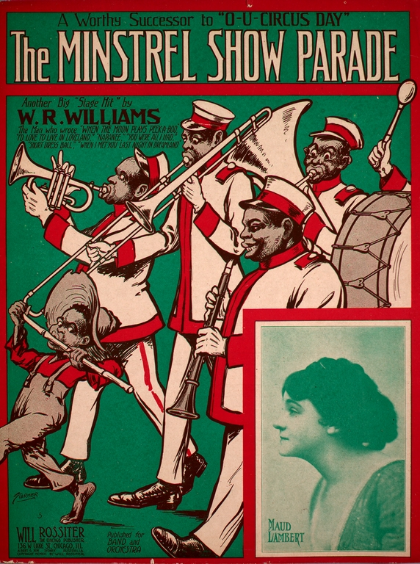
Notes:
-

Slide 21
Victor Minstrel Records Listed
Notes:
-

Slide 22
Later History
After 1900 gradually became more nostalgic, and for a time more racial
Revived in 1920s as pure nostalgia
Much more use of pre-Civil War songs
Generally respectful
“Victor Minstrel Show of 1929”
Later depicted in films, on radio, even TV

Slide 23
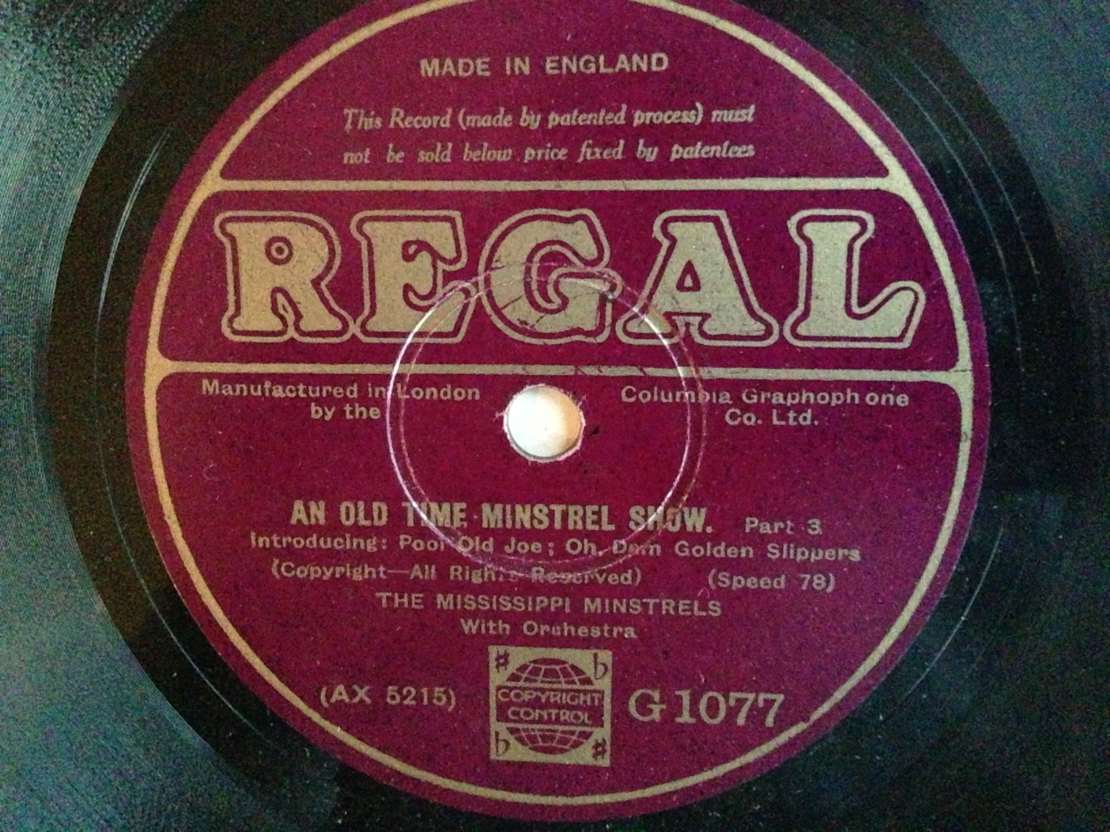
Notes:
-

Slide 24
Summary: The Era of Minstrel Records
Wildly popular from 1894 to 1914
Early repertoire surprisingly contemporary
Show us different ways in which jokes and dialogue were delivered
Mockery of African-Americans one component in a complex and evolving entertainment form
Evolved from contemporary entertainment (1890s) to pure nostalgia (1920s)

Slide 25
Thank You!
www.timbrooks.net
Lost Sounds: Blacks and the Birth of the Recording
Industry, 1890-1919

