Slide 1
The Charles K. Wolfe Audio Collection

Slide 2
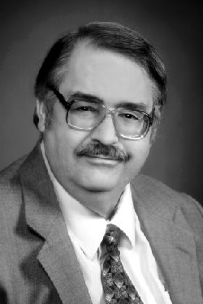
Charles Wolfe

Slide 3
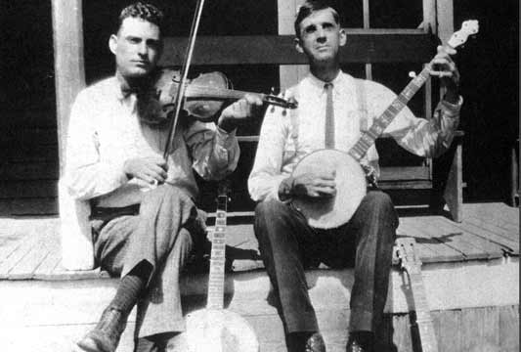
Dick Burnett
Notes:
http://musicman.mtsu.edu/broadsides/CharlesKWolfeTapes_Mp3/WolfeC_173_504-1&2_DickBurnettInterview4_19740919_S1&2_DAKLNC-60.mp3

Slide 4
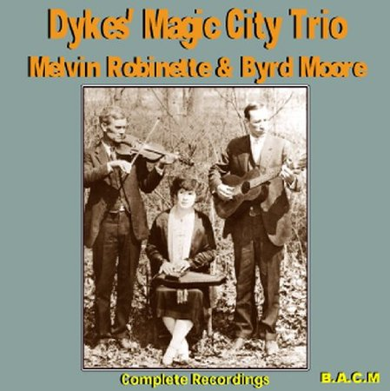
Melvin Robinette

Slide 5
Jim Stanton

Slide 6
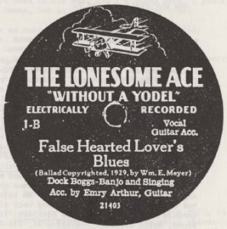
C. E. Myer (son of William Myer)

Slide 7
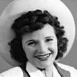
Patsy Montana and Millie McCluskey

Slide 8
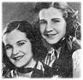

Slide 9
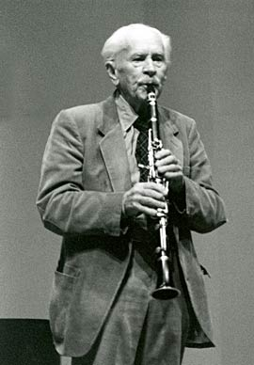
Kasper “Stranger” Malone

Slide 10
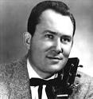
Don Gibson

Slide 11
Connor Hall

Slide 12
Johnnie Lee Wills

Slide 13
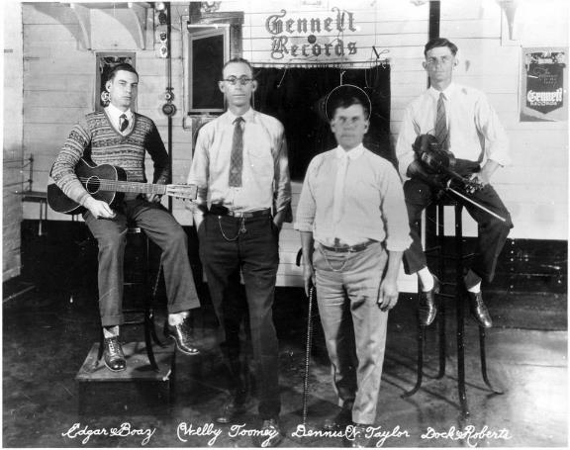
James Roberts/Fiddlin’ Doc Roberts

Slide 14
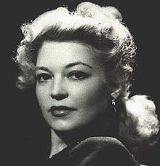
Cindy Walker

