Slide 1
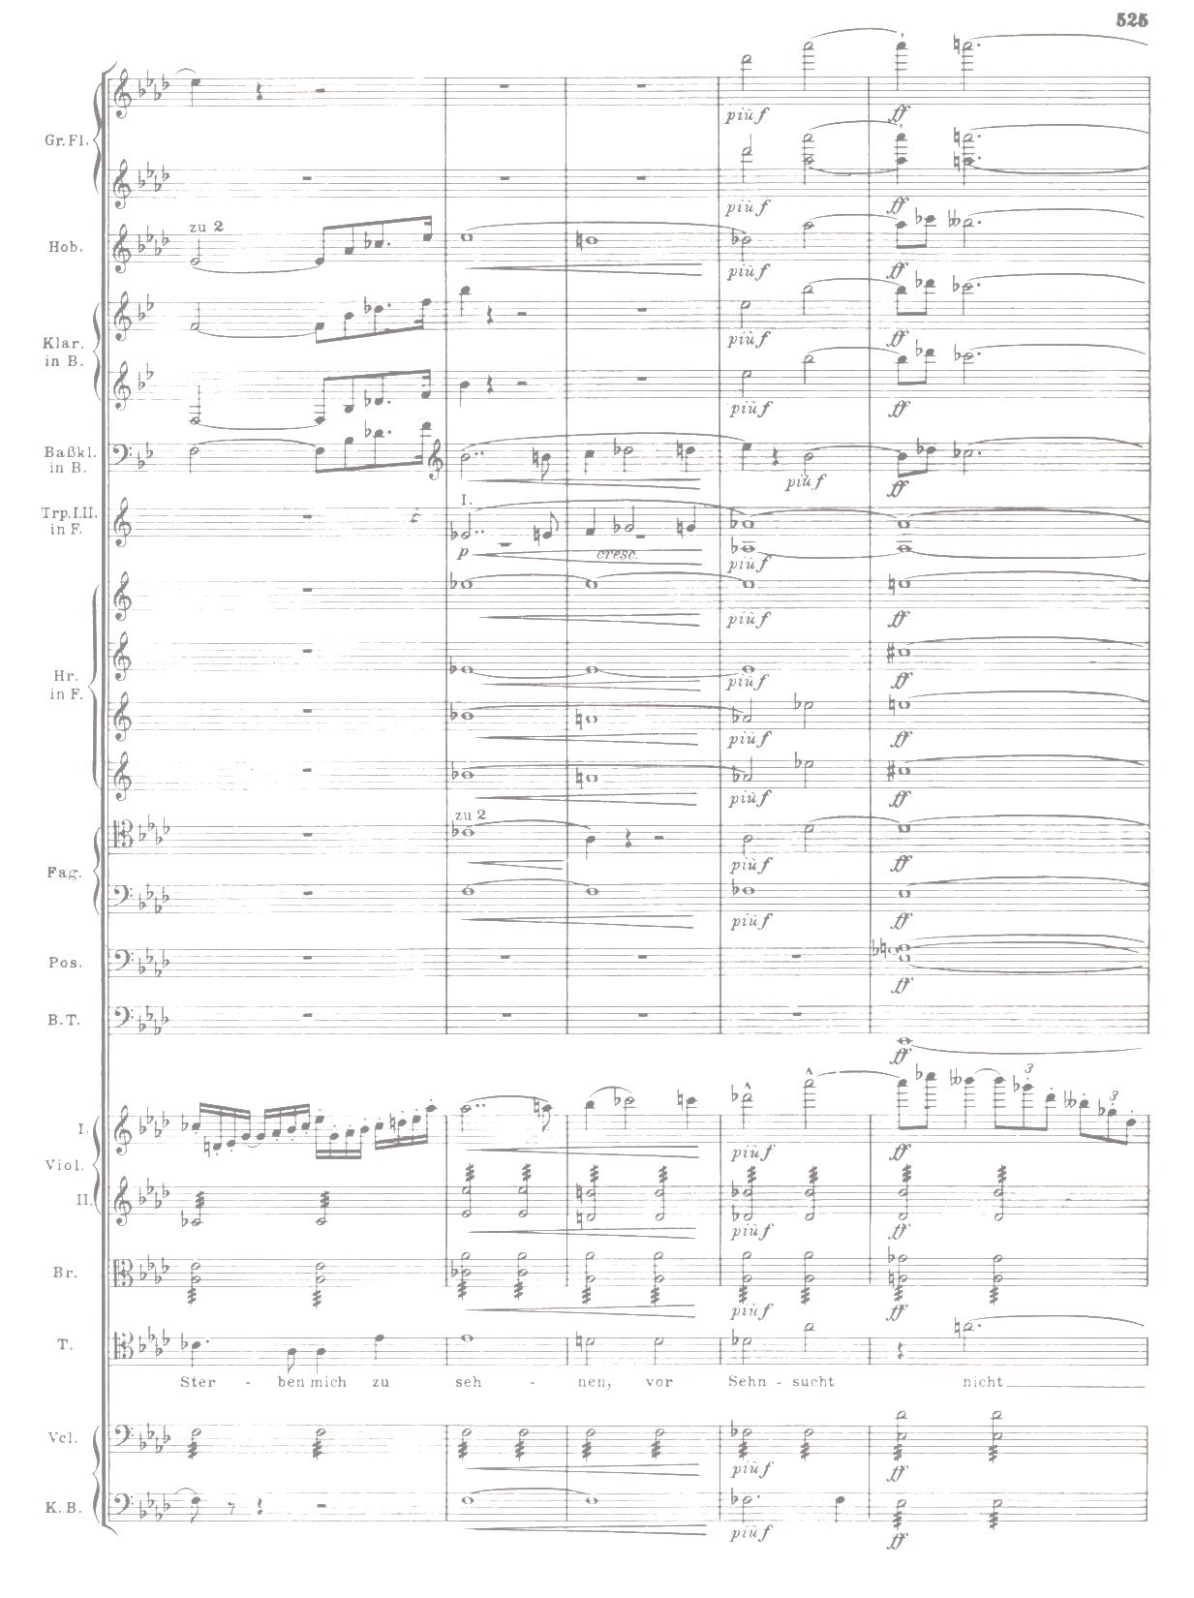
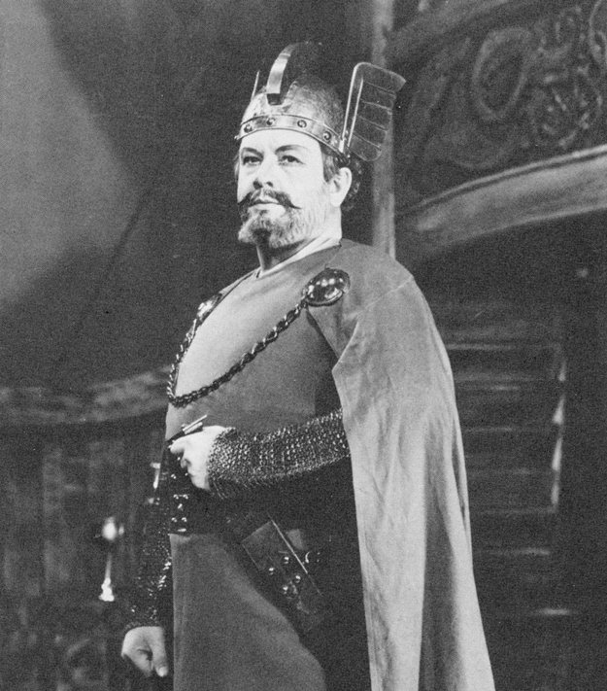
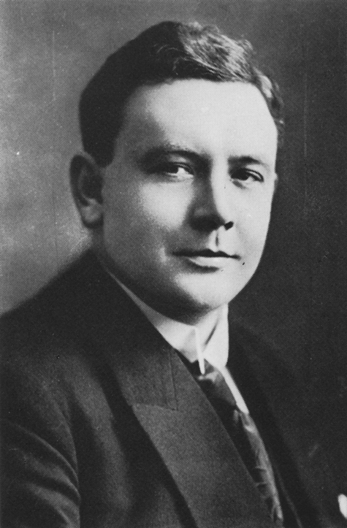
THE
GREAT
DANE
Lauritz Melchior
March 20, 1890 – March 18, 1973
Presented by
Gary Galo – ARSC 2013

Slide 2
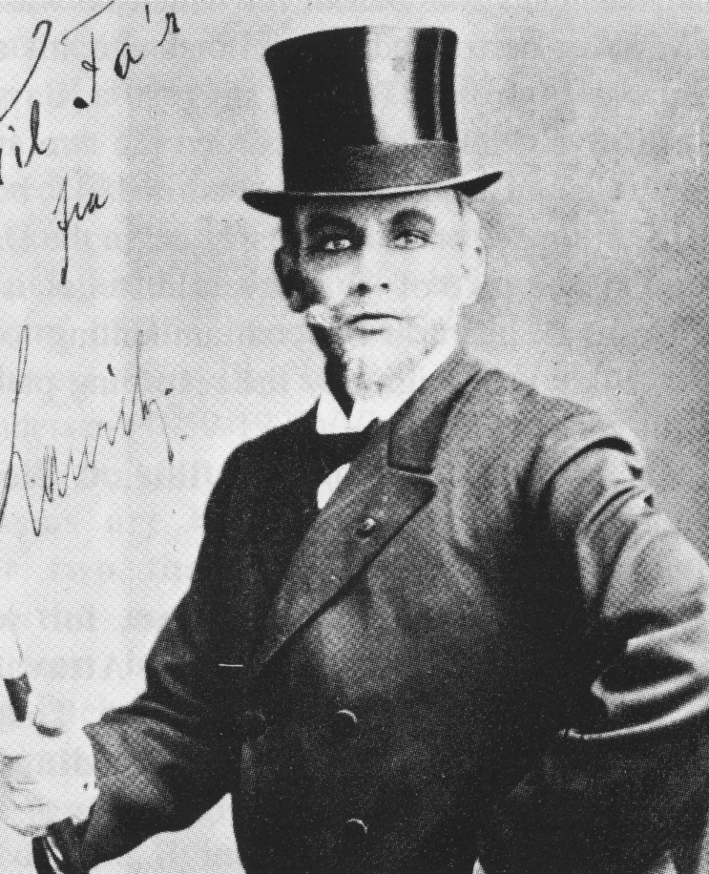
Germont
in
La Traviata
1912

Slide 3
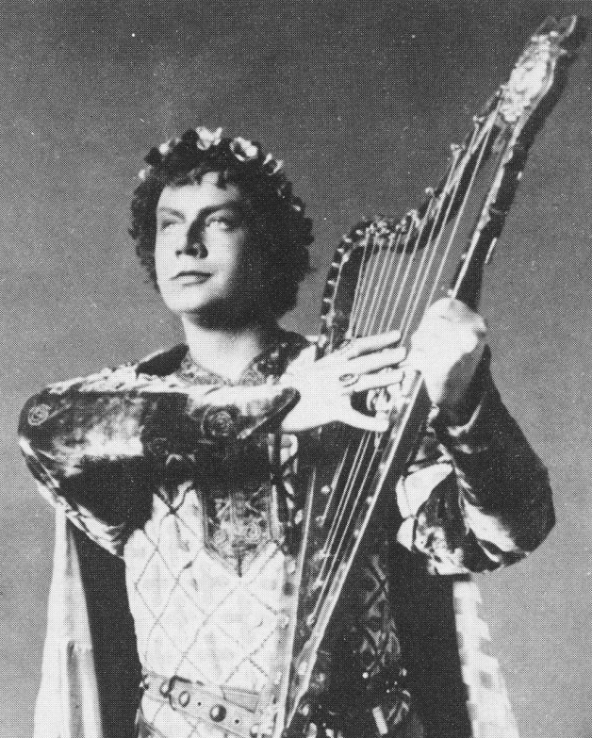
Tannhäuser
in
Tannhäuser
1918

Slide 4
Melchior’s Technical Foundation
Ability to sing softly, in all registers, always on-the-breath
Superb legato
Properly-developed low register
Well-developed passaggio, at all dynamic levels
Voice even throughout the registers
Ease of production at all dynamic levels in all registers
Unrivaled stamina
Ability to sing Wagner’s most demanding roles
without tiring
Voice remained in remarkable condition well past age 60; Not a trace of wobble even at 70!
Sjöberg: “Tonerna” (An die Musik)
Rec. 1926 (Polydor)

Slide 5
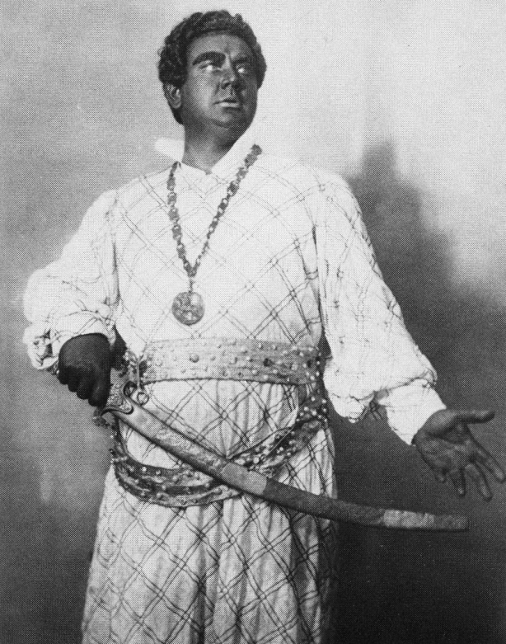
Otello
in
Otello

Slide 6
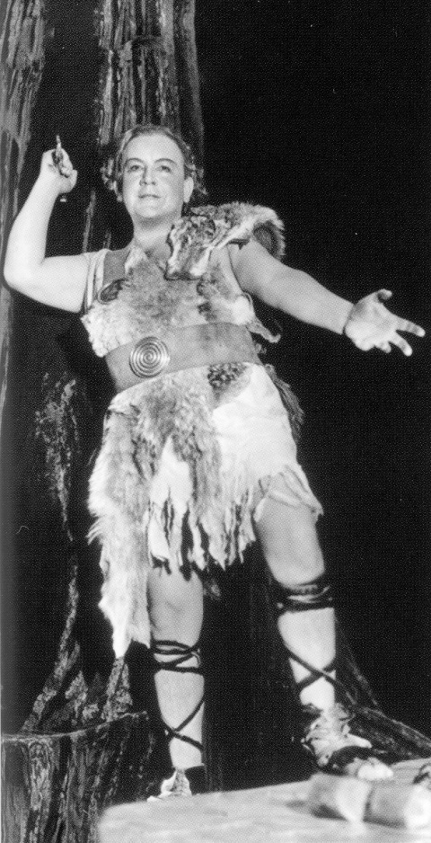
Siegmund
in
Die Walküre

Slide 7
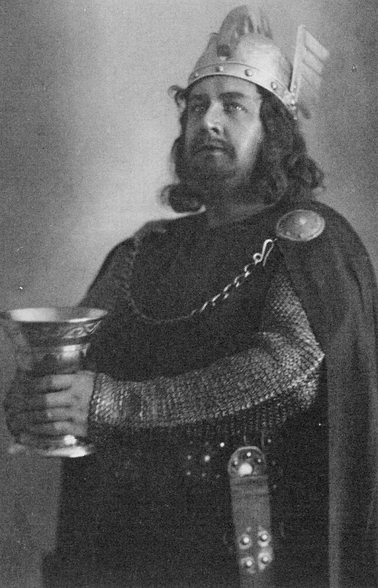
Tristan
in
Tristan und Isolde

Slide 8
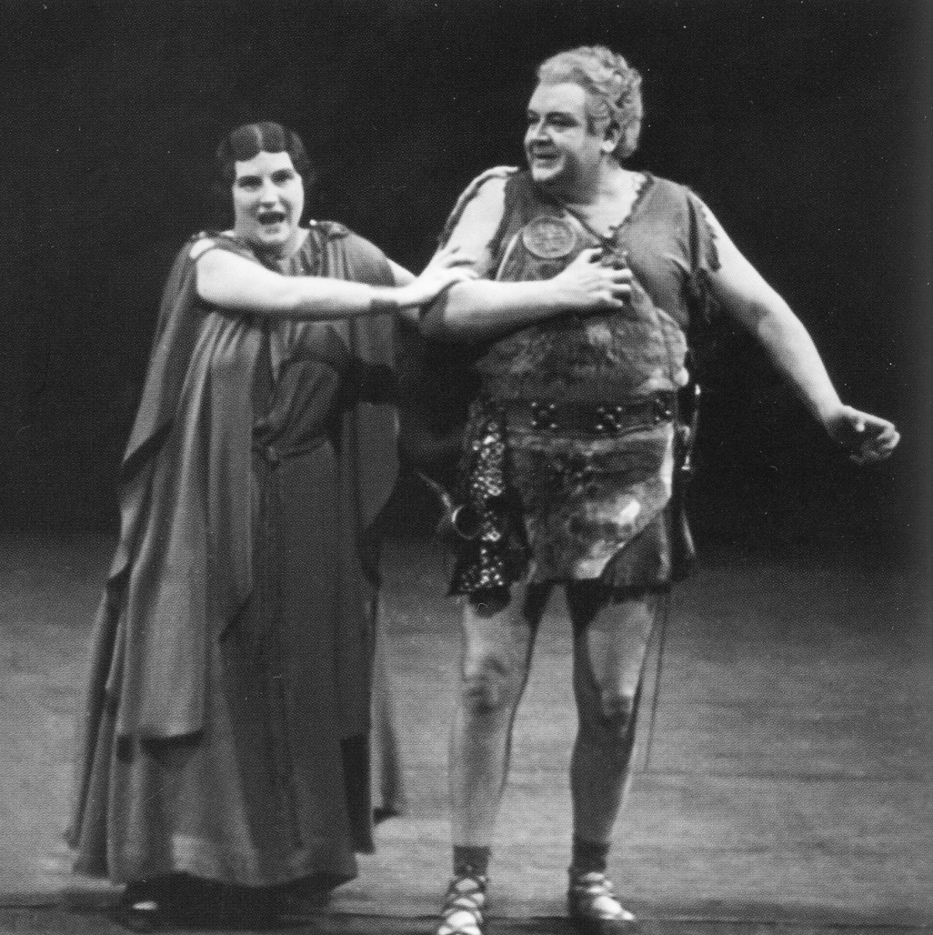
Siegfried in Siegfried
with Kirsten Flagstad as Brünnhilde

Slide 9
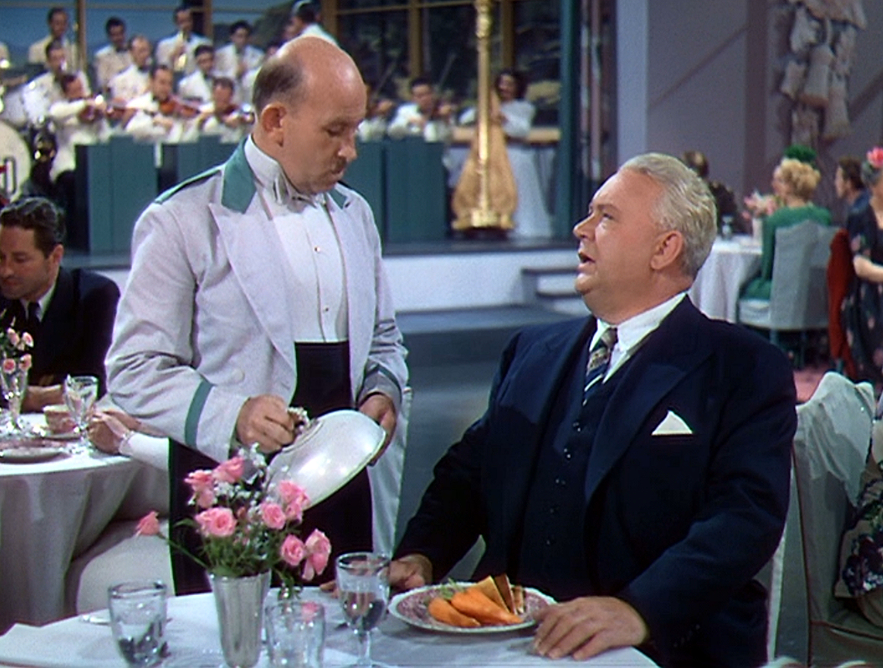
Scene from Thrill of a Romance (MGM,1944)
Melchior as Nils Knudsen • Vince Barnett as Oscar

Slide 10
Melchior’s Wagnerian Totals
Tristan in Tristan und Isolde: 223
Siegmund in Die Walküre: 183
Siegfried in Siegfried: 128
Siegfried in Götterdämmerung: 107
Lohengrin in Lohengrin:106
Tannhäuser in Tannhäuser (Paris): 104
Parsifal in Parsifal: 81
Tannhäuser in Tannhäuser (Dresden): 40
Grand Total: 972 Performances

Slide 11
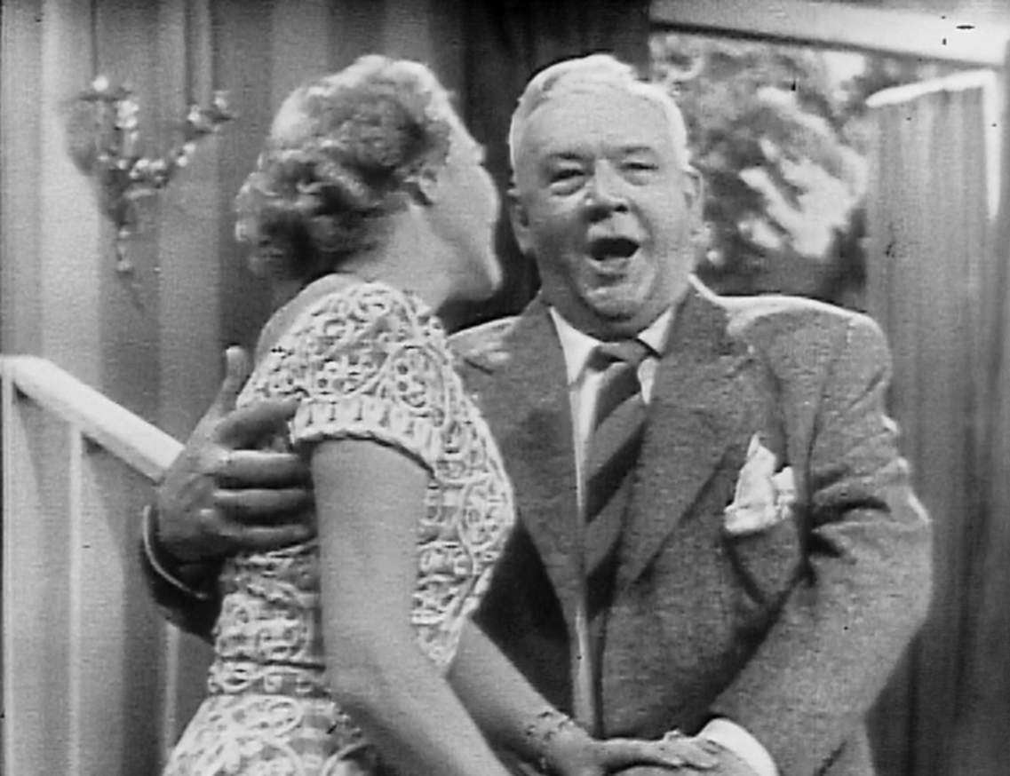
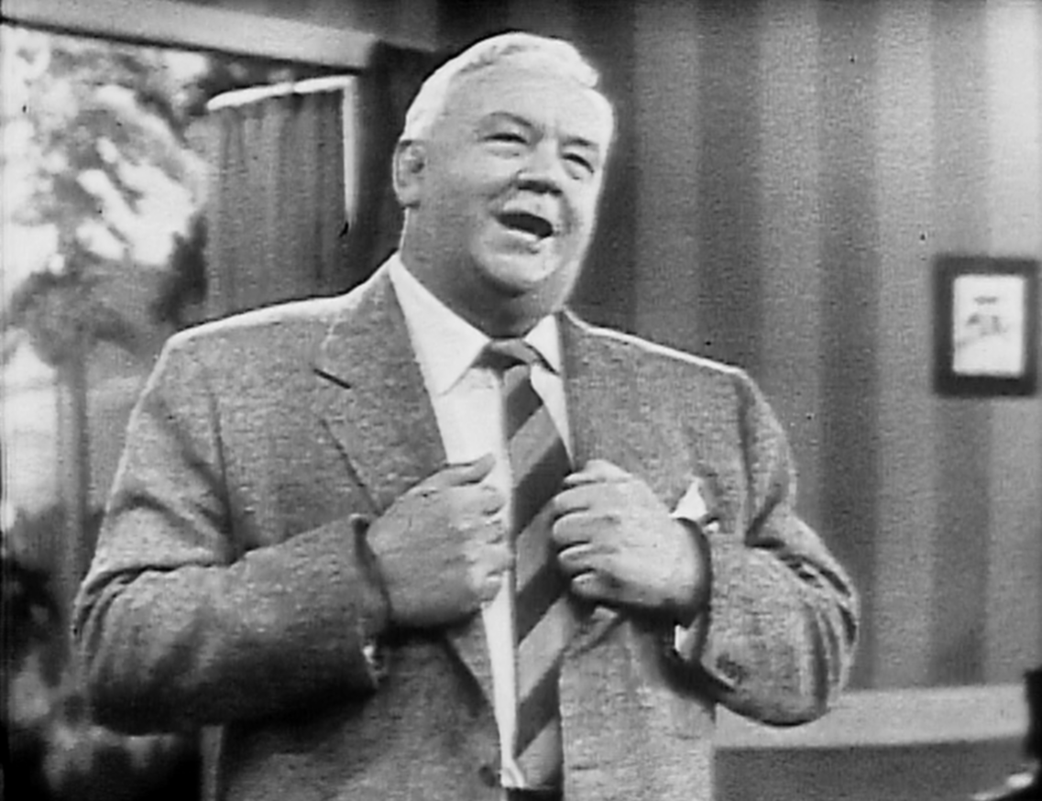
Richard Strauss:
“Zueignung”
Voice of Firestone Telecast
Sept. 24, 1951

Slide 12
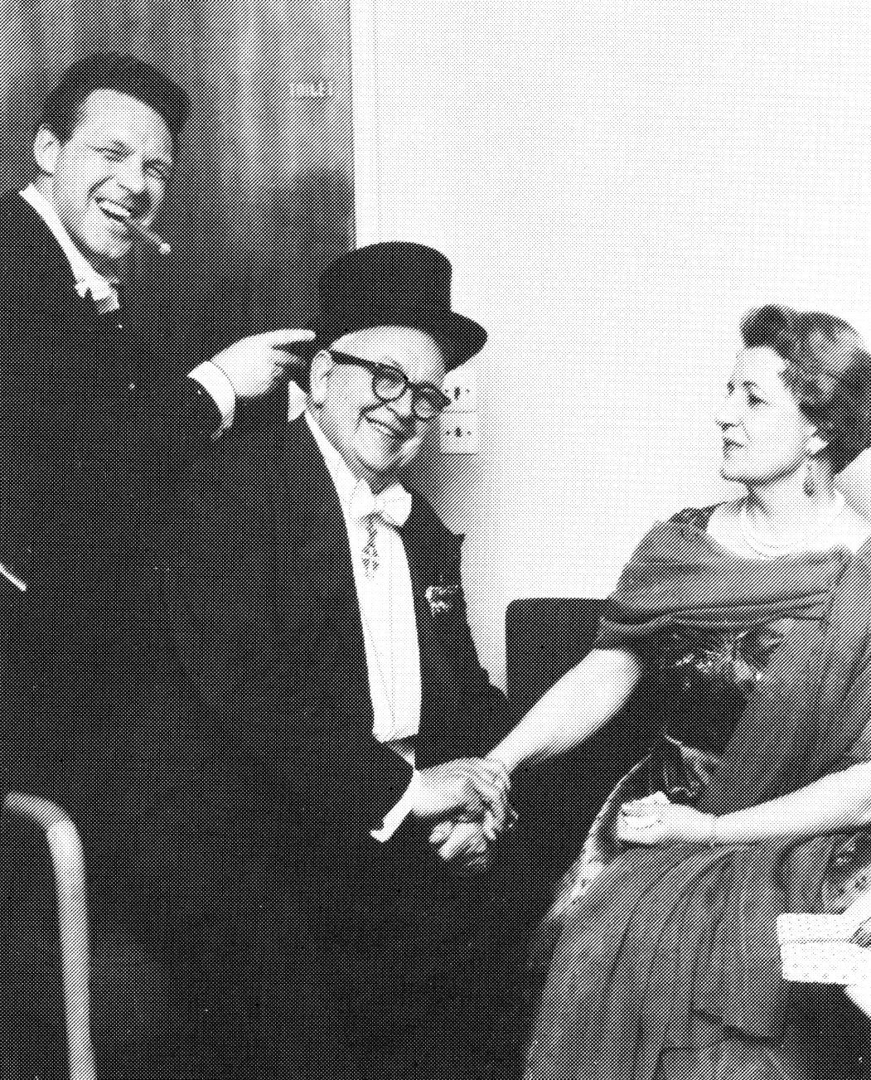
70th Birthday Concert
Die Walküre – Act I
March 31, 1960
with
Mogens Wedel (Hunding)
and
Dorothy Larsen (Sieglinde)

Slide 13
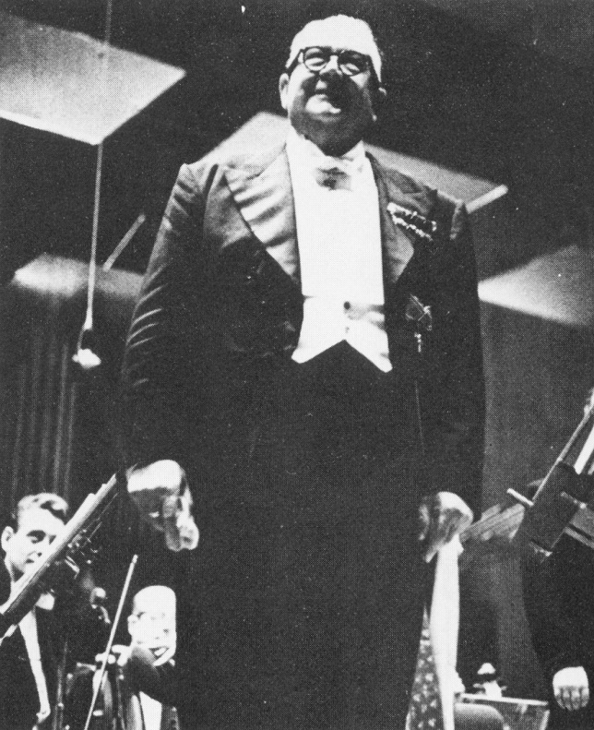
Curtain Call
Die Walküre – Act I
1960

Slide 14
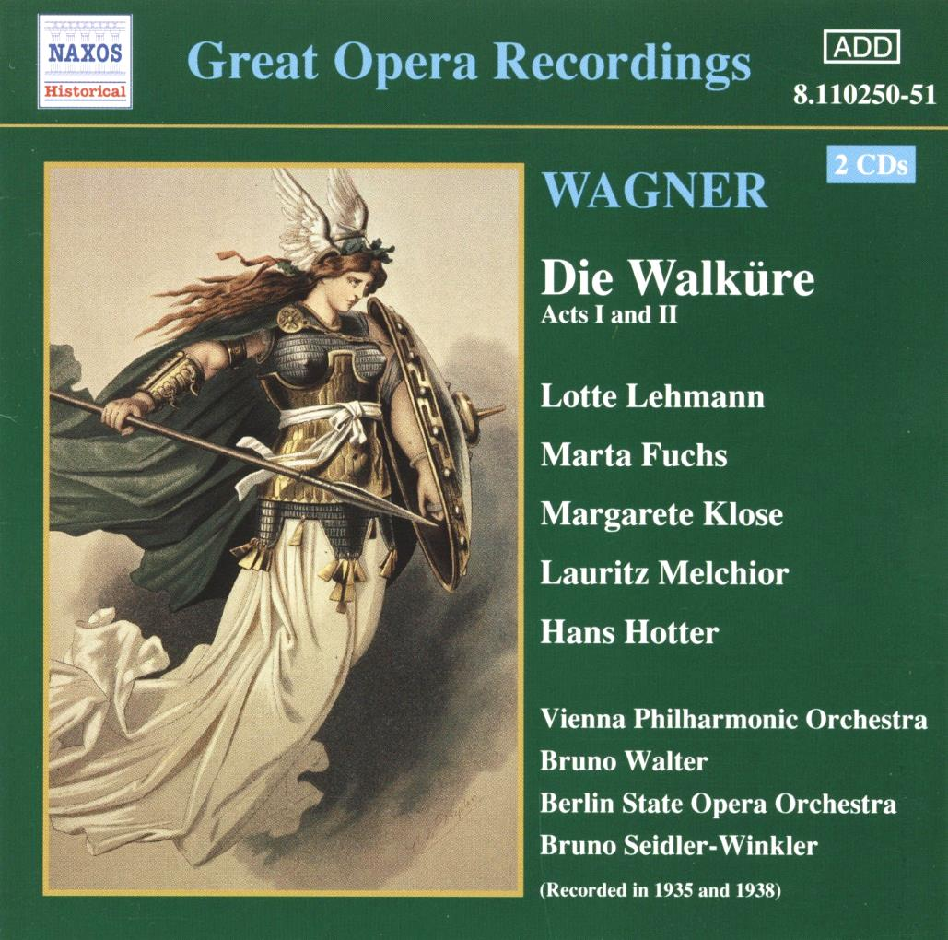
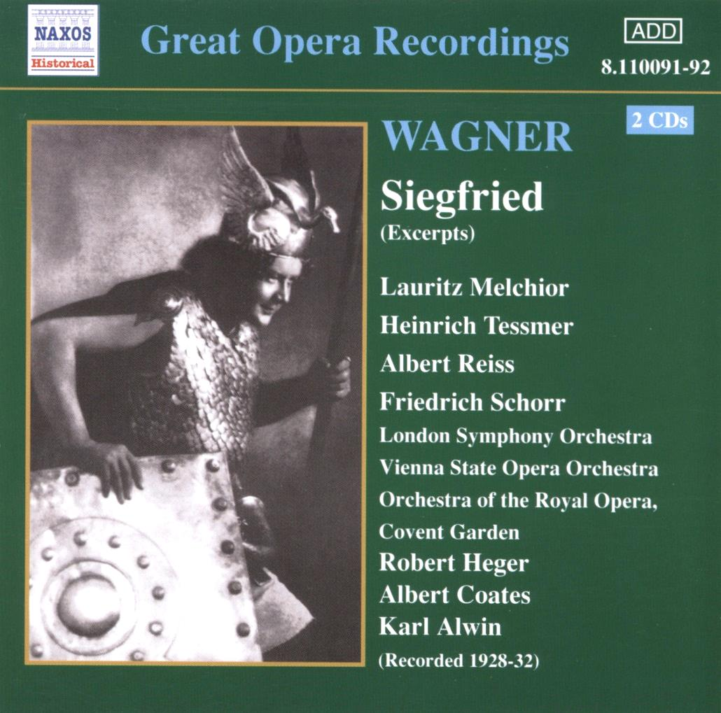
The Essential Melchior Reissues
Naxos Historical 8.110250-51
Naxos Historical
8.110091-92
HMV Die Walküre and Siegfried

Slide 15
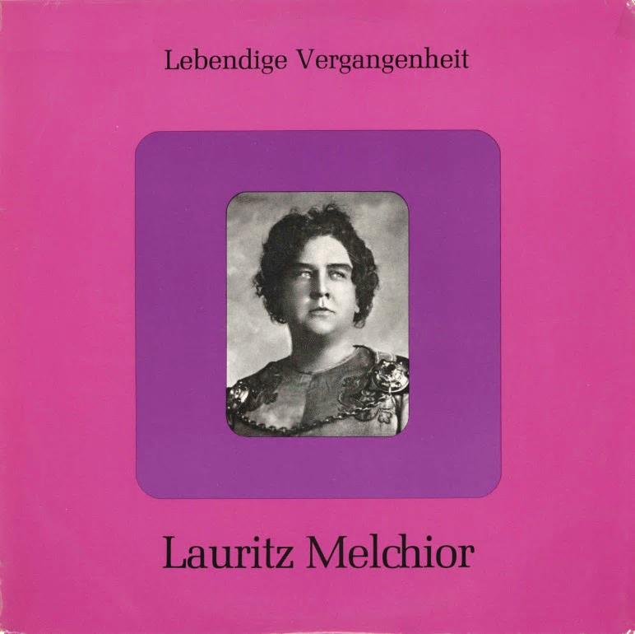
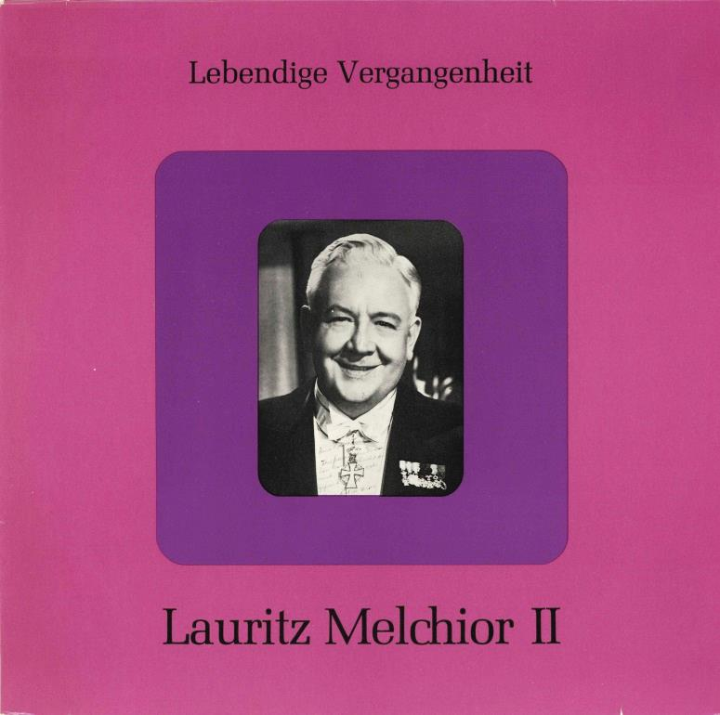
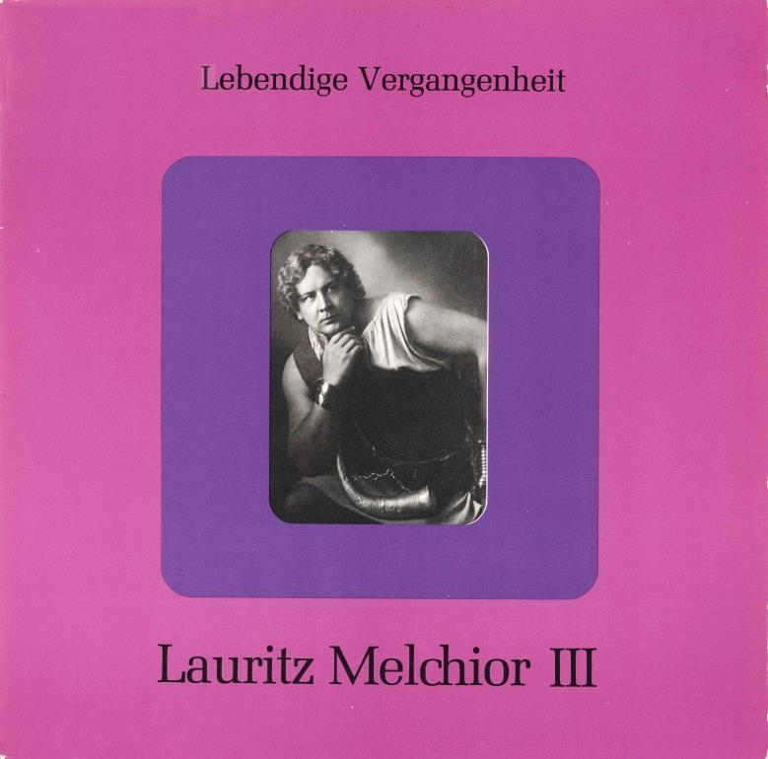
The Preiser LPs
LV-11, LV-124
& LV-226

Slide 16
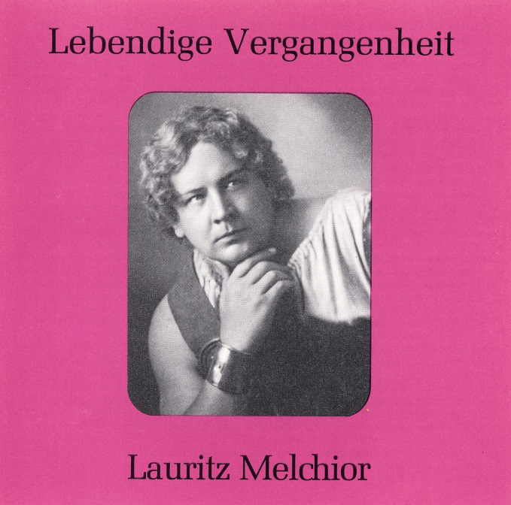
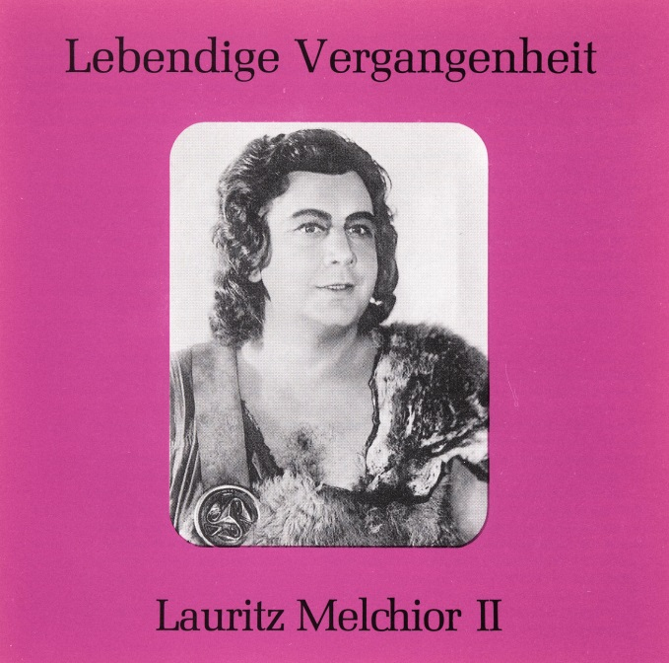
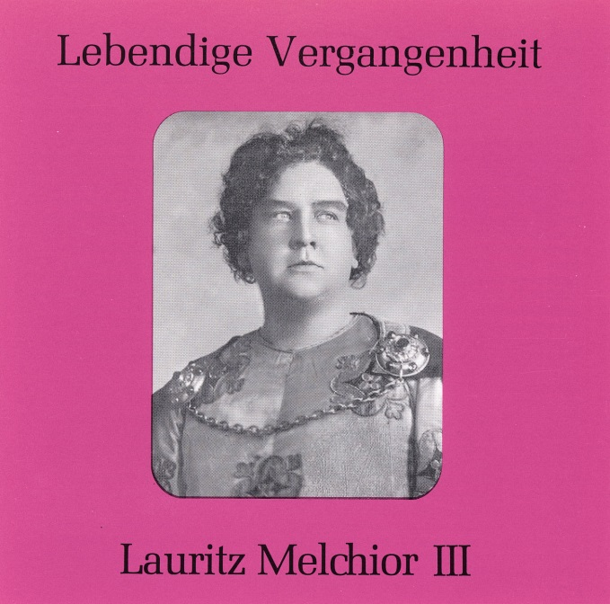
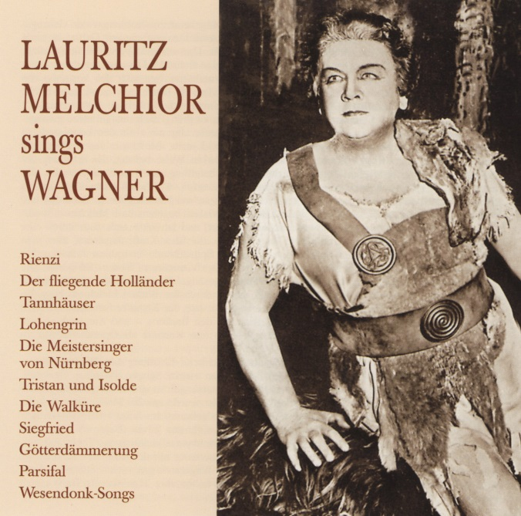
89032
89068
89086
The Preiser CDs
89032 (2 CDs)

Slide 17
Recordings on the Preiser LPs,
but not on the Preiser CDs:
Wagner: Tannhauser – “Als ich erwacht” – Rec. 1926, Berlin
Grammophon 66439 (Matrix no. 150 bm)
Wagner: Die Meistersinger von Nürnberg – “Morgenlich leuchtend im rosigen Schein”
Rec. May 16, 1931, London – HMV DB 1858 (Matrix no. 2B 545-I)
Wagner: Die Walküre – “Winterstürme wichen dem Wonnemond”
Rec. 1927, Chicago – Brunswick 50085 (Matrix no. unknown)
Wagner: Die Walküre – “Siegmund heiß' ich”
Rec. June 15, 1929, Berlin – HMV D 2022, EJ 475 (Matrix no. CLR 5461-I)
Wagner: Götterdämmerung – “Hast du, Gunther, ein Weib?”
with Friedrich Schorr, Rudolf Watzke and Liselotte Topas
Rec. June 15, 1929, Berlin – HMV D 1700, EJ 471, ES 619 (Matrix nos. CLR 5458-IIA/9-IA)
Meyebeer: Die Afrikanerin – “Land so wunderbar”
Rec. 1926 – Grammophon 66439 (Matrix no. 148 bm)

Slide 18
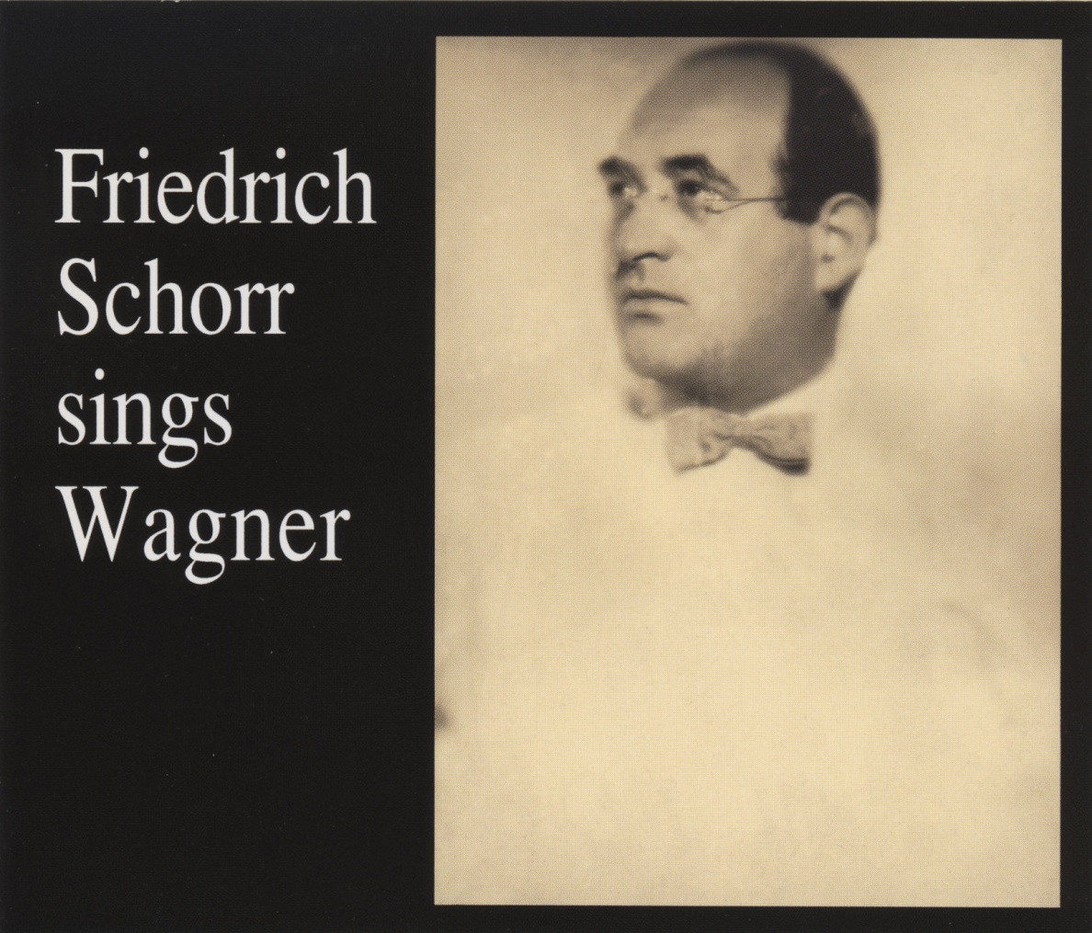
Preiser
89214 (2 CDs)
Contains:
Götterdämmerung: “Hast du, Gunther, ein Weib” (1929)
Die Meistersinger: “Abenlich glühend” (1931) and
“Selig wie die Sonne meines Glückes lacht” (Act III Quintet)
with E. Schumann, F. Schorr, et al. (1931)

Slide 19
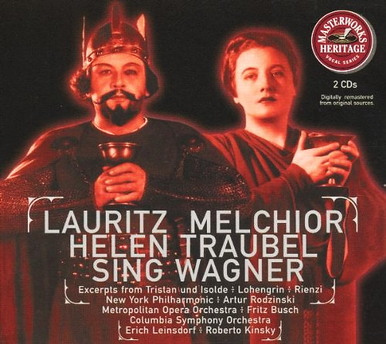
Sony Masterworks Heritage MH2K 60896
American Columbia Wagner Recordings
Including excerpts from Tristan und Isolde – Act III
(Recorded at Teatro Colón, Buenos Aires 1943)

Slide 20
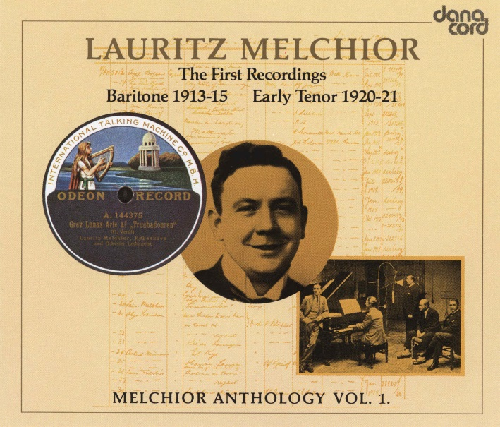
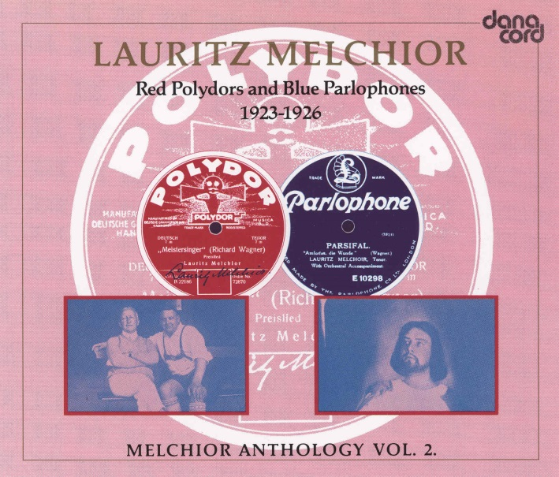
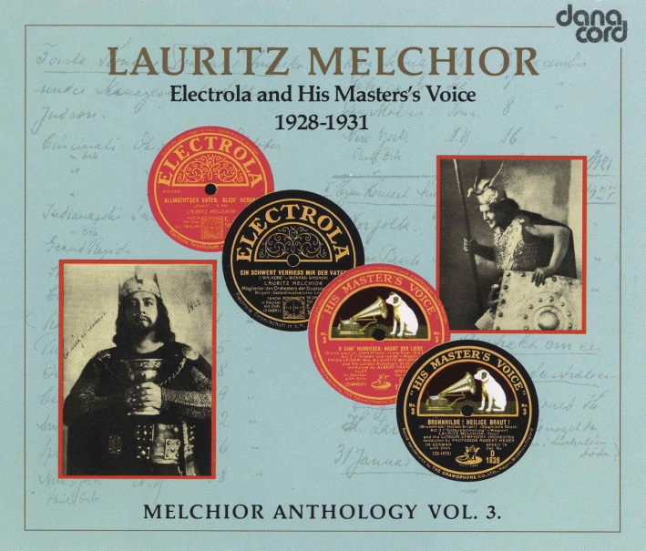
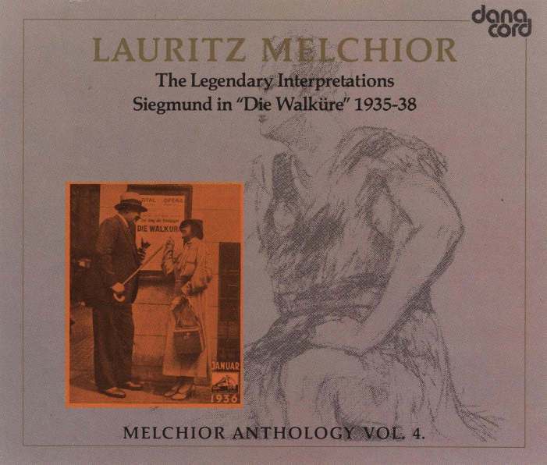
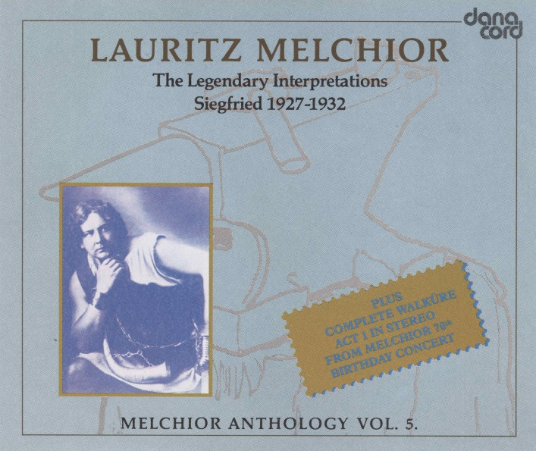
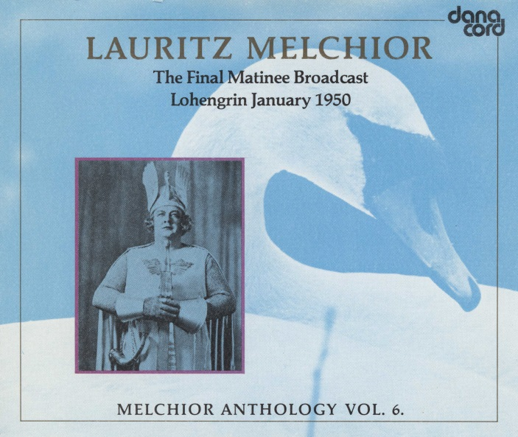
The Danacord Melchior Anthology

Slide 21
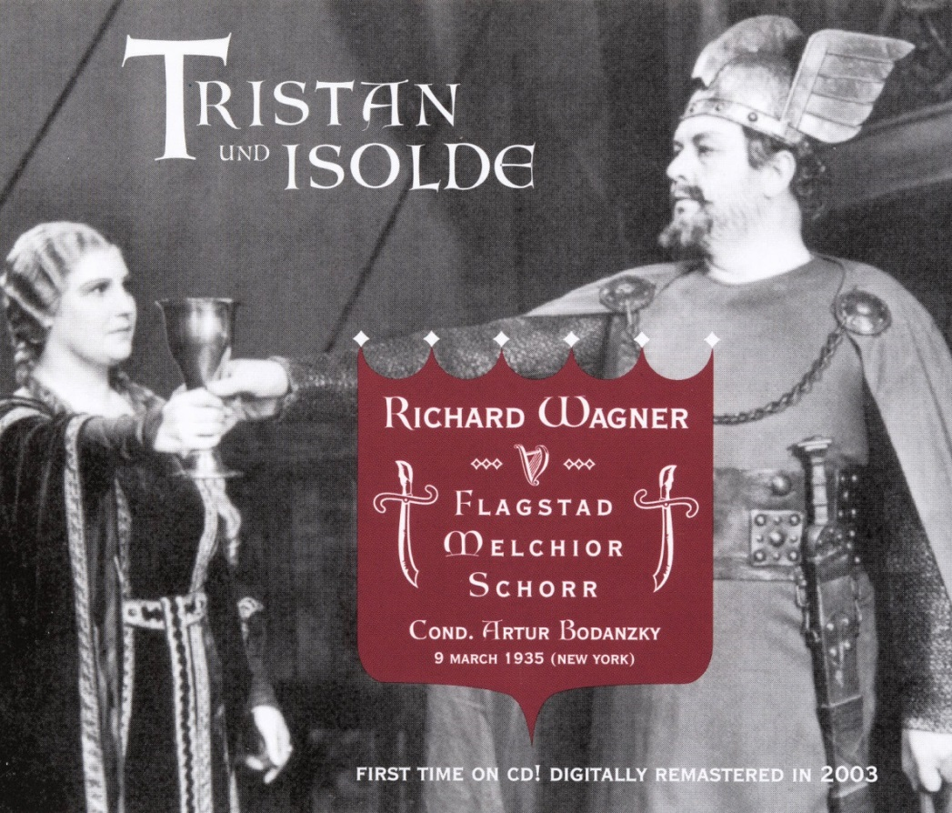
The Essential Live Recordings
Tristan und Isolde – Met 1935
West Hill Radio Archives WHRA 6001

Slide 22
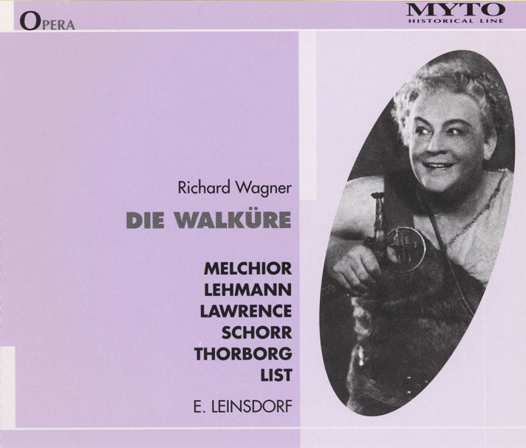
Die Walküre – Met in Boston
3/30/1940
Myto 992.H027
Siegfried – Met 1937
Naxos Historical 8.110211-13

Slide 23
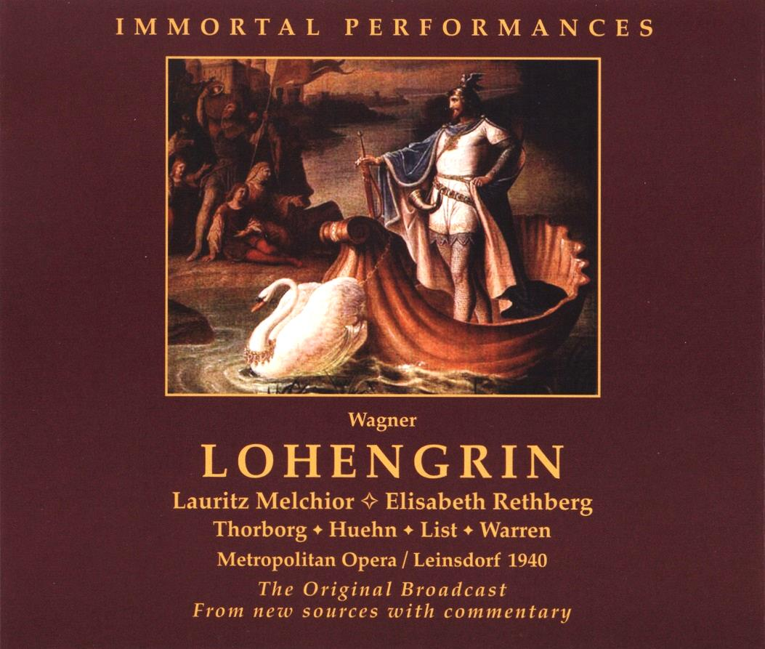
Götterdämmerung – Met 1936
Naxos Historical 8.110228-30
Lohengrin – Met 1940
Immortal Performances
IPCD 1018-3

Slide 24
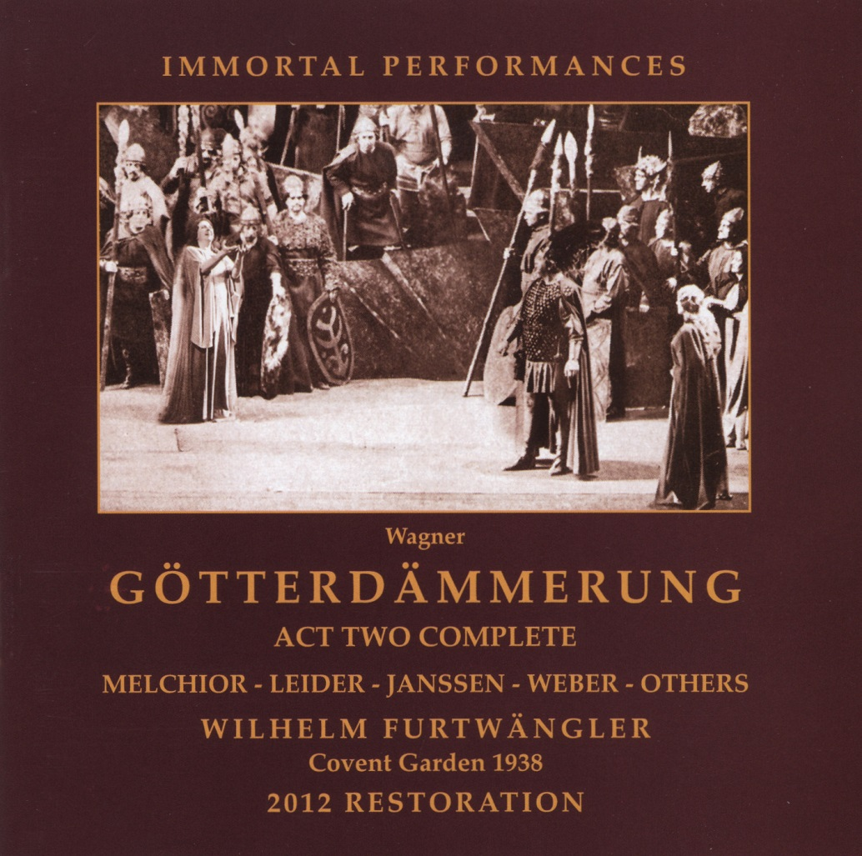
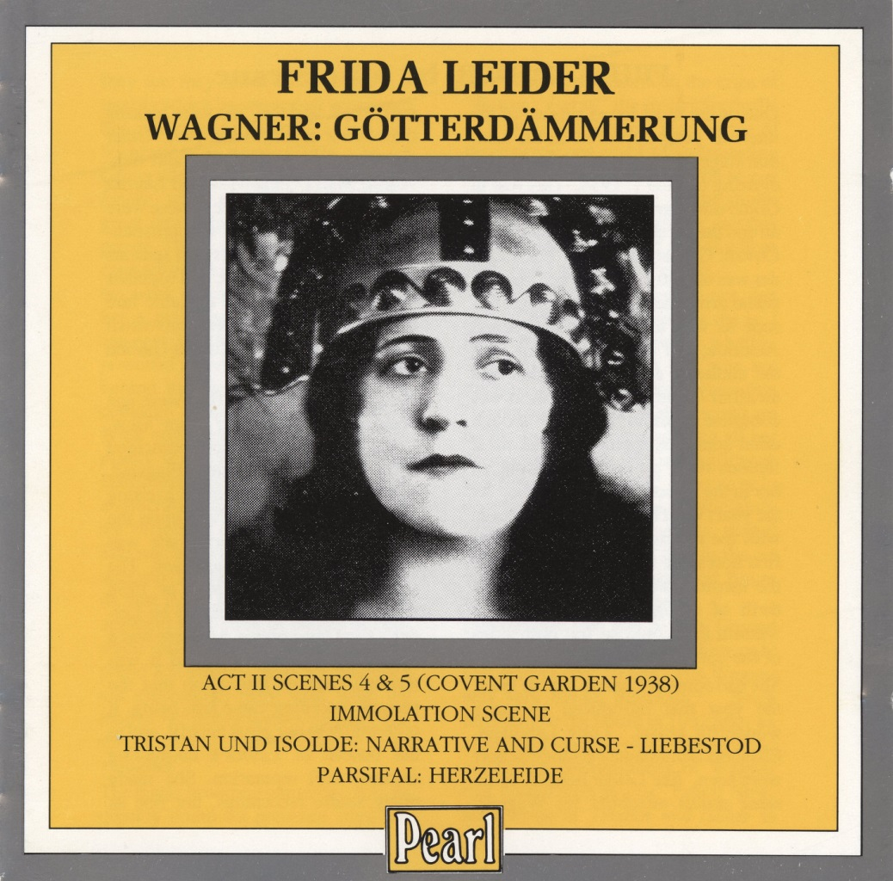
Immortal Performances
IPCD 1022-1
Pearl CD 9331
Götterdämmerung – Covent Garden 1938

Slide 25
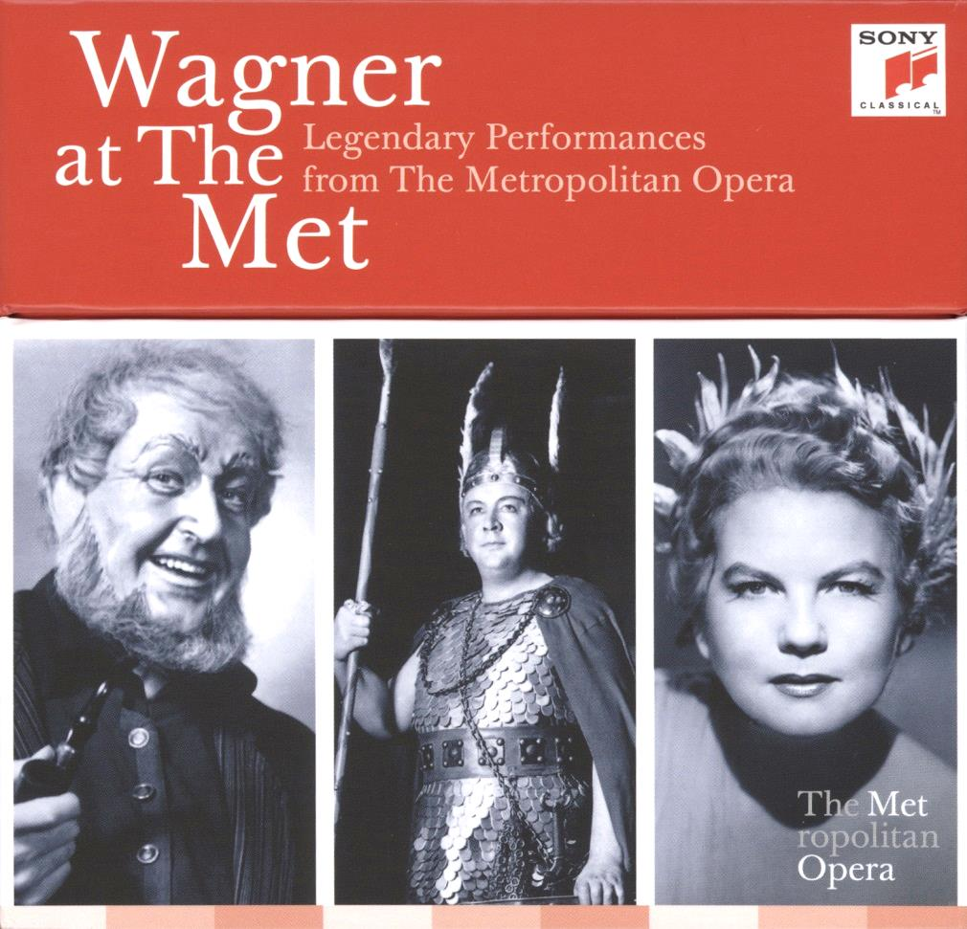
Melchior Performances:
Lohengrin (1/2/1943)
Die Walküre (2/17/1940)
Siegfried (1/30/1937)
Götterdämmerung (1/11/1936)
Tristan und Isolde (4/16/1938)

Slide 26
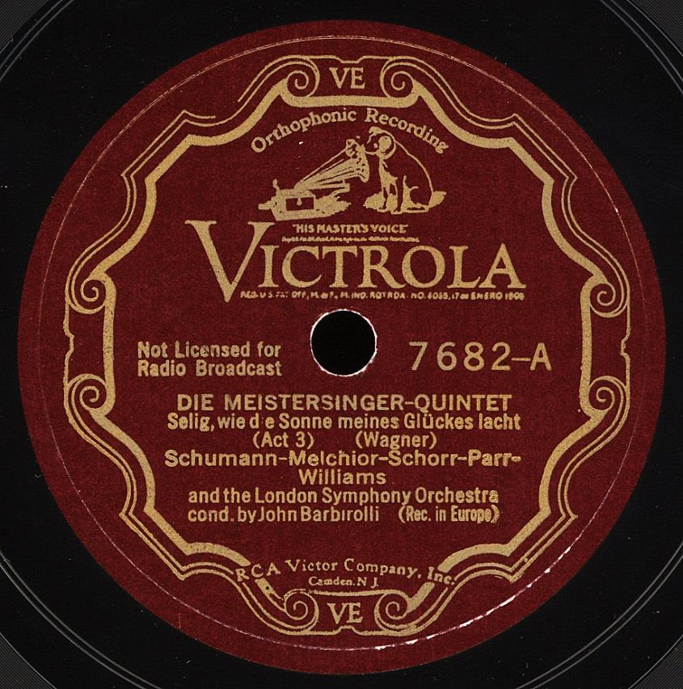
Bonus Recording
Wagner: Die Meistersinger von Nürnberg –
Act III Quintet
with E. Schumann, G. Parr, B. Williams and F. Schorr
John Barbirolli, cond. – Rec. 1931

