Slide 1
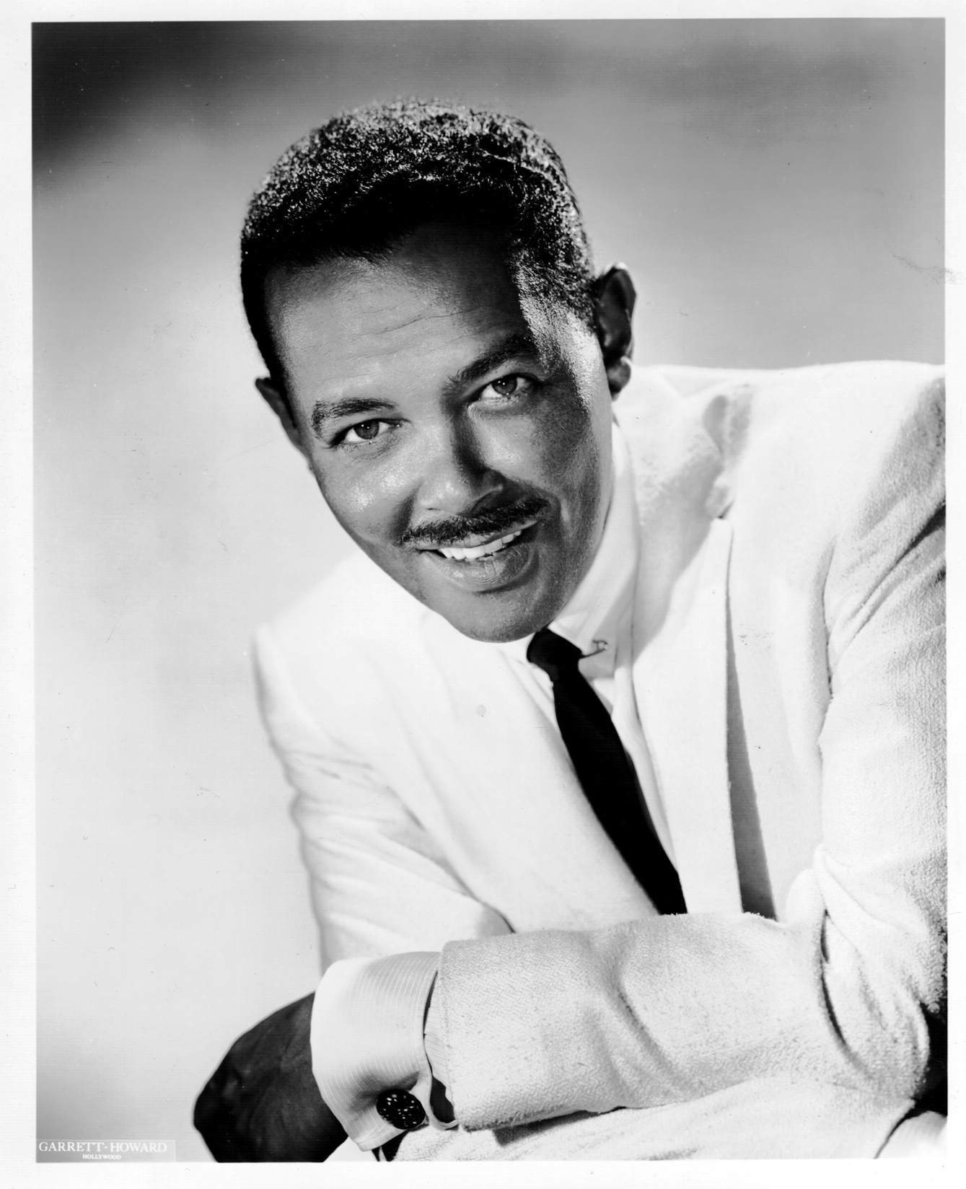
Billy Eckstine:
The Rise and Fall of the Fabulous Mr. B.
ARSC – 2013
Presentation by
Cary Ginell

Slide 2
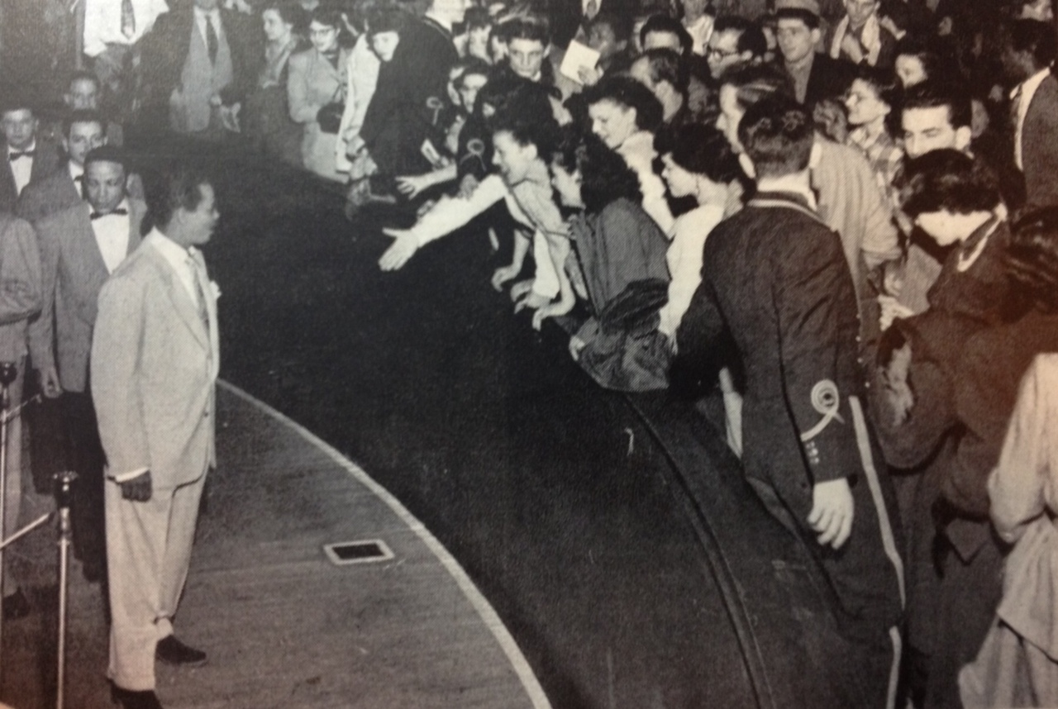
Pandemonium at the Paramount, New York, 1949

Slide 3
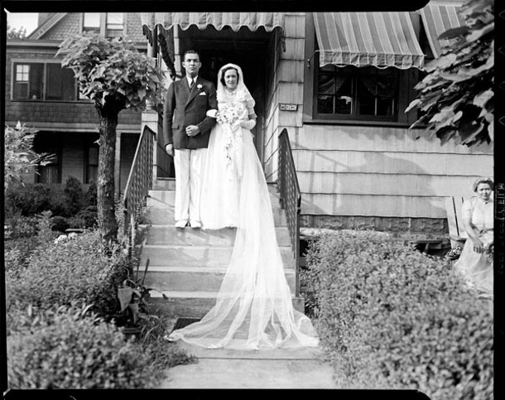
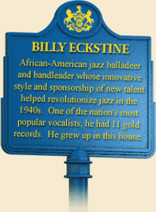
5913 Bryant St., Pittsburgh
Pictured are Maxine Eckstein, Billy’s older sister, & her new husband

Slide 4
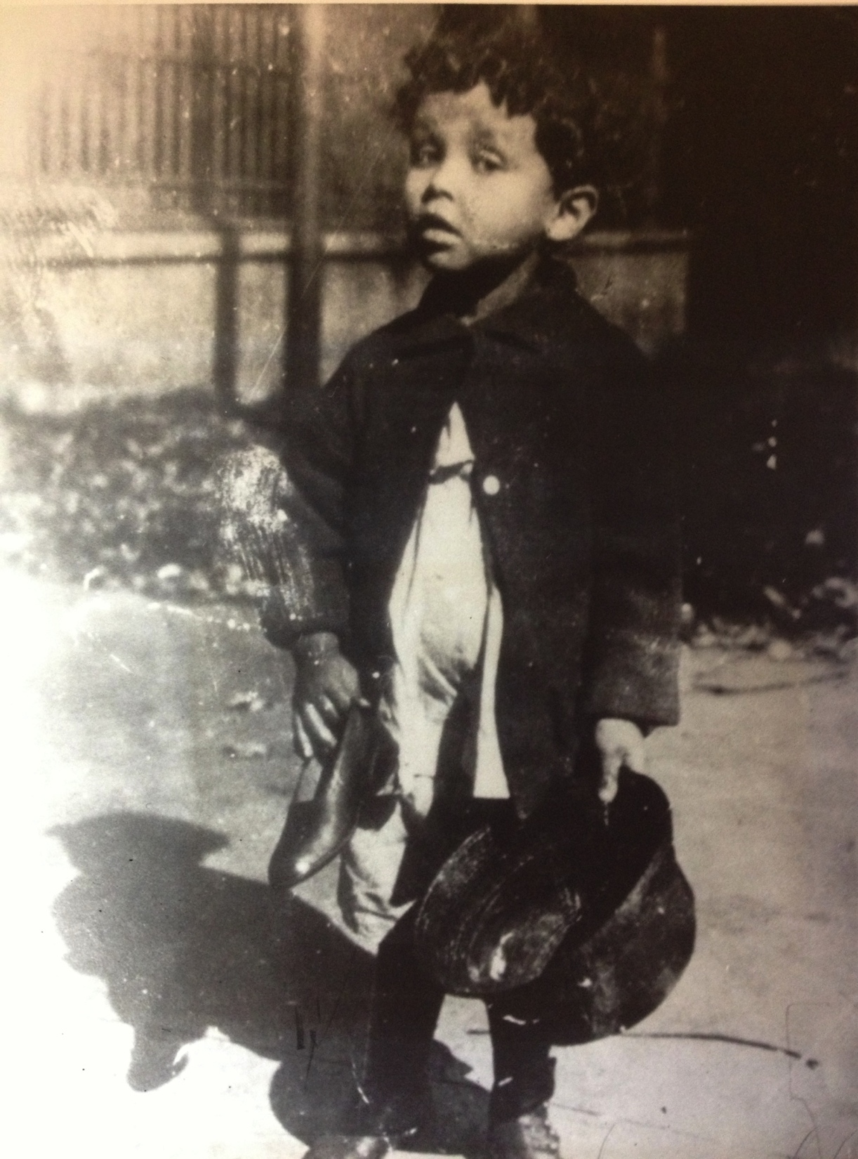
Pittsburgh, c. 1918.

Slide 5
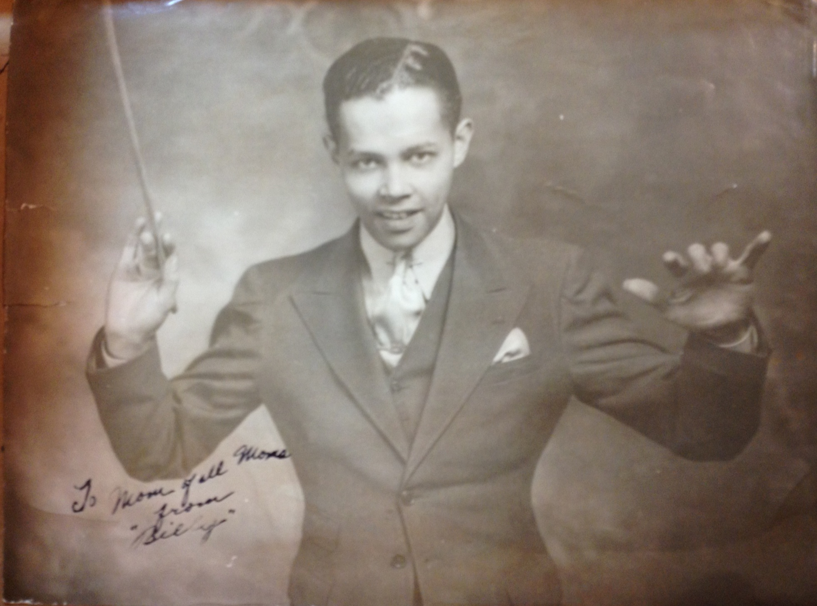
Billy Eckstine (then spelled “Eckstein”) in high school

Slide 6
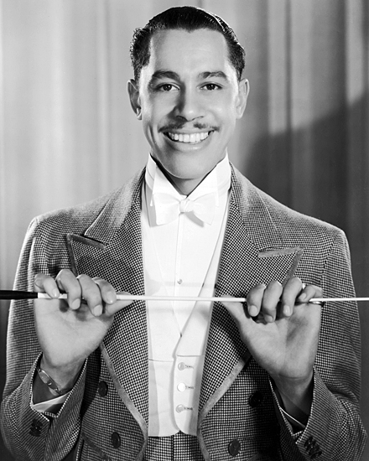
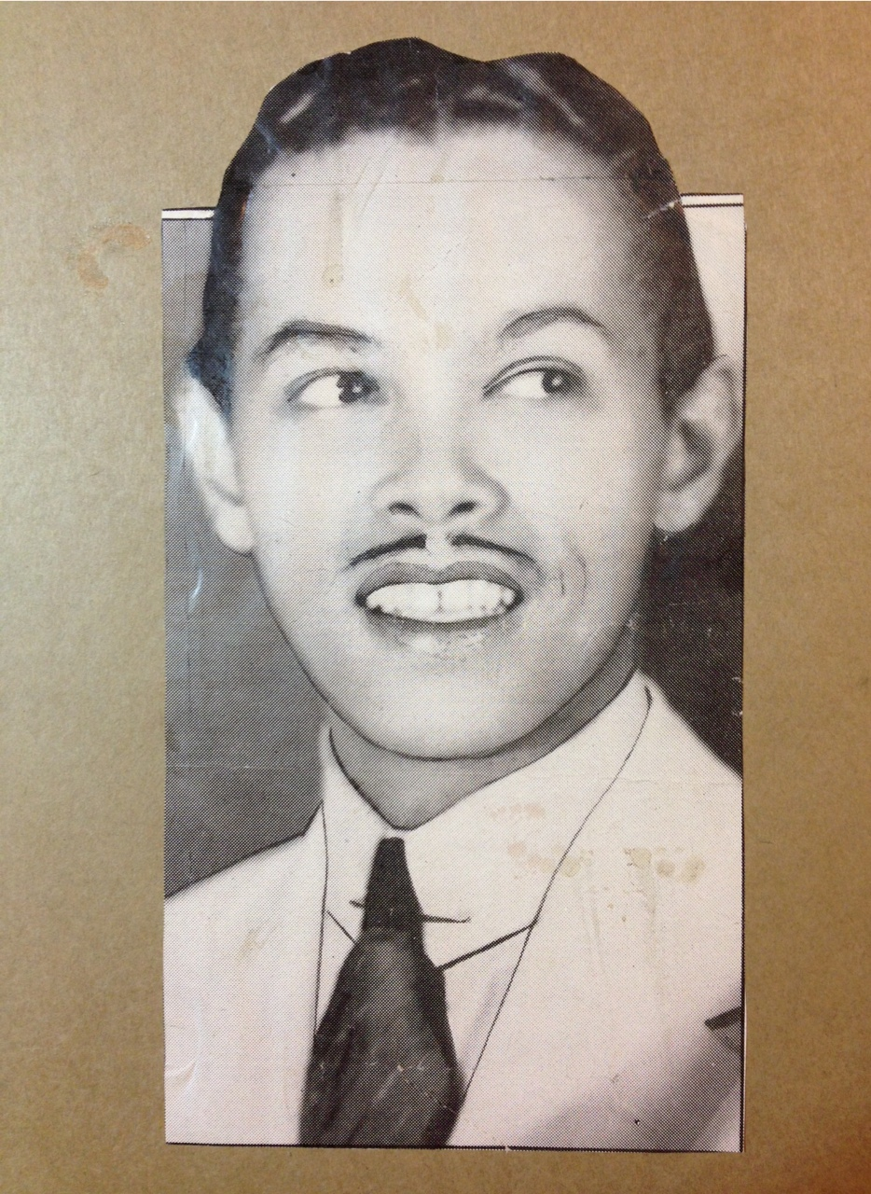
Billy
Cab

Slide 7
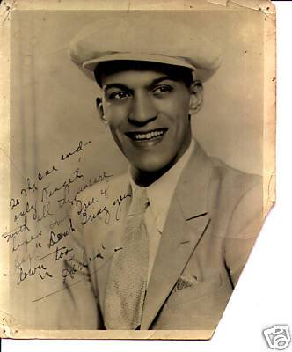
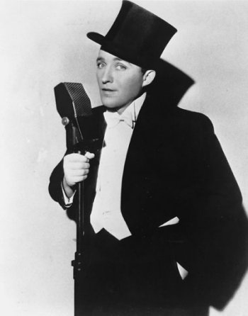
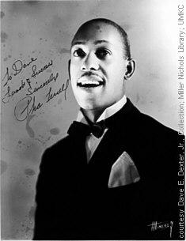
Harlan Lattimore
Bing Crosby
Pha Terrell

Slide 8
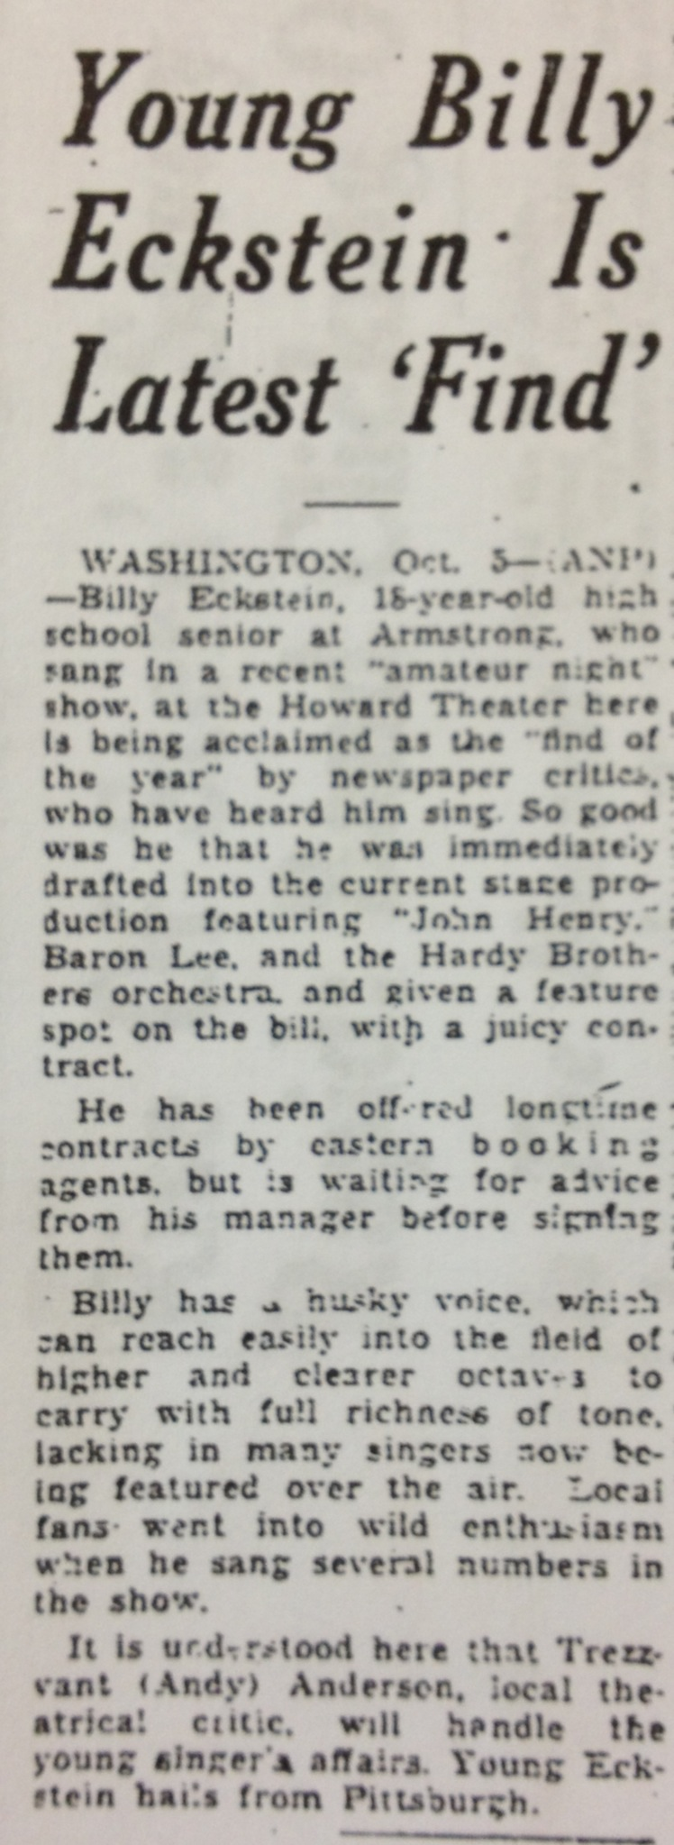
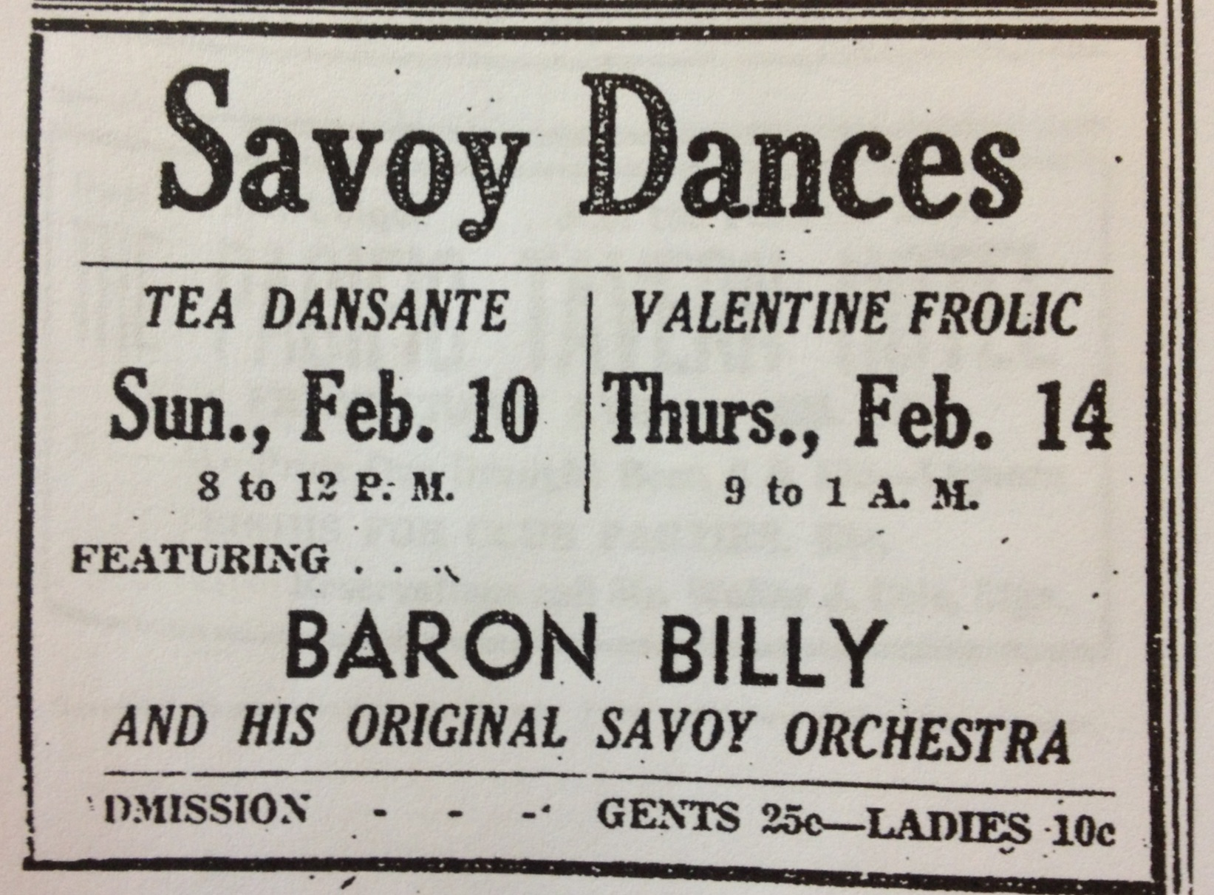
February 1935
October 1933

Slide 9
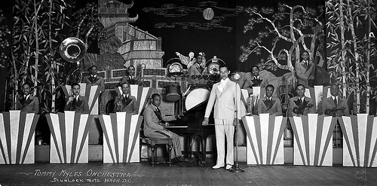
Leading the Tommy Myles Orchestra, 1934

Slide 10
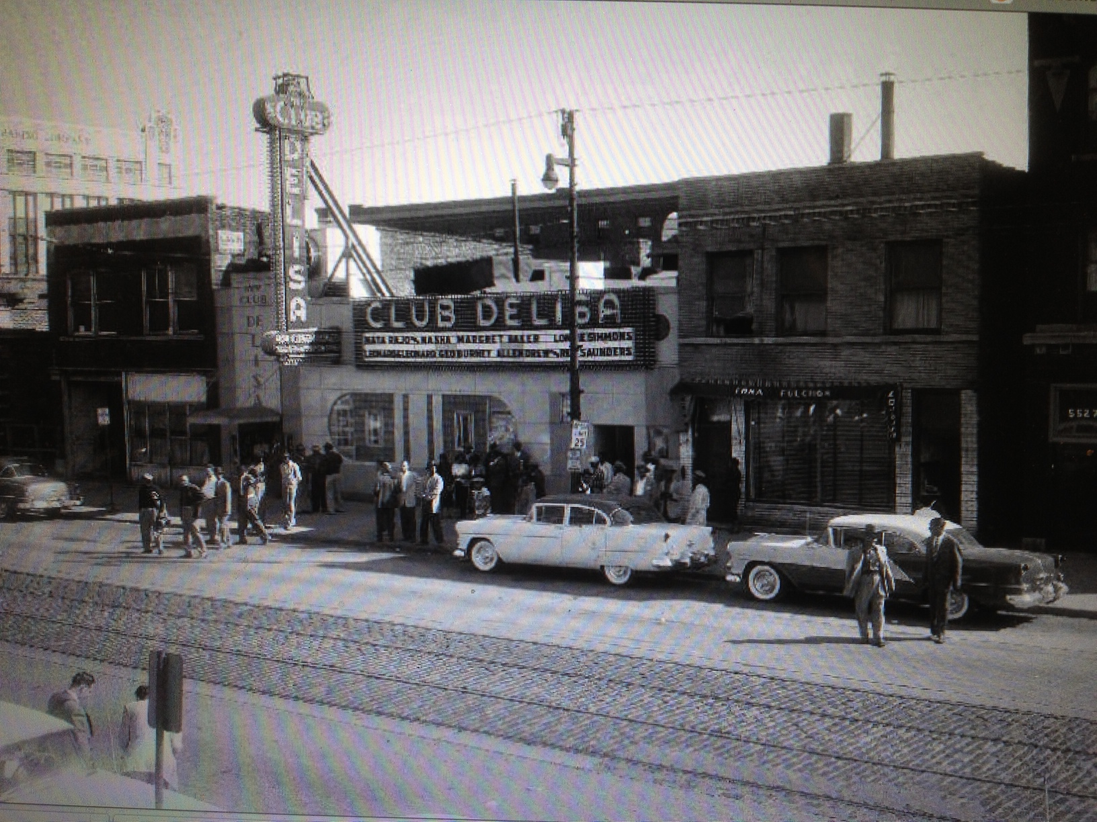
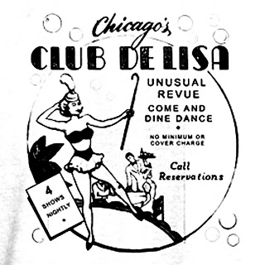

Slide 11
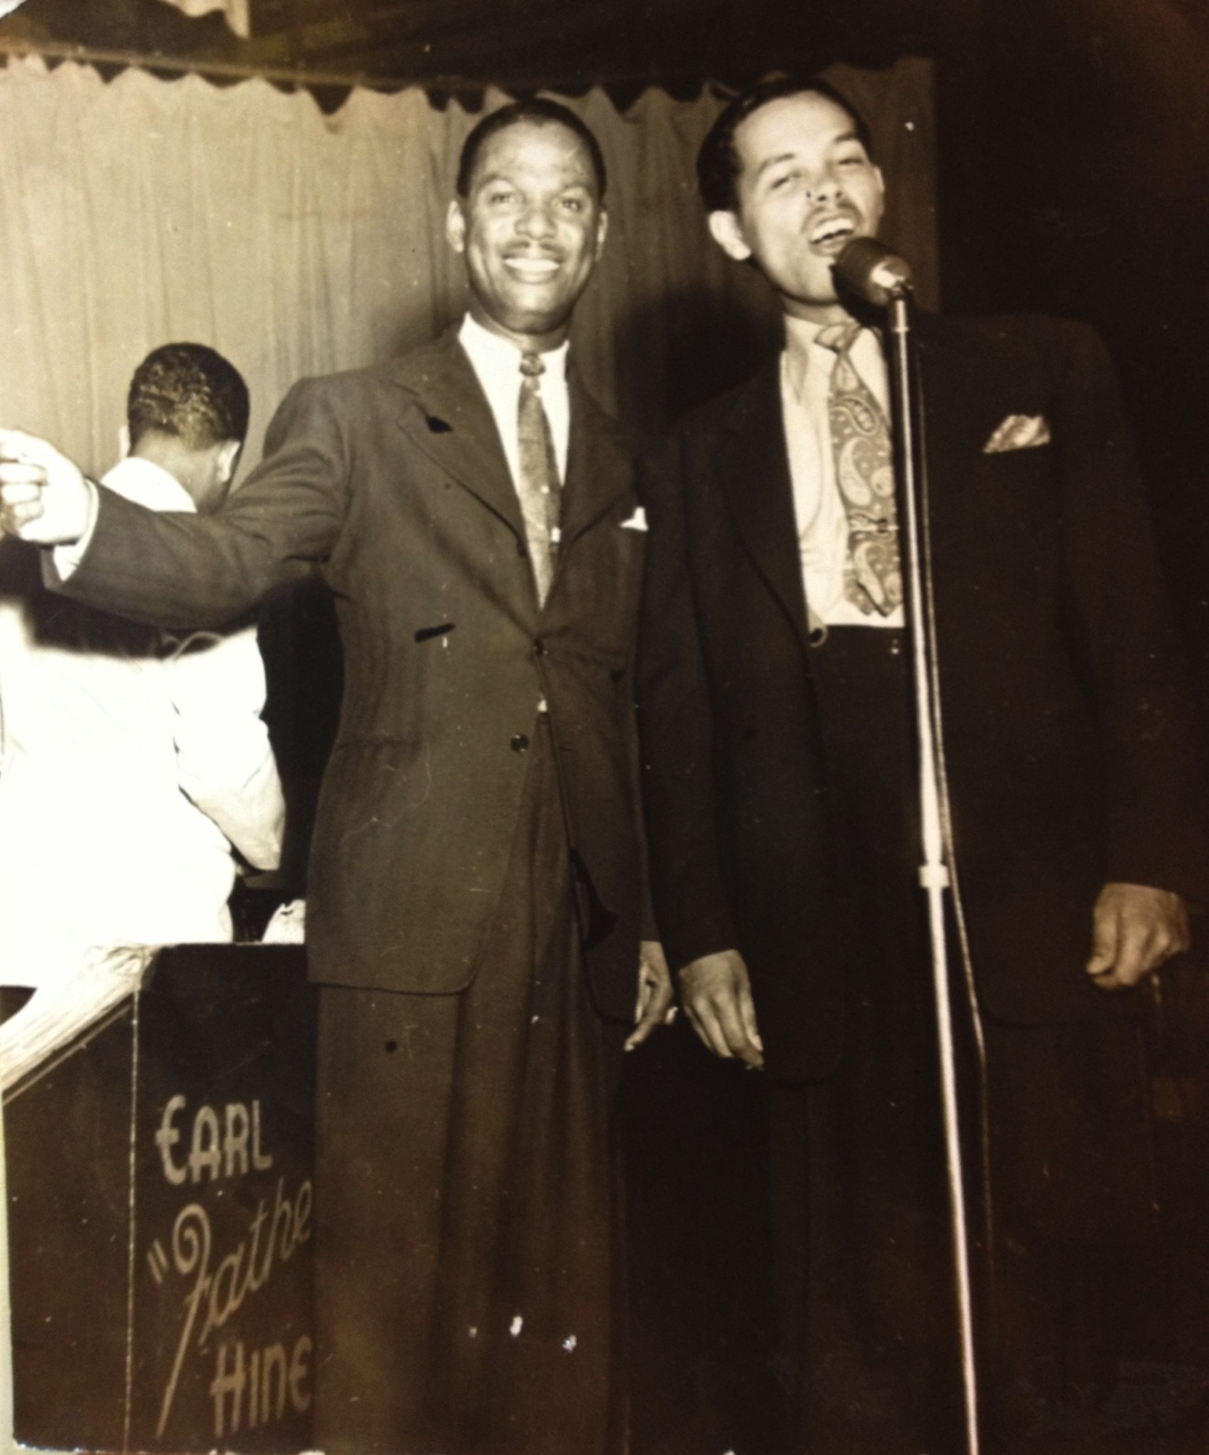
“Father” Hines & his singer,
Billy Eckstein

Slide 12
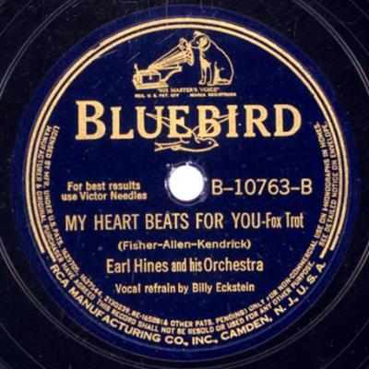
Billy Eckstine’s 1st record, recorded February 13, 1940

Slide 13
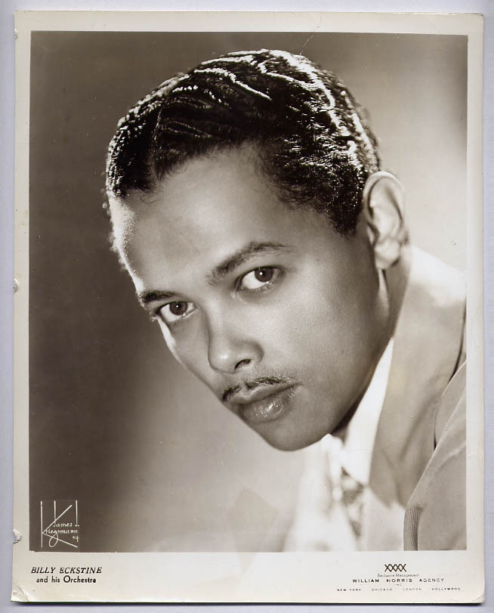

Slide 14
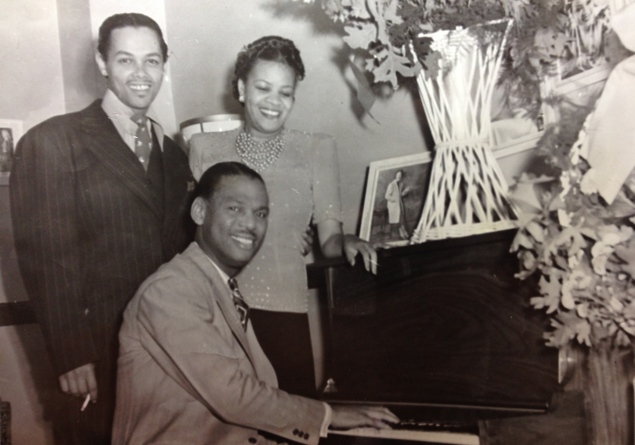
With vocalist Madeline Greene, & Earl Hines, c. 1940

Slide 15
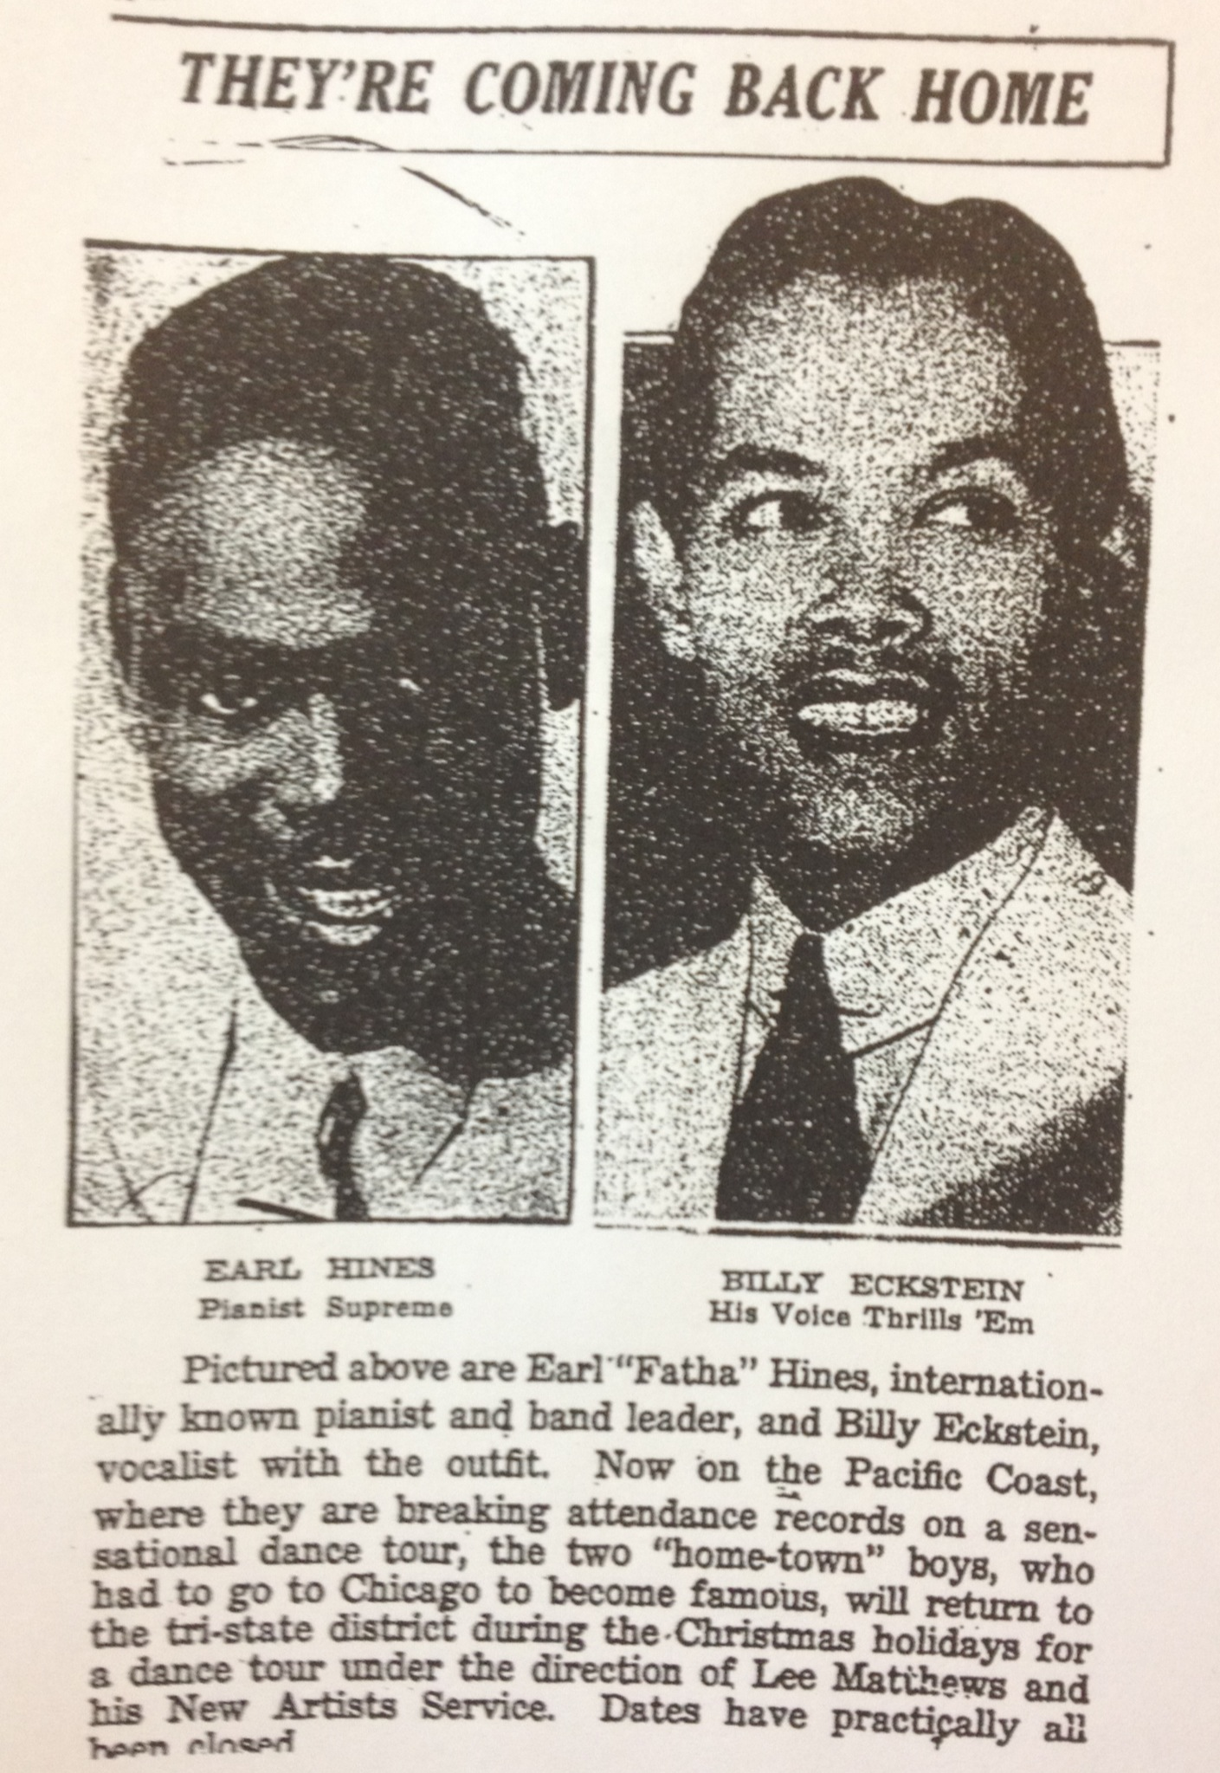
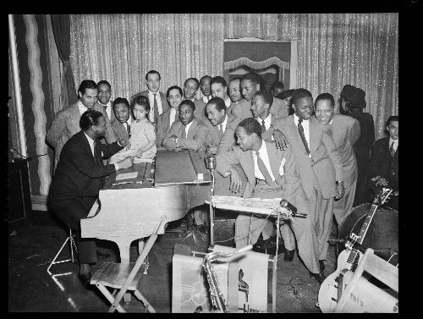
Pittsburgh Courier, November 1940

Slide 16
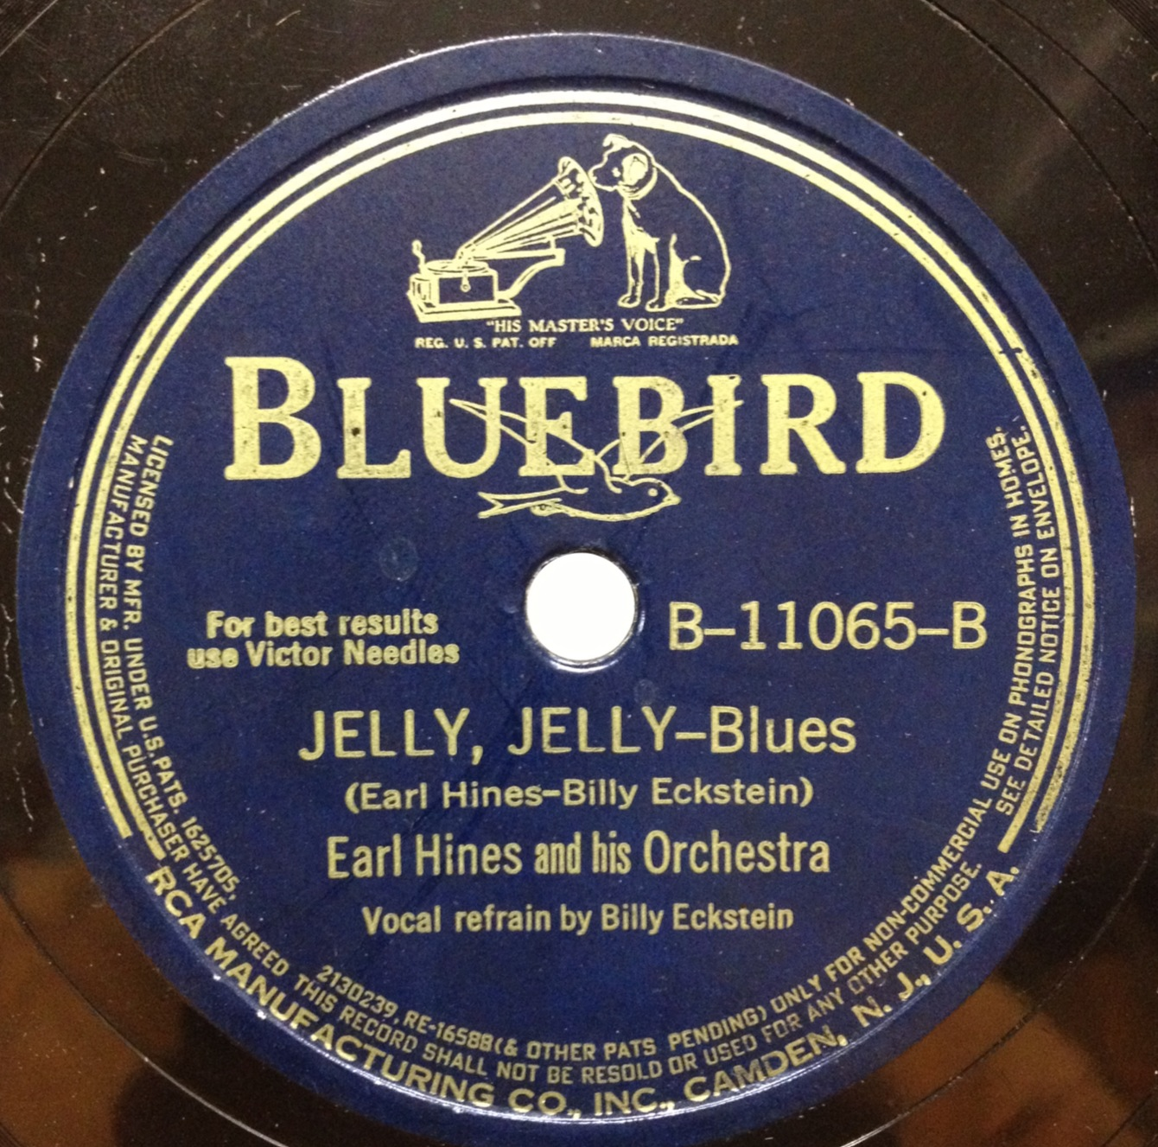
December 2, 1940

Slide 17
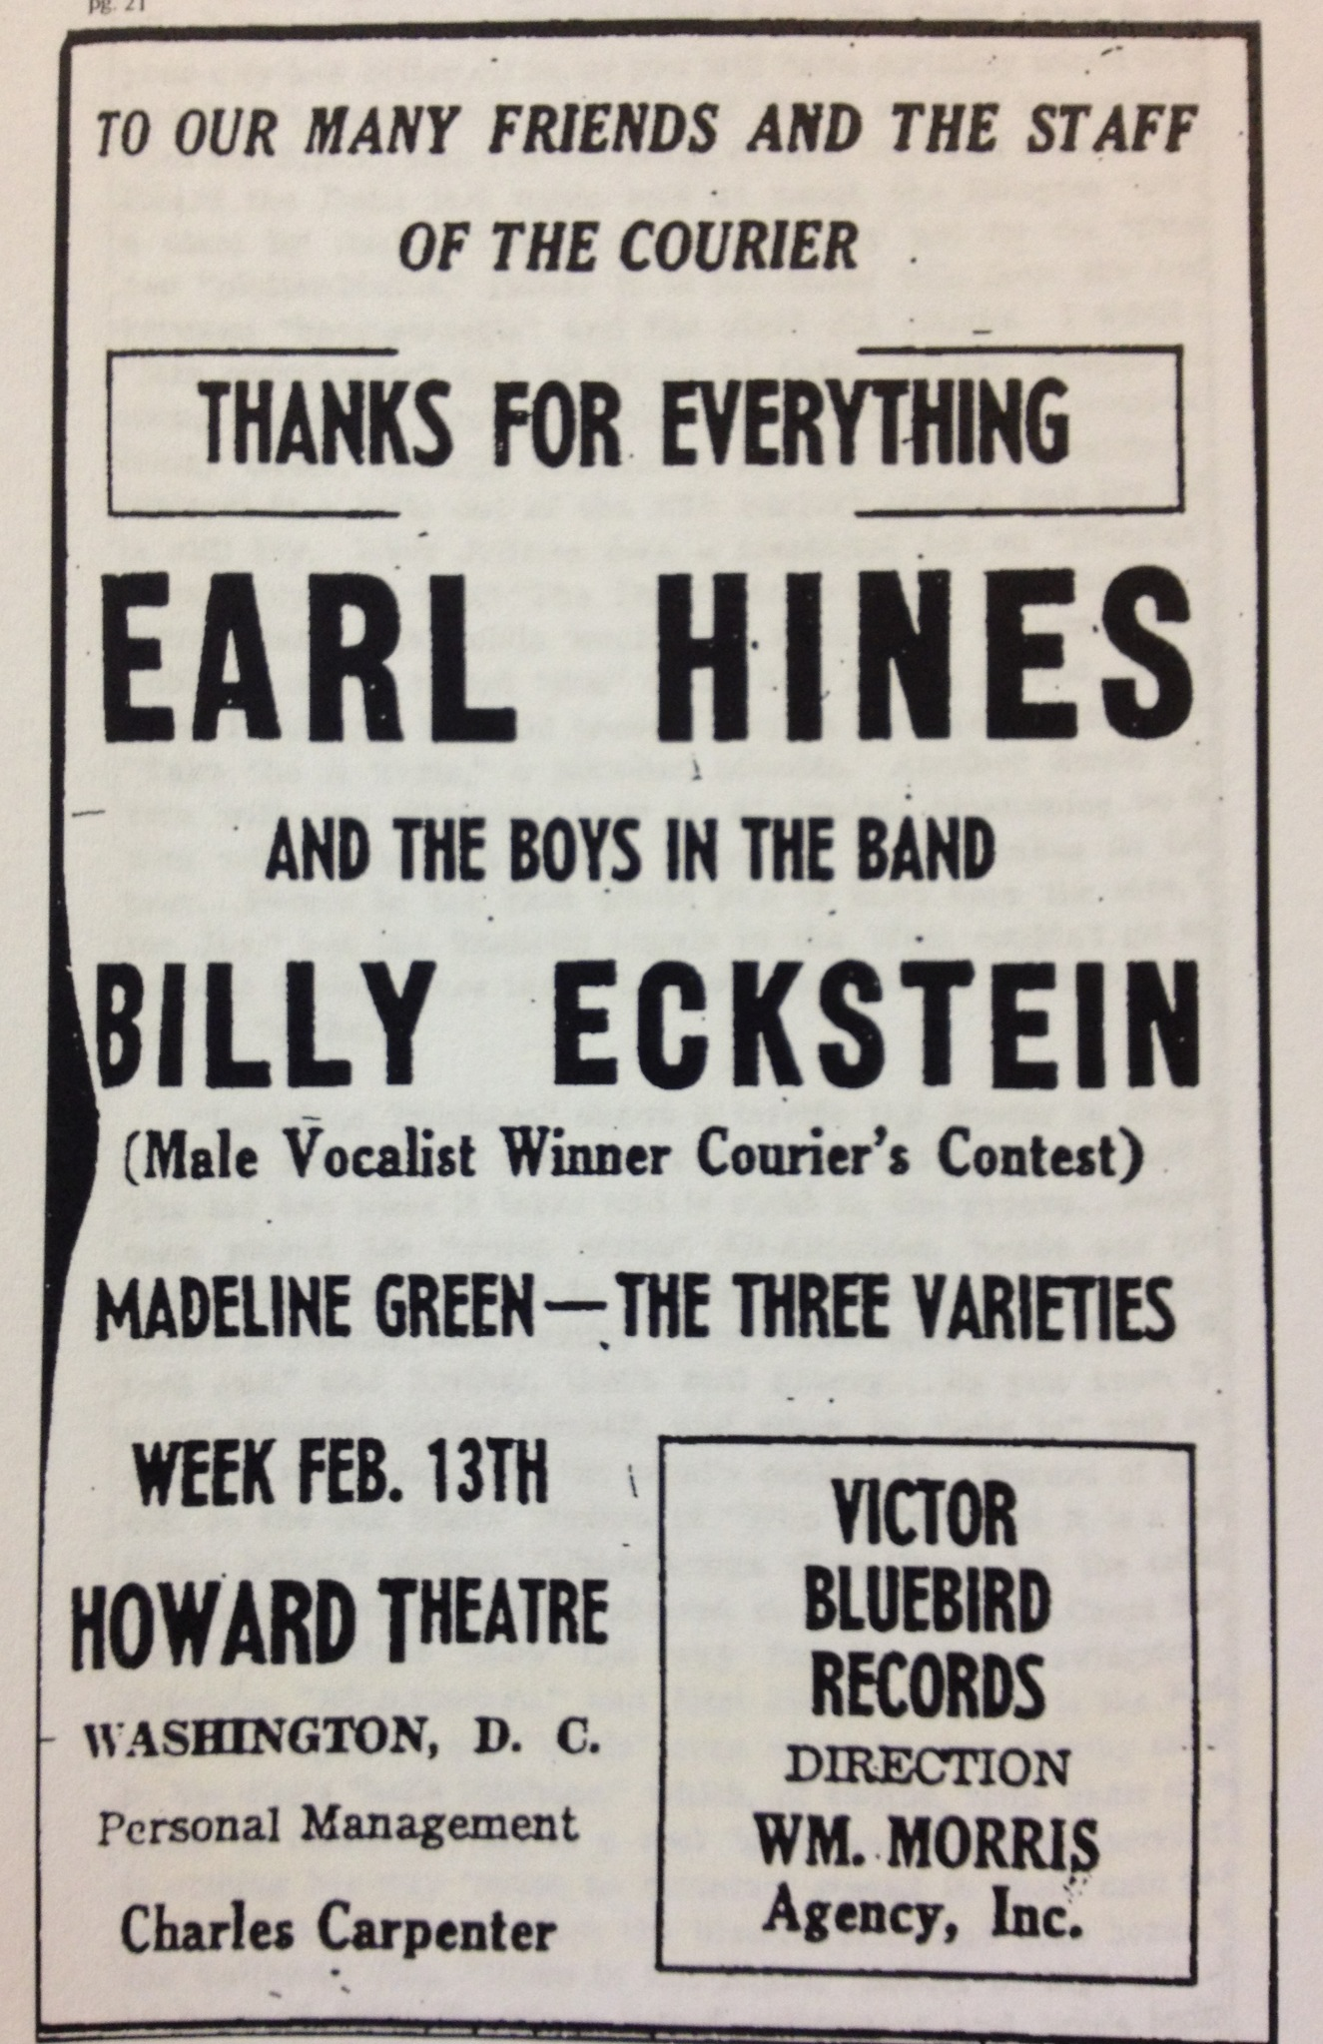
Pittsburgh Courier, 1942

Slide 18
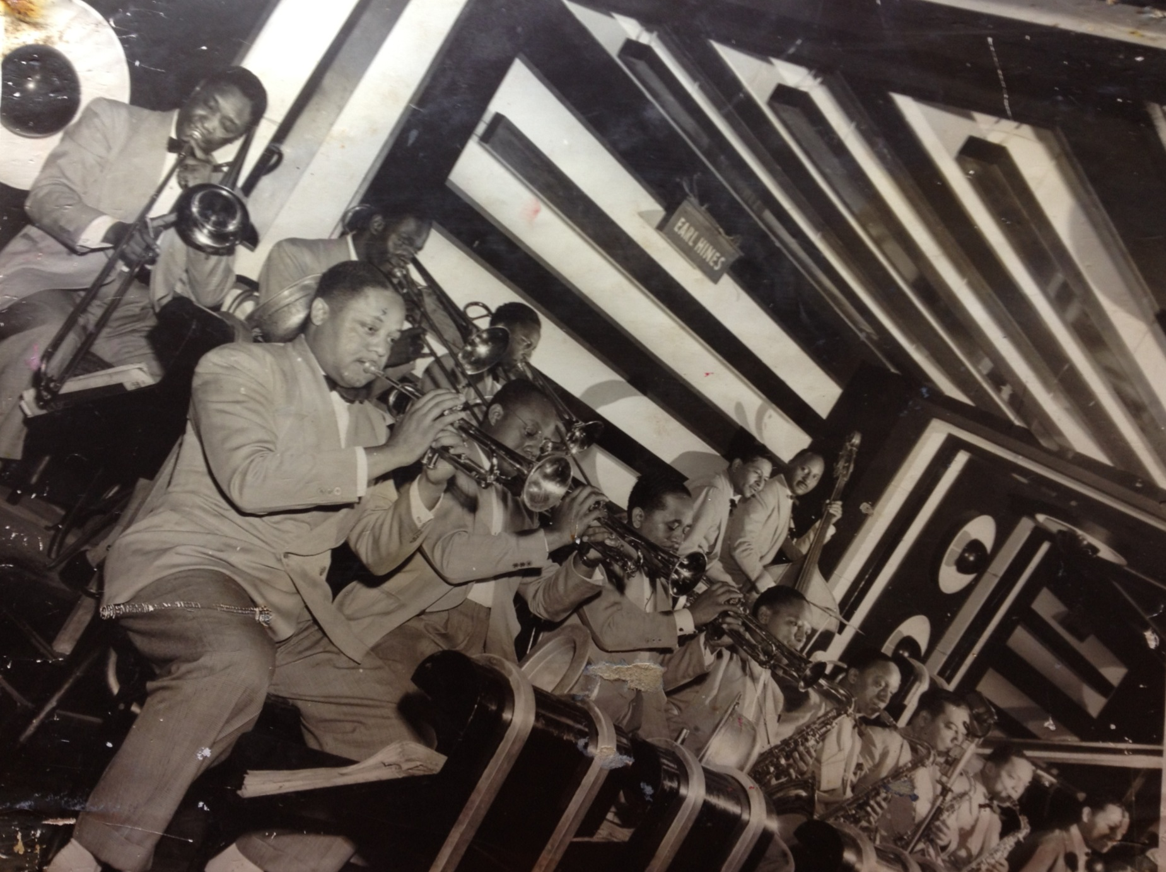

Slide 19
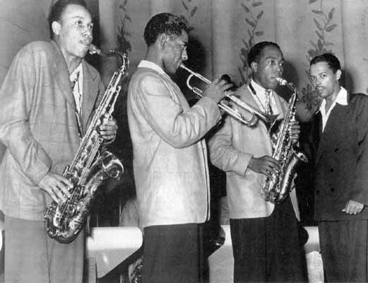
Lucky Thompson, Dizzy Gillespie, Bird, & B

Slide 20
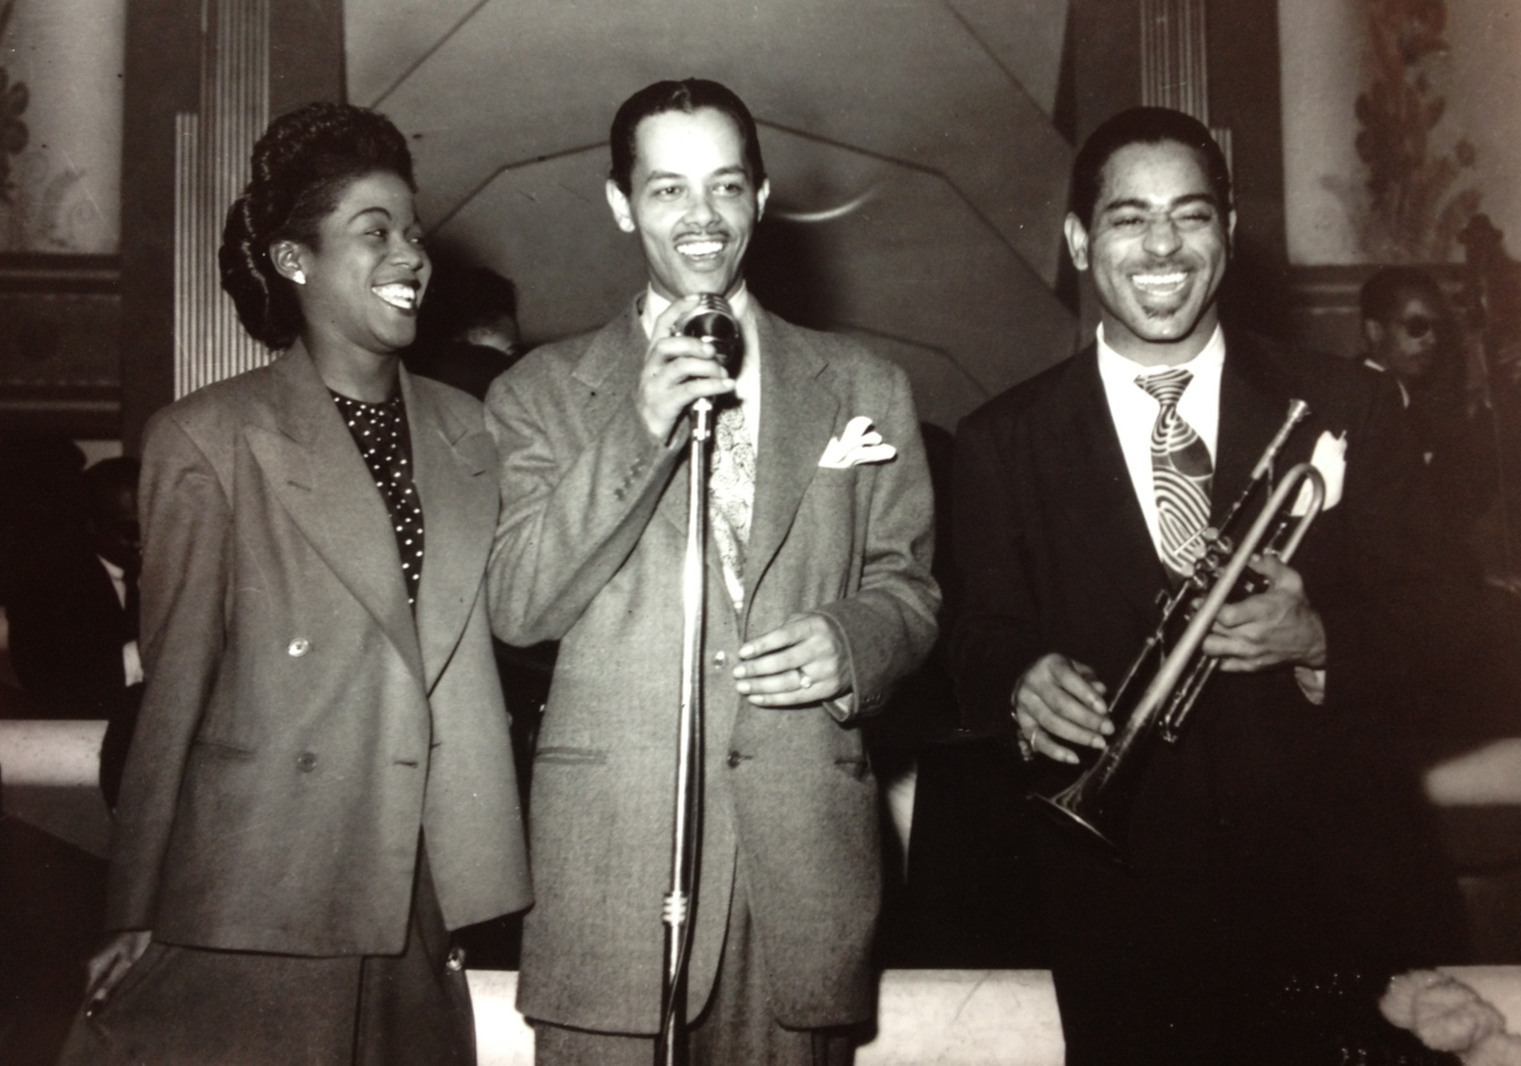
Sarah Vaughan, Billy Eckstine & Dizzy Gillespie, 1944

Slide 21
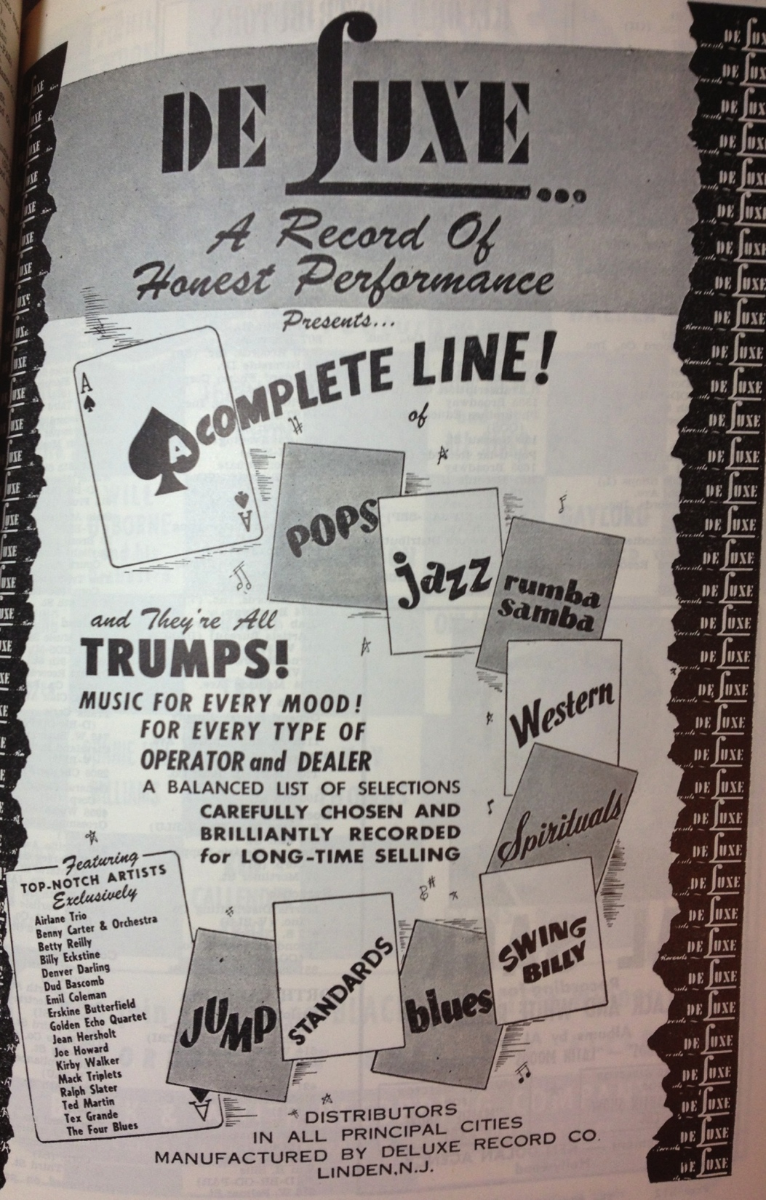

Slide 22
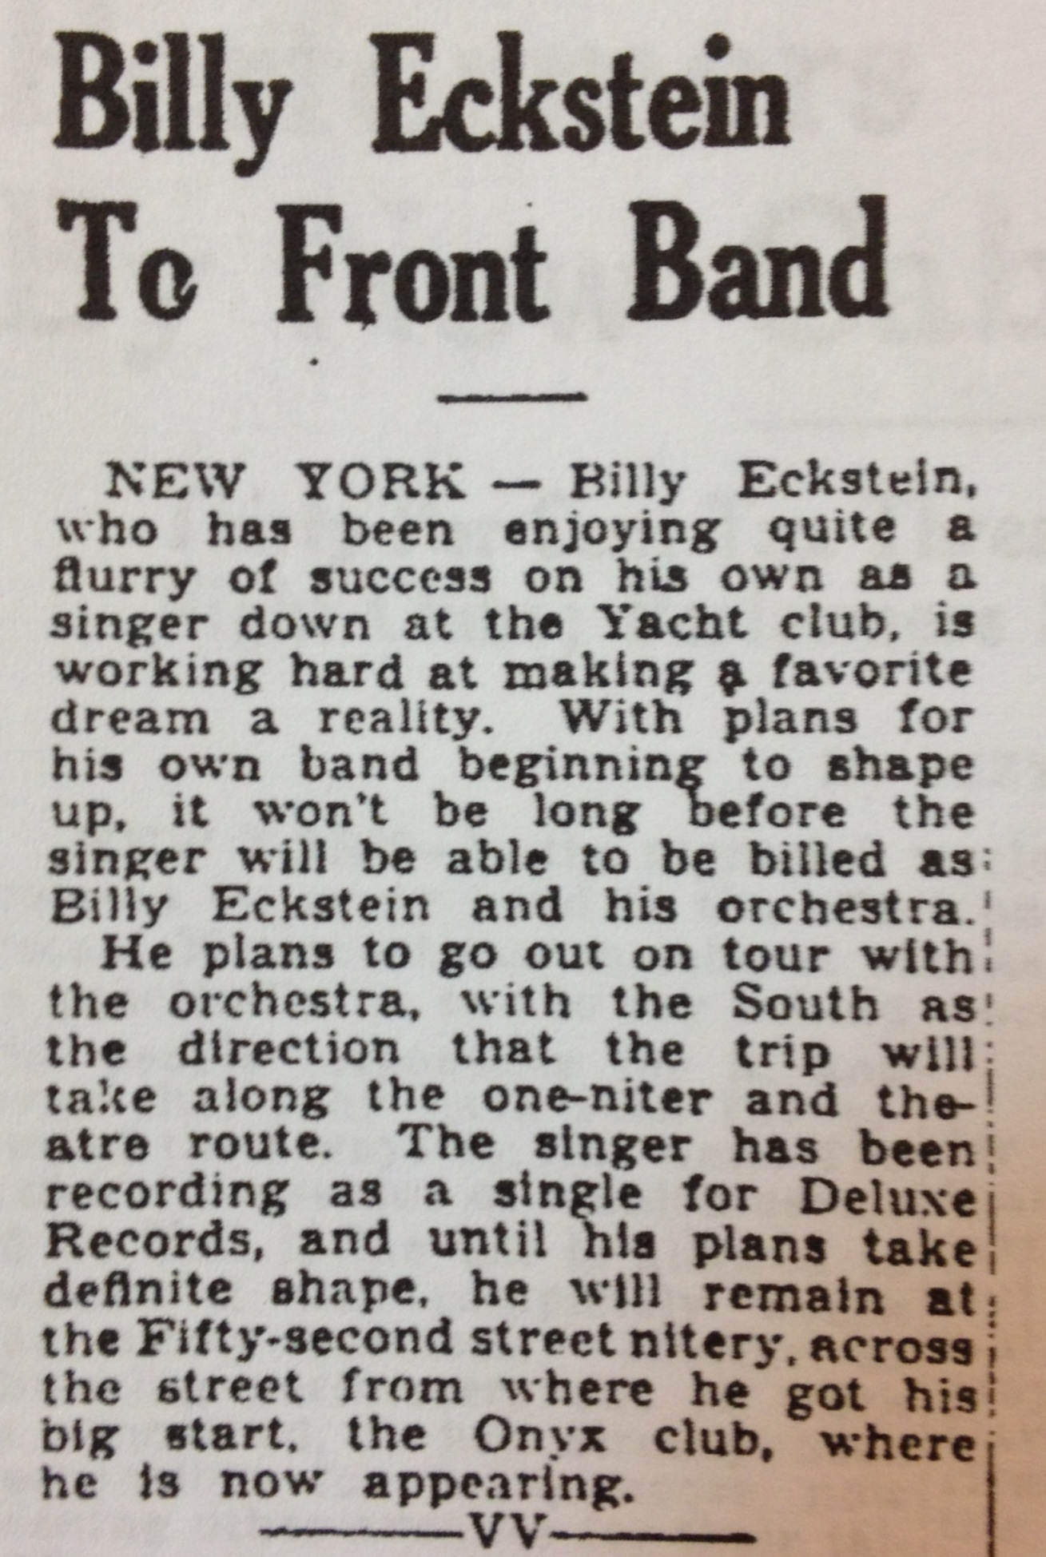
April 1944

Slide 23
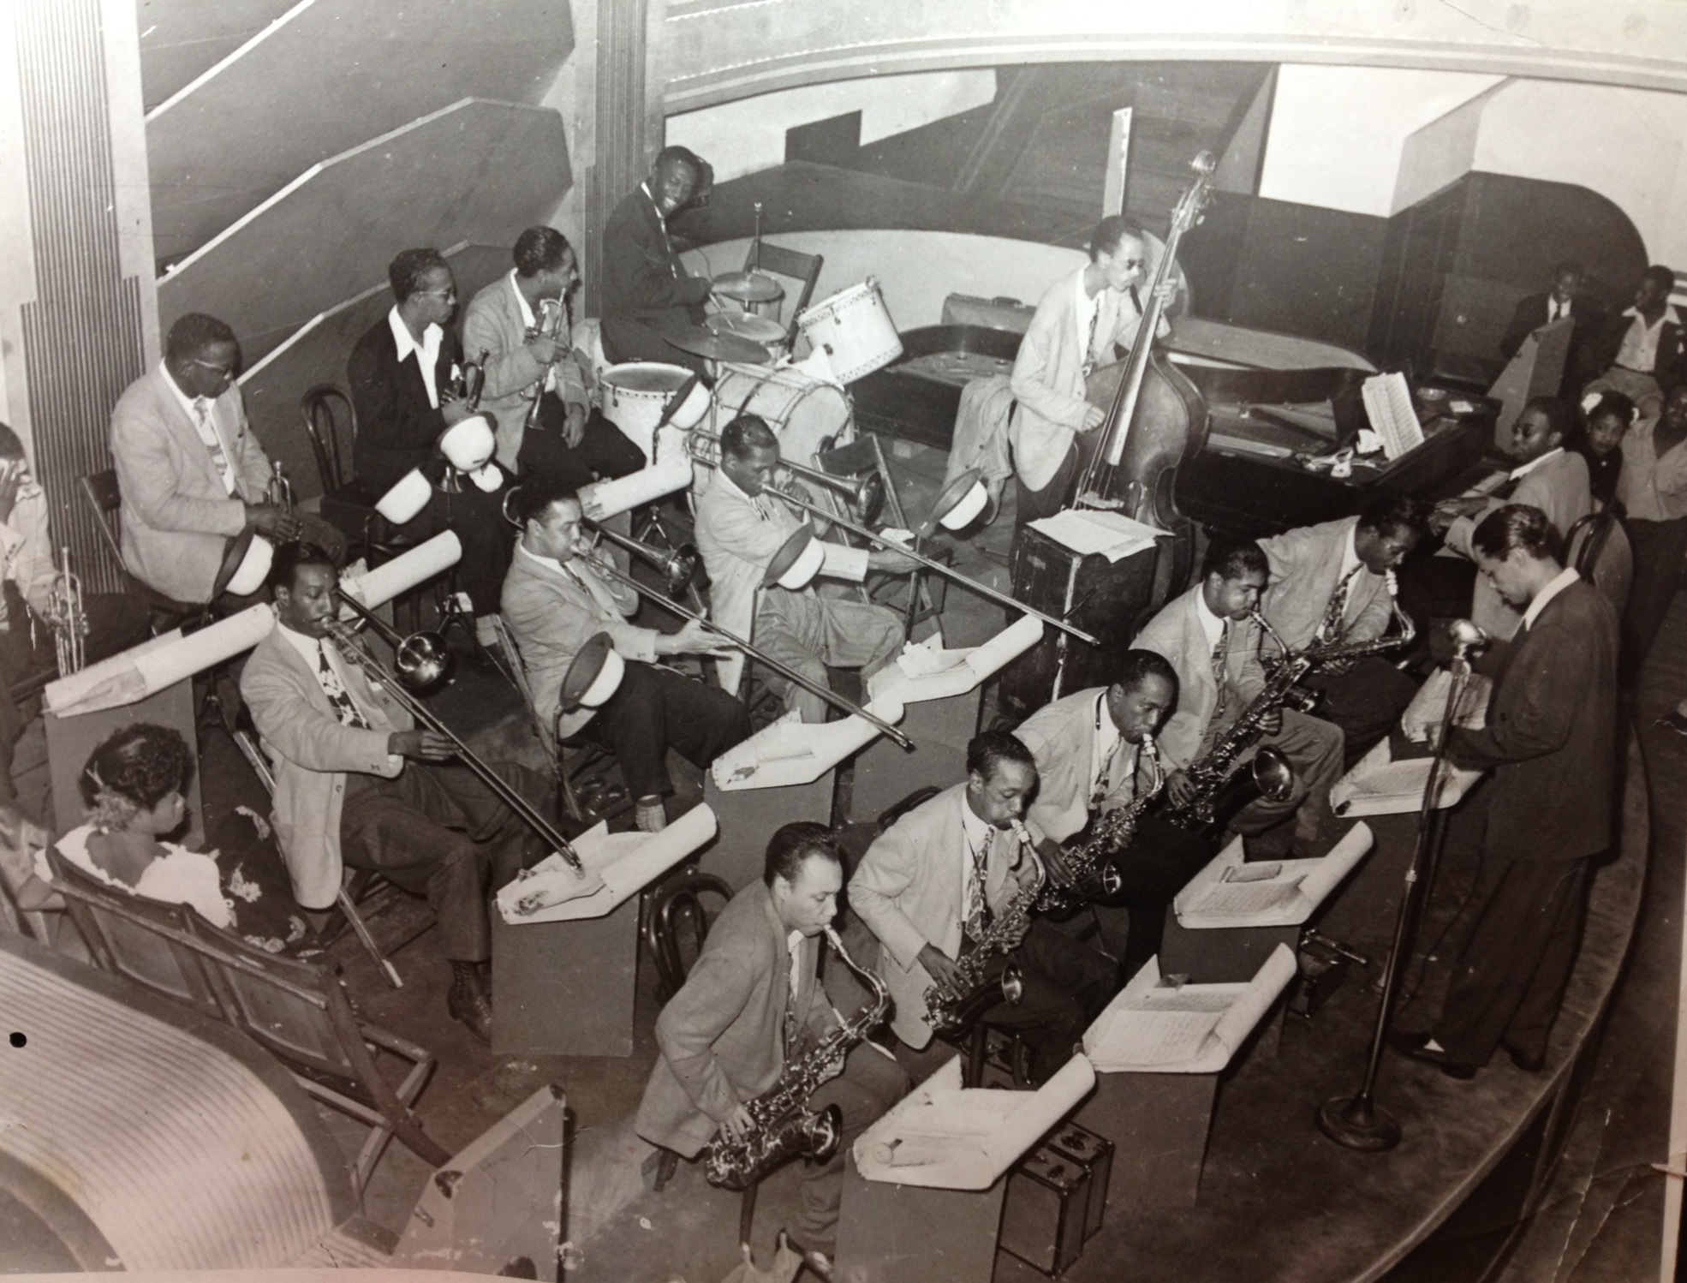
Billy Eckstine & his Orchestra, c. 1944

Slide 24
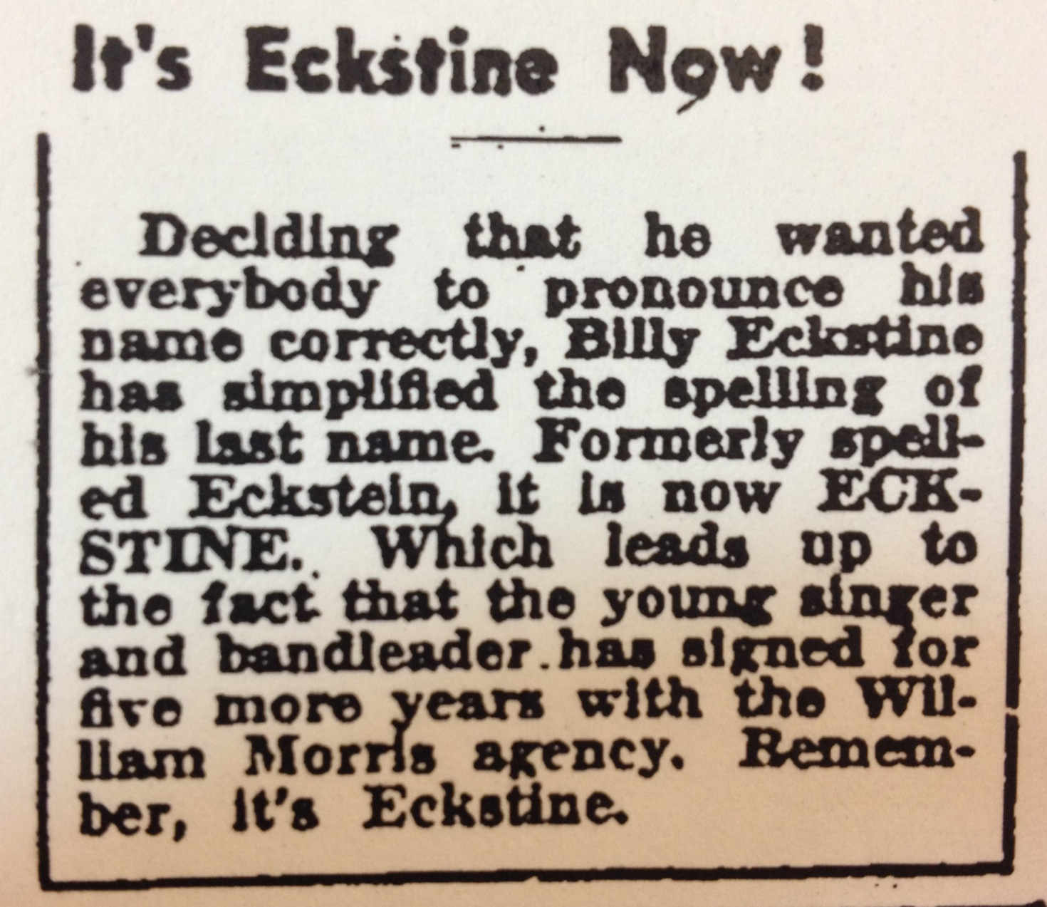

Slide 25
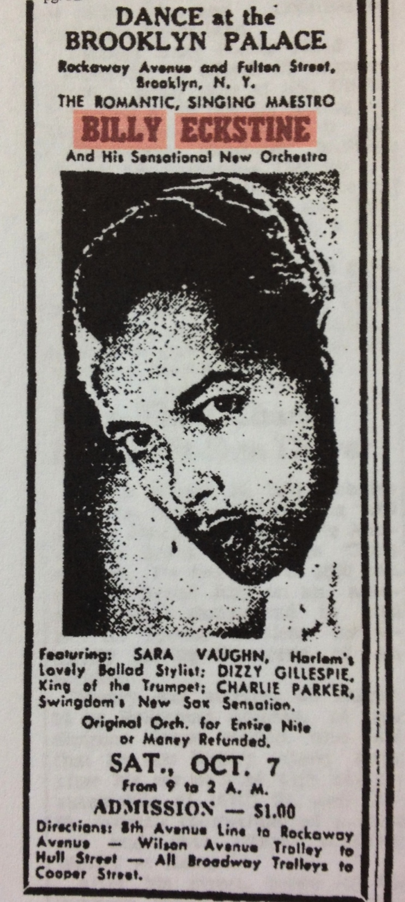
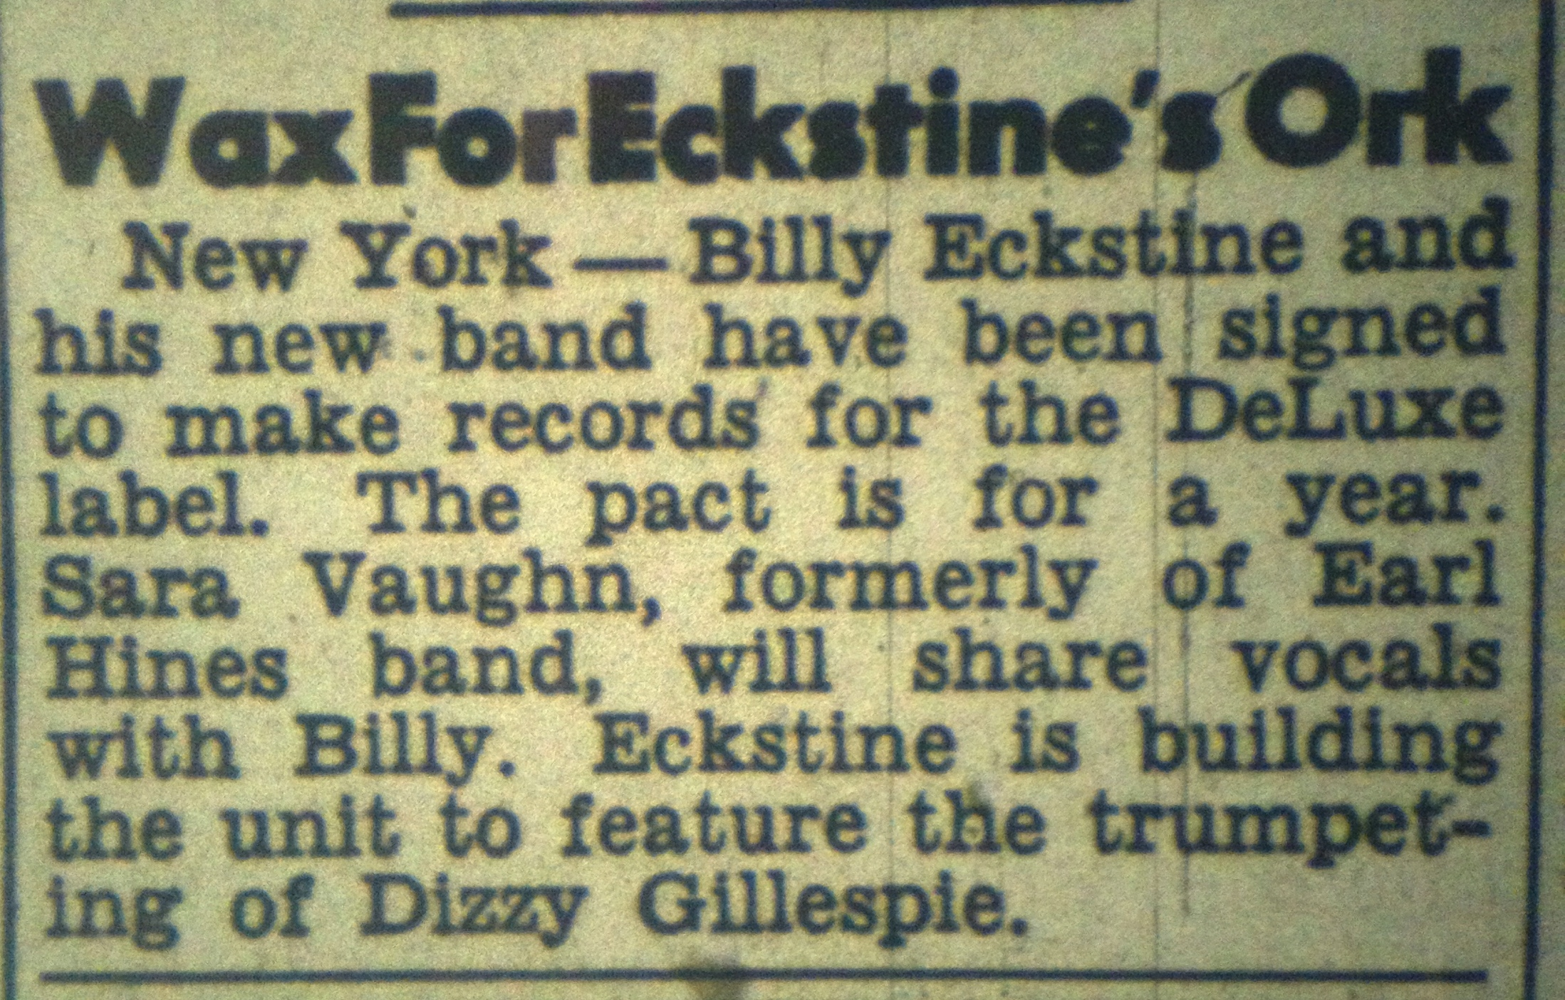

Slide 26
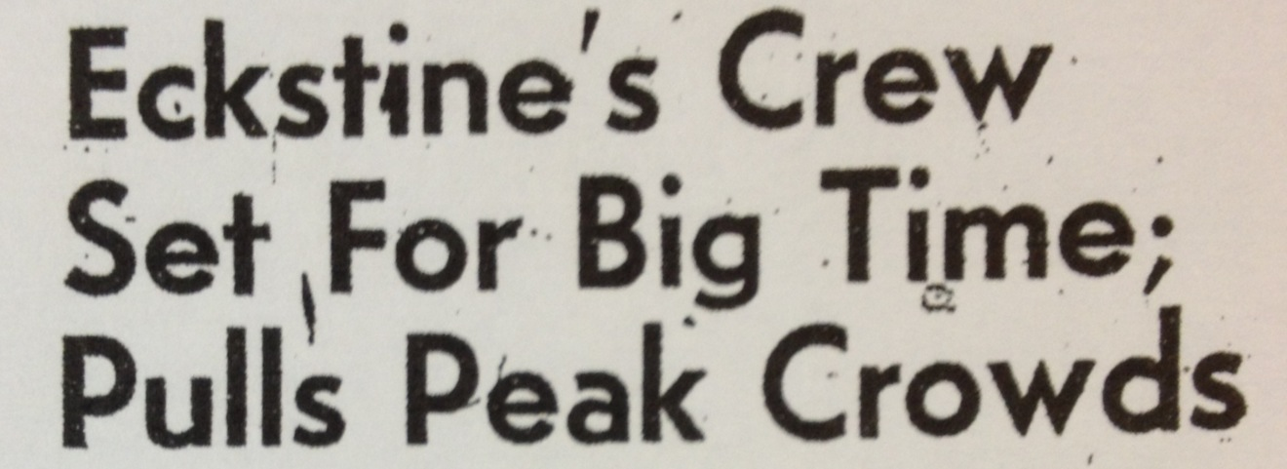
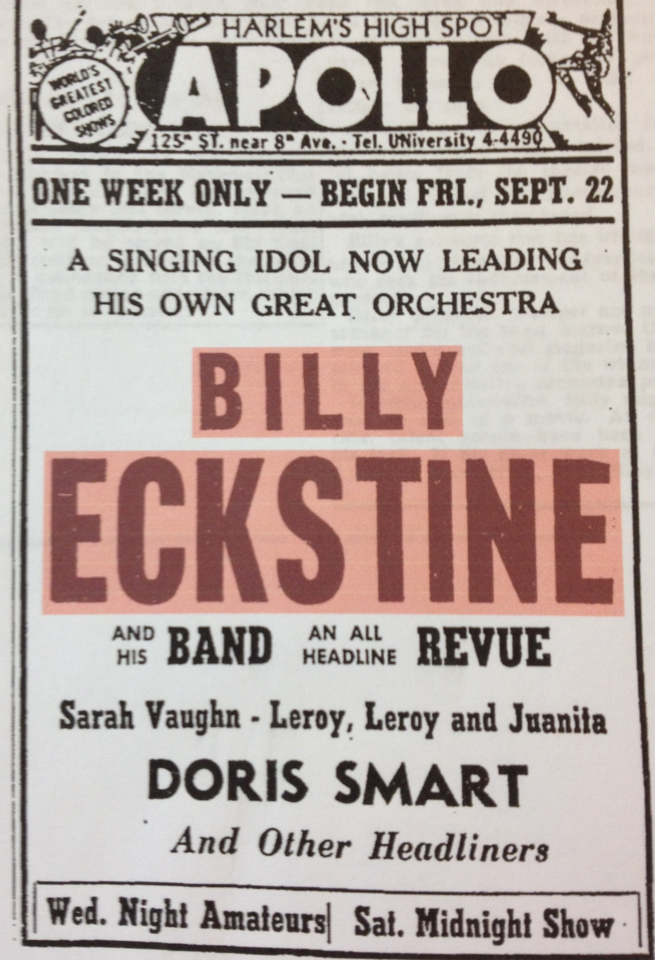
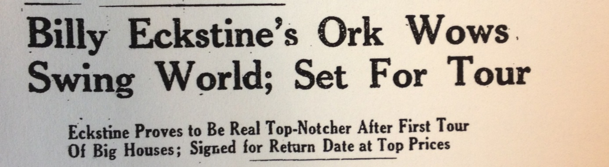
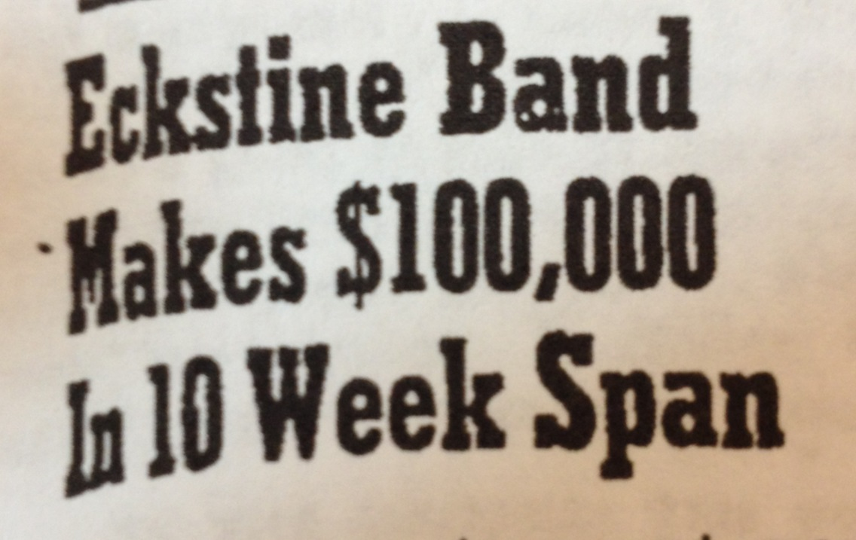
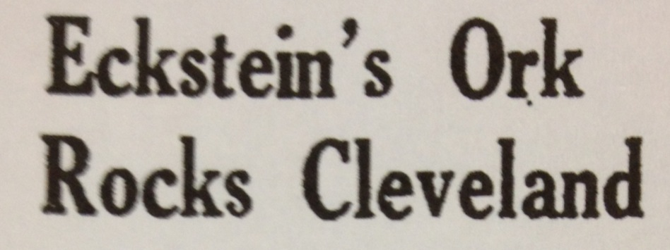

Slide 27
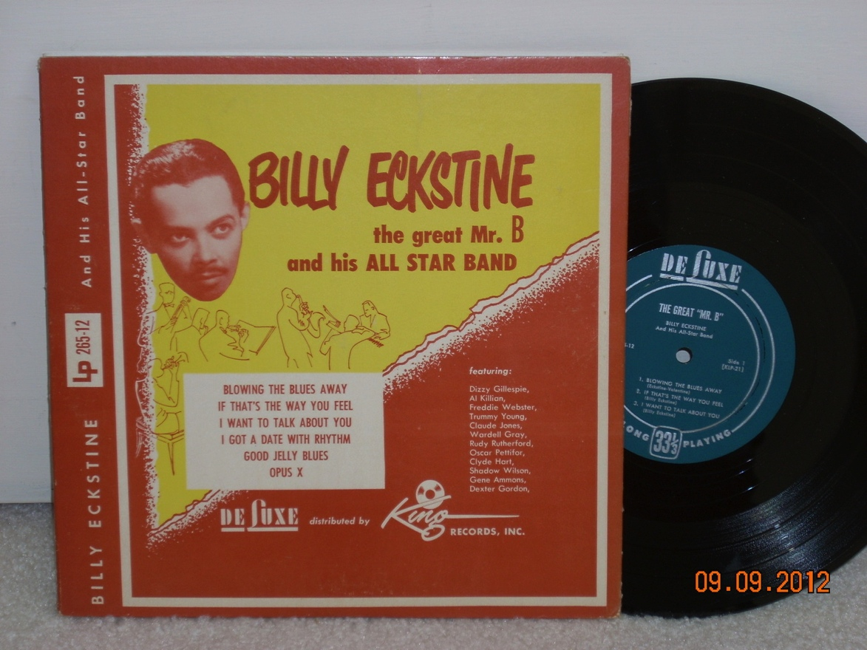
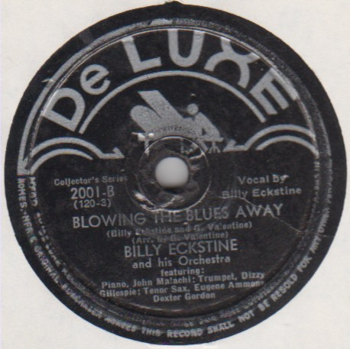

Slide 28
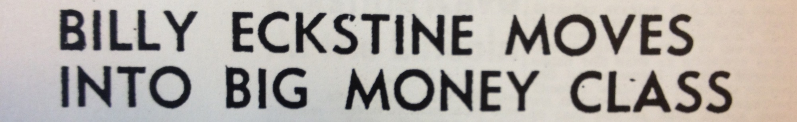
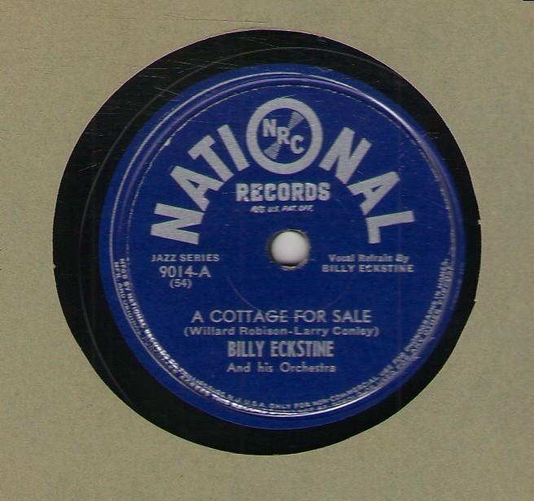
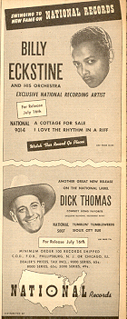

Slide 29
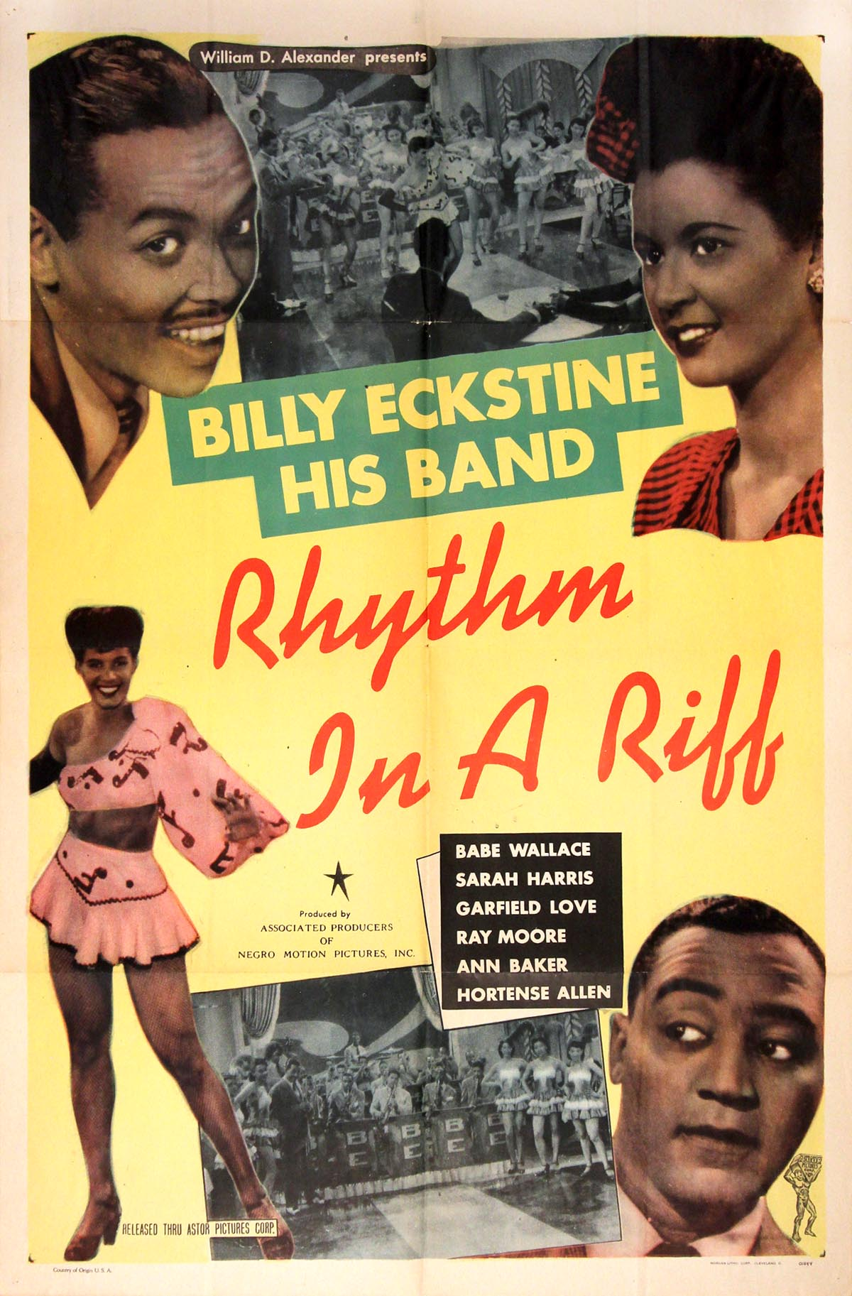

Slide 30
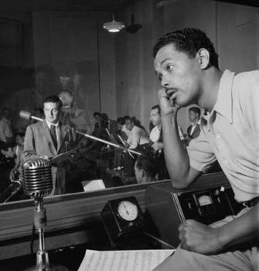

Slide 31
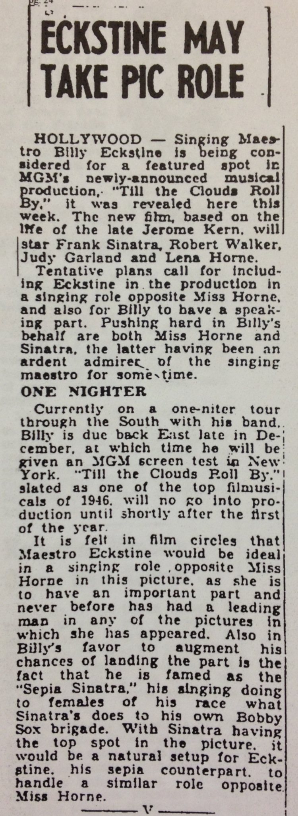
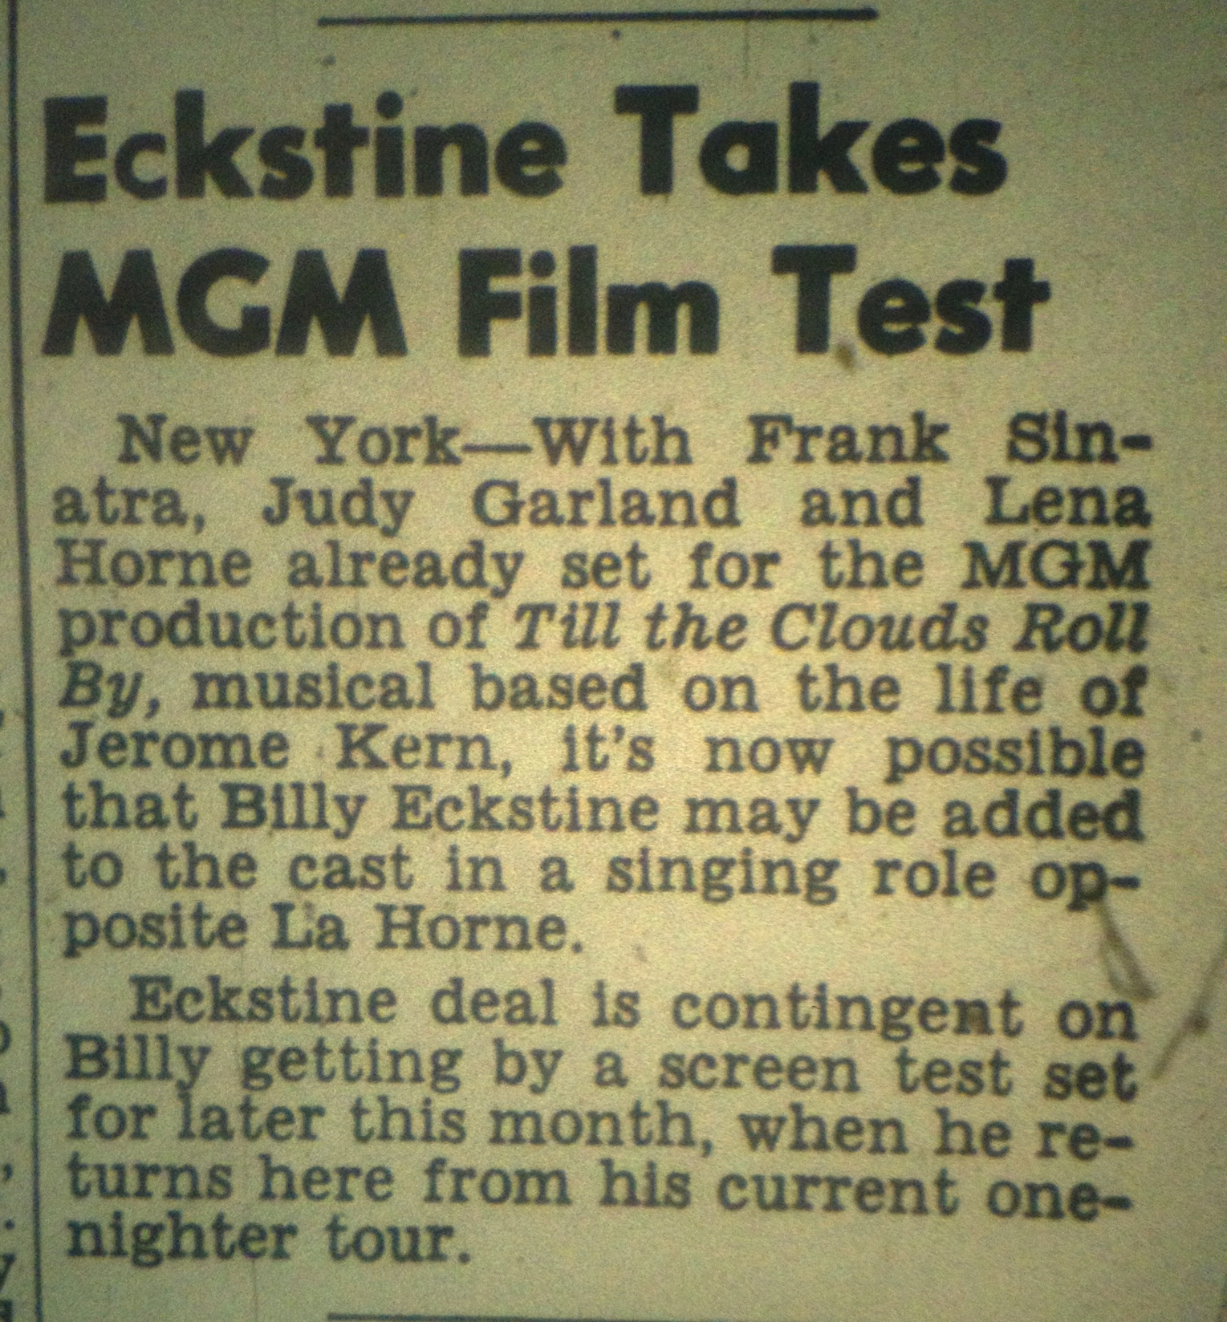
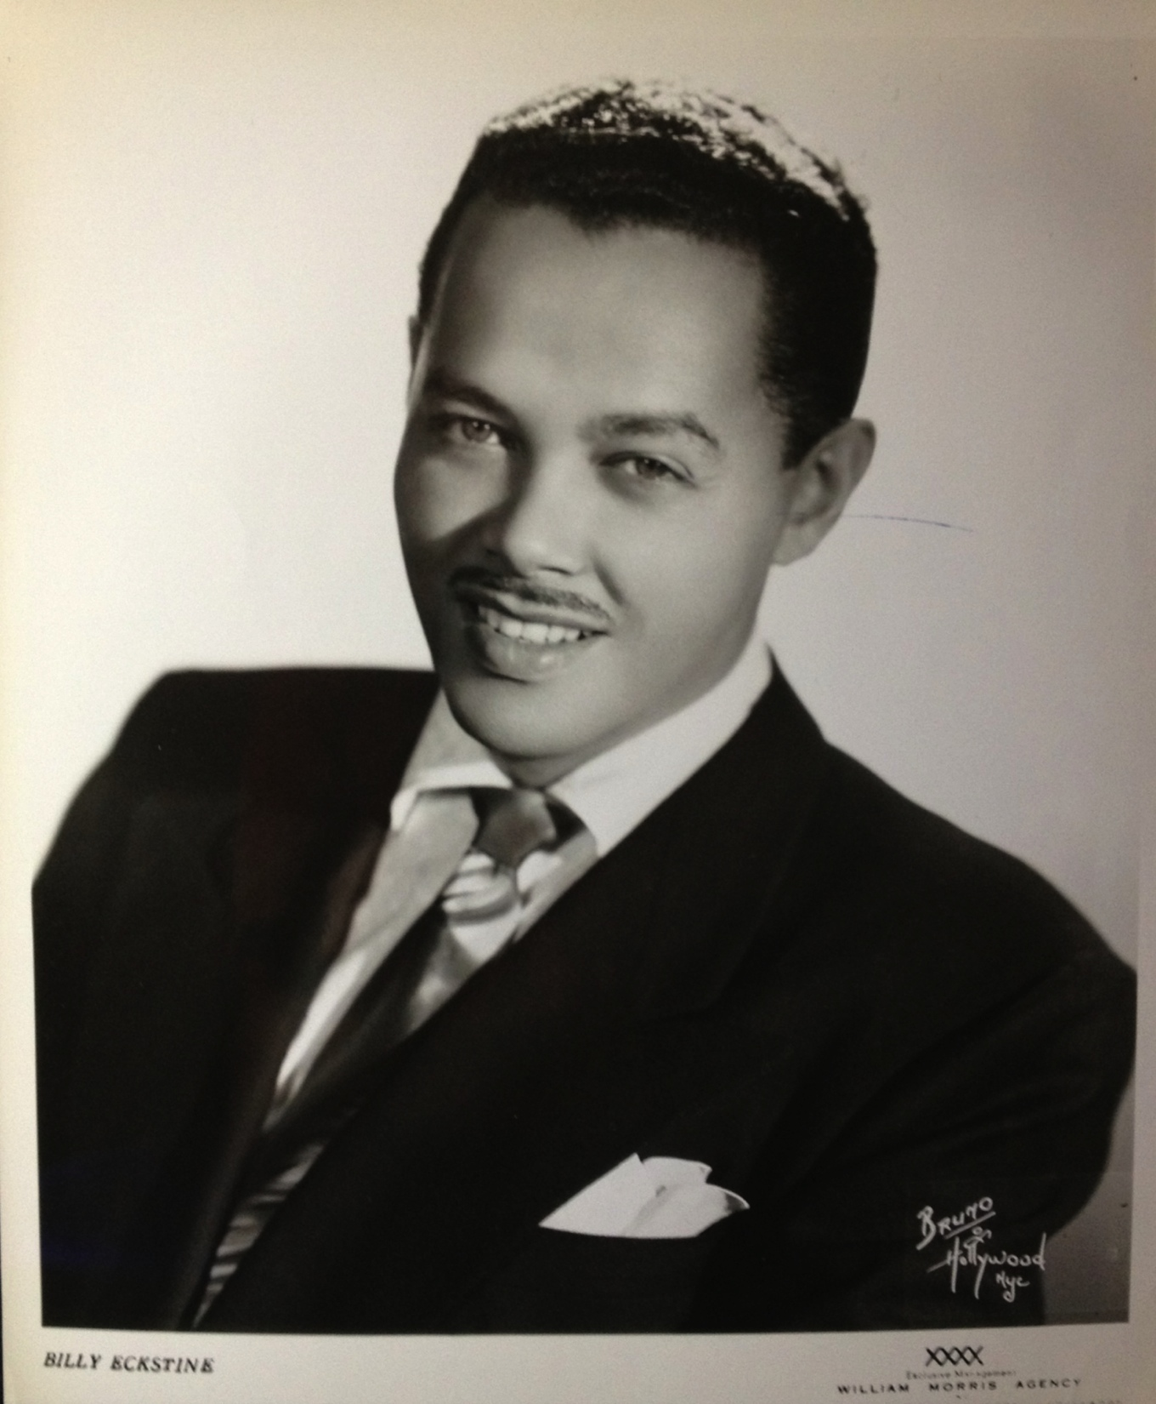

Slide 32
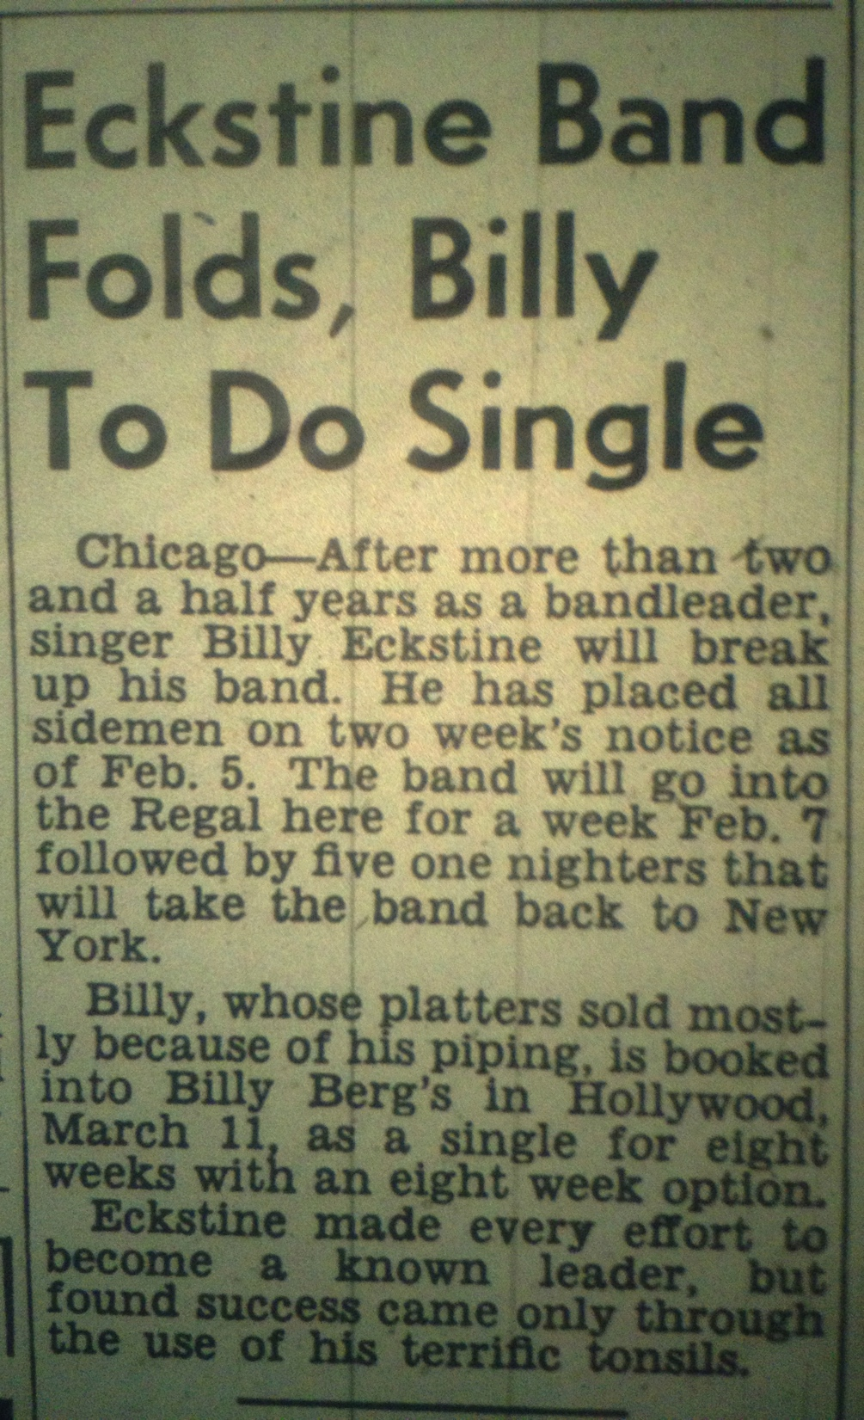
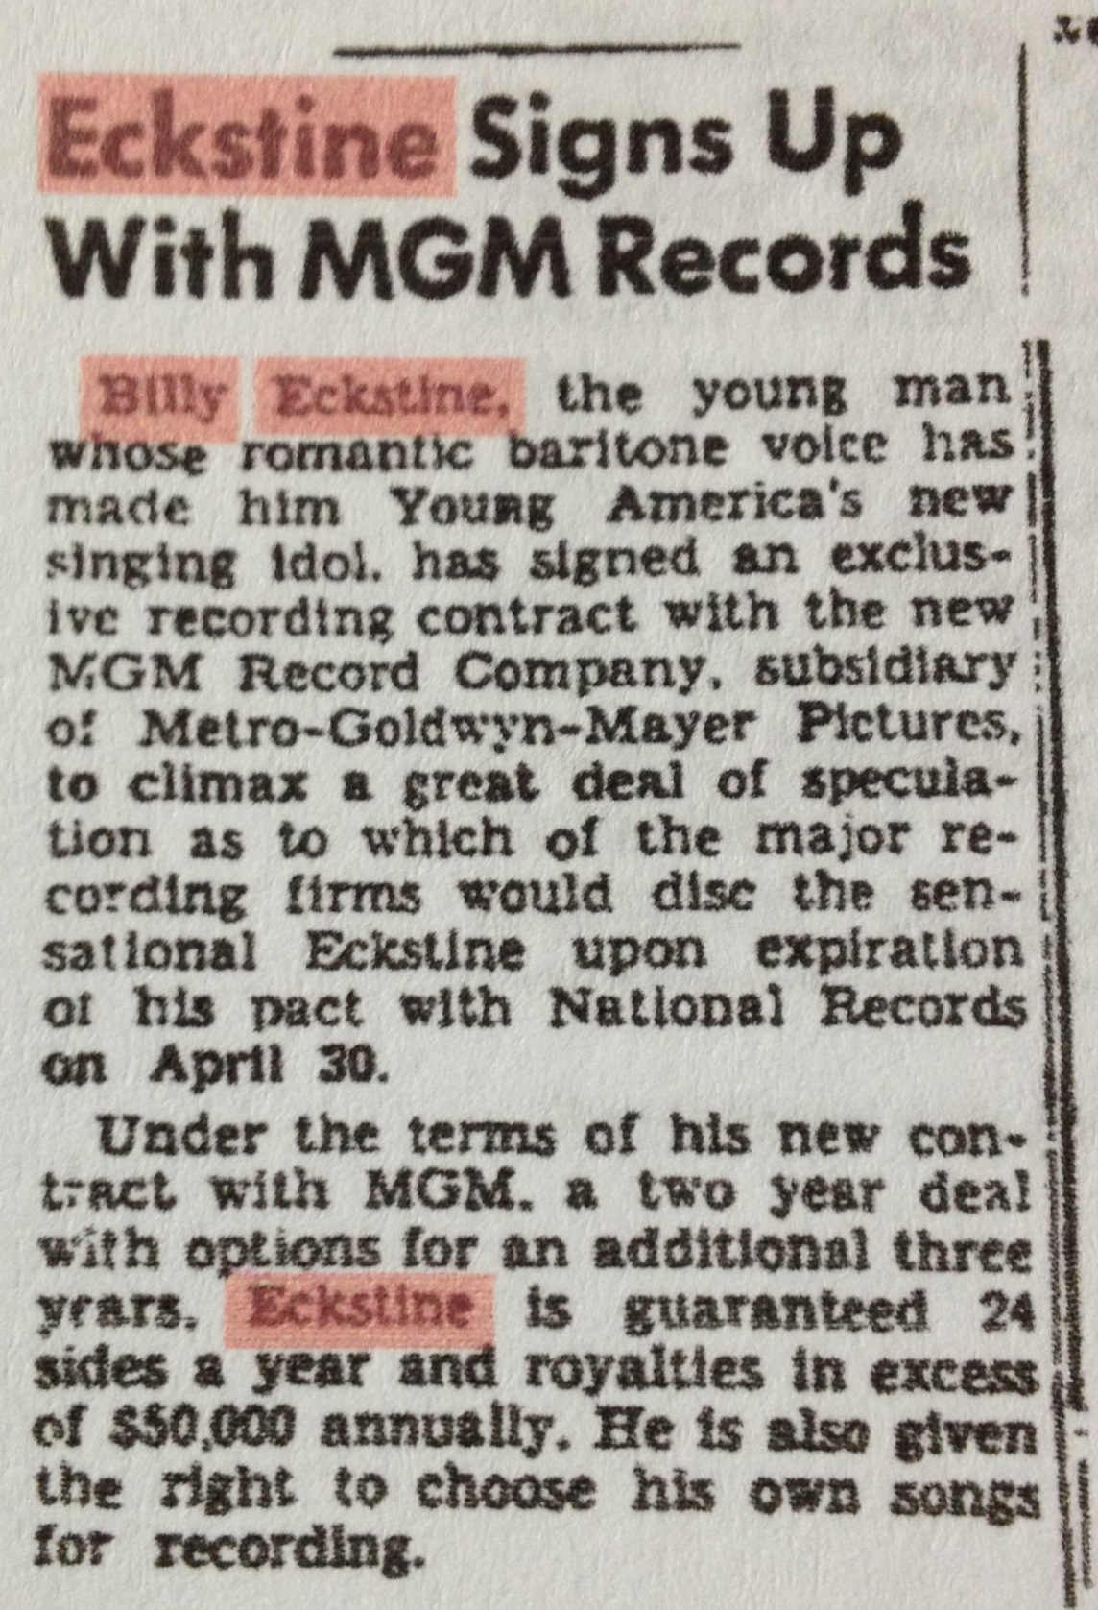

Slide 33




Slide 34

Eckstine with Nelson Riddle and M-G-M executives

Slide 35



Slide 36

The Paramount, April 1949

Slide 37

Life: April 24, 1950

Slide 38


With George Shearing (left) and Woody Herman (above).

Slide 39

Recording for M-G-M, 1949

Slide 40


Slide 41

Eckstine’s hits were generally retreads of songs from the early 1930s

Slide 42


Slide 43


Slide 44


Slide 45


Slide 46



Spike Jones
Paul Frees
1952

Slide 47


Slide 48


Slide 49



Slide 50

Hugo Winterhalter with Eckstine in the studio

Slide 51


Slide 52


Slide 53


Slide 54


Slide 55


Slide 56


Slide 57


Slide 58

With Count Basie, 1959

Slide 59


Slide 60


Slide 61


Slide 62


Slide 63

The First U.S. Bossa Nova Record
Featuring Carlos Monteiro de Souza & his Orchestra; Baden Powell, guitar, 1960

Slide 64

“A Felicidade” was featured in the 1959 Brazilian film Black Orpheus, triggering the U.S. bossa nova craze

Slide 65



Slide 66



Slide 67


Slide 68



Slide 69


Slide 70

With Stax owner Al Bell and actor
Melvin Van Peebles, early 1970s

Slide 71

Singing “Jelly, Jelly” in an episode of
Sanford & Son (“The Stand-In”) in 1975

Slide 72


Slide 73

On the links with Jackie Robinson during the 1960s

Slide 74


Slide 75


Slide 76

1984

Slide 77



Slide 78


Slide 79


Slide 80


Slide 81


