Slide 1
Early Bird: The Kansas City Recordings of Charlie Parker
Chuck Haddix

Slide 2
Bird: The Life and Music of Charlie Parker

Slide 3
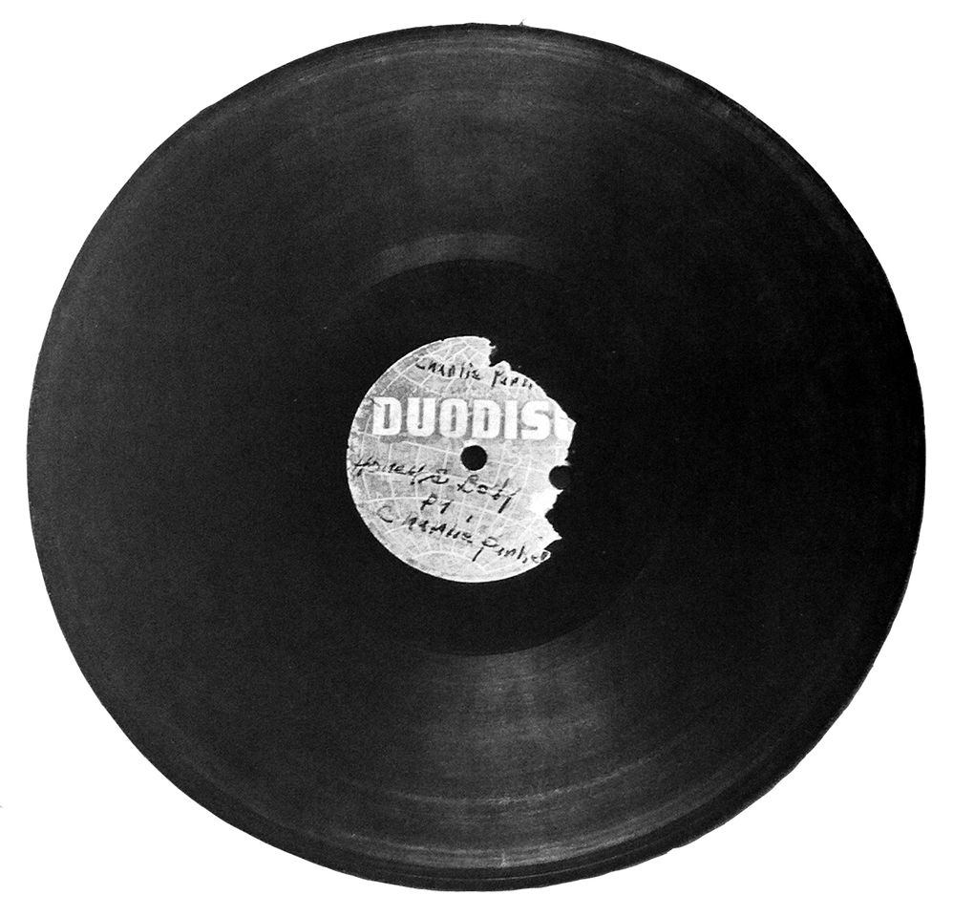
Honey & Body

Slide 4
Jay McShann Band in Wichita, 1940

Slide 5
Set List For RCA Reissue

Slide 6
Wichita Session Sign-in Sheet

Slide 7
Wichita Set List

Slide 8
Margie and I’m Getting Sentimental

Slide 9
Ad For Tootie’s Mayfair

Slide 10
Vic Damon Label

