Slide 3
SOLONDOVNIKOV OPERA HOUSE - MOSCOW

Slide 7
YERKES MARIMBAPHONE BAND

Slide 8
VAUDEVILLE THEATERS

Slide 10
MERRY SPARKLERS – THERE’S YES! YES! IN YOUR EYES

Slide 11
CALIFORNIA HERE I COME - SCORE

Slide 12
BEVO BLUES - 1919

Slide 13
GOLD MINERS SONGBOOOK

Slide 14
BMI ORCHESTRATION

Slide 15
ZIEGFELD FOLLIES

Slide 16
BORN HAPPY PLAYBILL

Slide 18
TRUMPETER OF SACKINGEN AD - 1916

Slide 19
JAZZ-O-HARMONISTS

Slide 20
CHRISTIAN SCIENCE MONITOR MAY 1926

Slide 21
LOUIS KATZMAN AND HIS KITTENS – UK RELEASE

Slide 22
RADIOTONE RECORDING - 1930’s

Slide 23
MUZAK BROCHURE

Slide 24
BMI TRANSCRIPTION DISC

Slide 26
THEME SONG FOR WHITTALL RADIO SHOW

Slide 27
KMBC AD FOR FRED ALLEN SHOW

Slide 28
GERSHWIN HANDWRITTEN SCORE

Slide 30
BROADCAST ADVERTISER - SEPTEMBER 1939

Slide 31
BMI ARRANGEMENTS DEPARTMENT 1940

Slide 32
CROSS-CUEING EXAMPLE (AFTER ALTMAN, 2004)

Slide 33
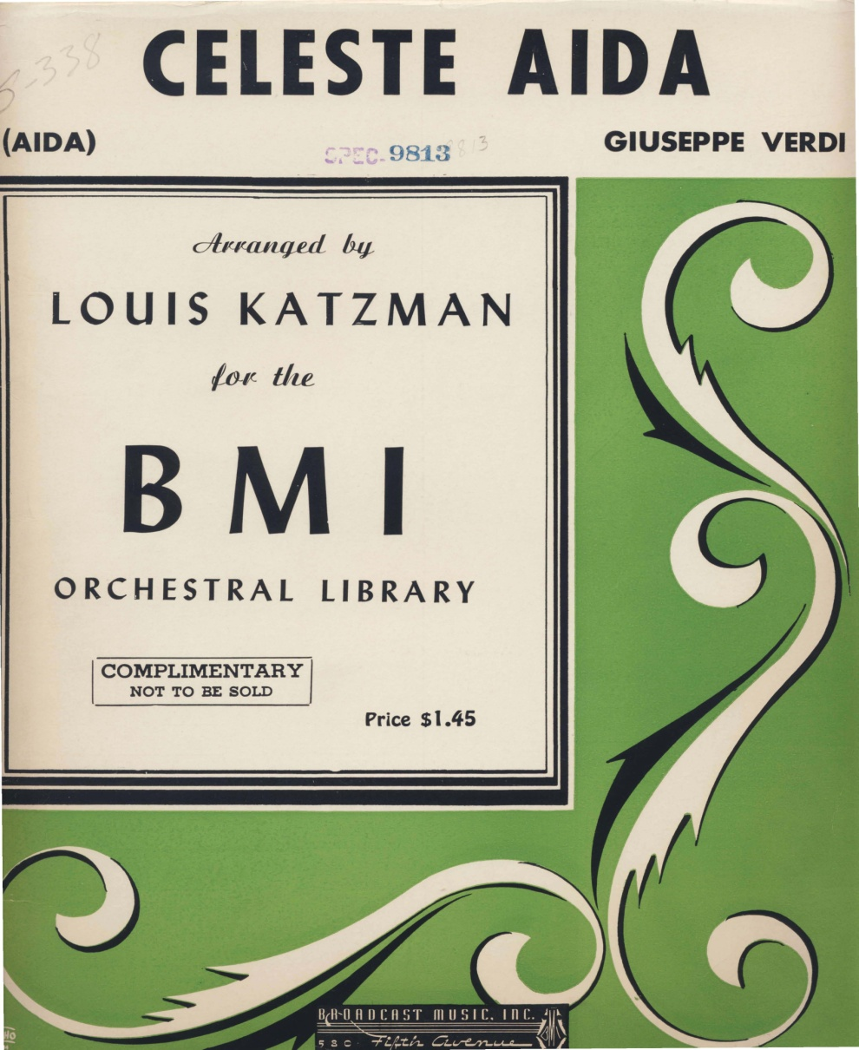

Slide 35
YERKES JAZZARIMBA ORCHESTRA

Slide 36
WOLVERINES

Slide 37
THE AMBASSADORS - 1928

Slide 38
BRUNSWICK ORCHESTRA - c 1930-31

Slide 39
KATZMAN ARRANGEMENT

Slide 40
ORIGINAL MEMPHIS FIVE

Slide 41
WASHINGTONIANS

Slide 42
MEANEST KIND OF BLUES RECORD LABEL

Slide 43
MEANEST KIND OF BLUES SHEET MUSIC COVER

Slide 44
MEANEST BLUES – MEMPHIS FIVE

Slide 45
SYMPHONO-JAZZ

Slide 46
ST. LOUIS BLUES LABEL

Slide 48
SYMPHONO-JAZZ

Slide 49
BROADCASTING MAGAZINE - DECEMBER 1940

Slide 50
