Slide 1
Sweet Home Chicago
Recording Blues in the Windy City in the 1930s

Slide 2
American Record Company
ARC

Slide 3
American Record Company
ARC

Slide 4
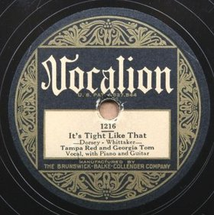
Brunswick Record Corporation (ARC) = Vocalion

Slide 5
Race labels in Chicago 1934
ARC Vocalion
Bluebird (Victor)
Decca

Slide 6
The A&R Men
Lester Melrose
J. Mayo Williams

Slide 7
First Bluebird Session – 2 August 1033
James “Stump” Johnson
Walter Davis
Roosevelt Sykes
Isabel Scruggs
St. Louis Jimmy Oden
Charlie “Speck” McFadden
Barrelhouse Buck McFadden
Tecumseh McDowell
Milton “Flyin’ Lindberg” Sparks
Aaron “Pine Top” Sparks
Dorothea Trowbridge

Slide 8
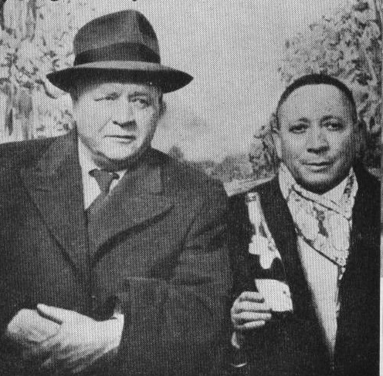
Melrose and Artists
Melrose, Tampa Red
Top: Little Son Joe, Big Bill Broonzy, Melrose, Roosevelt Sykes, St. Louis Jimmy Oden, Washboard Sam
Bottom: Merline Johnson, Melrose, Ransom Knowling

Slide 9
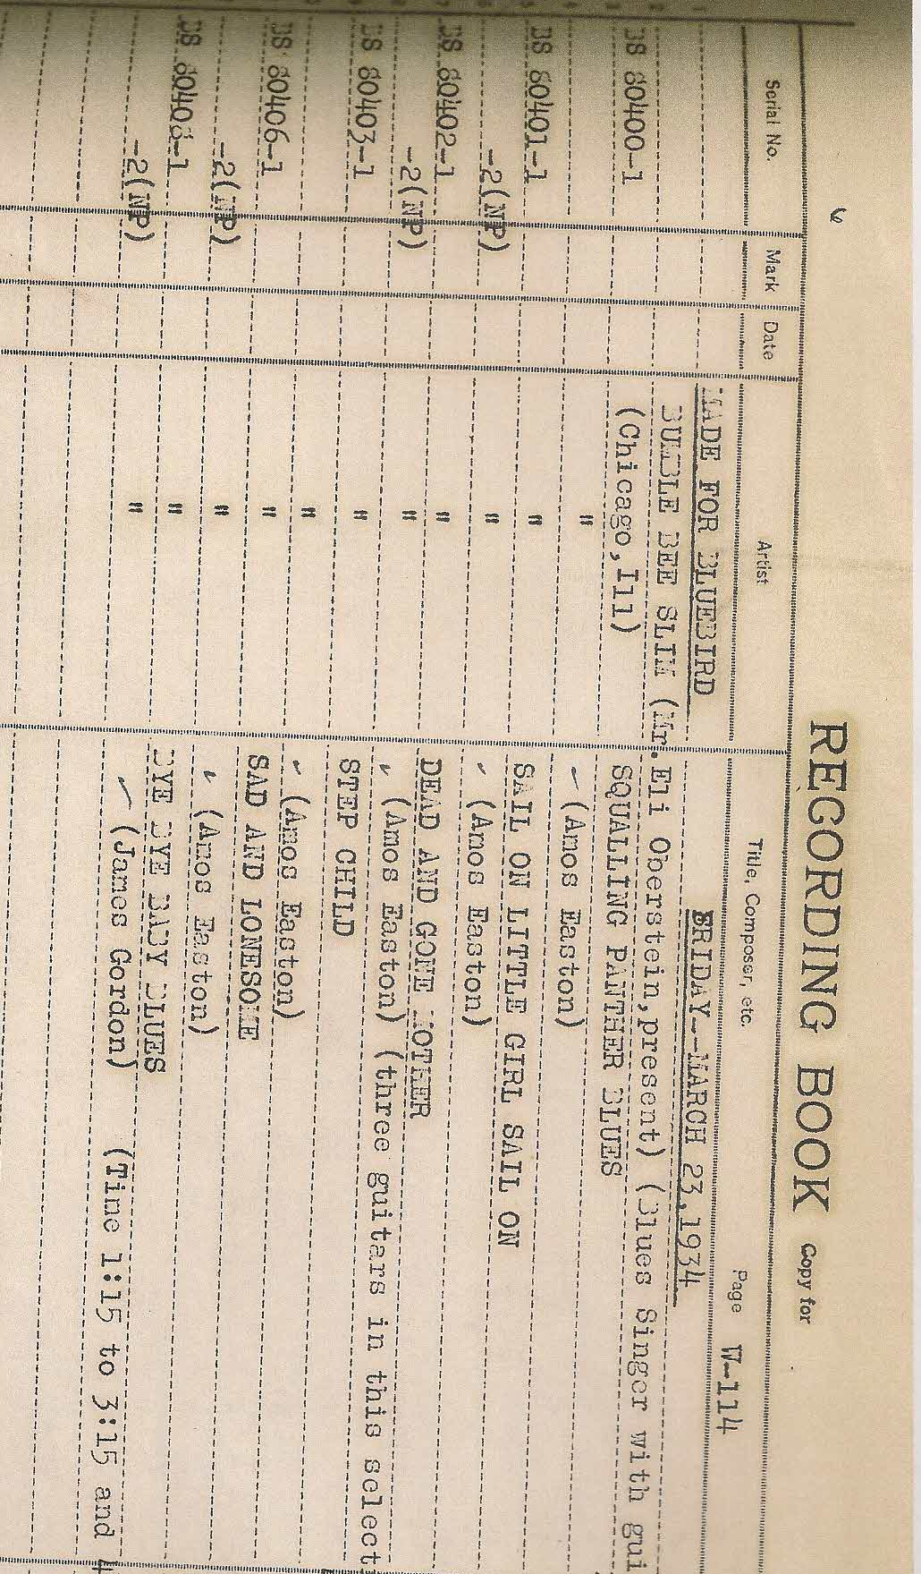

Slide 10
Decca Sidemen
Guitar: Ikey Robinson, Willie B. James, Charlie McCoy, Lonnie Johnson
Bass: John Lindsay,
Drums: Pearlis Williams, Bud Washington
Piano: Roosevelt Sykes , Honey Hill, Dot Rice, Charles Segar, Jimmy Gordon, Peetie Wheatstraw

Slide 11
Melrose Sidemen
Piano: Black Bob, Joshua Altheimer, Blind John Davis,Roosevelt Sykes
Bass: Bill Settles, Ransom Knowling
Drums: Jimmy Bertrand, Fred Williams
Percussion: Washboard Sam
Guitar: Big Bill Broonzy, Willie B. James, George Barnes (electric)

Slide 12
Chicago Blues Horns
Decca:
Trumpet: Herb Morand, Randolph Scott
Clarinet: Odell Rand
Sax: Chick Gordon, Leon Washington
Melrose:
Trumpet: Alfred Bell (aka Mr. Sheiks); Lee Collins, Punch Miller
Clarinet: Arnett Nelson,
Tenor sax: Bill Owsley
Alto sax: Buster Bennett
Trombone: Roy Palmer

Slide 14
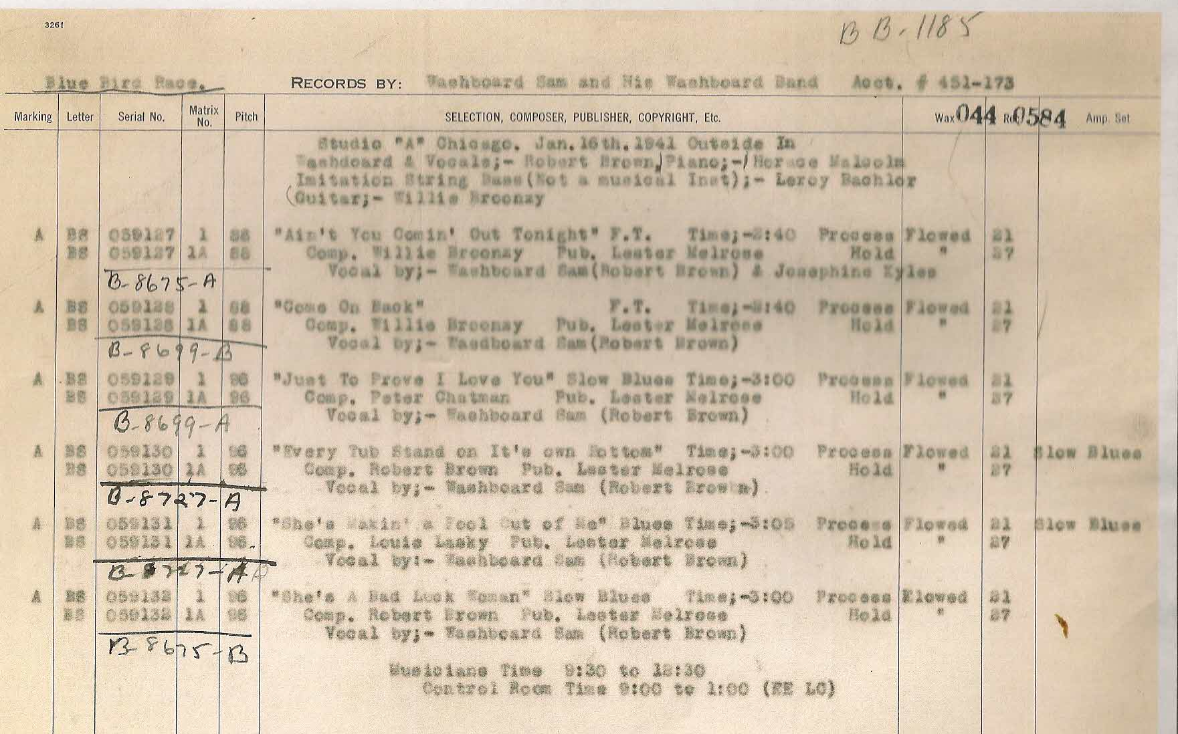

Slide 15
1930 Chicago Blues Sampler
Harlem Hamfats: Hallelujah Joe Ain’t Preachin’ No More
Leroy Carr: Papa’s on the Housetop
Tampa Red: Mean Mistreater Blues
Washboard Sam: The Big Boat
Tampa Red: I’m So Disappointed
Big Maceo Merriweather: Chicago Breakdown
Tampa Red: Let’s Get Drunk and Truck
Big Bill Broony: Goin’ Back to Arkansas

Slide 16
Country blues in Chicago: The notable
Blind Boy Fuller, Bukka White, Son Bonds, Yank Rachell, Hammy Nixon, Johnny Temple, Tommy McClennan, Robert Lee Nighthawk, Big Joe Williams, Robert Johnson (Ok, not Chicago)

Slide 17
Country blues in Chicago: the fallen (a short list)
Pigmeat Terry, Debs May, Arkansas Shorty, Sheik Johsnon, Ben Abney, Andy Boy, Black Spider, Butler Trixie, Otto Virgial, Kid Stormy Weather, and Corny Allen Grier

Slide 18
Blasts from the Past
Victoria Spivey, Minnie Wallace, Trixie Smith, Cow Cow Davenport, Rosetta Howard, Lonnie Johnson Frankie “Half-Pint” Jaxon

Slide 19
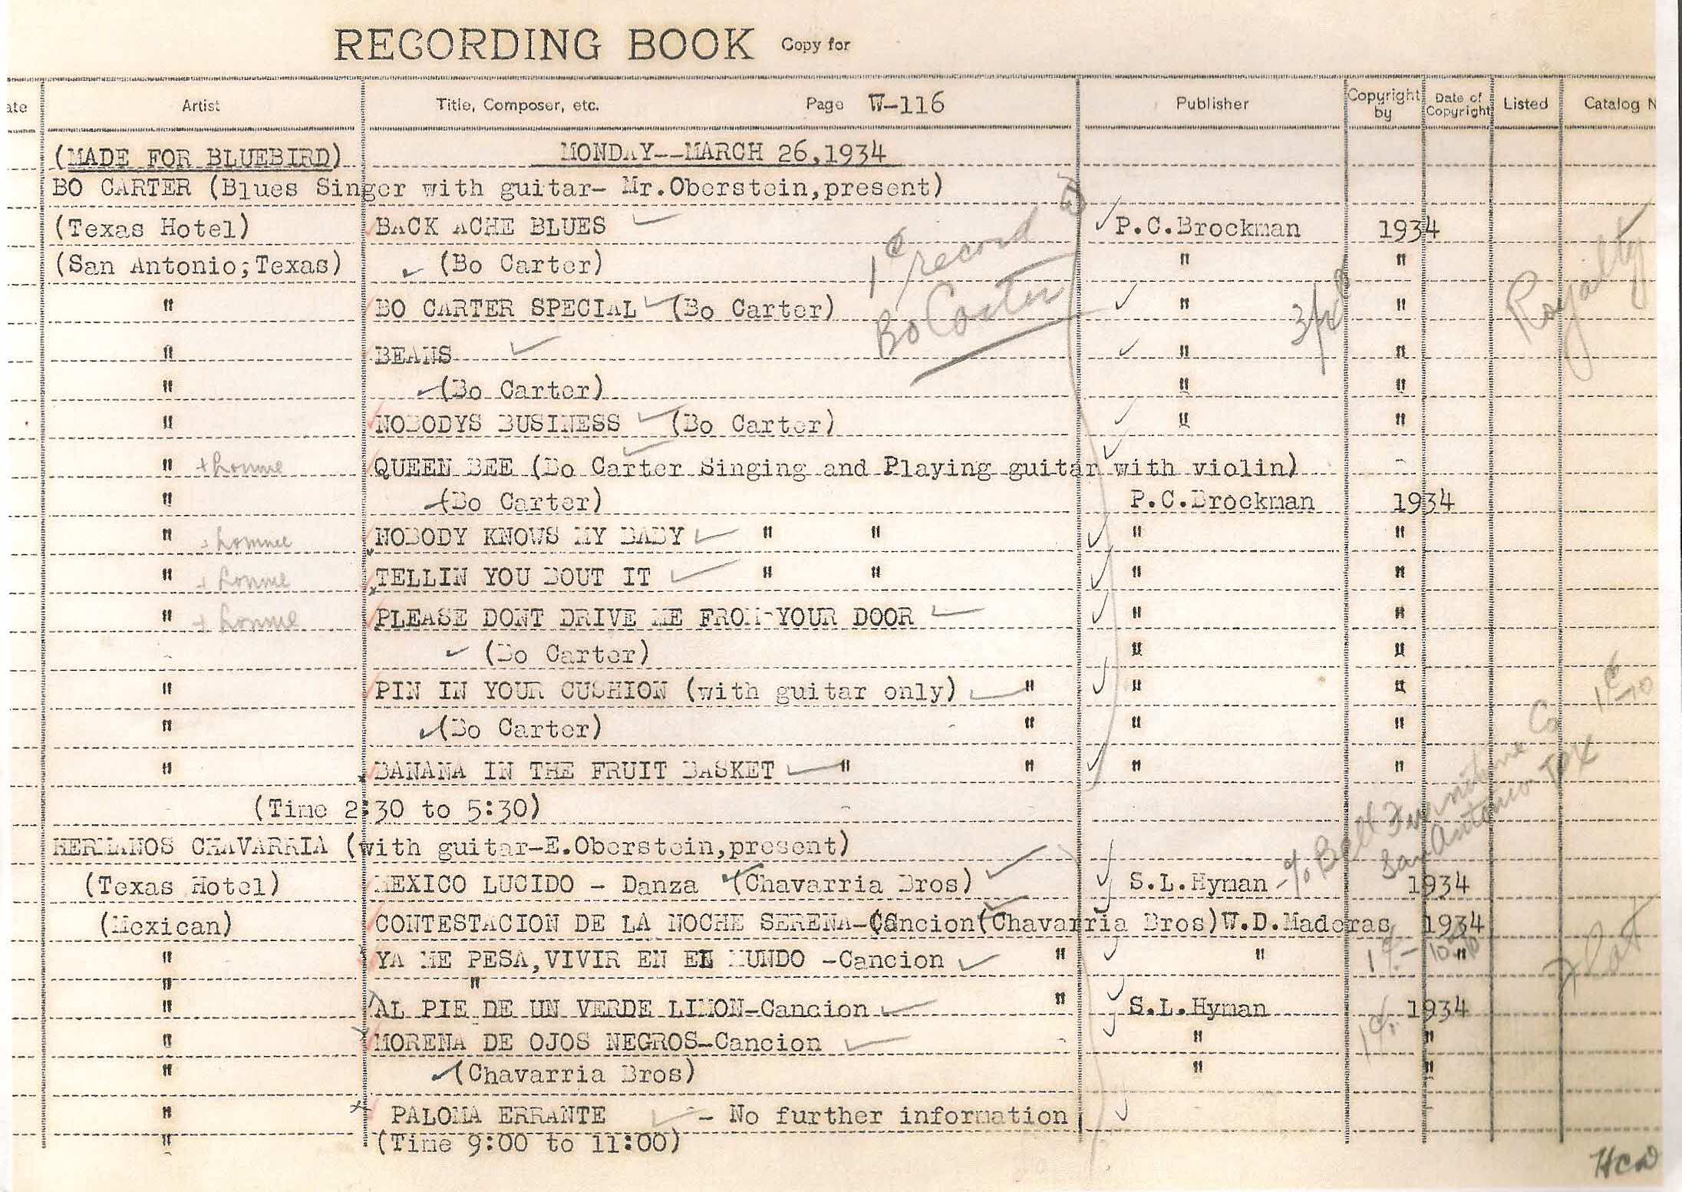

Slide 20
Chicago Music Company

Slide 21
The fine print:

Slide 22
