Slide 1
Green Discs
Jacob Smith, Northwestern University

Slide 3
Shellac
Acoustic

Slide 4
GREEN
DISCS

Slide 6
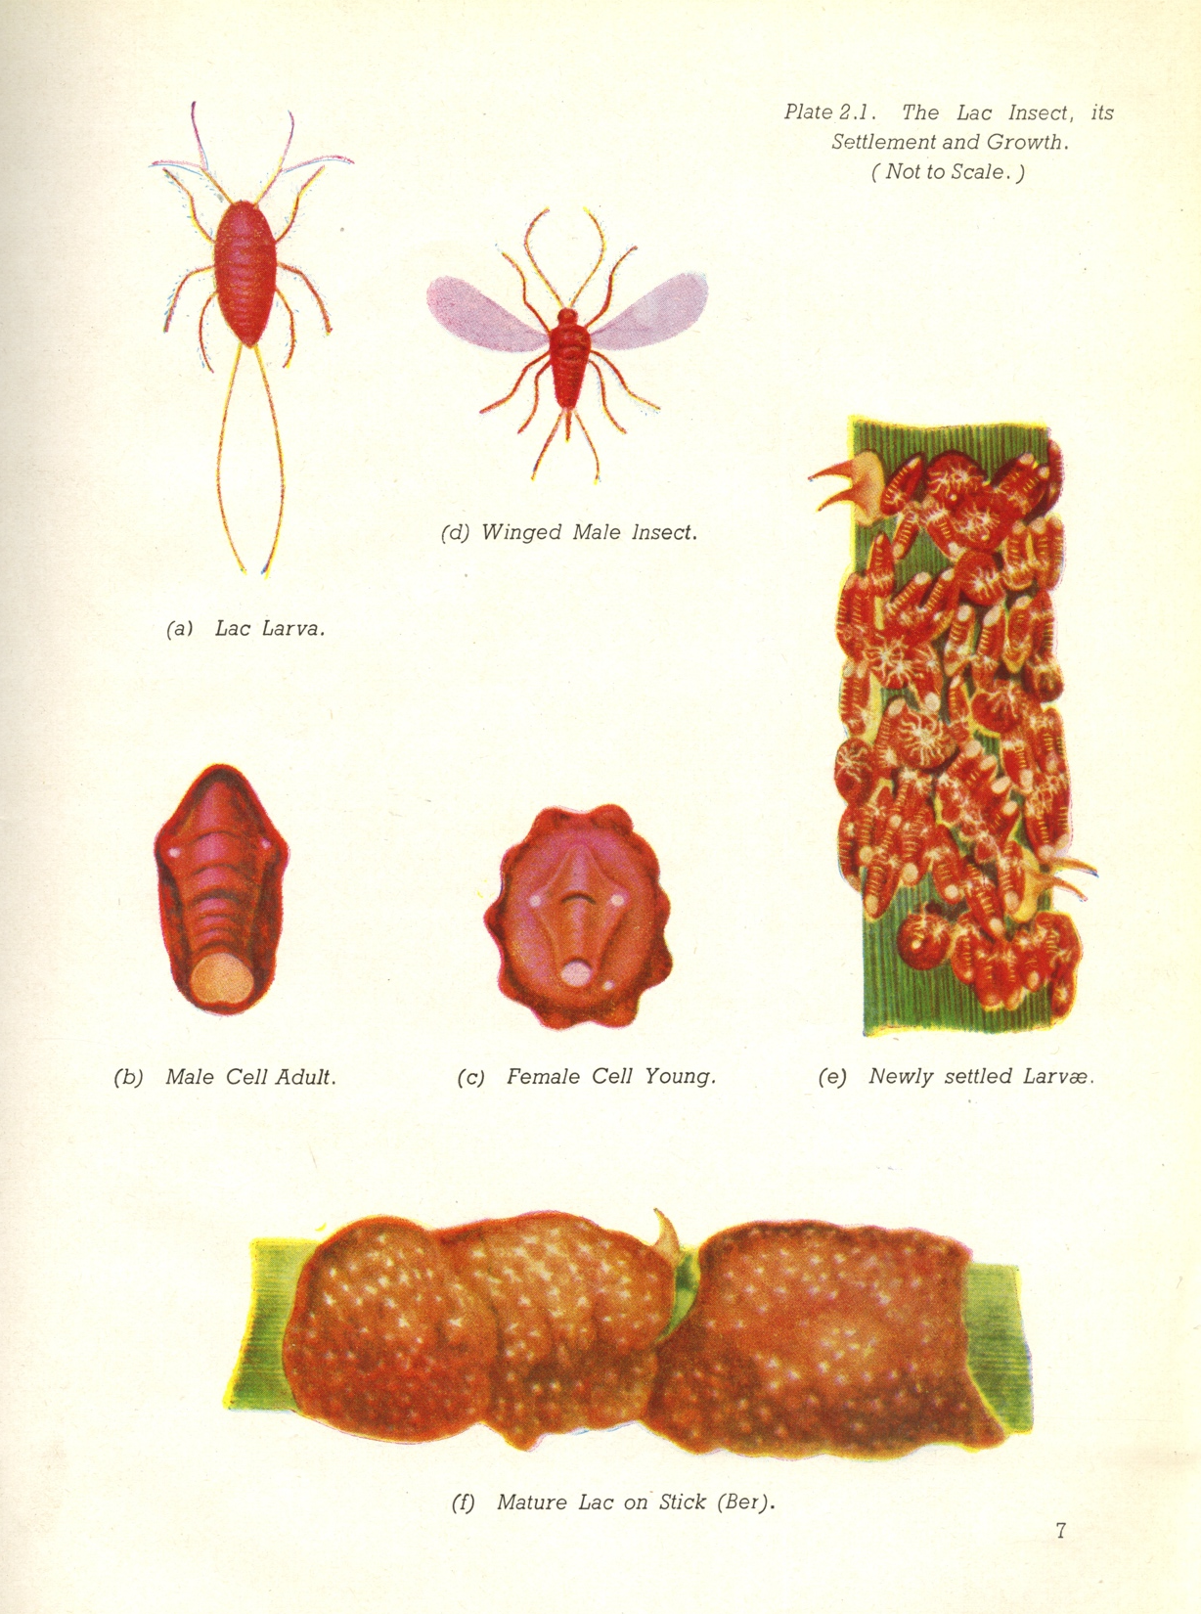

Slide 7
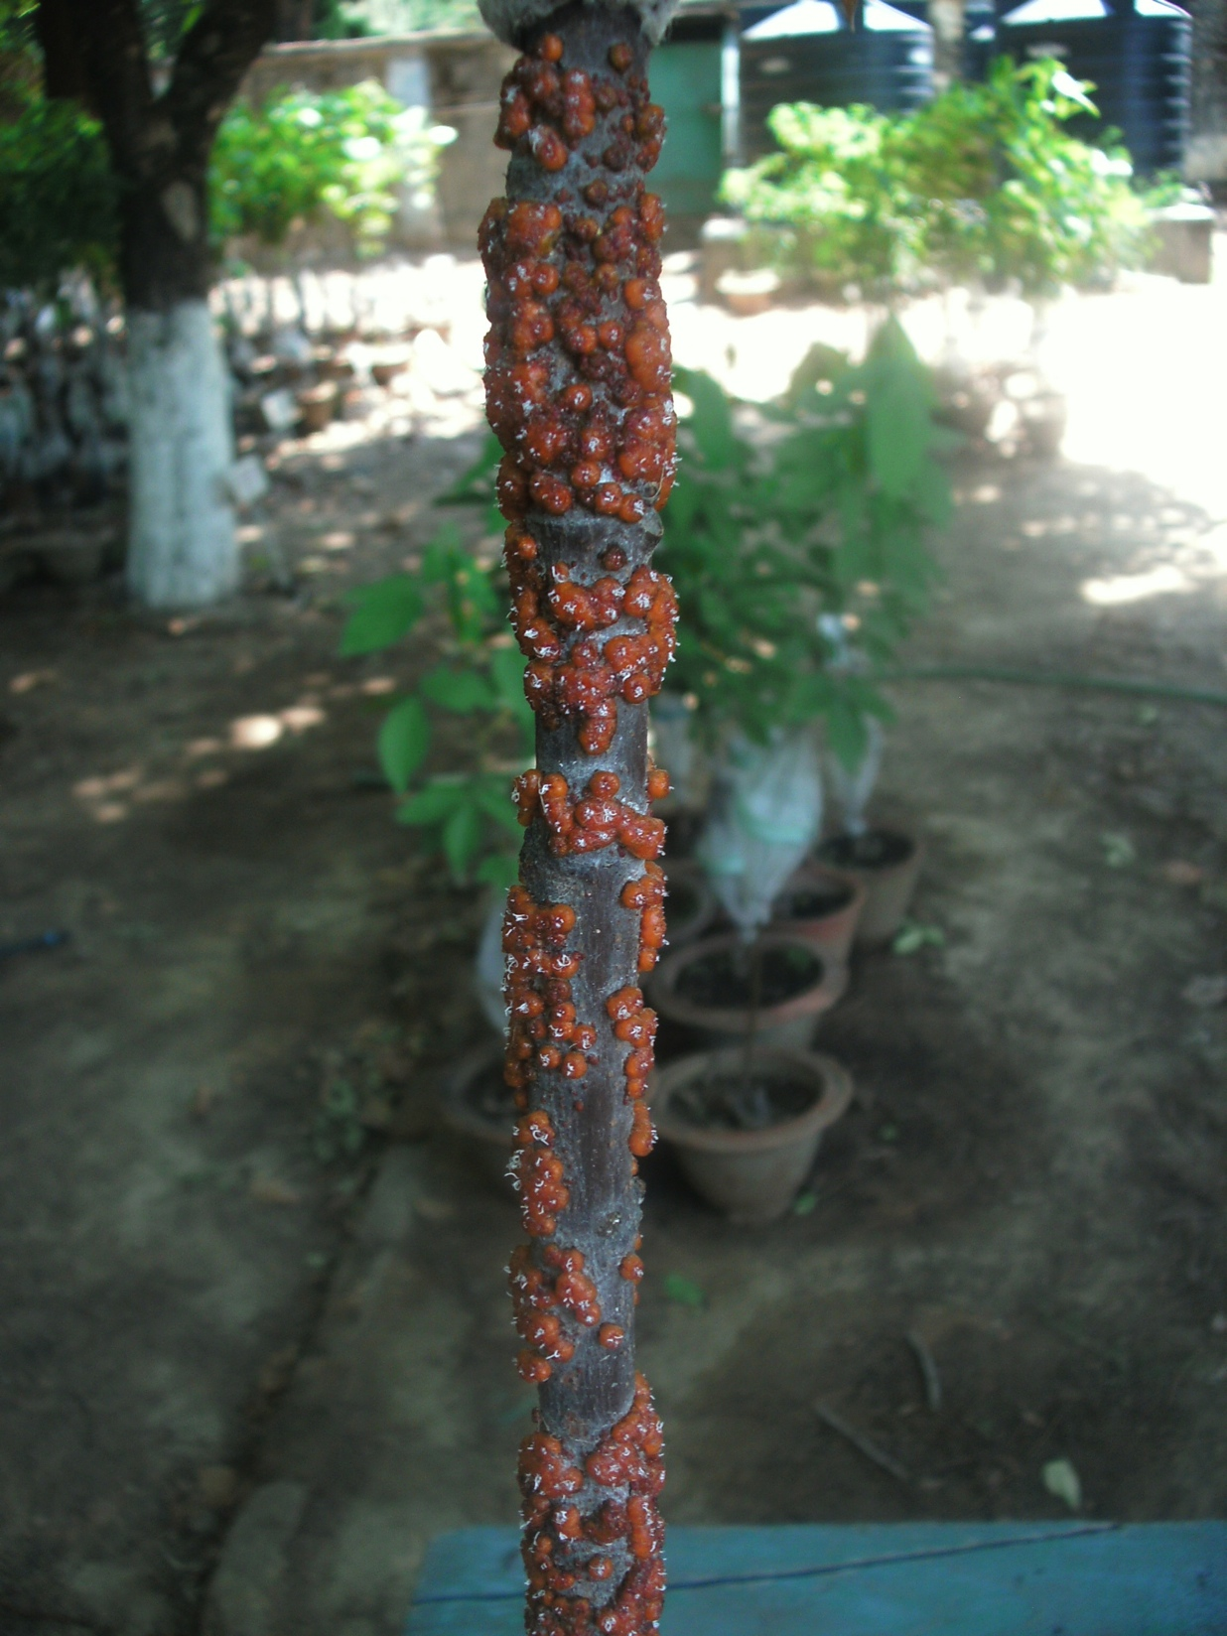

Slide 11
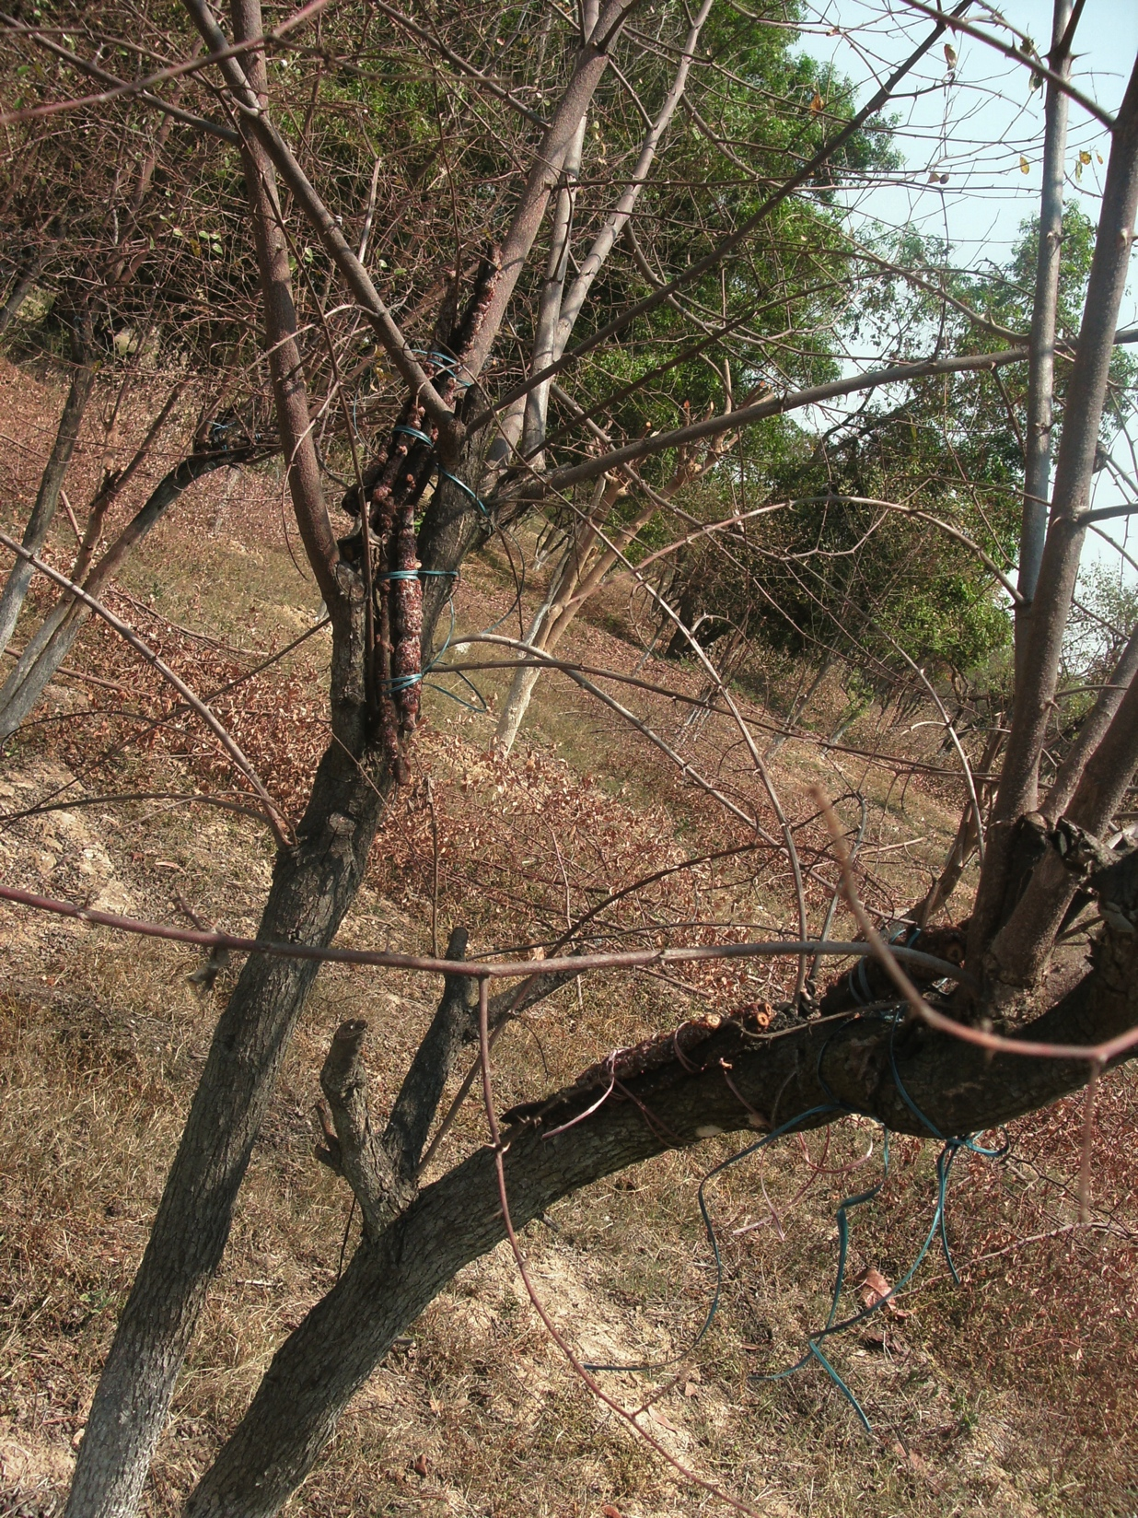

Slide 17
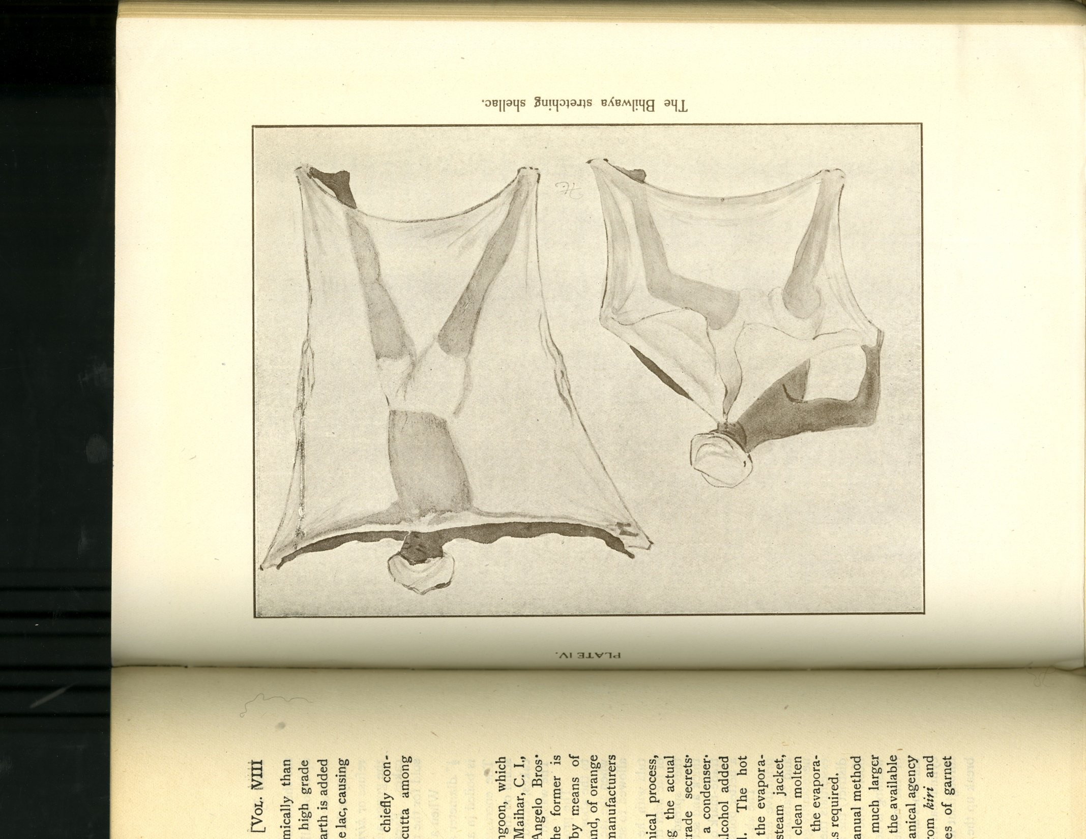

Slide 20
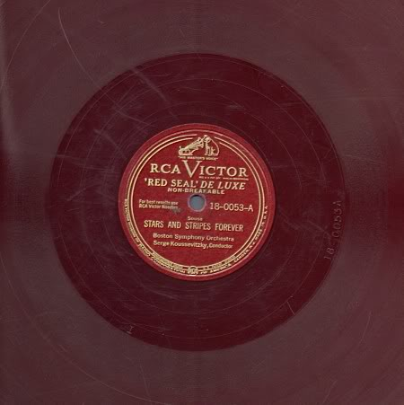

Slide 22
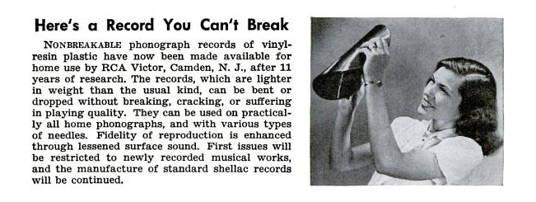

Slide 24
