Slide 1
Amplified Plunks: Recording the Harpsichord’s Weakness in Postwar Exotica
Jessica Wood
May 17, 2013

Slide 3
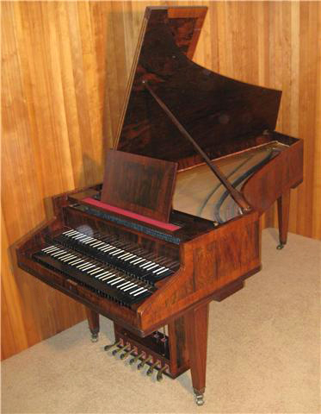
Harpsichord made by Maendler-Schramm firm, Germany, c. 1930s (modernist)

Slide 4
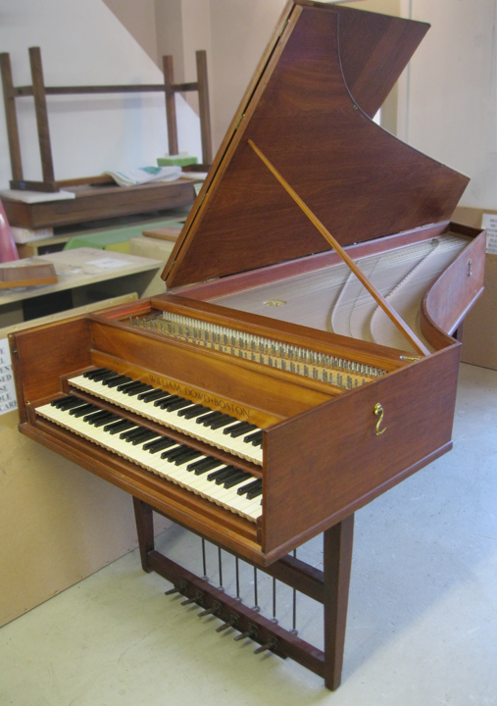
Maendler-Schramm (Germany), c. 1930s (modernist)
William Dowd (Boston), 1962
(historicist)

Slide 5
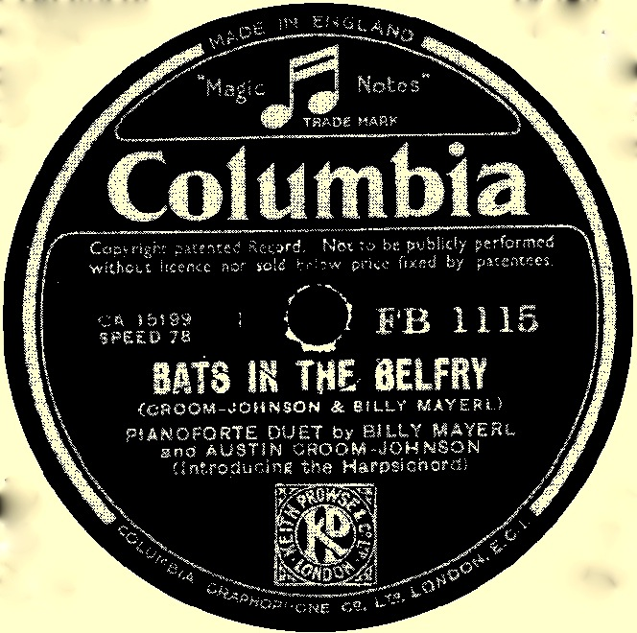
Billy Mayerl, “Bats in the Belfry,” Columbia, 1935

Slide 6
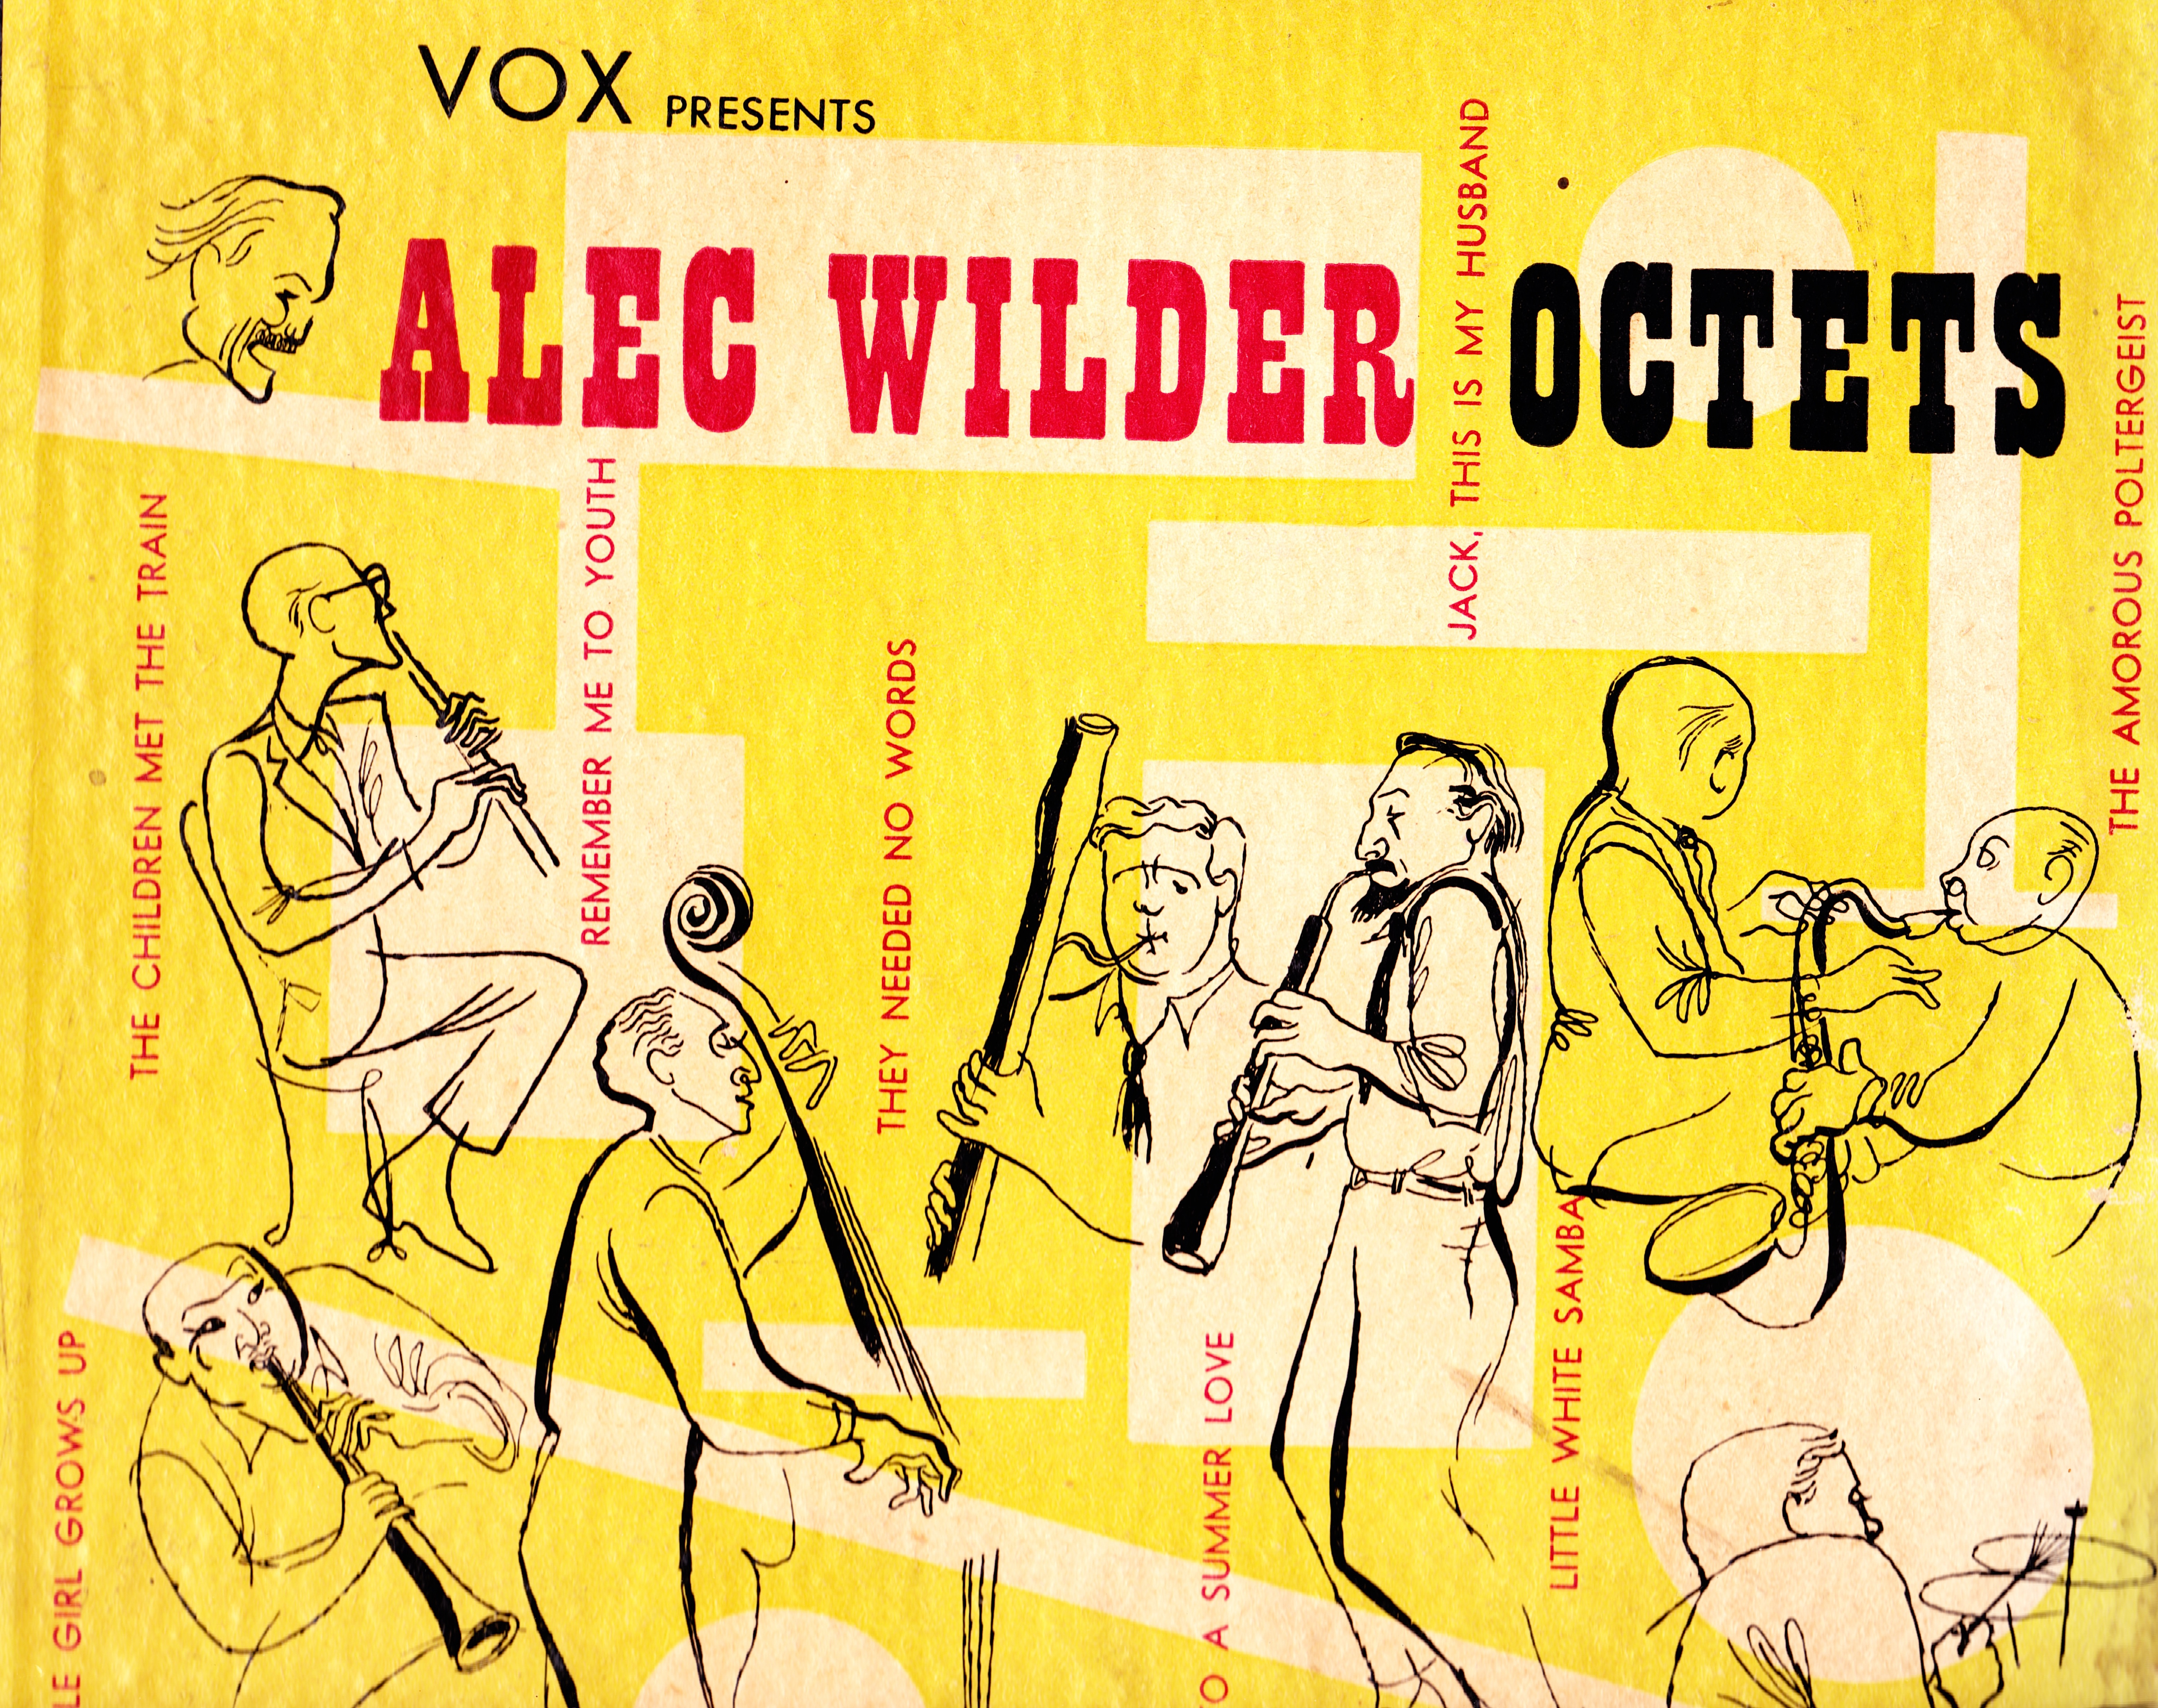
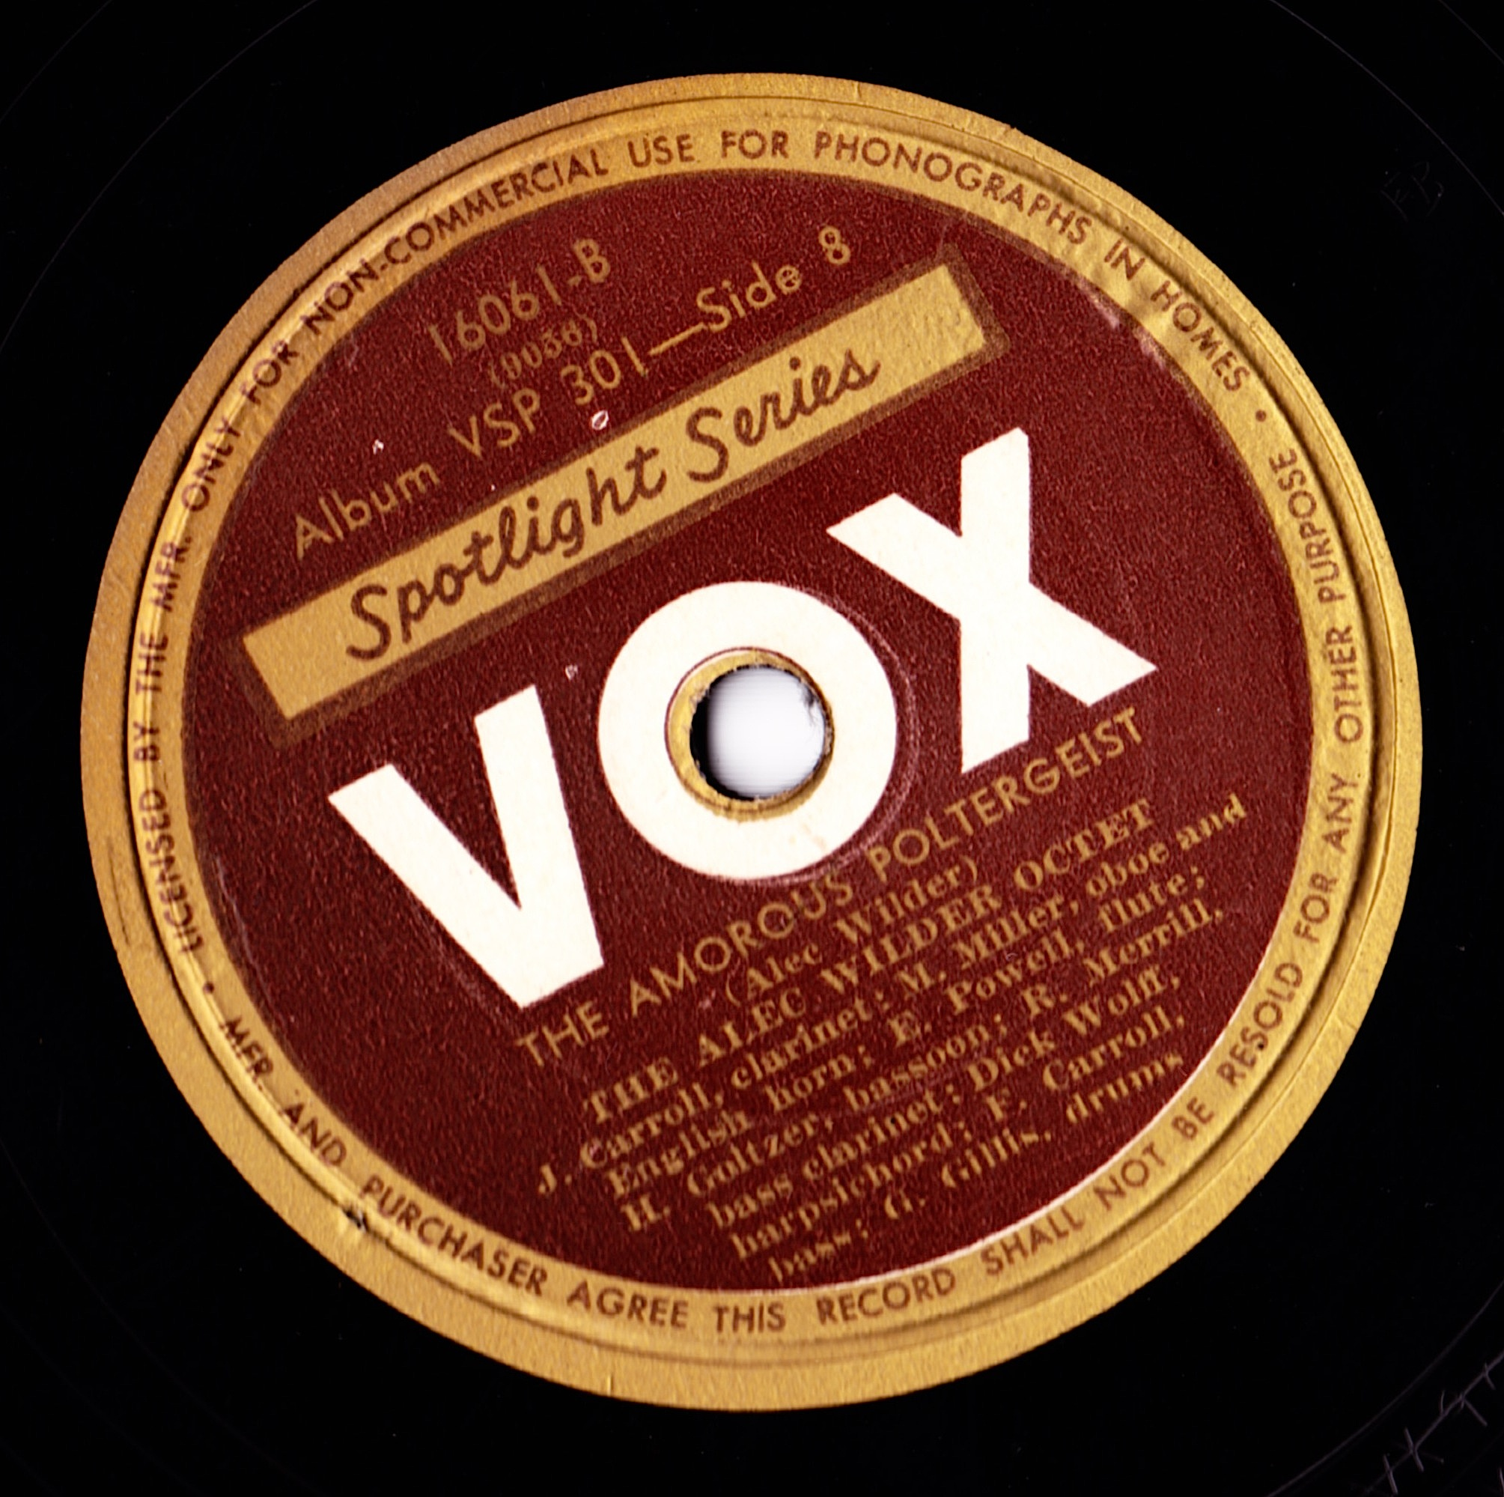
Alec Wilder Octet, “The Amorous Poltergeist,” Octets (album), Vox, 1939

Slide 7
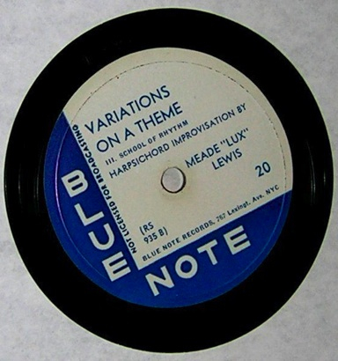
Meade Lux Lewis, Variations on a Theme, Blue Note, 1939

Slide 8
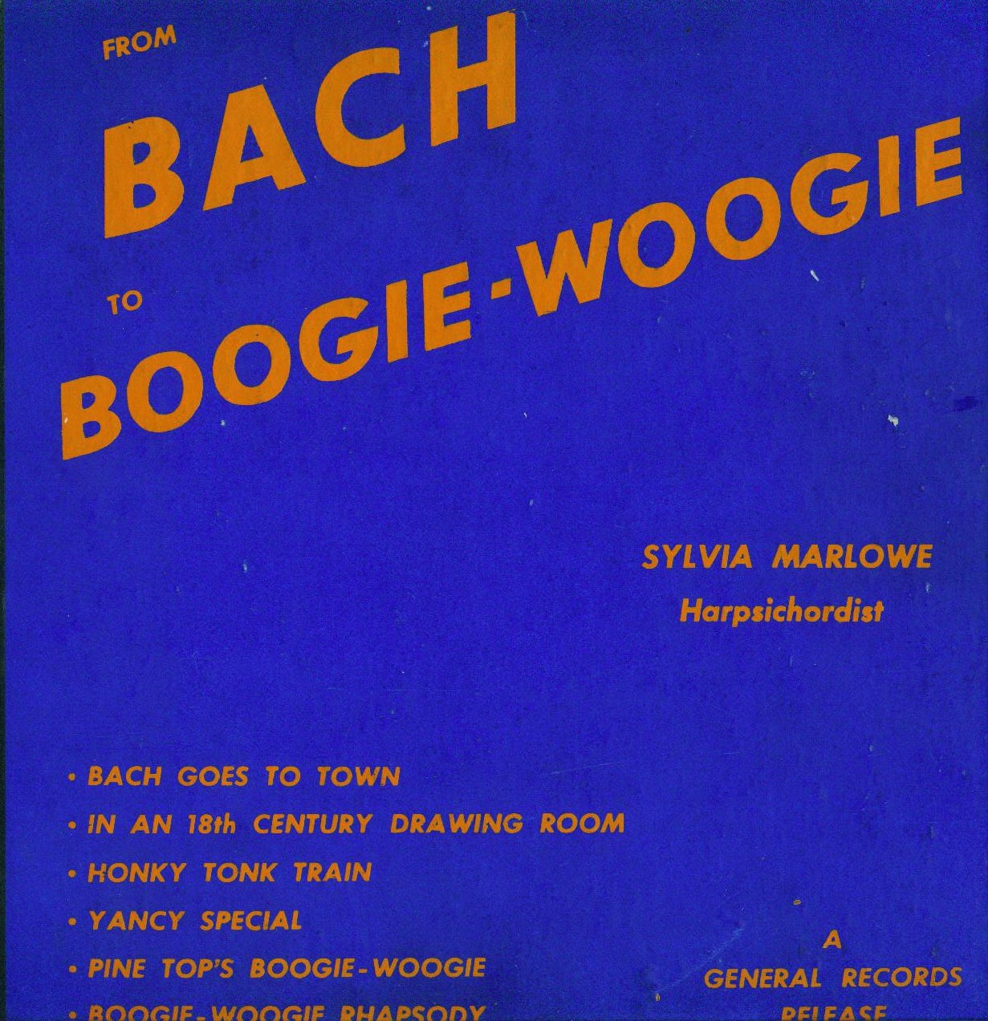
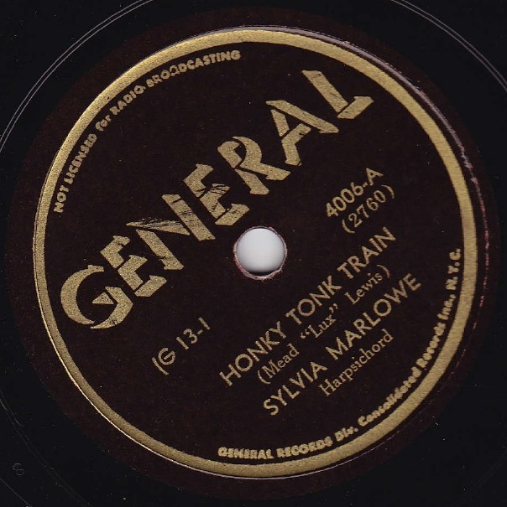
Sylvia Marlowe, “Honky Tonk Train,” General Records, 1945

Slide 9
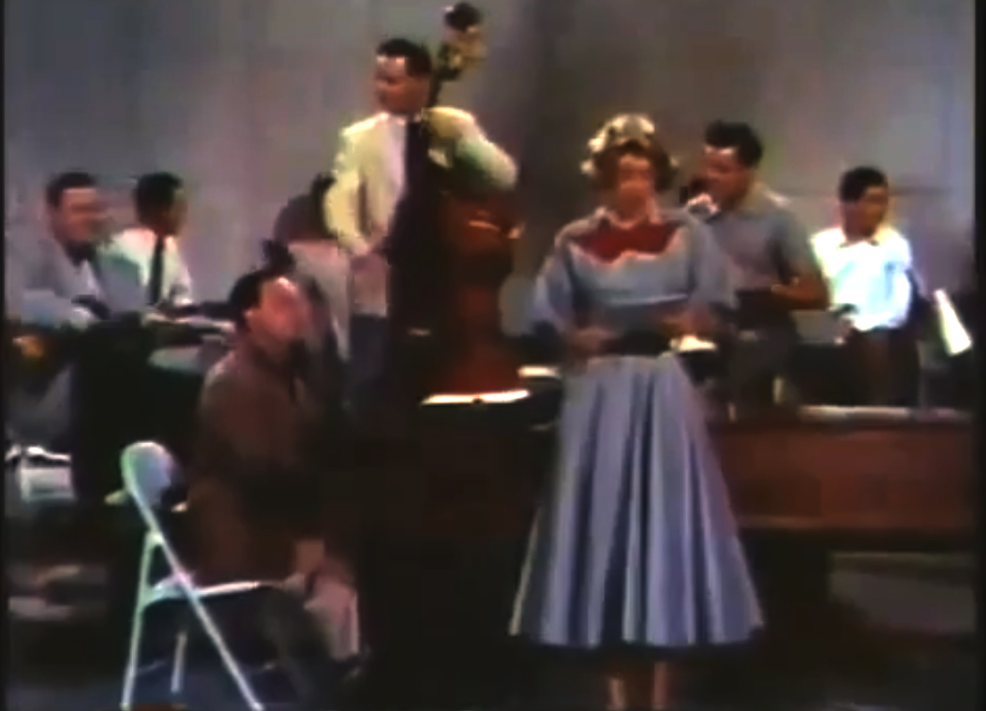
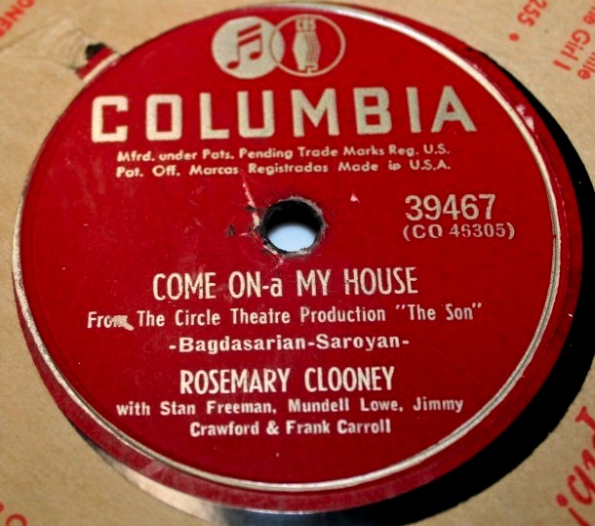
Rosemary Clooney, “Come On-A My House,” Columbia Records, 1951
harpsichord

Slide 10
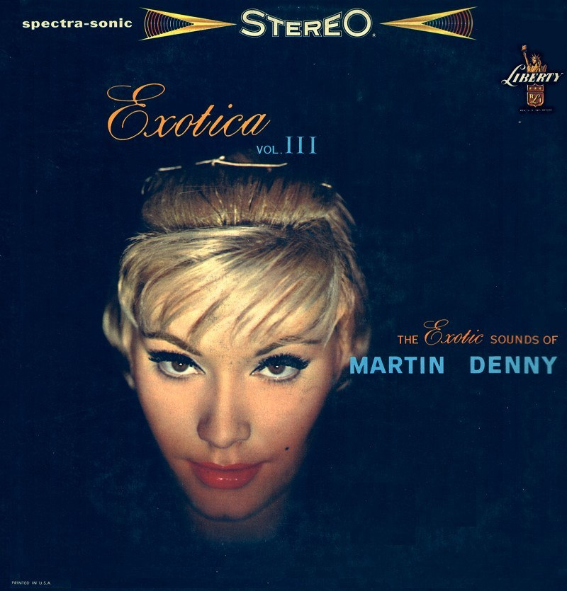
“Ringo Oiwake,” Exotica, Vol. III, Liberty Records, 1959

Slide 11
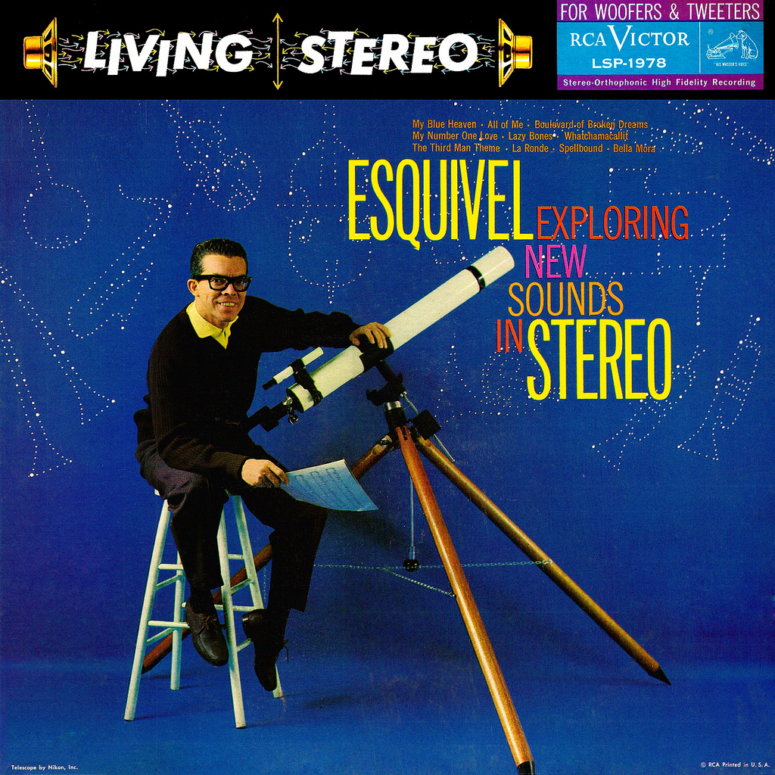
Esquivel, Exploring New Sounds in Stereo, RCA-Victor, 1959

Slide 12
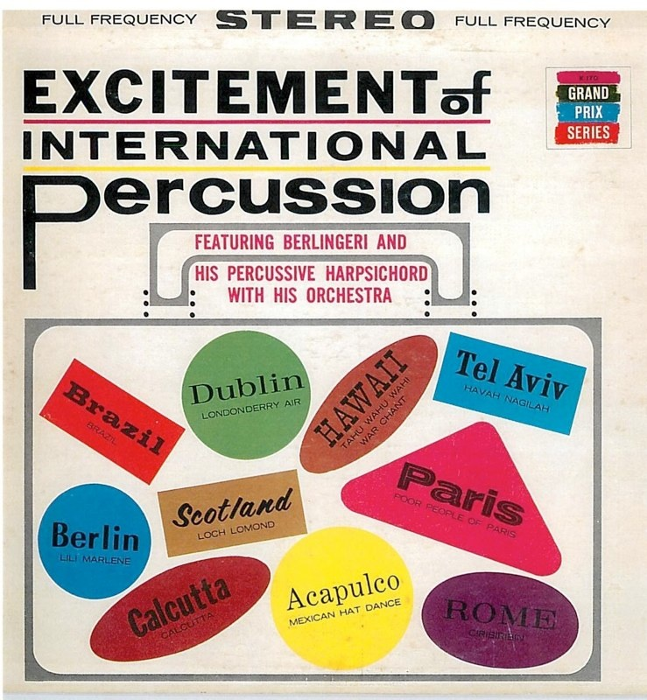
Berlingeri & His Percussive Harpsichord with His Orchestra, Excitement of International Percussion, Grand Prix, 1961

Slide 13
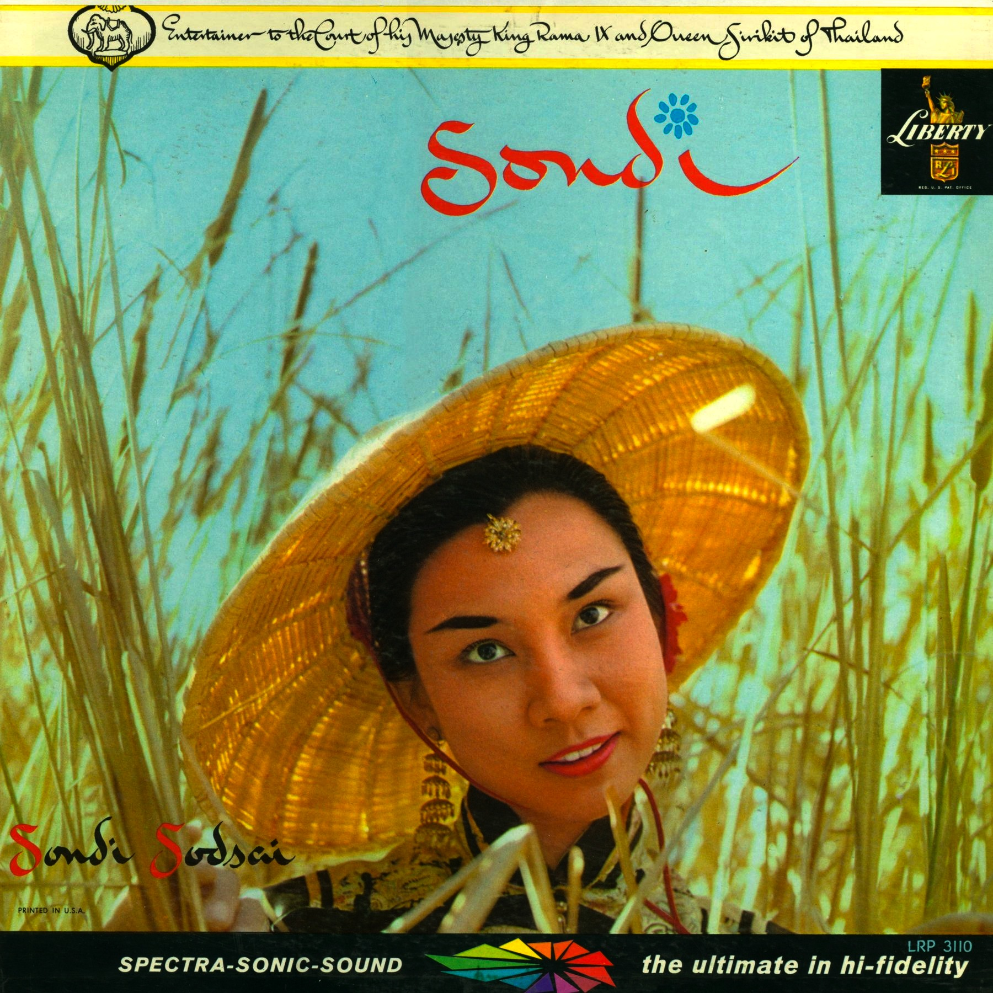
Sondi Sodsai, Sondi, Liberty, 1959
(Martin Denny, producer)

Slide 14
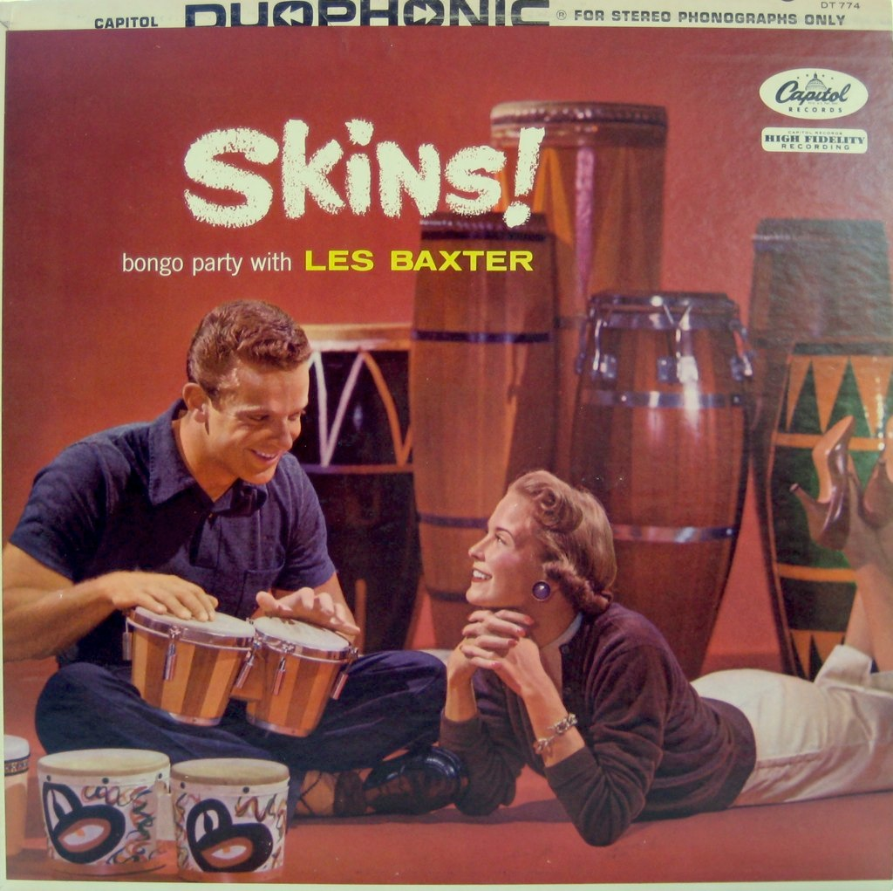
Skins! Bongo Party with Les Baxter, Capitol, 1957

Slide 16
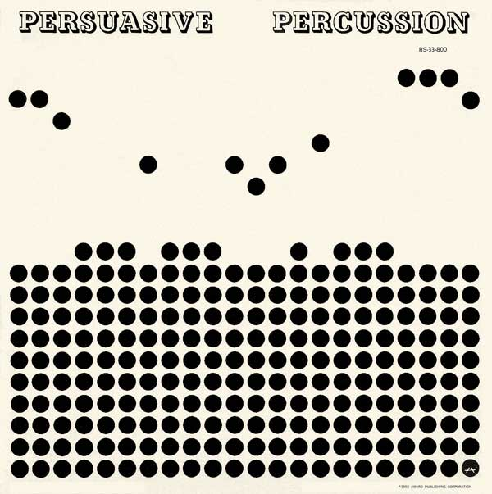
Persuasive Percussion, Command Records, 1959

Slide 17
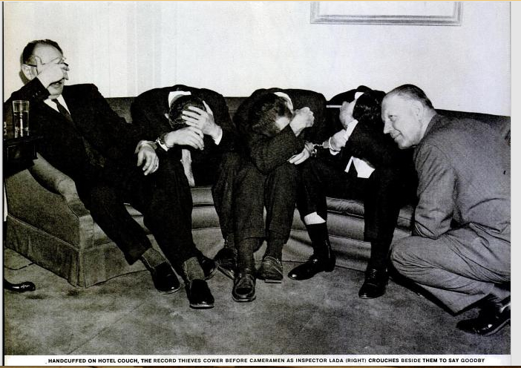
Persuasive Percussion counterfeit bandits in handcuffs. Life, May 19, 1961, p. 56

Slide 18
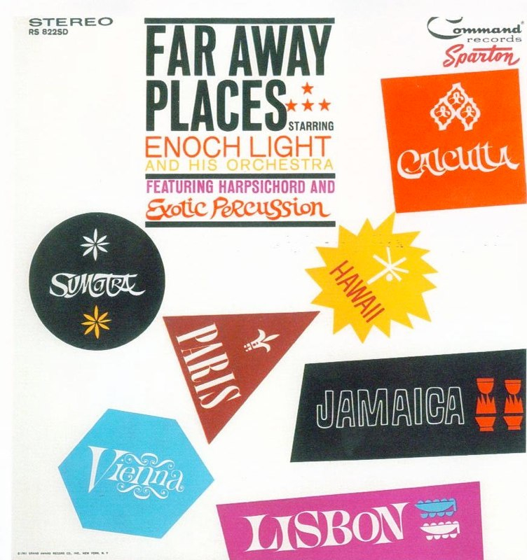
Enoch Light & His Orchestra, featuring Harpsichord and Exotic Percussion, Far Away Places, Command Records, 1961
“Sunrise over Sumatra”

Slide 19
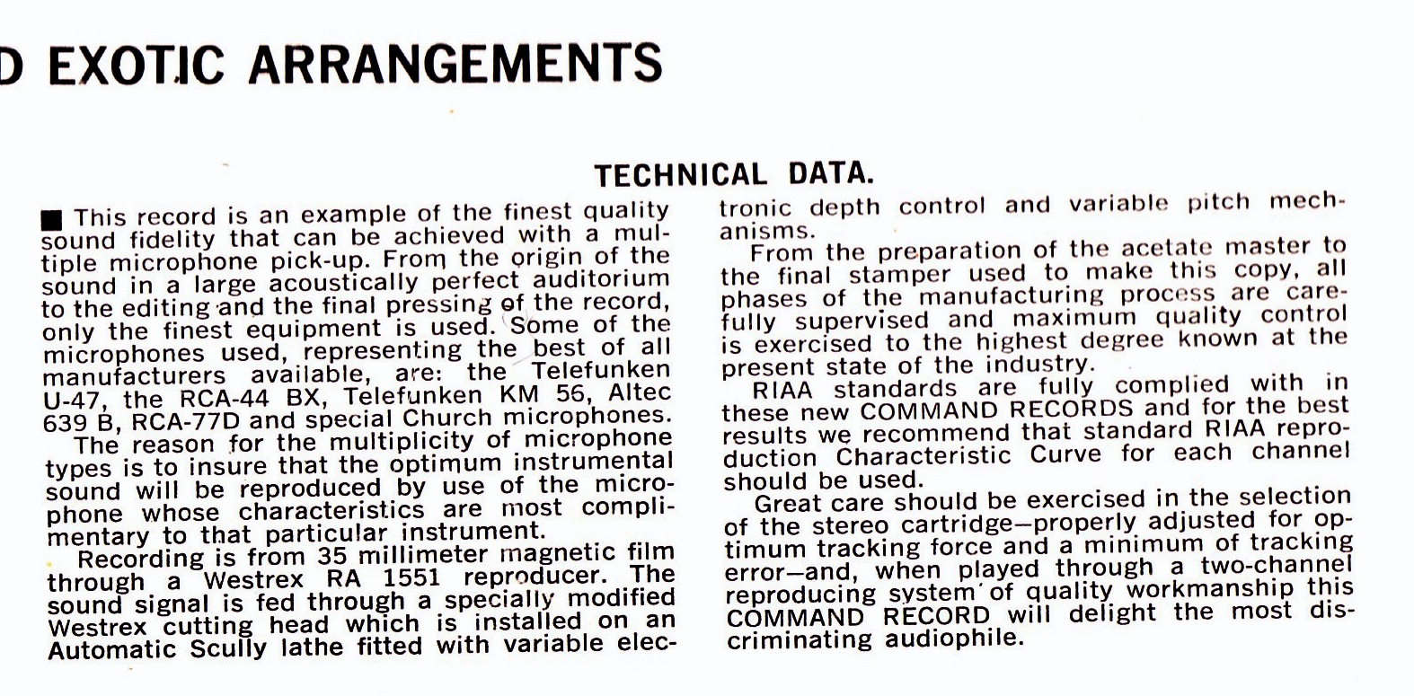
“Technical data” printed on record jacket to Far Away Places, 1961.

