Slide 1
Why Media Preservation Can’t Wait
The Gathering Storm
Mike Casey
Director of Technical Operations
Media Digitization and Preservation Initiative
Indiana University
May 15, 2014
Website: http://www.mdpi.iu.edu
Blog: http://mediapreservation.wordpress.com/
Slide design by Mike Lee

Slide 2
Once Upon A Time . . .
Flickr @garry

Slide 3
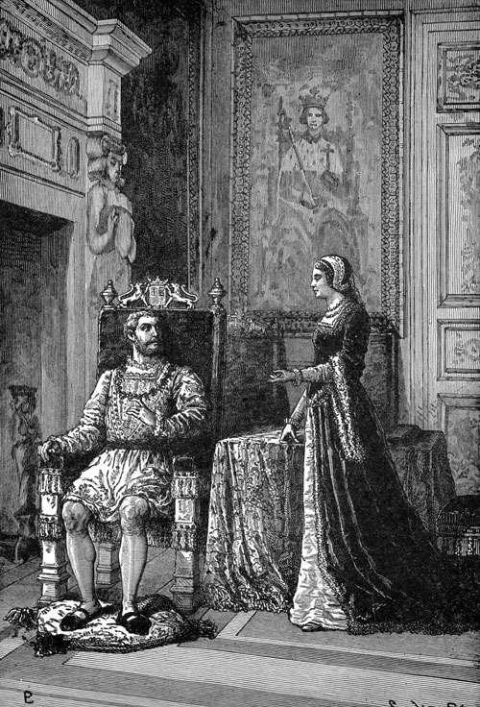
The King & Queen of Media
Flickr @garry

Slide 4
“…it is alarming to realize that nearly all recorded sound is in peril of disappearing or becoming inaccessible within a few generations.”
--National Recording Preservation Board in
“Capturing Analog Sound”
Creative Commons: Flickr @james_clear

Slide 5
“in the mid- to long-term there is a major risk that carrier degradation combined with playback obsolescence will defeat the efforts of archivists…”
--International Association of Sound and Audiovisual Archives
Creative Commons: Flickr @james_clear

Slide 6
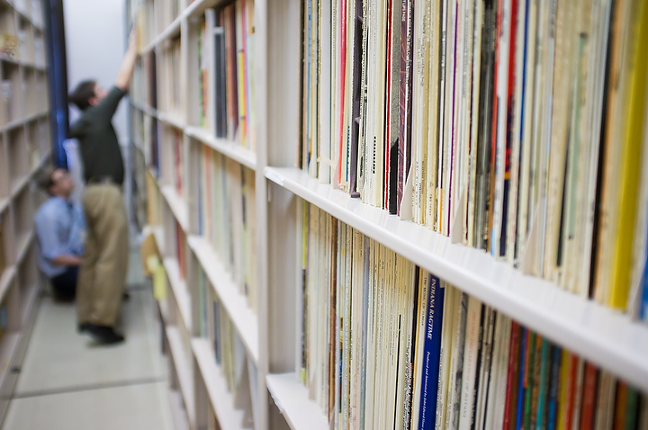
“Audiovisual materials are the fastest growing segment of our nation’s
archives and special collections.”
--The Library of Congress National Recording Preservation Plan, page 6

Slide 7
What is the problem?
Large numbers
Degradation
Obsolescence
High research value
Short time window

Slide 8
Indiana Numbers
More than 560,000 audio, video, film objects
364,000 audio (64%)
125,000 video (22%)
78,000 film (14%)
80 units
50+ formats

Slide 9
Degradation
All analog and physical digital media objects actively degrading
some catastrophically
Fungus
Vinegar Syndrome
Sticky Shed Syndrome
Plasticizer Exudation
Delamination
Windowing
Curling
Undiagnosed
Unplayability
Hydrolysis
Color Fading
Shedding
Scratches
Efflourescence
Crystalline Residue
Shrinkage
Mechanical Issues
Oxidation
Breaking
Binder Breakdown
Cupping

Slide 10
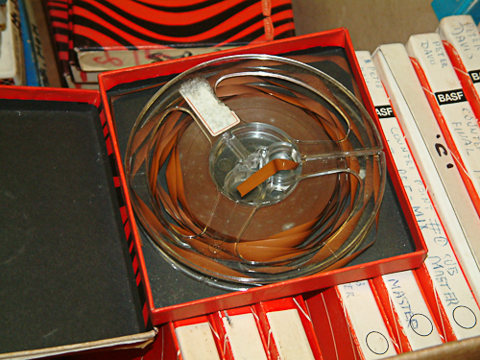

Slide 11
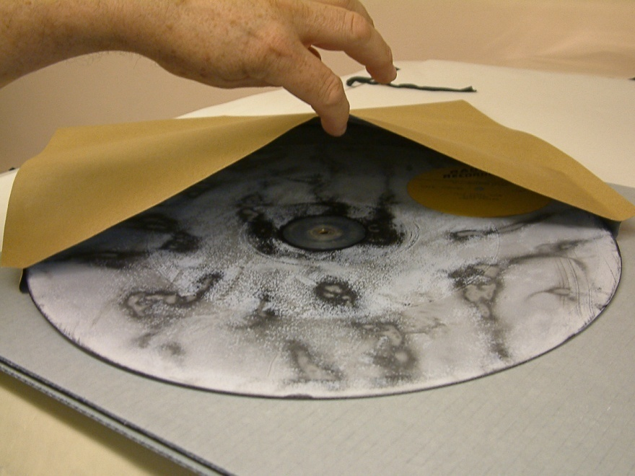

Slide 12
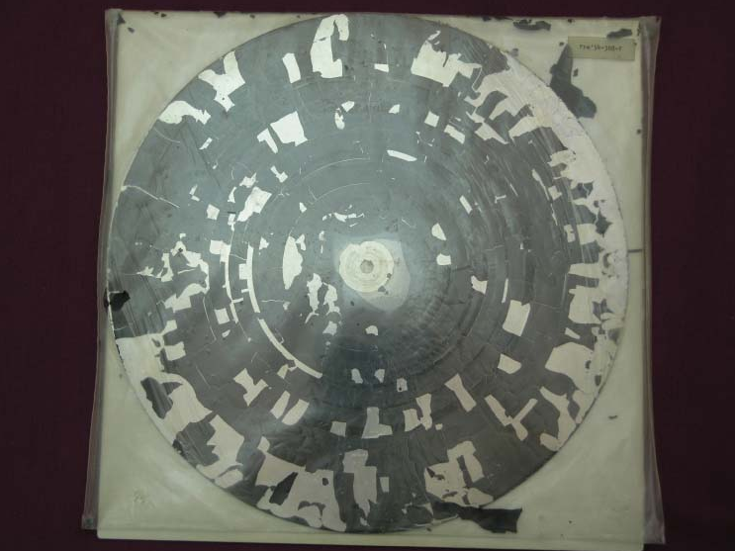
Notes:
12

Slide 13
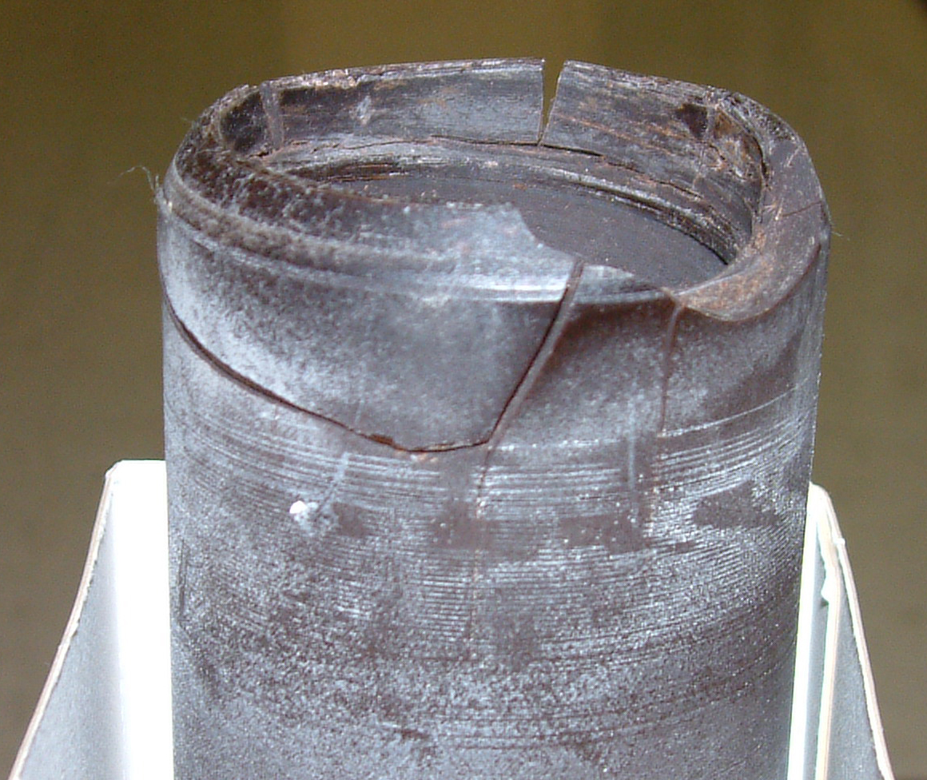
Notes:
This is part of the Roaming Scout collection -- the oldest known recording of extended narrative in any Native American language. The whitening visible in the groove suggests that the "wax" has undergone significant chemical breakdown since the cylinder was last played about twenty-five years ago.

Slide 14
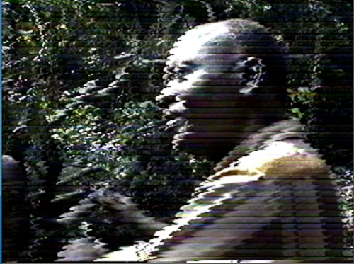

Slide 15
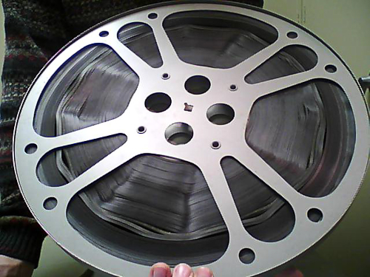

Slide 16
Obsolescence
Media formats
Equipment (playback machines, test devices)
Repair parts
Playback expertise
Repair expertise
Tools
Supplies

Slide 17
Obsolescence
Technics SP-15 turntable main bearing unavailable at any price
Sony PCM-70x0 series DAT machine capstan motors unavailable at any price
Audio alignment tapes—one company
Last run of playback heads for Studer tape machines
1” video machines, parts, playback expertise scarce
Type C head assembly $16,000
--information courtesy of George Blood
--information courtesy of George Blood

Slide 18
Obsolescence
Quad (video) machines, parts, playback expertise very scarce
Standard industry professional format
Estimated 100-200 machines left worldwide
Ampex AVR-1 (1970s) compressed air diaphragm unavailable at any cost
Playback heads must be replaced every three months

Slide 19
Obsolescence
One supplier – technician is age 65
Company appealing for money to continue refurbishing program
Trouble getting supplies
2009 cost for new head= $3500
2012 cost = $5200
--information courtesy of George Blood

Slide 20
Obsolescence
All analog audio and video formats are at different points on a similar obsolescence slope

Slide 21
Obsolescence
Not enough working audio and video playback machines to digitize everything currently in vaults
Audio equipment doubling/quadrupling in price on eBay

Slide 22
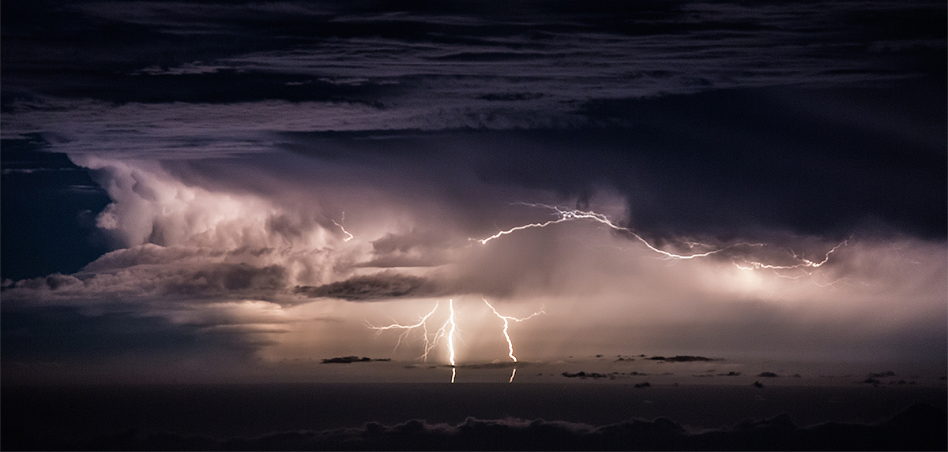
Degradation/Obsolescence
“For video the problem is even sharper: complete disappearance of an (affordable) ability to transfer.”
--Richard Wright, AMIA list, 2/17/2013
Creative Commons: Flickr @MichaelBolognesi1

Slide 23
Degradation/Obsolescence
“75% of the analogue video held in Europe in 2006 will be lost by 2023 when video digitisation will simply have "ceased to be."”
--Richard Wright, PrestoCentre Answers, 2/5/2013
Creative Commons: Flickr @MichaelBolognesi1

Slide 24
Degradation/Obsolescence
“ There is a massive disaster happening here.”
-- Clifford Lynch, Coalition for Networked Information,2011
Creative Commons: Flickr @MichaelBolognesi1

Slide 25
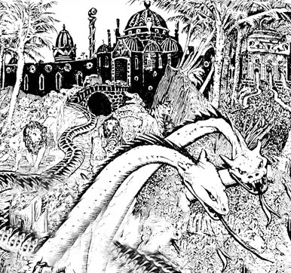
Degralescence Attacks the Kingdom of Media
Flickr @garry

Slide 26
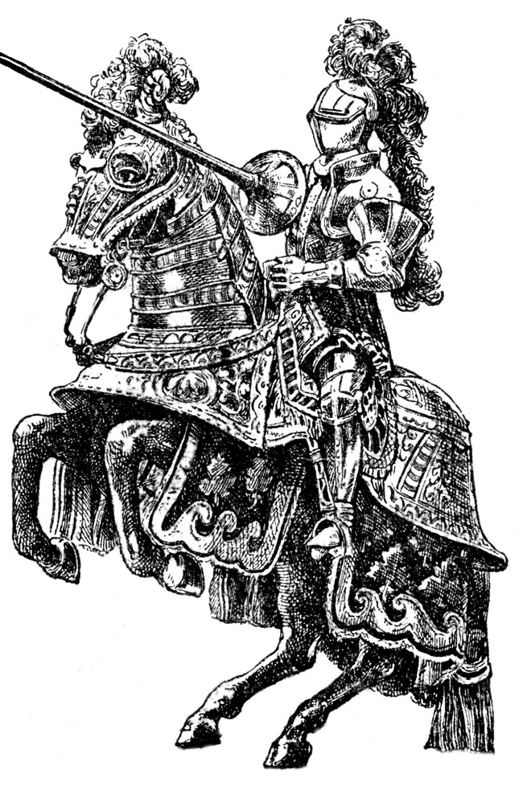
Prince Codec Brandishes the Sword of Migration
Flickr @garry

Slide 27
The Sands of Time Slip Away
Flickr @garry

Slide 28
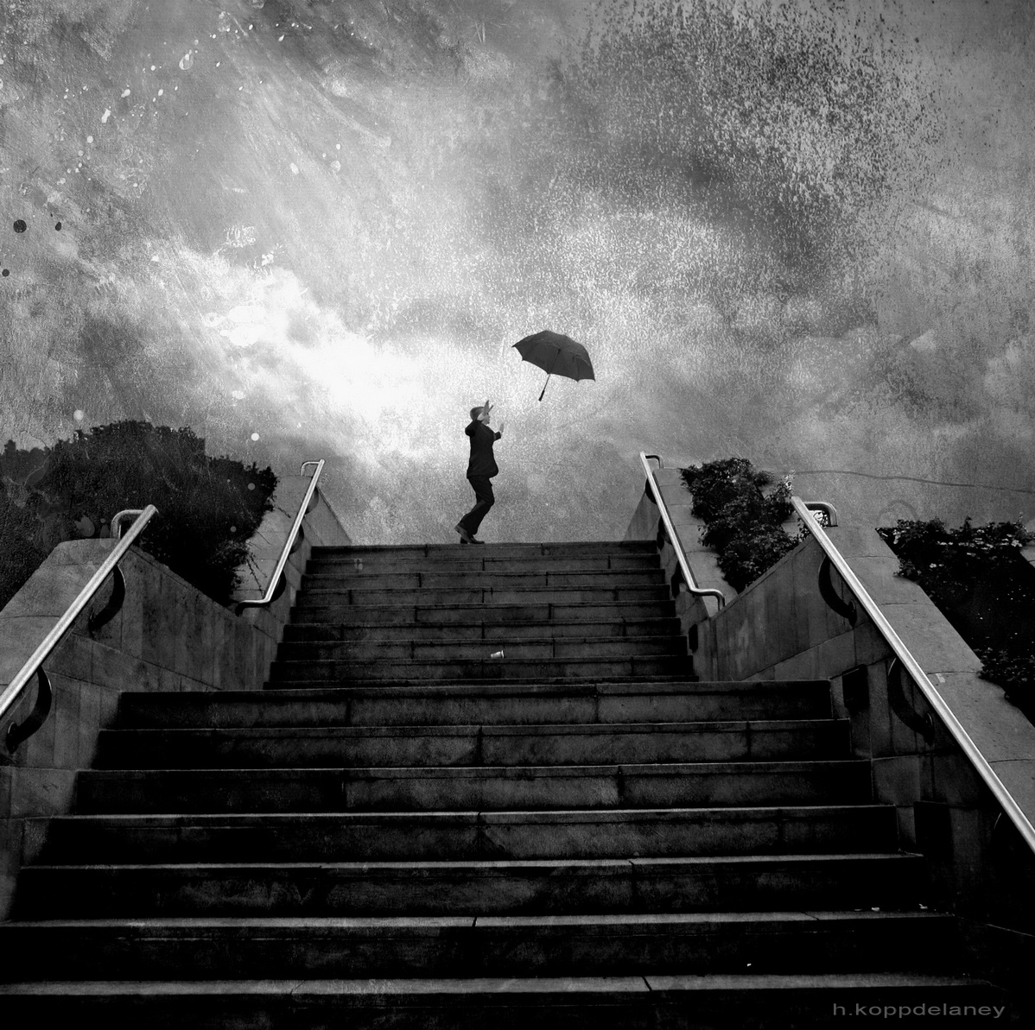
Degradation/Obsolescence
How much time do we have?
15-20 years
Flickr@h.koppdelaney

Slide 29
Degradation/Obsolescence
“…many analog audio recordings must be digitized within the next 15 to 20 years – before sound carrier degradation and the challenges of acquiring and maintaining playback equipment make the success of these efforts too expensive or unattainable.”
--The Library of Congress National Recording Preservation Plan, page 7

Slide 30
Degradation/Obsolescence
How much time do we have?
15-20 years
Less for some formats
Degradation + Obsolescence = Impossible/Too Expensive
Vendors and a few institutions stockpiling

Slide 31
Degradation/Obsolescence
How much time do we have?
10-15 Years

Slide 32
Strategies
Audio and Video
How long will it take?
At our current pace…
Archives of Traditional Music: 58 years
Music Library: 120 years
Key Words: Massive, rapid, considered

Slide 33
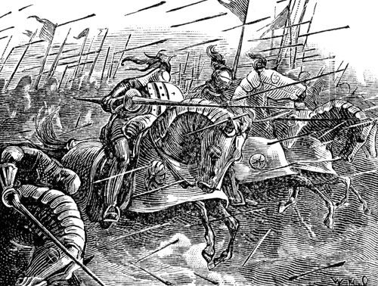
The Battle for Media Commences
Flickr @garry

Slide 34
What is Indiana University Doing to Weather this Storm?
Flickr @garry

Slide 35
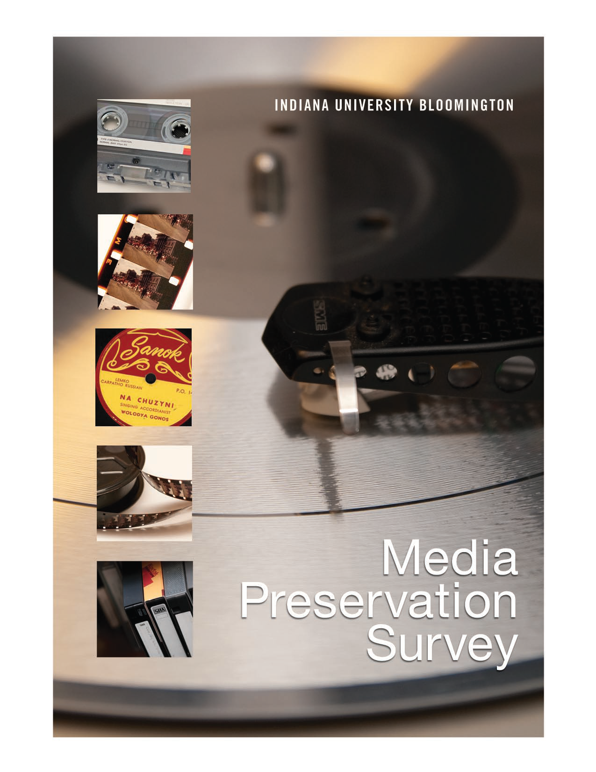

Slide 36
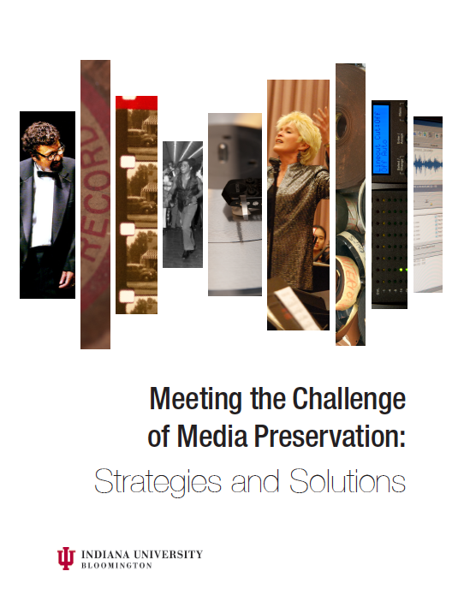

Slide 37
State of the University address October 1, 2013
Media Digitization
and
Preservation Initiative (MDPI)
Flickr @garry

Slide 38
State of the University address October 1, 2013
Digitization of all significant audio and video recordings
IU digitization master plan for all research collections
Flickr @garry

Slide 39
5-year plan
IU Bicentenary Initiative
“We got five years, my brain hurts a lot. Five years, that’s all we’ve got”
David Bowie
Flickr @garry

Slide 40
Funded by:
Office of the President
Office of the Provost
Office of the Vice President for Research
Flickr @garry

Slide 41
University-wide initiative
Other IU campuses
Preliminary survey
~76,000 objects
~22,000 unique objects
Flickr @garry

Slide 42
Film
Develop separate proposal
Longer than five years?
Flickr @garry

Slide 43
Partnership
Flickr @garry

Slide 44
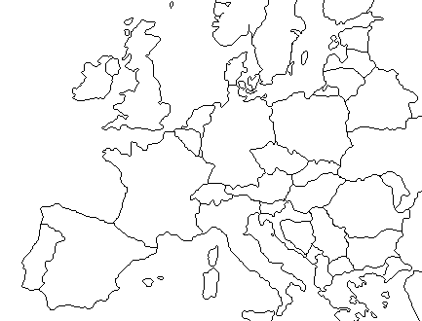
Memnon Archiving Services Brussels & Liège facilities
Brussels

Slide 45
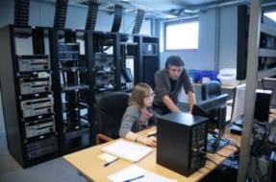
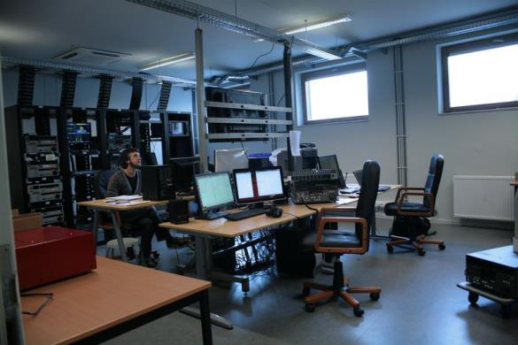
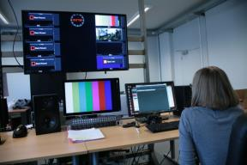
Video Digitization / encoding facility

Slide 46
Over 10 years experience in large scale digitization
Large scale digitization services
Partnership for improved efficiency
Multiple client references
Over 1,000,000 hours digitized
R&D Projects
Dedicated I.T. team
Expertise in metadata management
Automated content enrichment

Slide 47
Strategy
Memnon – parallel transfer workflows
IU – 1:1 workflows for fragile formats and items
Digitize more than 350,000 recordings in five years
Flickr @garry

Slide 48
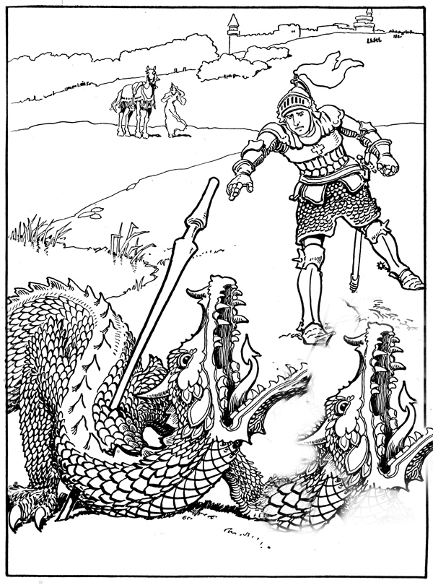
Degralescence is Brought under Control
Flickr @garry

Slide 49
The End
Flickr @garry

Slide 50
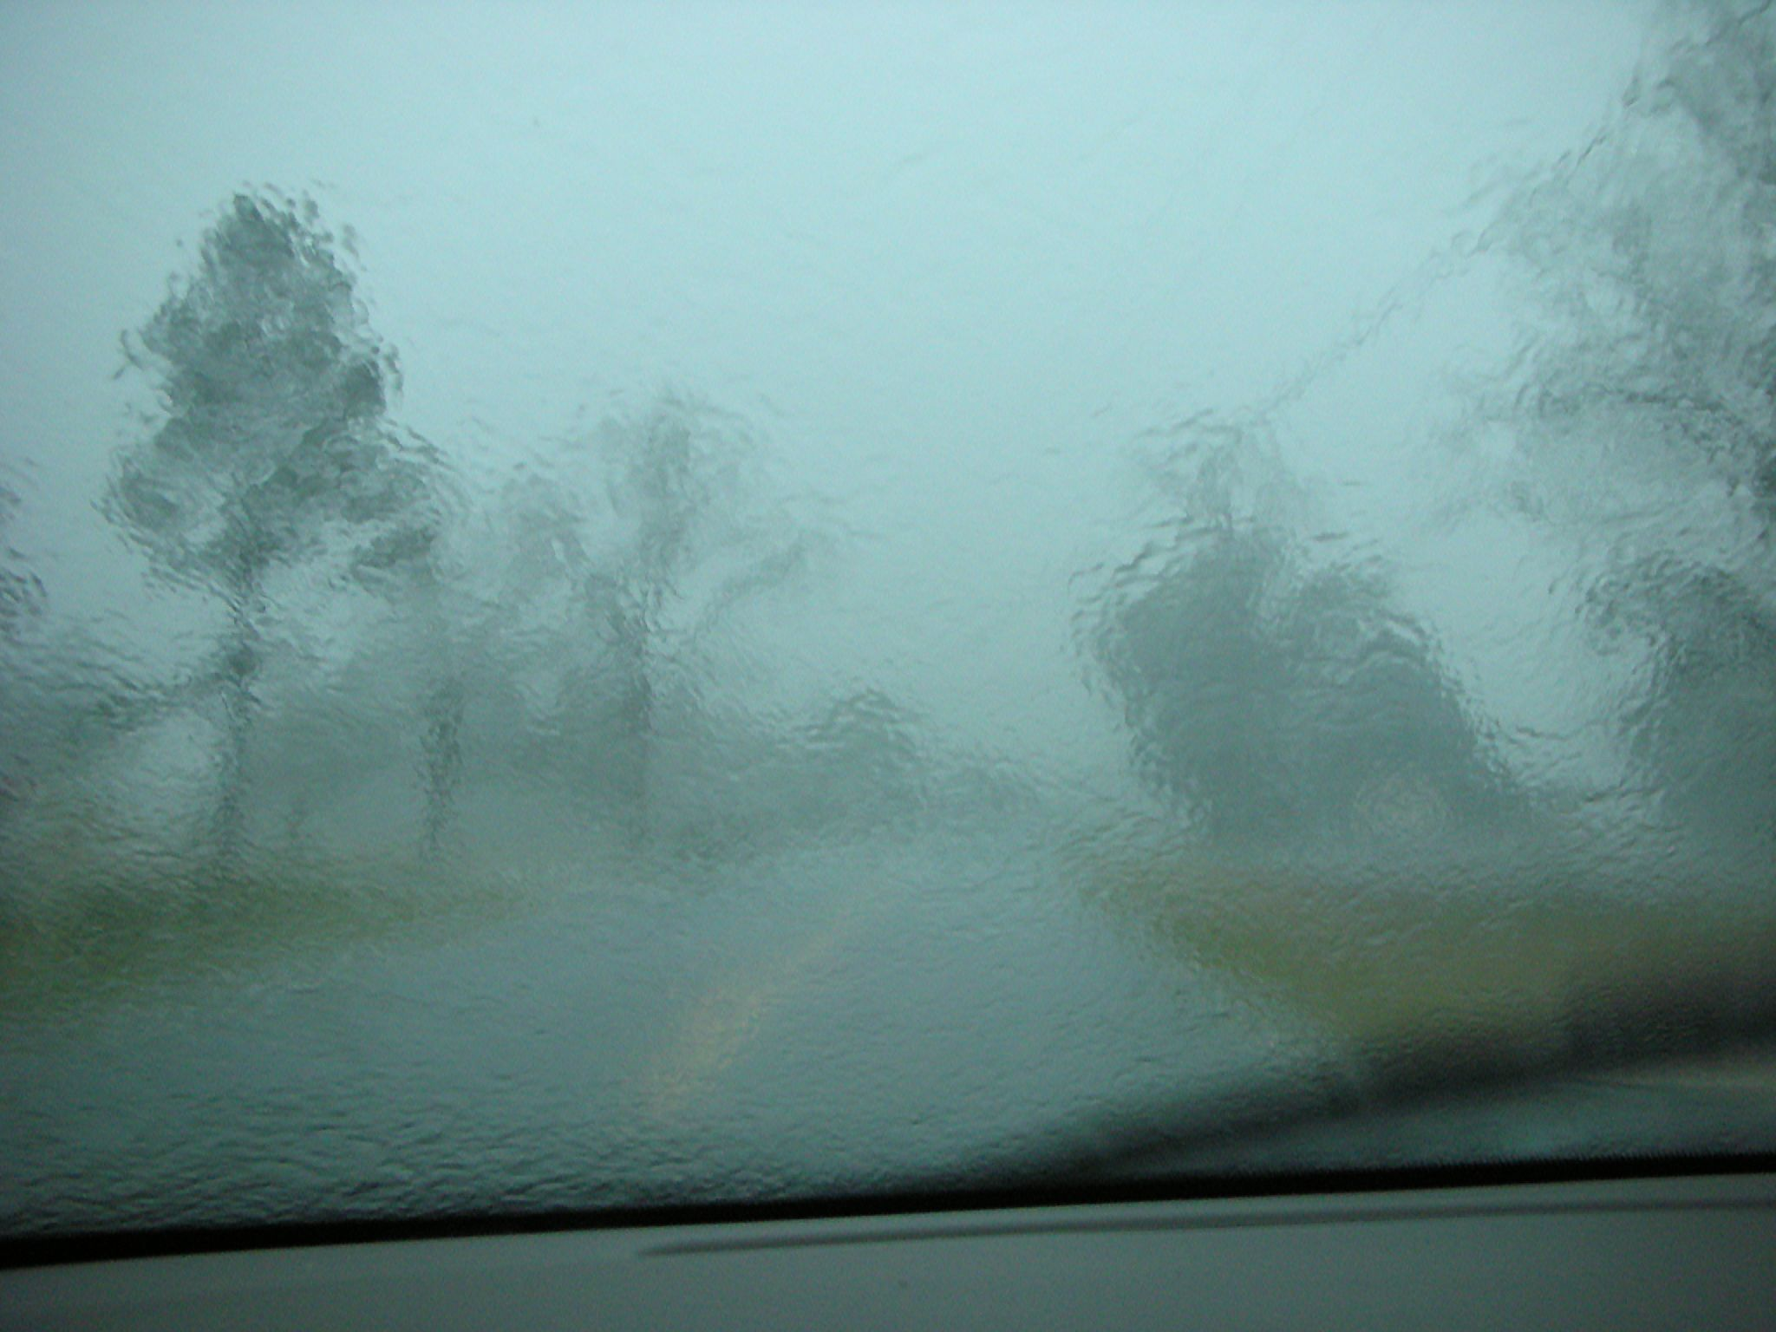
Why Media Preservation Can’t Wait
The Gathering Storm
Mike Casey
Director of Technical Operations
Media Digitization and Preservation Initiative
Indiana University
May 15, 2014
Website: http://www.mdpi.iu.edu
Blog: http://mediapreservation.wordpress.com/
Flickr @Old Woman Shoe

